Slide 1
COMMUNITY HEALTH NEEDS ASSESSMENT (CHNA) ROADSHOW
Carmen Hua, MPH, CHES Health Educator | CHA/CHIP Coordinator Office of Disease Surveillance and Control
Notes:
Introduction

Slide 2
AGENDA
What is the CHNA
Purpose, Vision and Goals
Partnership Process
Benefits
2025 Roadmap
Hospital Partners
Become a CHNA Champion
Notes:
Agenda

Slide 3
ALONE, WE CAN DO SO LITTLE; TOGETHER, WE CAN DO SO MUCH
– HELEN KELLER
Notes:
Opening quote to paint the picture
What is the CHNA, why hospital collaboration is important
How we can align efforts and address priority issues in the community
i.e. Maricopa County and what their LHD and Hospital collaboration efforts are like
What this partnership will do

Slide 4
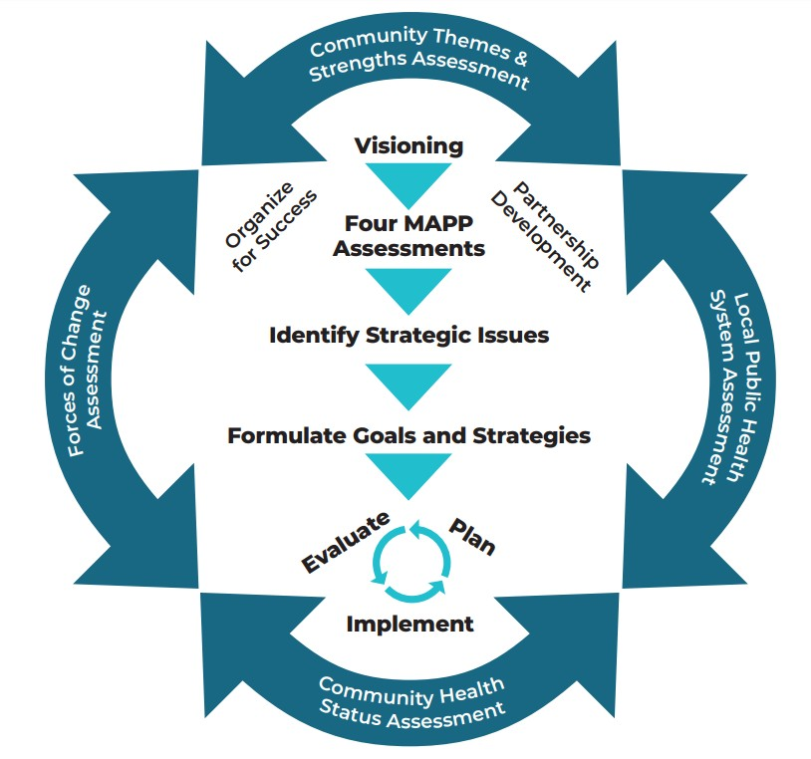
COMMUNITY HEALTH NEEDS ASSESSMENT
WHAT IS IT?
A systematic process involving the community to identify and analyze community health needs.
WHY IS IT IMPORTANT?
CHNAs will allow hospitals to support patient health and the social determinants of health.
HOW IS IT USED?
By local hospitals as a process for determining the needs, or "gaps," between a current and desired outcome.
Notes:
Background information on what exactly the CHNA is
Non-profit hospitals need to complete CHNA every 3-years for ACA requirements
Answering the What, Why, and How

Slide 5
PURPOSE, MISSION, AND VISION
PURPOSE
Conjoin community efforts and increase collaboration in projects, programs, and activities occurring in Southern Nevada.
MISSION
Impact real-time, critical health issues where we live, work, learn, and seek care in Southern Nevada. Empowering communities working together to reach optimal health and quality of life for all.
VISION
Participate in a collaborative approach that identifies community needs, assets, resources, and strategies towards assuring better health and health equity for all Southern Nevada residents.
Notes:
Purpose, Mission, and Vision
Exactly why we need this collaboration to happen, how it is going to benefit the community and what direction we are looking at for the future

Slide 6
CHNA CHAMPION PROCESS
Develop CHNA Survey and Focus Group Questions
Conduct CHNA Survey and Focus Groups
Analyze Data Indicators (Data Report)
3-Year CHNA Working Agreement
Create Strategic Plan
Develop CHNA
Report
Prioritize Health Needs
Notes:
Partnership Process Visual
How hospital will be involved/engaged in the process
Walkthrough of what needs to be done for the CHNA and the anticipated outcome
This is the vision, this is the ask – what we need from you

Slide 7
Working Agreement Details
Memorandum of Agreement (MOA)
Annual financial contribution to support data collection of the CHNA
Utilization of the HealthySouthernNevada website population health data
Access to reports, connection to the network of community partners throughout Southern Nevada, tools, and services
Engagement
Time Commitment: 1-hour a week
Monthly meetings – minimum 1 representative per hospital agency
Data engagement with populations served (surveys, focus groups, etc.)
Notes:
This is what we would like to build – this is the working agreement – reach out to me if you need more details.
Vision for the project and alignment
Interested in learning more about details, contact me – benefits on next slide.
Monthly meetings: Collaborate, share updates and information, network
Evolving relationship – what do you need, what do you want the report and data collection to look like, help shape report to suit needs.

Slide 8
BENEFITS
Help health care systems, public health, and community partners focus available resources to address the communities' most critical health needs
Create an effective and sustainable CHNA process
Build stronger relationships between health care systems and public health
Identify opportunities for joint efforts to improve the health and well-being of Clark County
Eliminate duplicative efforts
Notes:
The main benefits – what they get out of this partnership (benefits package) – the selling point on why they want to buy-in
Additional access to reports, access to network/connections, tools, services and opportunities to build a strong needs assessment

Slide 9
LEVERAGING COMPREHENSIVE DATA
SOURCES
Community Surveys
Community Focus Groups
Health Indicators
Death Records
Hospital Discharge
Emergency Department Visits
U.S. Census Bureau
Racial Equity Index
And much more!
Notes:
But wait there’s more - Additional benefits
Data sources and what we utilize to collect input

Slide 10
GOALS
AVAILABILITY
Addressing health needs via
reports ensuring it is widely available to the public
COMMUNITY
Increase city/town
participation for engagement & data collection
COLLABORATION
Increase partnerships and build relationships for
engagement and outreach
Notes:
Goals (Flexible – depending on conversation with committed partners, goals may be modified)
Primary goals of what Hospital x LHD partnership will achieve

Slide 11
2025 CHNA ROADMAP
1
NOVEMBER 2023
Official CHNA Cycle Begins
Establish Steering Committee
3
APRIL 2023
Local Public Health System Assessment
Focus Groups
5
OCTOBER 2024
Data Analysis and Edits
JANUARY 2024
Forces of Change Assessment
Pilot A Survey
Community Themes & Strengths Assessment
MARCH 2025
Publish CHNA data reports, profiles, and update data dashboards
2
4
JULY 2023
Community Health Status Assessment
Identify secondary data
6
Notes:
CHNA Roadmap
A very high-level glance at the upcoming timeline for this CHNA phase
Anticipated publication March 2025 (according to Dignity Health’s timeline)

Slide 12
2022 COMMUNITY HEALTH NEEDS ASSESSMENT
Notes:
Dignity Health Example – our committed Hospital Partner
Has collaborated and have been engaged since the 2019 CHNA
Increased partnership, collaboration, engagement with Dignity Health workers (different sectors within the organization)
Simplified process and an increase of participation
Alignment of community priorities are the same

Slide 13
www.HealthySouthernNevada.org
Notes:
HSN Website is where the CHA/CHNA/CHIP will be published
Updates will be made accordingly
Full access and availability to the reports

Slide 14
Summary
Increase the amount of hospital facilities as contributing partners
Expand engagement and collaboration in assessing community health needs
Notes:
End presentation by reiterating the overall vision – what we want out of this
We are asking you: To financially support a community group to put CHNA’s together and align

Slide 15
THANK YOU
BECOME A CHNA CHAMPION TODAY!
Carmen Hua, MPH, CHES Health Educator | CHA/CHIP Coordinator
c: 702-759-1209
e: huac@SNHD.org
Notes:
Thank you & Questions

