Slide 1
HOSPITALS, EMERGENCY DEPARTMENTS, AND URGENT CARES- A Call for Help
Sarah Lugo, MSN, Rn
Community Health Nurse Supervisor Mass COVID-19 Vaccine Program
Southern Nevada health district

Slide 2
Introduction
10 years experience in overseeing CDC’s ublic health immunization programs at SNHD: Immunization Outreach, Perinatal Hepatitis B, Childcare Immunizations, and Vaccines for Children
Med/Surg Nurse
School nurse for low income and high-acuity schools
Education:
Masters of Science in Nursing-Family Nurse Practitioner from UNLV, 2022
Masters of Science in Nursing-Leadership and Management from Western Governors, 2013
Bachelors of Science in Nursing from UNLV, 2007
Sarah Lugo, MSN, RN
Community Health Nurse Supervisor
Mass COVID-19 Vaccine Program
Southern Nevada Health District

Slide 3
Objectives
Discuss the current status of COVID-19 vaccinations in Clark County
Discuss hospital involvement in COVID-19 vaccine administration
Inform hospitals of simplified schedule, easier ordering, and changes in storage and handling

Slide 4
Where are we now?

Slide 5
Background
Emergency departments act as an access point for healthcare to 1/5 of US population. (CDC, 2022a)
Urgent cares handle 29% of all primary care visits in the country. (CDC, 2022a)
CDC recommends offering vaccine to all patients at hospital discharge who are not moderately or severely ill. (CDC, 2022a)
Many skilled nursing facilities and long-term care facilities require COVID-19 vaccine for admission.
Hospitals may currently offer other vaccines as standard protocol at discharge

Slide 6
The Ask
Carry small amount of COVID-19 vaccine in the hospital pharmacy to be available for patients being transferred to long-term care facilities or other alternative facilities that may require COVID-19 vaccine.
If hospital currently administers other vaccines as standard protocol, such as flu and pneumonia, consider adding the COVID-19 vaccine.
Notes:
What I am not asking is for you to become a vaccine clinic?
All Clark County hospital are currently enrolled and able to receive free vaccine

Slide 7
New Simplified Schedule ≥ 12 Years and Older Without Immunocompromise
≥ 12 yo
Unvaccinated
One bivalent mRNA dose-Vaccination Complete
≥ 12 yo
History of 1 or more monovalent mRNA doses and no doses bivalent mRNA
8-week interval
≥ 12-64 yo:
NO doses indicated- Vaccination complete
≥ 12 yo
History of 1 dose of bivalent mRNA
≥ 65 yo:
Optional: One bivalent mRNA dose
4-months interval
https://www.cdc.gov/vaccines/covid-19/clinical-considerations/covid-19-vaccines-us.html
Notes:
https://www.cdc.gov/vaccines/covid-19/clinical-considerations/covid-19-vaccines-us.html

Slide 8
New Simplified Schedule ≥ 6 Years and Older With Immunocompromise
≥ 6 yo and immunocompromised
NO history of bivalent mRNA doses
One bivalent mRNA dose-Vaccination Complete
≥ 6 yo and immunocompromised
history of bivalent mRNA doses
Optional: One bivalent mRNA dose (FDA, 2022)
Additional one bivalent mRNA based on clinical provider’s discretion (FDA, 2022)
2-month interval*
*Current FDA Authorization as of 04/18/2023 until further CDC guidance provided

Slide 9
Easier Storage and Handling
Ultra-cold no longer necessary
Same refrigerator as other vaccines (2°C - 8°C)
Pfizer stores for 10 weeks (CDC, 2022b)
Moderna stores for 30 days (CDC, 2022c)
Notes:
Moderna can be stored in freezer to extend shelf life until expiration date.
Cool/Room Temp (8-25 C or 46-77 F)
Pfizer- 12 hours unpunctured, 12 hours punctured
Moderna- 24 hours unpunctured, 12 hours punctured

Slide 10
Enrollment and Ordering
Order from the State for direct shipment
Decreased minimum order
SNHD is a redistribution center
Transfer small amounts to your hospital
Single dose syringes
Avoiding missed opportunities
Don’t let multi-dose vials deter you
https://www.cdc.gov/vaccines/covid-19/clinical-considerations/vaccination-upon-discharge.html

Slide 11
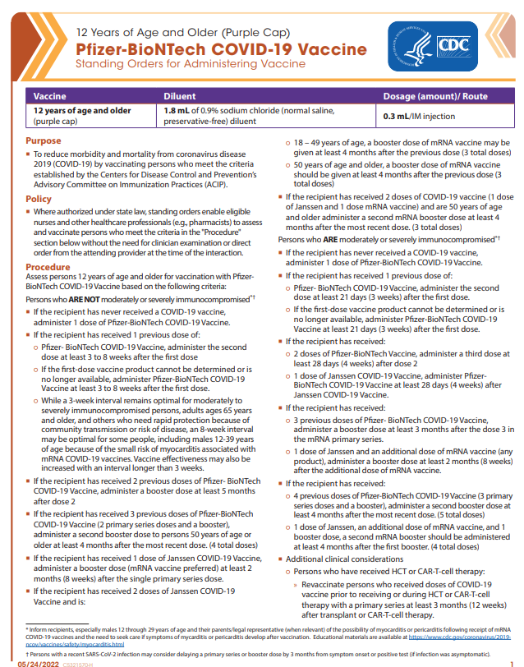
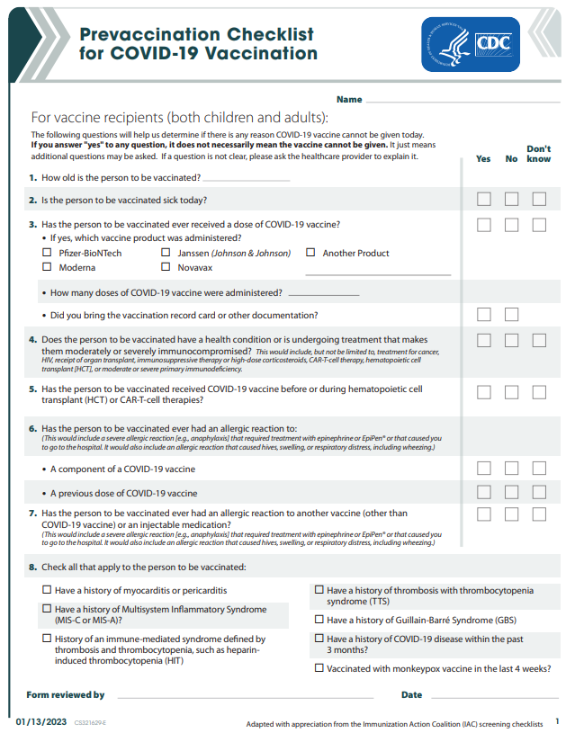
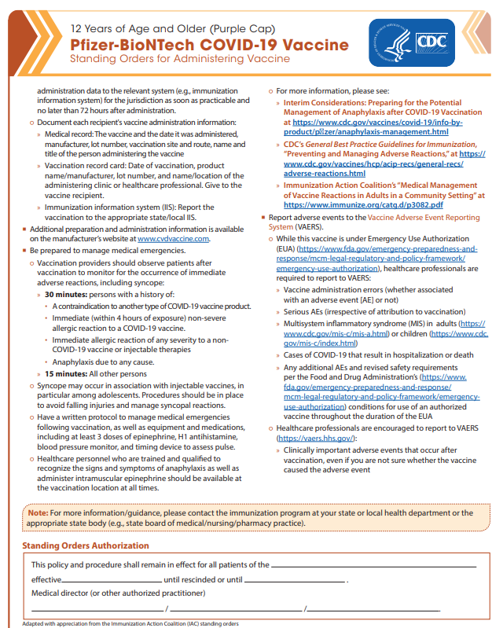
Tools to Make Vaccinating Easier: Standing Orders COVID-19 Vaccine Questionnaire
https://www.cdc.gov/vaccines/covid-19/info-by-product/pfizer/downloads/standing-orders.pdf
https://www.cdc.gov/vaccines/covid-19/info-by-product/pfizer/downloads/standing-orders.pdf
https://www.cdc.gov/vaccines/covid-19/downloads/pre-vaccination-screening-form.pdf
Notes:
What I am not asking is for you to become a vaccine clinic?

Slide 12
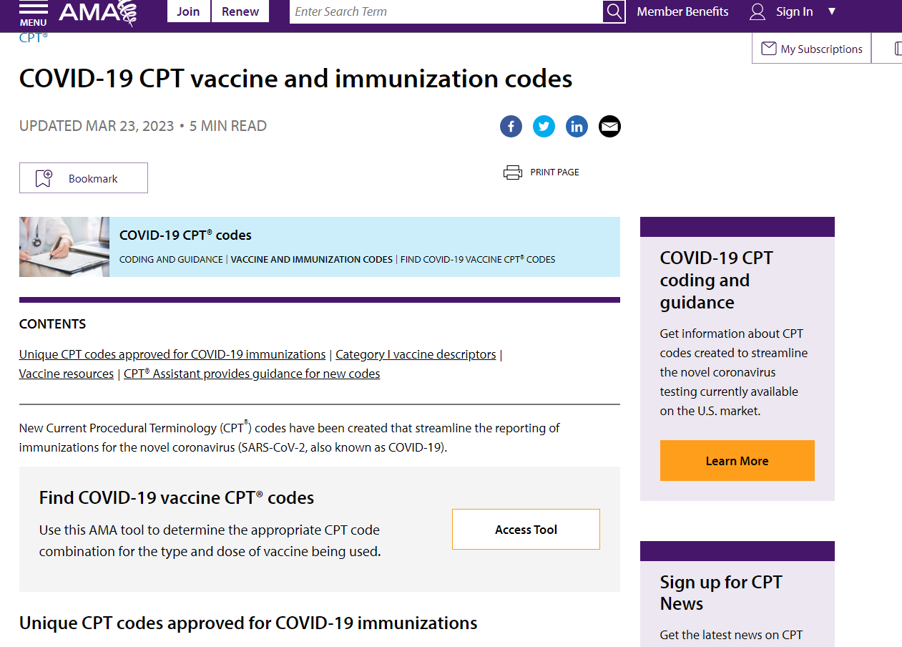
Tools to Make Billing Easier: American Medical Association Access Tool
https://www.ama-assn.org/practice-management/cpt/covid-19-cpt-vaccine-and-immunization-codes
Notes:
EDs and UCs can bill the patient’s insurance company for administration of COVID-19 vaccine; however, it should be billed separately from the services that were provided during the patient’s visit. https://www.cdc.gov/vaccines/covid-19/clinical-considerations/vaccination-upon-discharge.html
Can hospital bill?

Slide 13
Healthcare Provider Team
One-on-one training with staff or group training
Identify and assist in overcoming potential barriers
Developing individualized processes
Smaller dose distribution
Assistance with enrollment if needed

Slide 14
Discussion and Questions

Slide 15
References
Centers for Disease Control and Prevention. (2022a). Increasing access to vaccination opportunities: COVID-
19 vaccination upon discharge from hospitals, emergency departments, and urgent care facilities.
Retrieved from https://www.cdc.gov/vaccines/covid-19/downloads/discharge-hospital-ED-UC-jurisdiction-508.pdf
Centers for Disease Control and Prevention Prevention, (2022b). Pfizer-BioNTech COVID-19 Vaccine: Storage and handling summary. Retrieved from https://www.cdc.gov/vaccines/covid-19/info-by-product/pfizer/downloads/storage-summary.pdf
Centers for Disease Control and Prevention, (2022c). Moderna COVID-19 Vaccine: Storage and handling summary. Retrieved from https://www.cdc.gov/vaccines/covid-19/info-by-product/moderna/downloads/storage-summary.pdf
U.S. Food and Drug Administration. (2022, April 18). Coronavirus (COVID-19) update: FDA authorizes changes to simplify use of bivalent mRNA COVID-19 vaccines. Retrieved from https://www.fda.gov/news-events/press-announcements/coronavirus-covid-19-update-fda-authorizes-changes-simplify-use-bivalent-mrna-covid-19-vaccines

