Slide 1
The State of Nevada’s Public Health Safety Net

Slide 2

Federal Health Policy at a Crossroads:
Impacts on the Health Care Safety Net in Nevada
John Packham, PhD
Associate Dean, Office of Statewide Initiatives
University of Nevada, Reno School of Medicine
October 23, 2025

Slide 3
Setting the Stage for Today’s Discussion
Impact of federal health policy on health insurance coverage, public health, and the health care safety net in Nevada
Focus on H.R.1 (a.k.a. the “One Big Beautiful Bill Act” or OBBBA) signed into law on July 4, 2025 and current congressional debate over the expiration of Enhance Premium Tax Credits later this year
Also assess the impact of federal economic and social policy on health care and public health in Nevada, including executive orders related to tariffs, immigration, and higher education

Slide 4
Disclosures from Your Guest Speaker
“We all do better when we all do better” – Paul Wellstone
Americans deserve the right to the highest attainable standard of physical and mental health and well-being
Absolute importance of scientifically-informed, evidence-based public policy
We are no longer living in normal political times, we shouldn’t expect normal public policymaking
“Democracy is not a spectator sport” – Paul Wellstone

Slide 5
Politics, Power, Policy
Politics – the art and science concerned with winning and holding control over the government and levers of power in society.
Power – from Max Weber “within a social relationship, power is any chance (regardless of the basis of this chance) to carry through one’s own will (even against resistance)”.
Policy – authoritative decisions made within the federal government that are intended to direct or influence the actions, behaviors, or decisions of individuals and organizations.
Federal policies include lawmaking and decisions by Congress, rulemaking and administrative decisions made by the White House and executive agencies, and decisions made by federal courts and the Supreme Court.

Slide 6
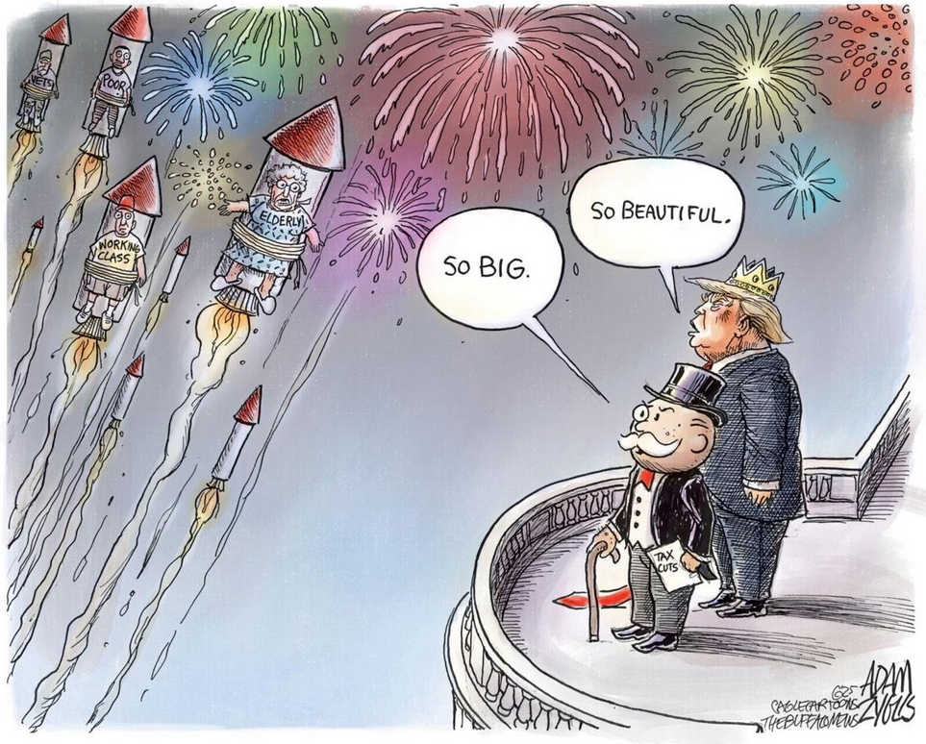
H.R.1 – At Its Core
First and foremost, this bill is a tax extension bill – benefits disproportionately concentrated among high income earners
Nonetheless, H.R.1 is the most significant health reform legislation since the passage of the Affordable Care Act in 2010
Over the next decade, it will result in the largest rollback of health insurance coverage in U.S. history – costs disproportionately concentrated among low-income individuals and families
Goodies are front loaded, pain will occur after the 2026 mid-term elections

Slide 7
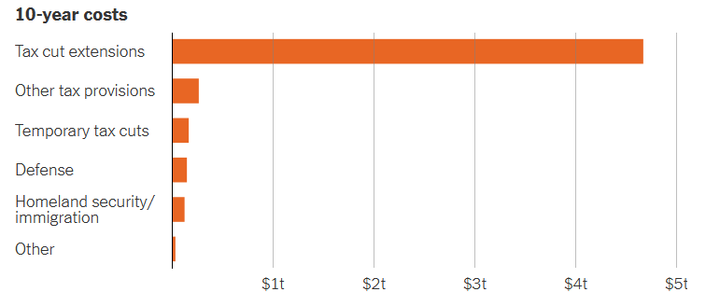
H.R.1 … Tax Cuts and New Spending

Slide 8
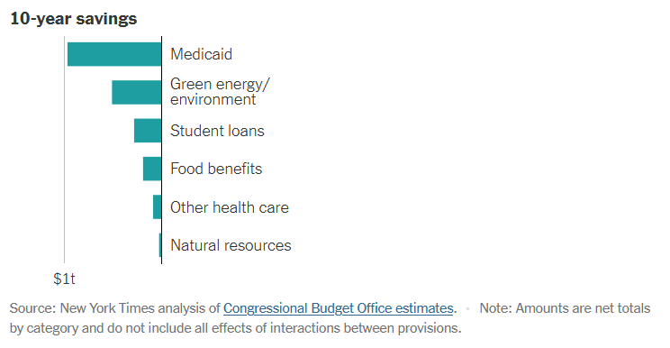
H.R.1 … Spending Cuts and other “Savings”

Slide 9
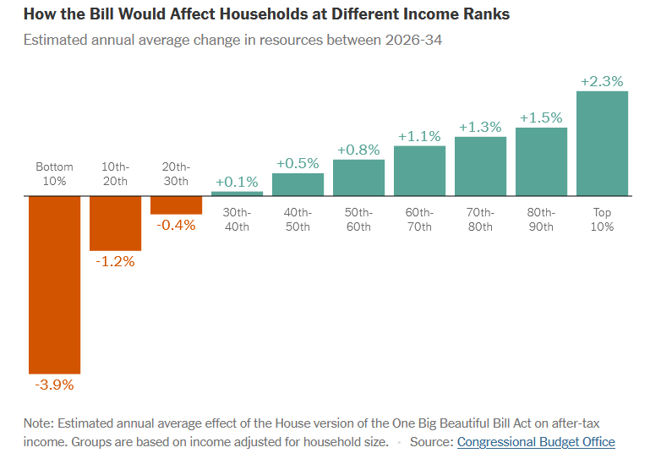
H.R.1 … Winners and Losers

Slide 10
H.R.1 – Medicaid Program Changes
Work requirements – Non-disabled adults aged 19-64 must complete 80 hours/month of work, education or volunteering to maintain eligibility
Eligibility redeterminations – States must verify eligibility every six months versus annually
Retroactive eligibility reductions – coverage is limited to one month prior to enrollment, down from three
Expanded cost sharing on beneficiaries – States may impose co-pays on service and premiums for those above 100% of the FPL
Provider tax restrictions – Gradual phase-down of provider taxes and funds available to states to address Medicaid payment shortfalls

Slide 11
H.R.1 – ACA Rollbacks
Marketplace subsidy elimination and sunset of enhanced premium tax credits not addressed – resulting in increased out-of-pocket costs for those receiving coverage on the health exchange
Stricter eligibility standards – Income and documentation requirements are tightened, including restrictions on lawful immigrants
Marketplace instability – historically, rising premium costs have led to individuals exiting plans, destabilizing risk pools, and increasing volatility and churn in insurance coverage

Slide 12
H.R.1 – Impact on Providers and Hospitals
Uncompensated care – Coverage losses will likely increase the number of uninsured, especially in rural and medically underserved areas
Financial pressures – Safety-net and rural hospitals will face additional financial strain and challenges, which will not be offset by the establishment of the $50 billion Rural Health Transformation Program
Operational and administrative complexity – Hospitals and clinics must navigate new eligibility rules, disenrollment risks and churn, and reduced reimbursement from Medicaid and ACA market plans

Slide 13
H.R.1 – Impact on Payers
Medicaid Managed Care Organizations (MCOs) – Expect reduced funding, increased churn of Medicaid beneficiaries in and out of coverage, and overall administrative complexity
A reduction in MCO community reinvestment funds will impact providers, nonprofit health and human service organizations, and underserved communities
ACA Marketplace Plans – Higher premiums and reduced enrollment will prompt some insurers to exit markets

Slide 14
H.R.1 – Impact on Insurance Coverage and Access
Coverage losses – 14.2 million increase in uninsured individuals by 2034
Federal spending cuts – Over $1 trillion in federal health care funding for Medicaid and Marketplace plans through 2034
Medicare sequestration – Deficit increases will trigger automatic reimbursement nearly $500 billion in Medicare reimbursement cuts
States and counties will be forced to raise taxes, reduce payments to providers, and/or further restrict eligibility to maintain the health care safety net

Slide 15
H.R.1 – Projected Nevada Impacts
Medicaid coverage losses – Nevada Health Authority estimates 100,000 Nevadans or 12.5% of Medicaid enrollees could lose coverage in 2027 to 2028
Marketplace coverage losses – New restrictions, such as preventing lawfully present immigrants to access Marketplace subsidies and tax credits, will cause additional insurance coverage losses among low- and middle-income Nevadans
Providers will be squeezed – Reduced Medicaid enrollment and state directed payments to hospitals and nursing homes in Nevada will negatively impact hospital revenues and operating margins
Looming state budget challenges – Impacts will create fiscal challenges for state lawmakers beginning with the 2027 legislative session (if not sooner)

Slide 16
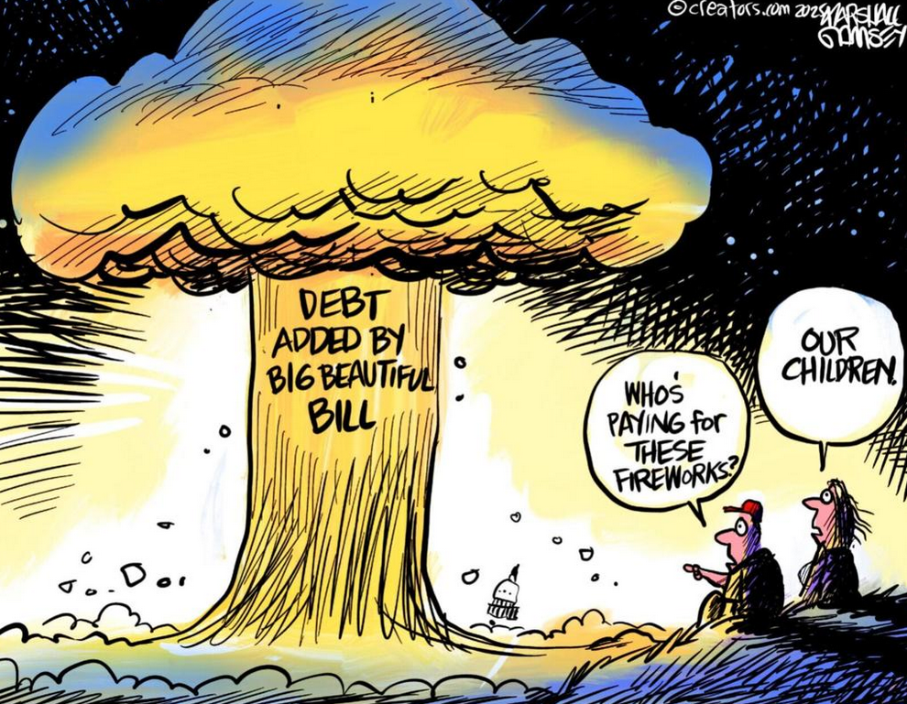

Slide 17
“We’re going to need a bigger boat”
Executive orders, legislative recissions, executive impoundments, and other policy changes have already begun to impact health insurance coverage, public health, and the safety net over the coming decade
Current and projected funding cuts to National Institutes of Health (NIH) grants and indirect cost reductions impacting academic medical centers and schools of medicine in Nevada
Current and projected cuts to the Centers for Disease Control and Prevention (CDC) will increase the unfunded public health roles of safety net providers, including community health centers
Executive orders are already accelerating workforce challenges and medical supply chains, especially medical devices and pharmaceuticals

Slide 18
Questions?

