Slide 1

POLICY RESEARCH FOR NEVADA: Examining the Public Health Safety Net
Pierron Tackes, JD, MPH
Director of Health and Social Policy
Guinn Center for Policy Priorities

Slide 2

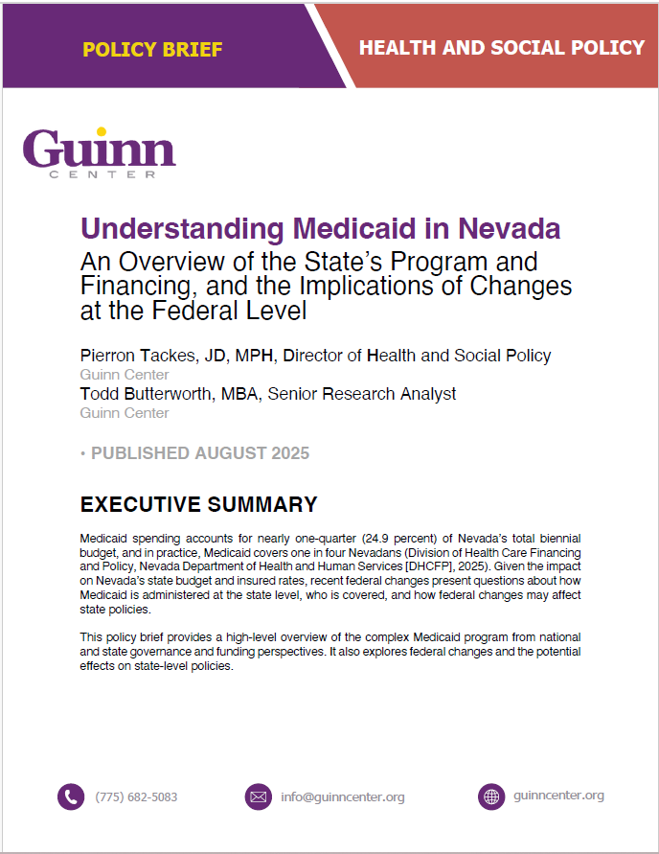
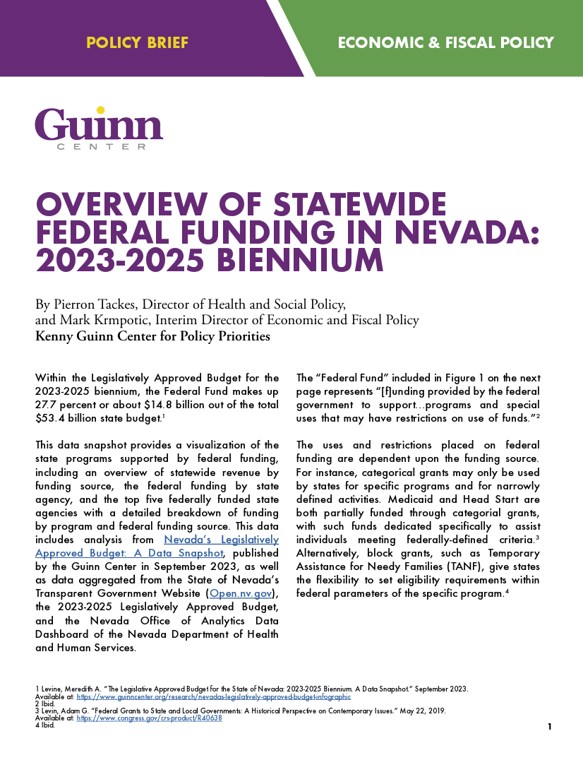
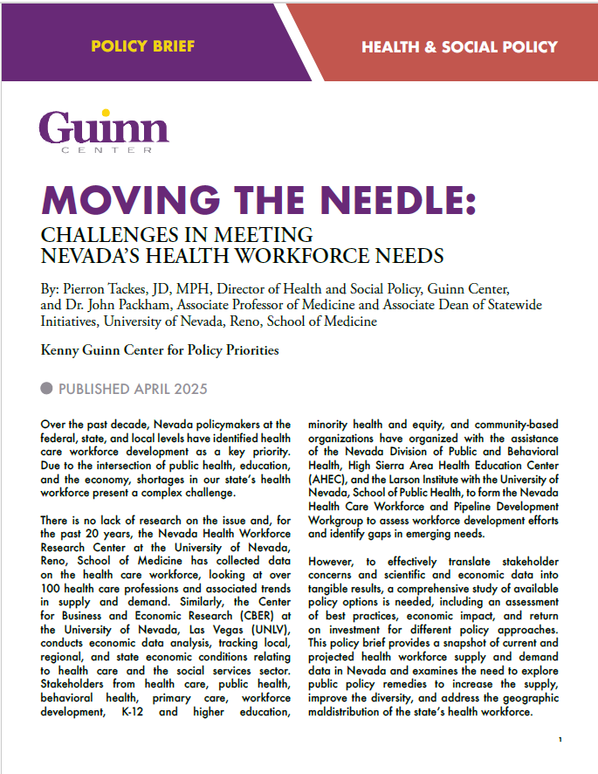
Founded in 2014
Evidence-Based Recommendations
Research & Analysis
Affiliated with UNR in 2021
150 Policy Reports and Briefs
The Guinn Center for Policy Priorities is a nonprofit, nonpartisan policy research center addressing key challenges faced by policymakers and all Nevadans.
Notes:
2014 – Founded by a group of dedicated Nevadans who saw a need for an independent, nonpartisan think tank to address the increasingly complex issues facing our rapidly growing state.
Advancing evidence-based policy solutions for Nevada through research, public engagement, and partnerships.
Dedicated to data-driven research that supports evidence-based policy-making at the state and local levels.
Funded by philanthropic donations, federal and state grants, and contracts.

Slide 3
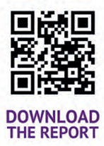
What does Medicaid look like in Nevada? How will federal changes impact Nevada?
Notes:
Joint state and federal program – both in how it is financed and in policy. The federal government sets baseline parameters, the states can then expand upon what and who it covers. With changes from HR 1, states will experience changes in who and what is covered, as well as the ability to finance the program. This has a huge impact on Nevada’s safety net providers, who rely on Medicaid reimbursements to keep their doors open.

Slide 4
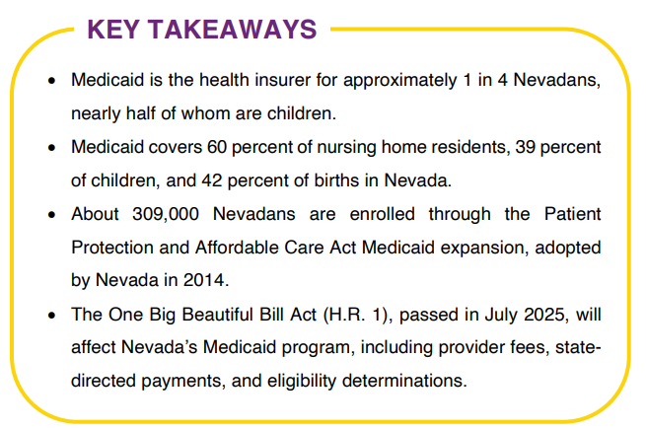
Notes:
Accounts for ¼ of Nevada’s total biennial budget

Slide 5
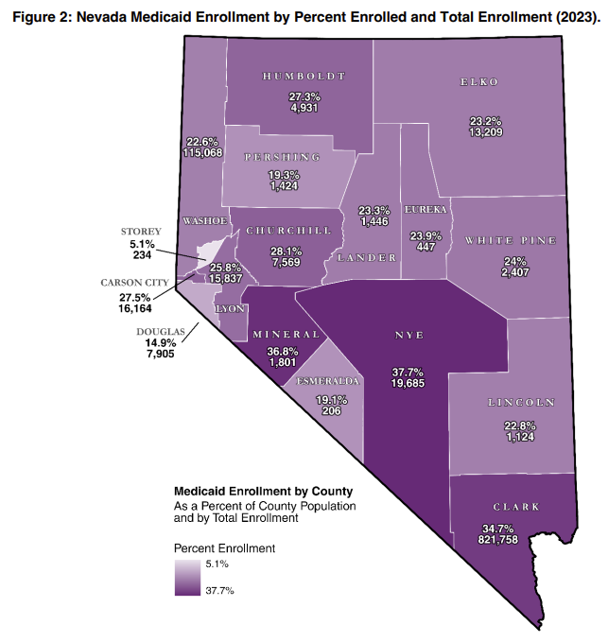
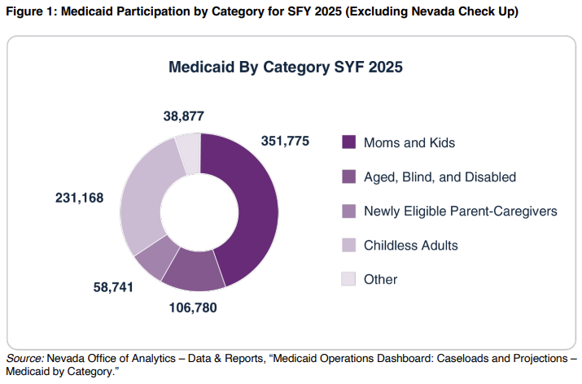
Notes:
45% are moms and kids, 29% are childless adults, 14% are aged, blind and disabled, 7% are newly eligible parent-caregivers, 5% fall into some other population
Nevada’s urban counties – Clark, Washoe, and Carson City – about 30% of the county population is on Medicaid, and then the rural counties vary with Nye and Mineral experiencing the highest percentage of their populations enrolled.

Slide 6
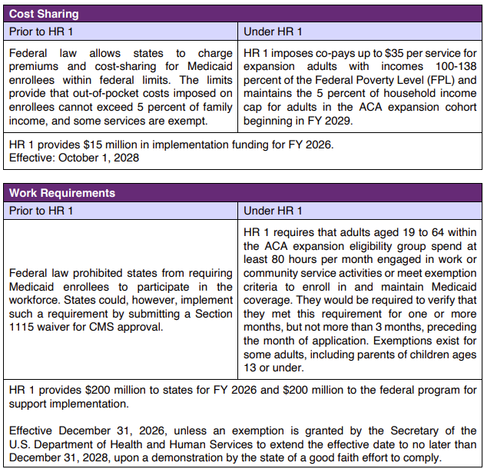
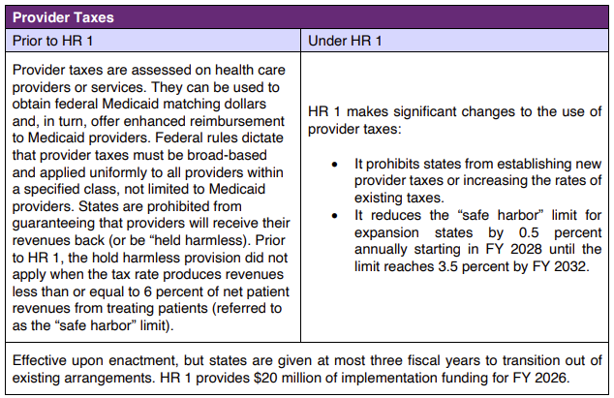
Notes:
The brief also discusses at length how Medicaid is financed, providing an overview of the federal medical assistance percentage, and also the policy levers available to states to finance the state portion of Medicaid.
HR 1 makes significant cuts to entitlement programs – not just Medicaid – but this brief goes into the changes that will likely affect Nevada’s Medicaid program.
Changes will affect: Individuals covered, providers who serve Medicaid patients, and the state in administering the program.
Cost-sharing
Work Requirements (and also eligibility redeterminations)
-Work requirements 2/3rds of Nevada adults on Medicaid are working full or part time.
-Two states have implemented work requirements prior to this change; GA spent more than $91M to implement the work requirement, $50M of which was spent on building the eligibility reporting system. And Arkansas, which observed 18,000 people losing Medicaid coverage with not increase in employment rates.
-If a person is disenrolled due to work requirements, they have to file a new application to re-apply, which will triggering the compliance check for at least the one month prior to application.
-If a person is denied Medicaid due to work requirements, they are not permitted to receive marketplace tax credits.
Provider Taxes: One mechanism to assist both the state in capturing federal matching dollars, but also offer enhanced reimbursement to Medicaid providers. Nevada has two provider taxes in place, one on nursing facilities and one on private hospitals, both at 6 percent.

Slide 7
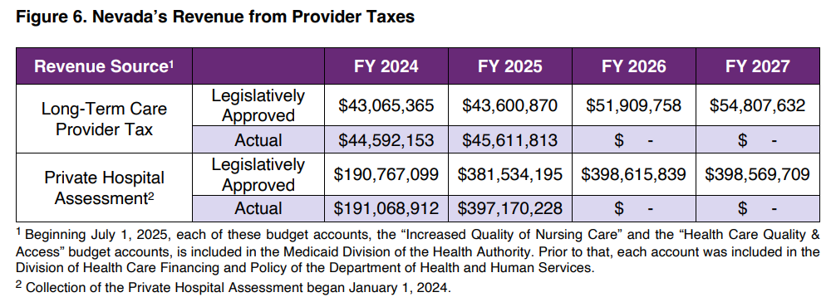

Slide 8
Impacts of HR 1 relating to Medicaid
State Administration
Eligibility Determinations
Work Requirement Implementation
Providers
Provider taxes, state-directed payments, Disproportionate Share Hospital Payments
Recipients
Eligibility Determinations
Cost Sharing
Retroactive Coverage
Termination
Health insurance overall
System wide impact
Changes to health insurance exchanges

Slide 9
What is the federal funding picture in Nevada?
Analysis of Nevada’s 2023-2025 biennial budget, examining the top 5 federally funded state agencies.

Slide 10
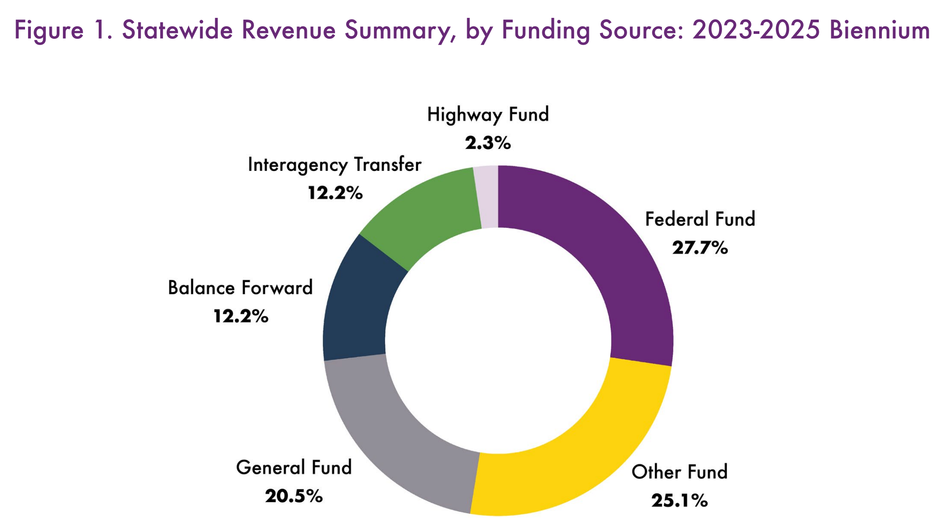
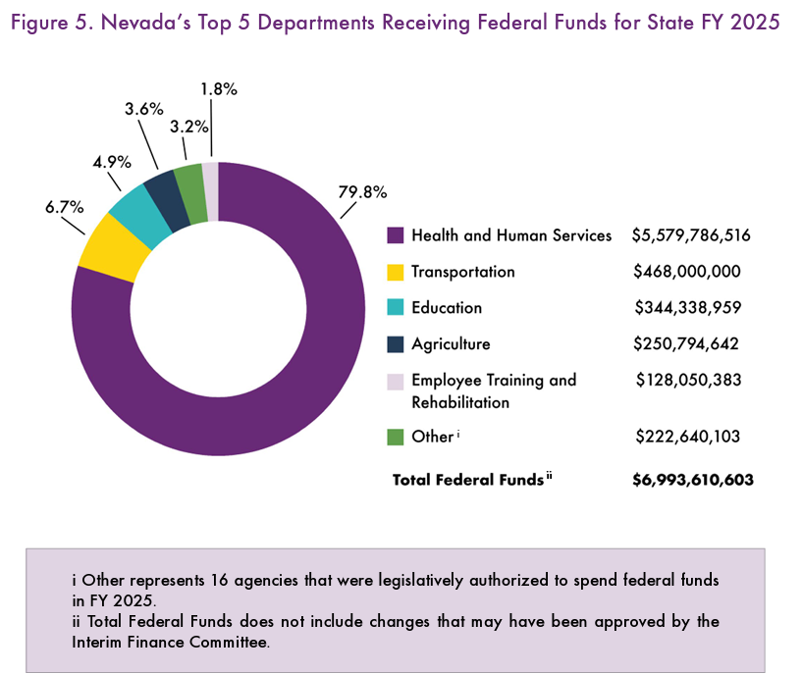

Slide 11
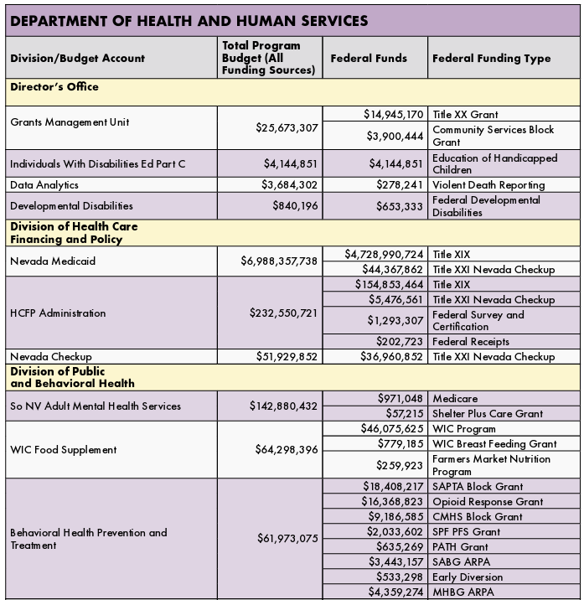

Slide 12
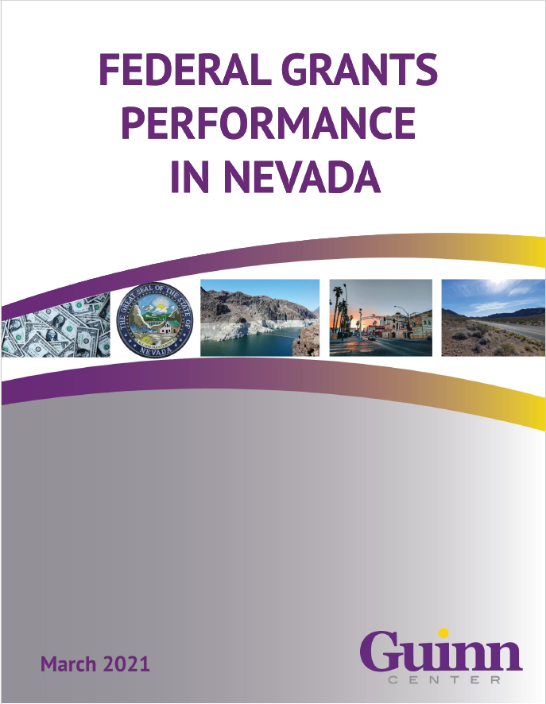
Grant Utilization in Nevada
Federal grants per capita over time:
$700 in FFY 2008
$2,296 in FFY 2020
$2,999 in FFY 2025
In 2023, Nevada ranked 47th for federal grant funding per capita.

Slide 13

Part II: Understanding the Pass-Through Dollars
Examining federal pass-through dollars of top five federally funded state agencies to understand the burden that non-profits and third parties carry in providing direct services.
Preliminary findings

Slide 14
