Slide 1
The State of Nevada’s Public Health Safety Net
Emma Rodriguez, MPP
Communications & Legislative Affairs Administrator, SNHD

Slide 2
Nevada’s Public Health Funding History
Historically low investment in public health
Reliance on federal categorical grants
Limited state funding for core services

Slide 3
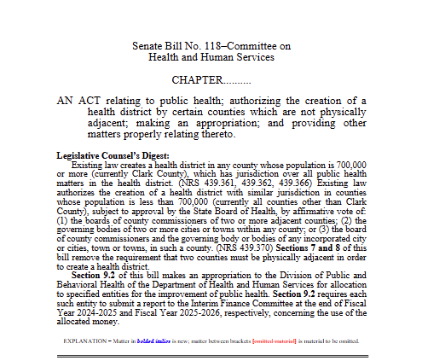
Senate Bill 118
SB118 passed in 2023 legislative session
$15M statewide / $10.95M to SNHD
Two-year award (FY25–26)
Flexible, one-time investment to strengthen public health capacity and programs
Funds must be expended by June 30, 2026

Slide 4
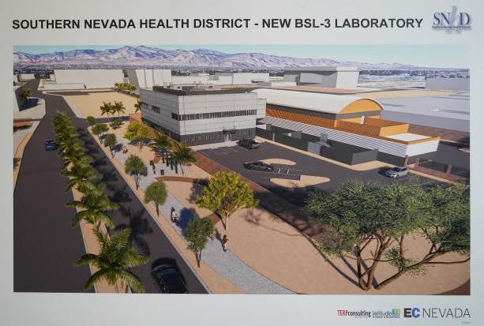
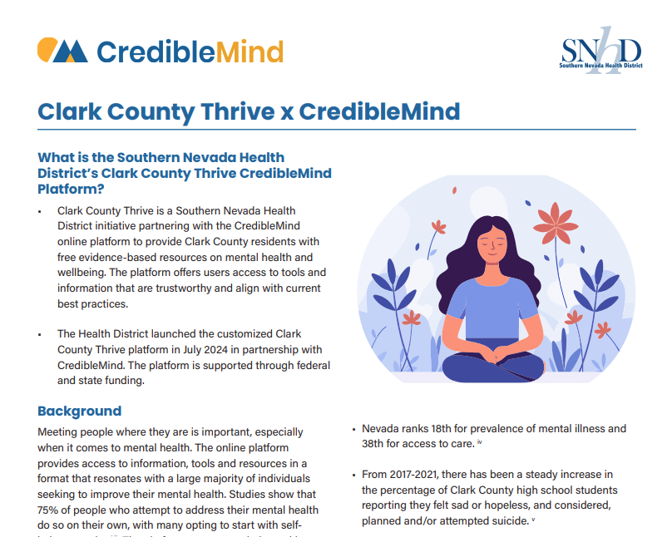
SB118 Priority Areas at SNHD
Disease Surveillance & Control – STI workforce, lab annex, TB VDOT, Smarty geocoding
Enhancing Access to Care – Mobile van for immunization and STI outreach
Contingency Management & Youth Vaping Prevention – Stimulant use disorder training, tobacco prevention
Health Equity – Safe drinking water, public health communications, CredibleMind platform

Slide 5
Early Impacts of SB118
32,680 STI/HIV reports processed in FY25
4,500 case investigations completed
Youth vaping prevention: >1M monthly social media impressions
Lab annex planned: 12,000 sq. ft. expansion
Syphilis nurse navigators: outreach, training, congenital syphilis prevention

Slide 6
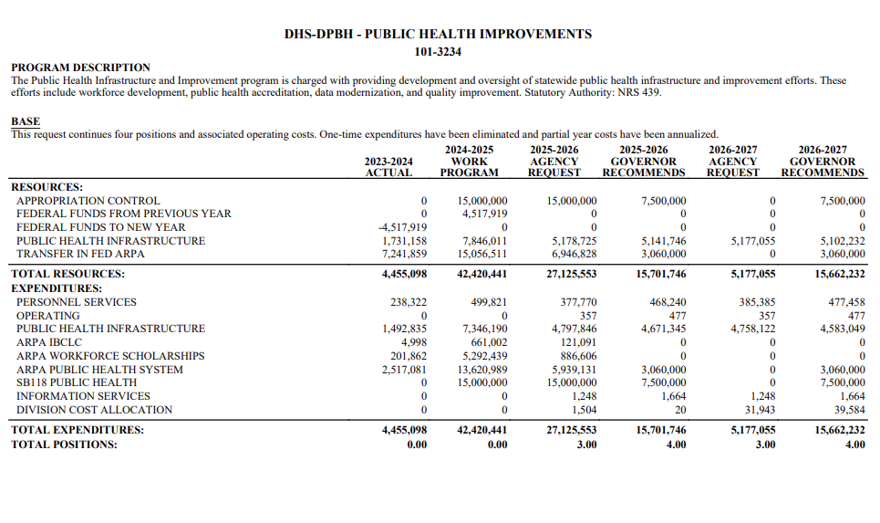
State Public Health Funds (SPHF)
Established in 2025 Legislative Session
$15M statewide / $10.8M to SNHD
Provides ongoing base funding to support core public health capacity
SNHD priorities:
  HAI prevention & control
  Maintain epidemiology & lab capacity

Slide 7
Current Environment & Legislative Outlook
State revenues tied to gaming and tourism
Narrowing surpluses; budget uncertainty by 2027
Public health must compete for limited dollars

Slide 8
Sustainable Public Health Funding
Stable, predictable funding is essential for core capacity
Demonstrated impact builds support (e.g., STI response, vaping prevention, lab expansion)
Prevention investments reduce long-term costs
Coordination across partners strengthens sustainability
Transparency and accountability build trust

Slide 9
Building a Sustainable Future
Nevada is at a turning point
Dedicated state dollars are reaching local health departments for the first time
Next step: move from short-term to stable, long-term funding
Continued alignment across state and local partners will be key to sustaining progress

