Slide 1
Medicalization of Consumer Health: What Bariatric & Aesthetic Nurse Practitioners Encounter
Nikesha “Nikki” Mobley
DNP, APRN, AGACNP-BC
Assistant Professor of Nursing, UNLV
Owner/Nurse Practitioner, Elite Health and Wellness
June 26, 2025

Slide 2
Objectives
Define medicalization and its consumer-driven evolution.
Describe specific patient scenarios reflecting medicalization in bariatrics and aesthetics.
Identify the Nurse Practitioner’s role in ethical decision-making and patient education.

Slide 3
What is Medicalization?
Definition: Redefining everyday problems as medical issues.
Driven by science, pharma, culture, and consumer demand.
Modern twist: Medical care as a pathway to personal enhancement and identity.
Notes:
From menopause to body fat to wrinkles, more people seek "treatment" for what was once considered natural aging or variation.

Slide 4

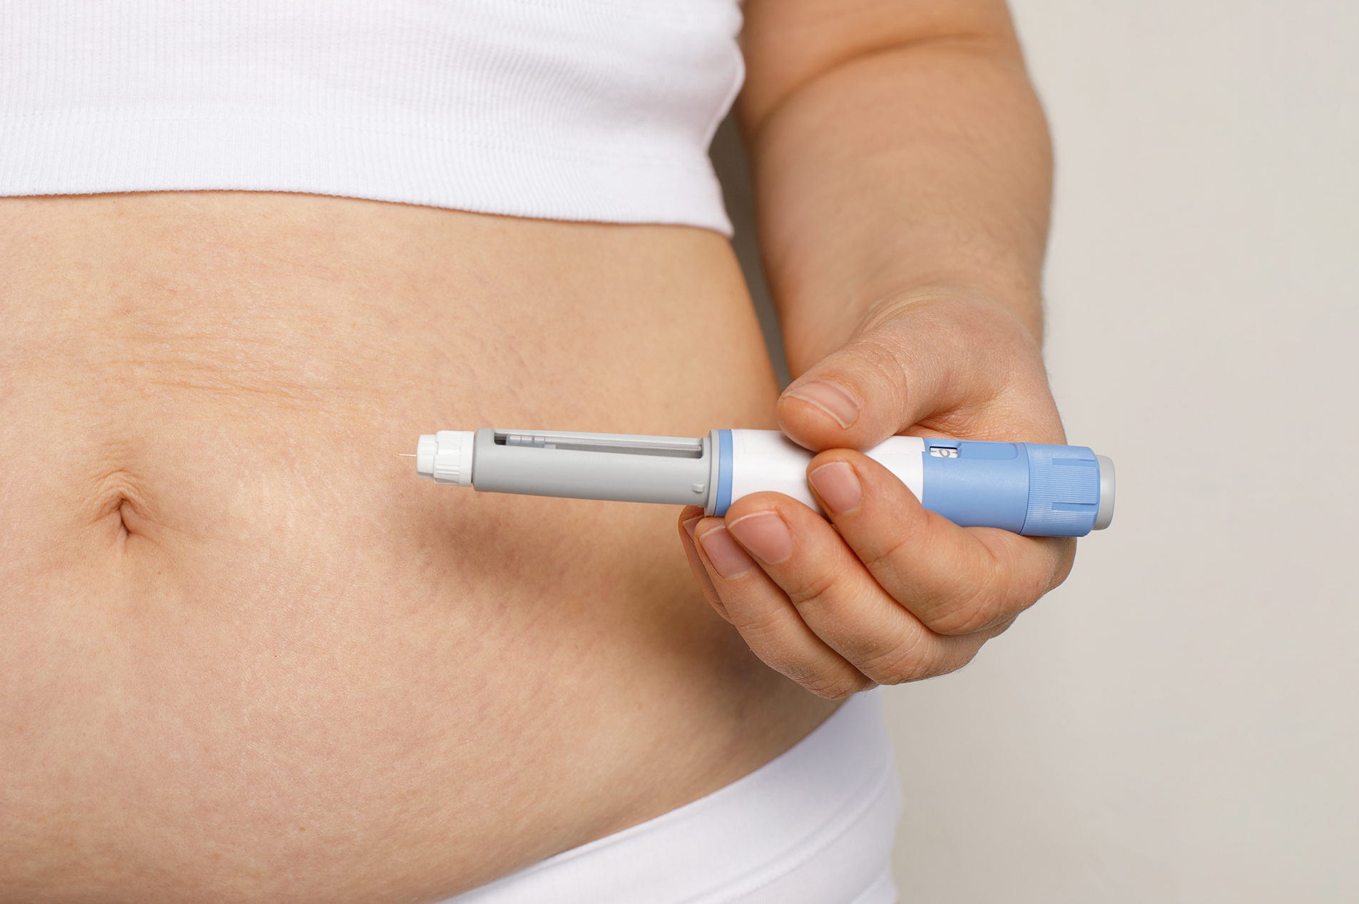
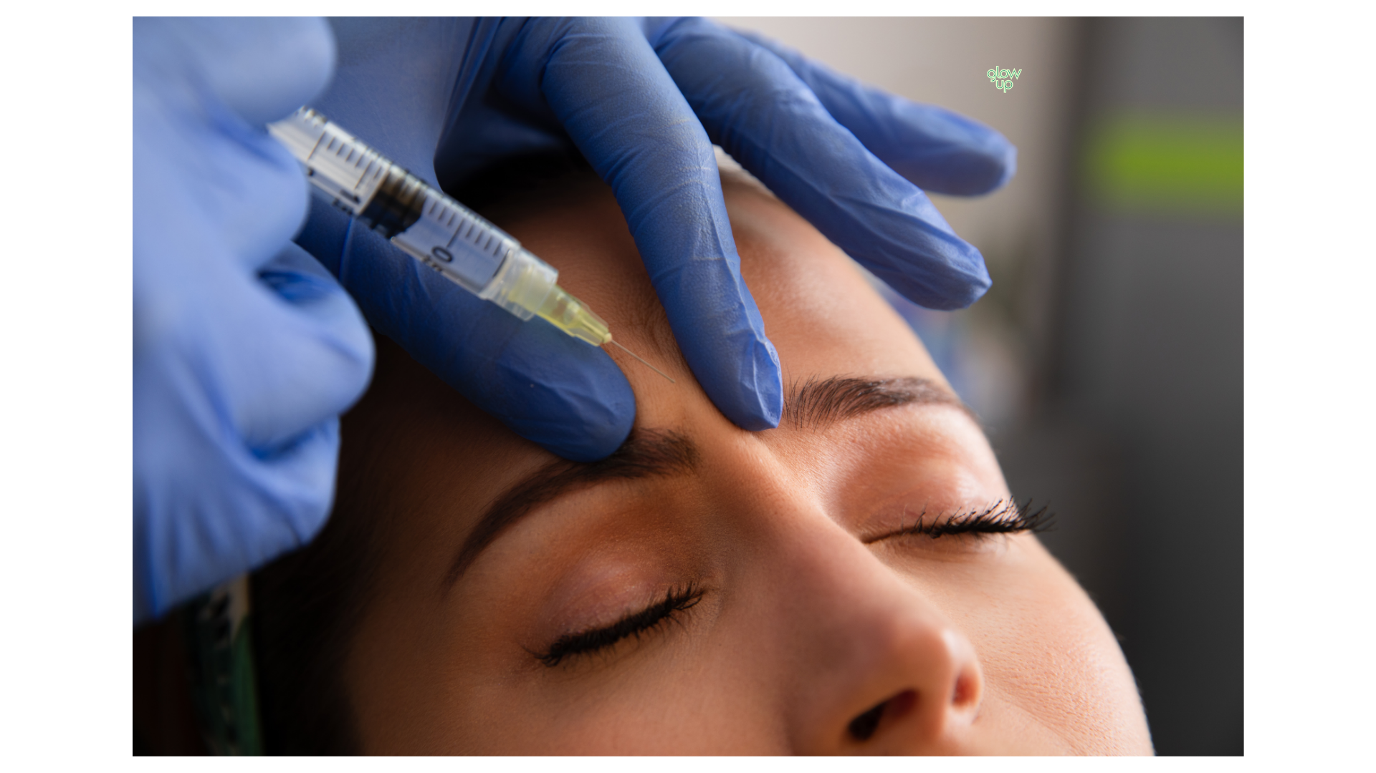
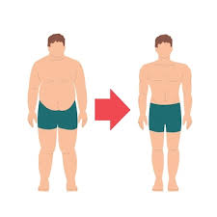

Consumer Health Culture
Social media, TikTok trends, and celebrity influence
Direct-to-consumer advertising: GLP-1’s, Neurotoxins, Dermal Fillers
Patients arrive already asking for specific treatments
Lose 10 pounds in 1 week

Slide 5
Case 1: “10 pounds from Instagram”
Scenario: A healthy 30-year-old BMI 26 wants GLP-1 for aesthetic weight loss.
Issues:
  Clinical indications vs. cosmetic motives
  Pressure to prescribe based on social trends
Notes:
The line blurs between weight management and body optimization. How do we assess risk, set boundaries, and educate?

Slide 6
Case 2: “Wellness Meets Weight”
Scenario: 48-year-old woman wants ozempic + compounded hormone therapy from TikTok clinic trends.
Issues:
  Polypharmacy risk
  "Wellness" used to justify multiple off-label or unregulated interventions
Notes:
How do we differentiate evidence-based care from “medicalized wellness consumerism”?

Slide 7
Case 3: “Preventative Botox at 21”
Scenario: Young patient wants full-face Neurotoxin for “wrinkle prevention”
Issues:
  What’s the source of concern? (e.g., social comparison)
  Is this truly preventative, or over-treatment?
Notes:
Fear of aging is now a reason to medicate youth

Slide 8
Case 4: “Fix My Face, Not My Feelings”
Scenario: Client with body dysmorphic tendencies requests Polydioxanone (PDO) threads monthly
Challenges:
  Is this a psychological need or a clinical issue?
  When to refer for counseling
Notes:
PDO- minimally invasive cosmetic procedure that uses dissolvable sutures to lift and tighten sagging skin on the face and body; lasts 12-18 months
Must screen for deeper issues when requests become extreme or recurrent.

Slide 9
Medicalization Red Flags in Practice
Over-medicalizing “non-pathological traits” (e.g., belly fat, aging skin)
Repeated treatment requests without clear benefit
Patient uses aesthetic/weight loss care to fix self-esteem
Minimal discussion of lifestyle changes
Seeking multiple aesthetic or weight loss treatments at once
Body image concerns that appear disproportionate to clinical findings
Reliance on social media or influencers as primary sources of health information

Slide 10
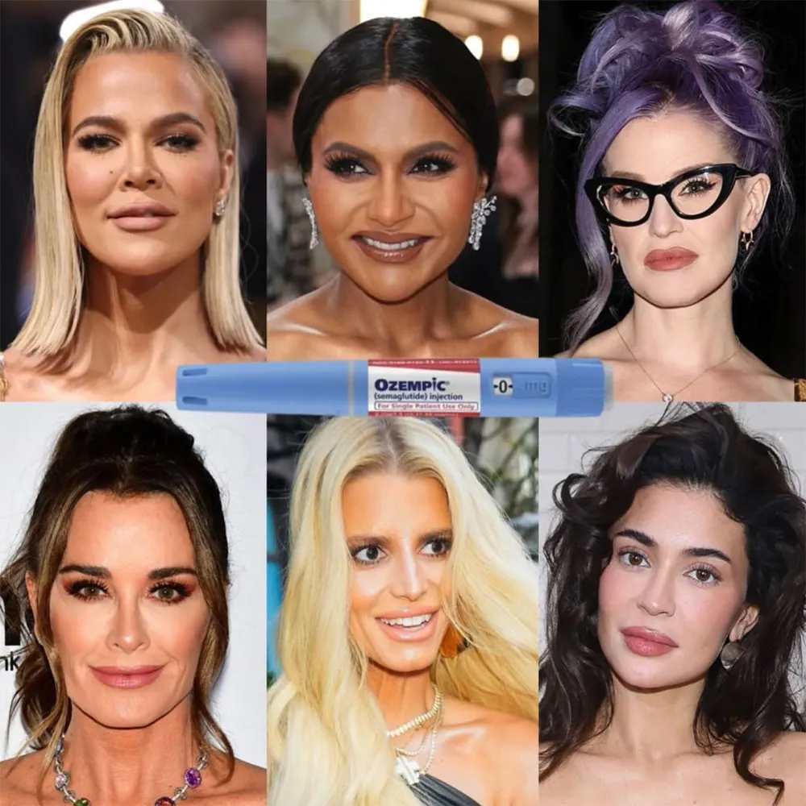
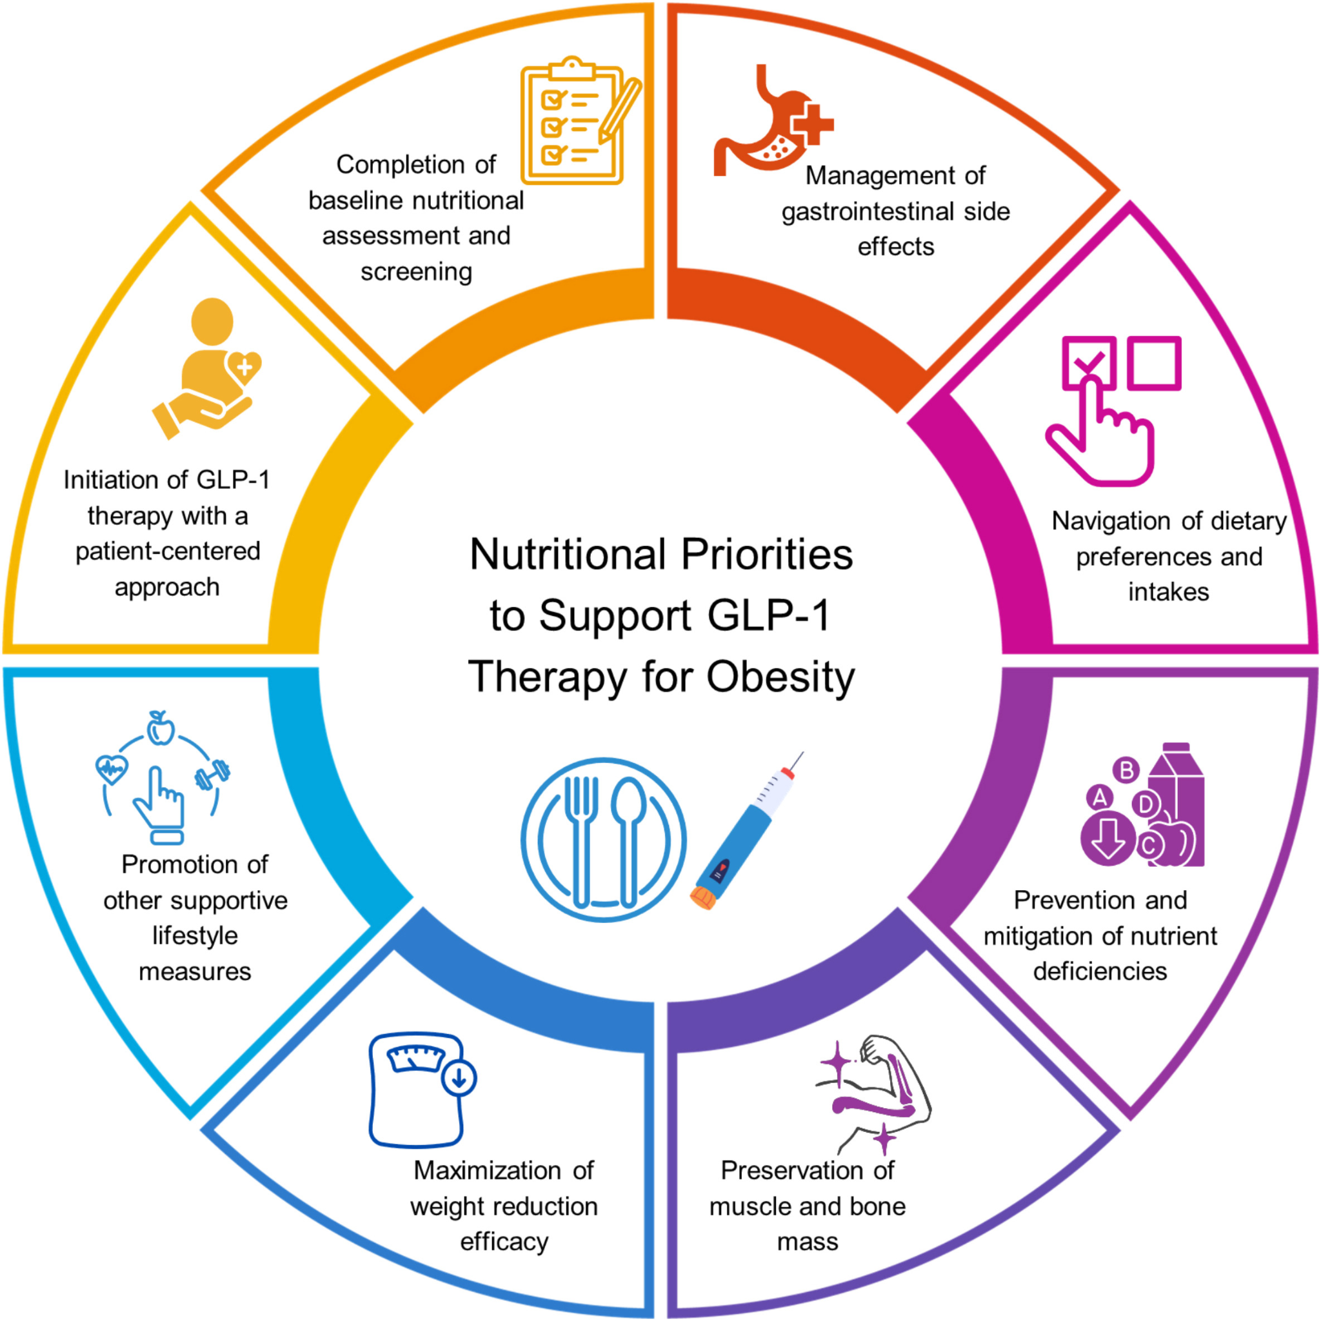
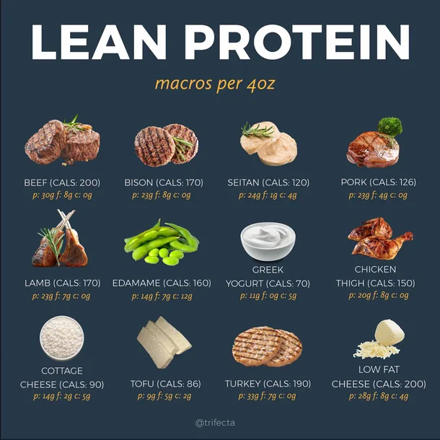
NP Role: Clinical + Cultural Translator
Educate: Counter misinformation and viral trends
  Patient asks for “Ozempic face filler” after seeing a viral post claiming facial fat loss from GLP-1s is inevitable.
    Offer a more balanced view on weight loss medications, including nutrition counseling to support healthy fat and muscle retention.

Slide 11
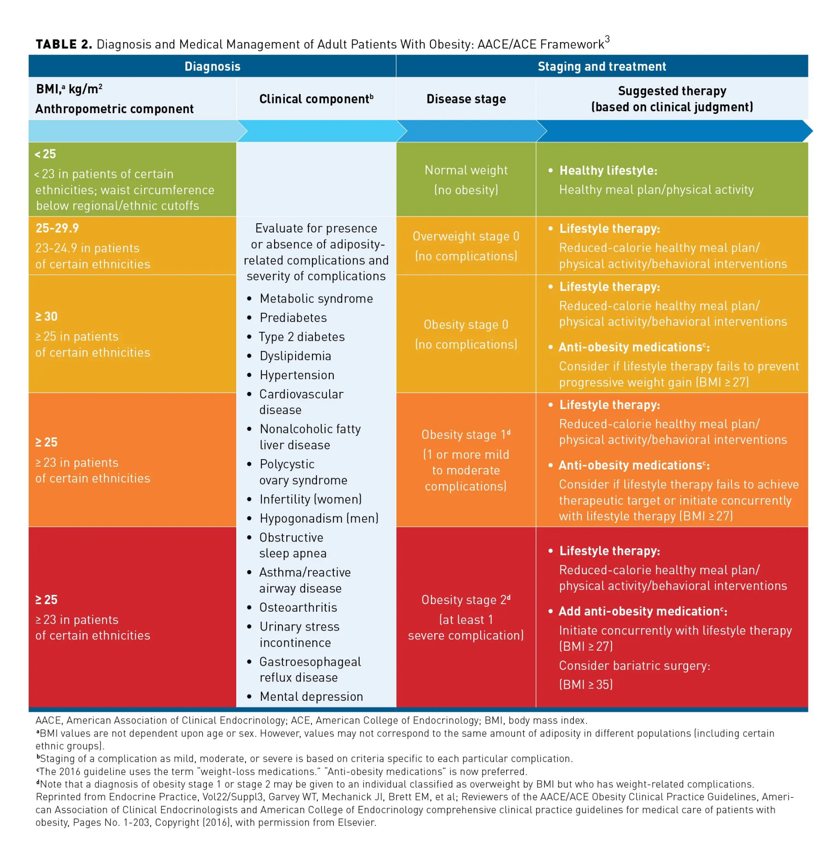
NP Role: Clinical + Cultural Translator
Evaluate: Use evidence-based criteria, not just demand
  A 35-year-old with BMI 24 asks for compounded tirzepatide “to stay slim.”
    Assess clinical history, screen for eating disorders, and explain that based on current guidelines, they don’t meet the criteria for medical weight loss treatment.
    Offer a referral to a registered dietitian and reinforce healthy lifestyle measures

Slide 12


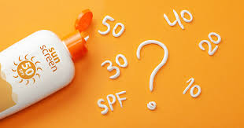
NP Role: Clinical + Cultural Translator
Empathize: Acknowledge concerns without unnecessary intervention
  A 23-year-old feels self-conscious about “smile lines” and asks for filler.
    Assess clinical history (e.g. sun exposure, smoking, hydration status)
    Explain that their skin is youthful and recommend medical-grade skincare and hydration

Slide 13
Ethical Dilemmas You Might Encounter
“Should I prescribe this off-label because everyone else is?”
“What if I lose clients if I say no?”
“How do I stay true to my training in a market-driven industry?”
Notes:
It's easy to justify, but our duty is patient safety, not popularity.

Slide 14
Professional Boundaries &
Best Practices
Prescribing FDA-approved or evidence-based uses
Use screening tools {e.g., SCOFF (eating disorder screening), PHQ-9 (depression screening)}
Practice informed consent beyond just a signature—ensure understanding

Slide 15
Future Outlook
Aesthetic and weight loss markets will continue to grow
Expect increasing pressure to “medicalize” more
NPs must stay grounded in science, patient-centered care, and ethics

Slide 16
Navigating the Path
Medicalization affects how patients view their bodies and identities.
Bariatric and aesthetic NPs are at the front lines of this shift.
Our clinical judgment, integrity, and communication are key to safe, empowering care.

Slide 17
Questions??

Slide 18
References
Bottcher, A., Guarino, A., Jensen, L. M., & Crowley, K. (2021). Perceptions of obesity pharmacotherapy by nurse practitioners. Journal of the American Association of Nurse Practitioners, 33(5), 350–357. https://doi.org/10.1097/JXX.0000000000000603
Clarke, A. E., Mamo, L., Fosket, J. R., Fishman, J. R., & Shim, J. K. (2023). The perils of medicalization for population health and health equity. The Milbank Quarterly, 101(2), 342–367. https://doi.org/10.1111/1468-0009.12608
Cornier, M.-A. (2022). A review of current guidelines for the treatment of obesity. The American Journal of Managed Care, 28(Suppl 15), S288–S296. https://doi.org/10.37765/ajmc.2022.89292
Mozaffarian, D., et al. (2025). Nutritional priorities to support GLP-1 therapy for obesity: A joint advisory from the American College of Lifestyle Medicine, the American Society for Nutrition, the Obesity Medicine Association, and The Obesity Society. The American Journal of Clinical Nutrition. Advance online publication. https://doi.org/10.1016/j.ajcnut.2025.04.023
Russell‑Goldman, E., & Murphy, G. F. (2020). The pathobiology of skin aging: New insights into an old dilemma. The American Journal of Pathology, 190(7), 1356–1369. https://doi.org/10.1016/j.ajpath.2020.03.007

