Slide 1




Empowering Sustainable Weight Management:
A mindful and evidence based approach
DR. VIVEK GUPTA, M.D., M.P.H.
Board Certified in Obesity & Internal Medicine
Manhattan Beach, CA
Las Vegas, NV
MINDFULWELLNESS.COM
Notes:
1

Slide 2

Where Healing Begins
Weight Loss
Pediatric Obesity
Wellness
Health Coaching
Addiction

Slide 3



ABOUT
We are family...
us...
Our team is a blend of real family members and former co-workers who have seamlessly integrated into a close-knit work family. Together, we bring a unique and cohesive dynamic to our work. WE LOVE IT!
Established in September 2020 as a sole provider, we have since expanded into a dedicated team of clinicians, coaches, and support staff, united in our mission to compassionately help patients achieve their health goals.
With a focus on growth and excellence, we have served over 1500 patients in multiple states. Our commitment to results is reflected in 100% of our patients experiencing weight loss.
CURRENTLY LICENSED: CA, WA, NV, AZ, OR, IL, MD, PA, GA, FL, TX, NY, NJ, TN, NC, CO

Slide 4






Dr. Vivek Gupta
Dr. Amit Misra
Traci Steenburgen
Aditya Nemani
CEO/FOUNDER
Board Certified
Obesity and Internal
Medicine.
PRESIDENT
Board Certified Pediatrics and Pediatric Critical
Care Medicine.
COO
Spa Owner & Operator for 18 years. Sales & Customer Care Management.
CFO
Master’s in Data Science from UC Berkeley.

Slide 5
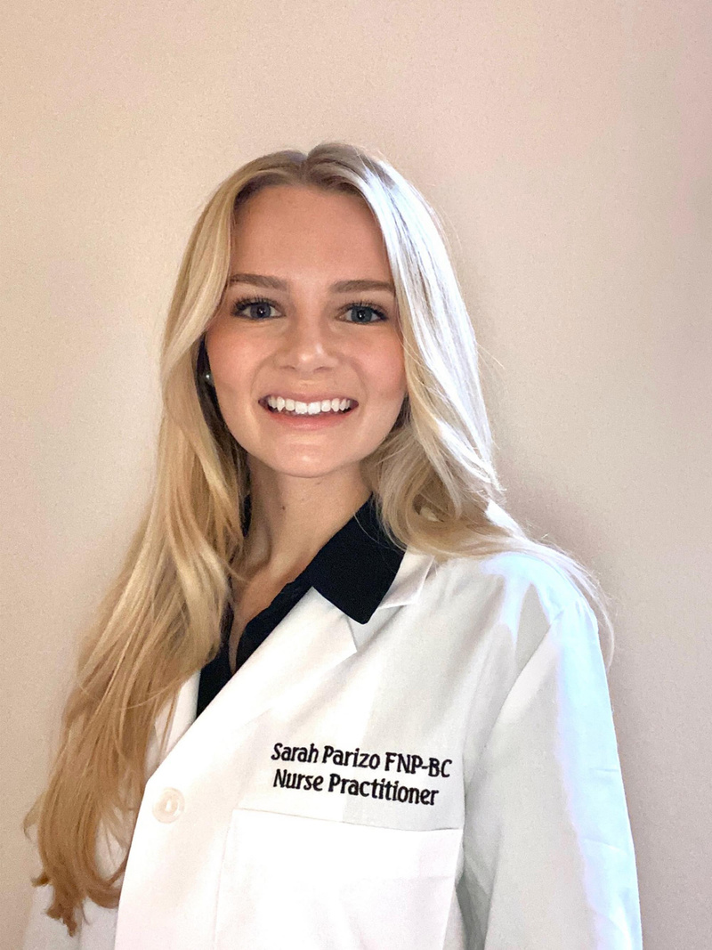




MEET
OUR CLINICIANS
Sarah Parizo, NP
Jessica Lee, NP
Carla Baccio, HC
Kristin Gonzalez, HC
Lizeth Flemino, HC
Board certified family nurse practitioner. Graduated from USC.
Board certified family nurse practitioner.
Graduated from CSU with a Master's degree.
Masters of Science Degree in Exercise Nutrition and Wellness. Personal Trainer.
Doctorate in Physical Therapy specializing in MPT DPT. OCS Ortho Certified Specialist, BCB-PMD Biofeedback.
Certification from the Institute of Integrative Nutrition.

Slide 6





OUR PATIENT
CARE TEAM
Emily Wiersma
Myrinda Brino
Michaela Maria
Evette Burgess
PATIENT CARE MANAGER Certified Personal Trainer
EXECUTIVE ASSISTANT
INSURANCE MANAGER
ACCOUNTING MANAGER

Slide 7

The Obesity Epidemic
70% of adults in United States struggle with weight
(Hales et al. 2020)
Around the world, more people struggle with diseases of too many calories more than too few calories
11 million deaths from diet-related diseases, surpassing 4.3 million deaths from undernutrition (IHME, 2020)
Overweight and obesity are the fifth leading risk for global death, contributing to over 5% of all deaths (Collaborators, 2014)
> 2 billion adults affected by overweight or obesity globally (WHO, 2023)

Slide 8

OBESITY IS A DISEASE
“A chronic, progressive, relapsing, and treatable multi-factorial, neurobehavioral disease, wherein an increase in body fat promotes adipose tissue dysfunction and abnormal fat mass physical forces, resulting in adverse metabolic, biomechanical, and psychosocial health consequences.” (Obesity Medicine Association)
THIS SUCKS AND IS UNFAIR!

Slide 9

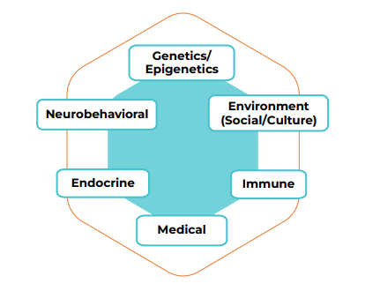
Bio-Pyscho-Social Reasons: (why this sucks)
  Food environment
  Parenting
  Partners, kids, friends, family (negative comments from your MIL)
  Social Media
  Microbiome
  Medications
  Micro-plastics, environmental hormones, and everything else!

Slide 10

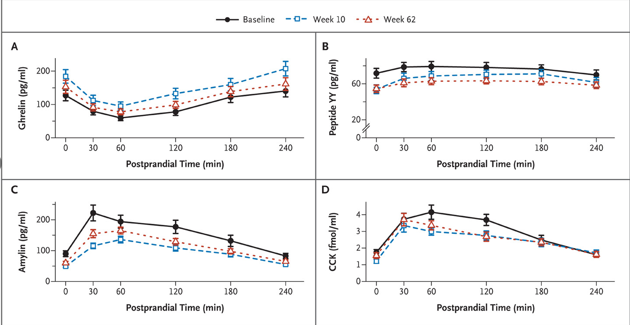
Physiological Reasons: (why this sucks)
Weight loss led to decreased satiety, increased hunger horomones (Sumithran et al., 2011)

Slide 11

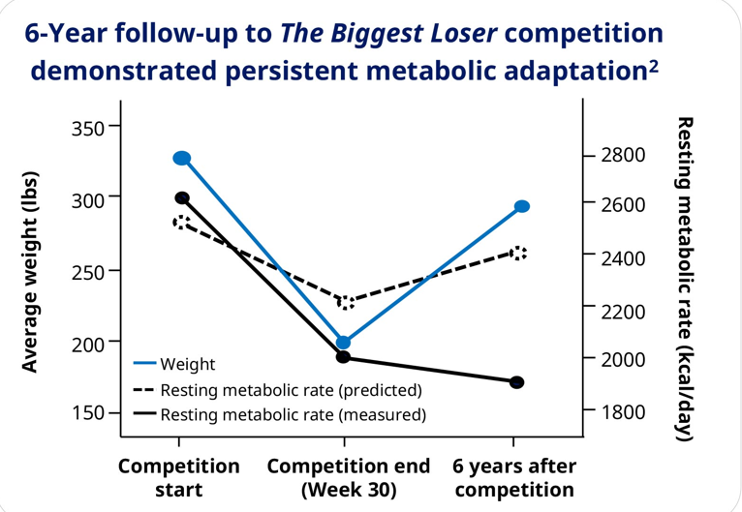
Physiological Reasons: (why this sucks)
"The Biggest Loser" study revealed weight loss led to decrease in metabolism.
(Fothergill E, et al., 2015)

Slide 12


Our Approach to Obesity
Coaching, Therapy, Mindfulness
Treatment plan involves Nutrition, Behavior, Physical Activity, Medications and Surgery
Compassion and Empathetic Approach

Slide 13


Nutrition - What do we eat?
  LOW CARB
  LOW FAT
  INTERMITTENT FASTING
  PALEO
  MEDITERRANEAN
  RAW FOOD DIET
  PROLON
There is no right answer!
The only answer is what works for you!

Slide 14

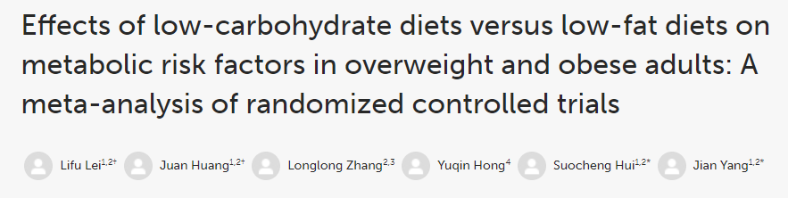
  Meta-Analysis: Low-Carb vs. Low-Fat Diets
    33 RCTs, 3,939 participants
    BMI ≥ 30; Intervention > 6 months
  Short-Term (up to 1 year):
    Low-Carb Diets: More weight loss than low-fat
    Average Difference: -0.91 kg (95% CI: -1.65, -0.17)
  Long-Term (beyond 1 year):
    No significant difference between diets
    Average Difference: -0.44 kg (95% CI: -1.07, 0.19)
Conclusion: Low-carb and low-fat diets lead to similar weight loss long-term.

Slide 15

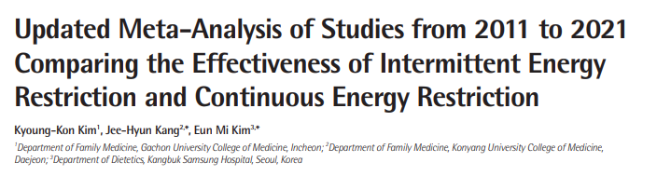
  Meta-Analysis: Intermittent vs. Continuous Energy Restriction (IER vs. CER)
    16 RCTs, 1,438 participants
    Inclusion Criteria > 12 weeks
  Weight Loss:
    No significant difference between IER and CER
  Metabolic Markers:
    CER: Better improvement in blood glucose and lower systolic BP
  Attrition Rates:
    IER: 26.6% | CER: 24.1%

Slide 16

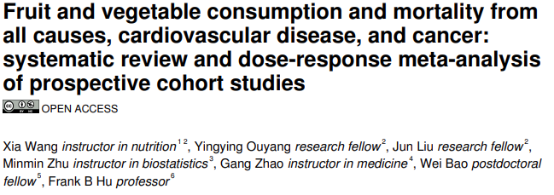
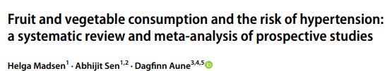
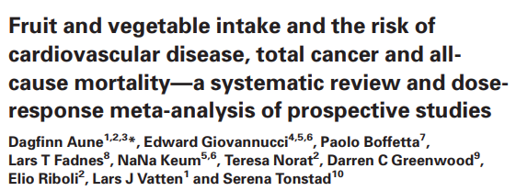
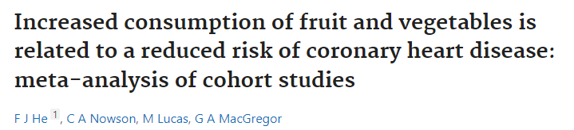
Fruits and Vegetables Are Great!
  18 prospective studies, 451,291 partiicipants
  Reduced risk hypertention with high intake fruits and vegetables
  16 prospective studies
  Follow up period 4.6-26 years
  Higher consumption fruits and vegetables associated lower risk of all cause mortality
  12 cohort studies, 278,459 individuals
  Medial follow up 11 years
  Fruits/veg consumption <3 to more than 5 servings/day related 17% reduction CHD
  95 Prospective Studies
  Reduced risk of CV diease, cancer and all-cause mortality

Slide 17

Nutrition: How is more important than what!
  Consider: Family, job, commute, stress, sleep, food environment, partner dynamics
  Food Preferences: What’s truly easy and sustainable
  Slow transition from ultra-processed foods to healthier options:
    Fruits, vegetables, complex carbs, unsaturated fats, proteins
  No morality in food choices—no right answer—only what works for the patient!

Slide 18

Physical Activity
AHA Recommendations
Aerobic Activity:
150 min/week of moderate intensity OR
75 min/week of vigorous intensity
Resistance Training:
Moderate to high intensity, 2+ days per week
Limit Sitting Time
Our Approach
Start where your patient is
Start with the smallest steps, what patient likes, take into account a person’s life
NO GUILT AND SHAME!!!!
Not helpful!

Slide 19

Behavior - Underlying causes and conditions
  Stress
  Partners/family
  Commute
  Organization Skills
  Job
  Depression/Anxiety
  Everything is on the table

Slide 20



SEMAGLUTIDE INJECTION
1ml / 2.5mg / ml
TIRZEPATIDE
Compound Injection
3ml
Anti-Obesity Medications!!
  Semaglutide (GLP)
    2017, OZEMPIC (dx: DM)
    2021, WEGOVY (dx: obesity)
  Tirzepatide (GLP & GIP)
    2022, MOUNJARO (dx: DM)
    2023, ZEPBOUND (dx: obesity)

Slide 21
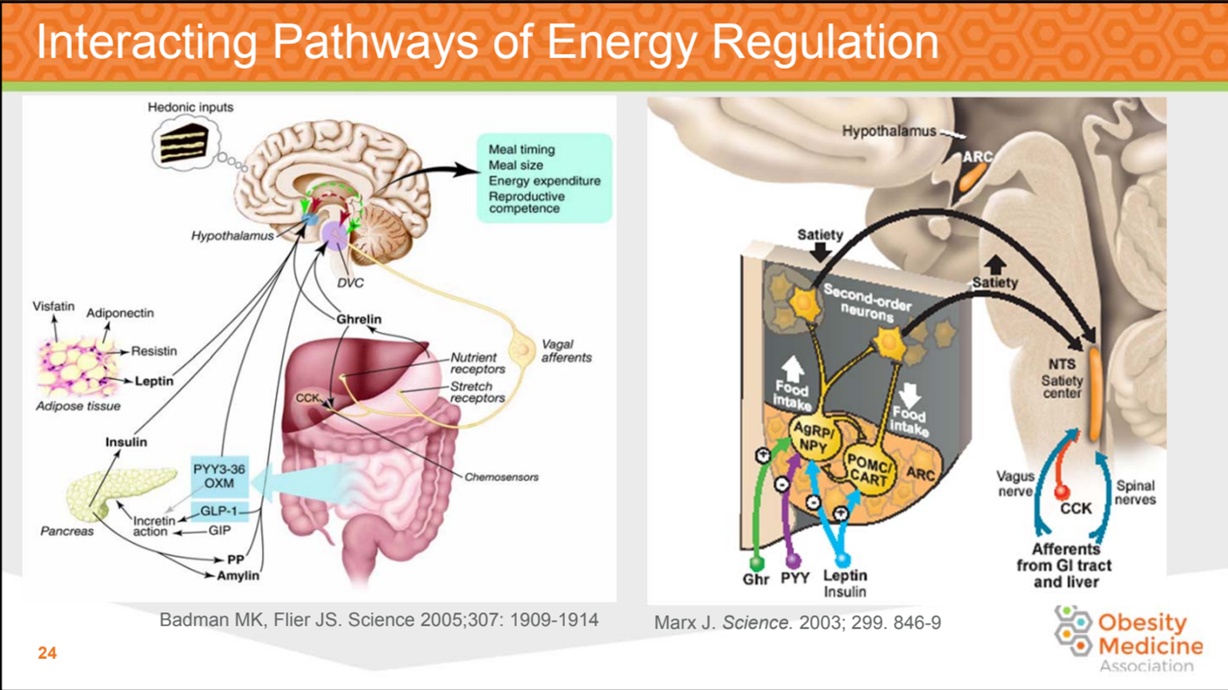

Slide 22
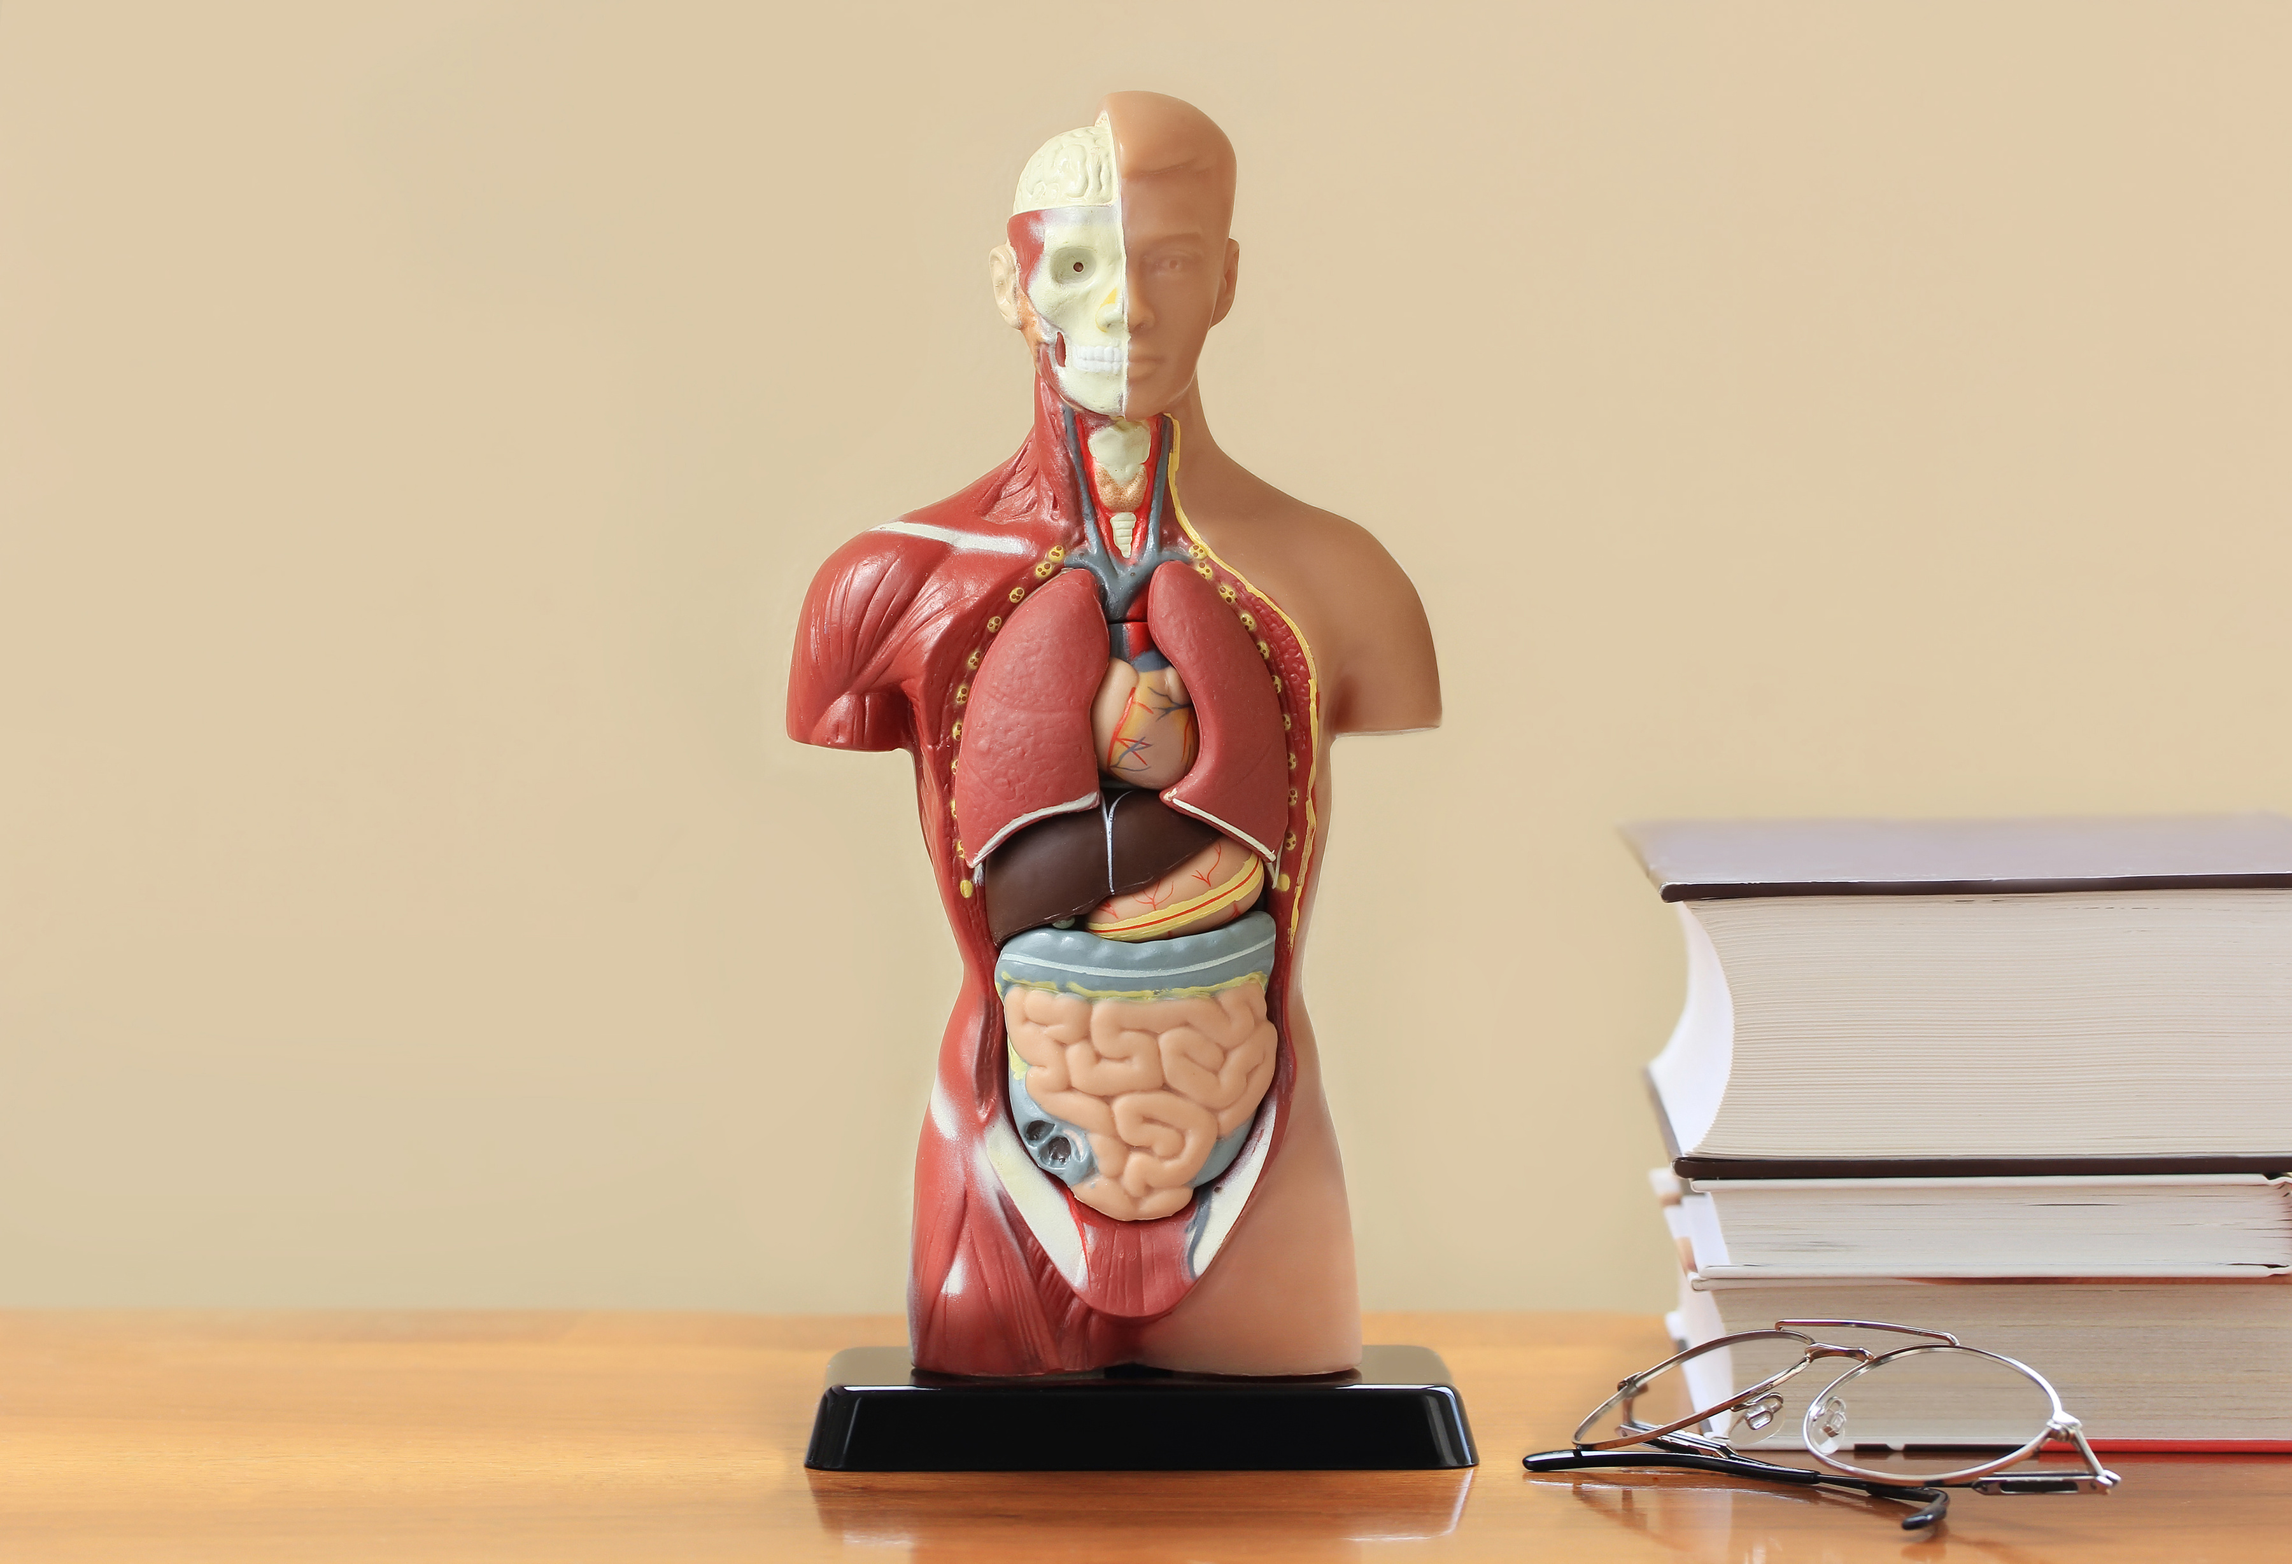
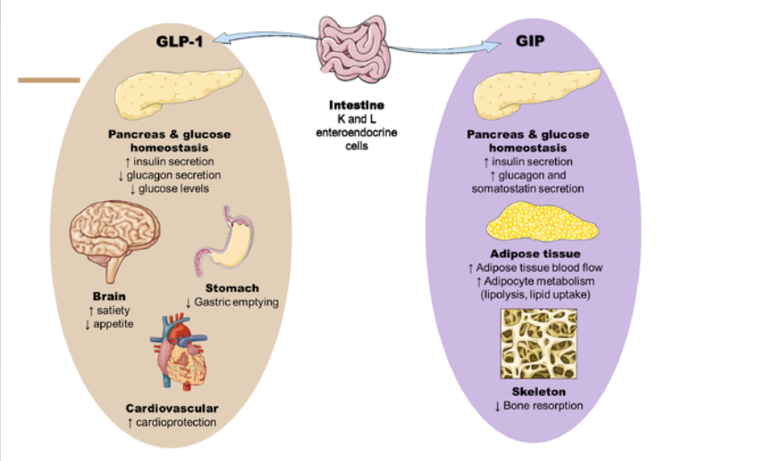

Slide 23

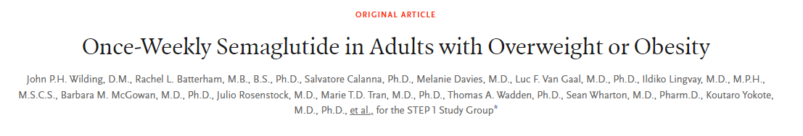
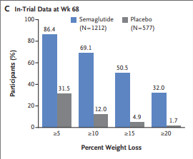
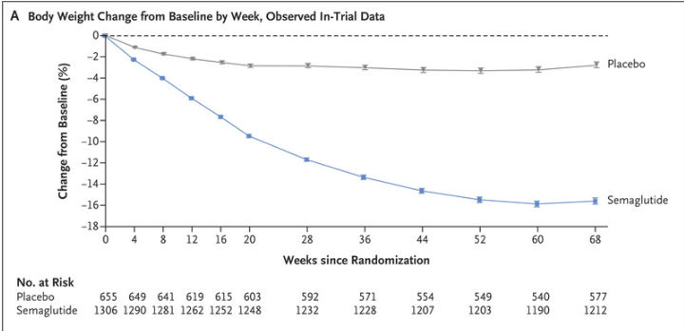

Slide 24


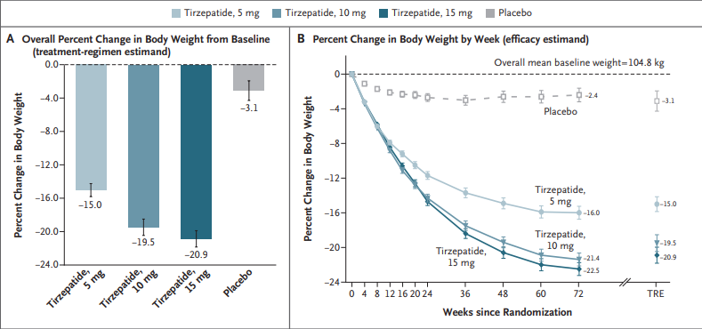

Slide 25
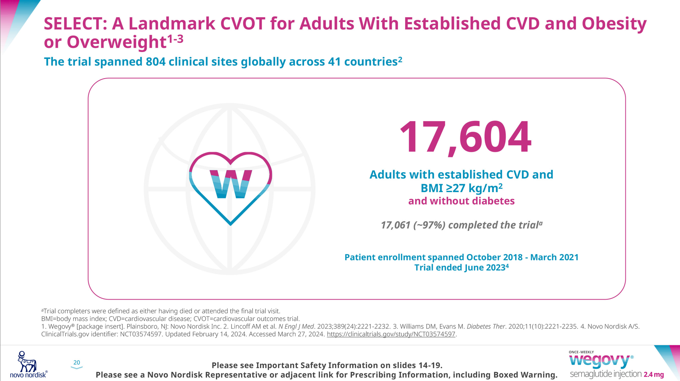

Slide 26
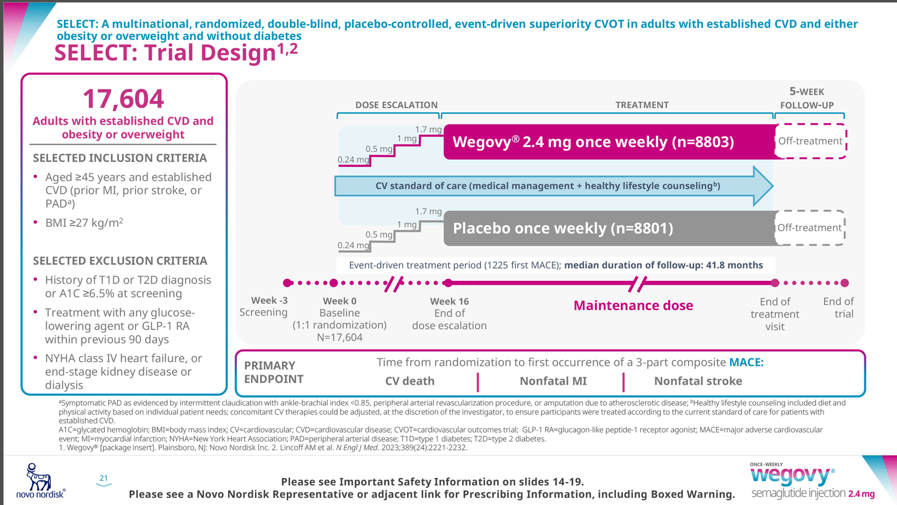

Slide 27
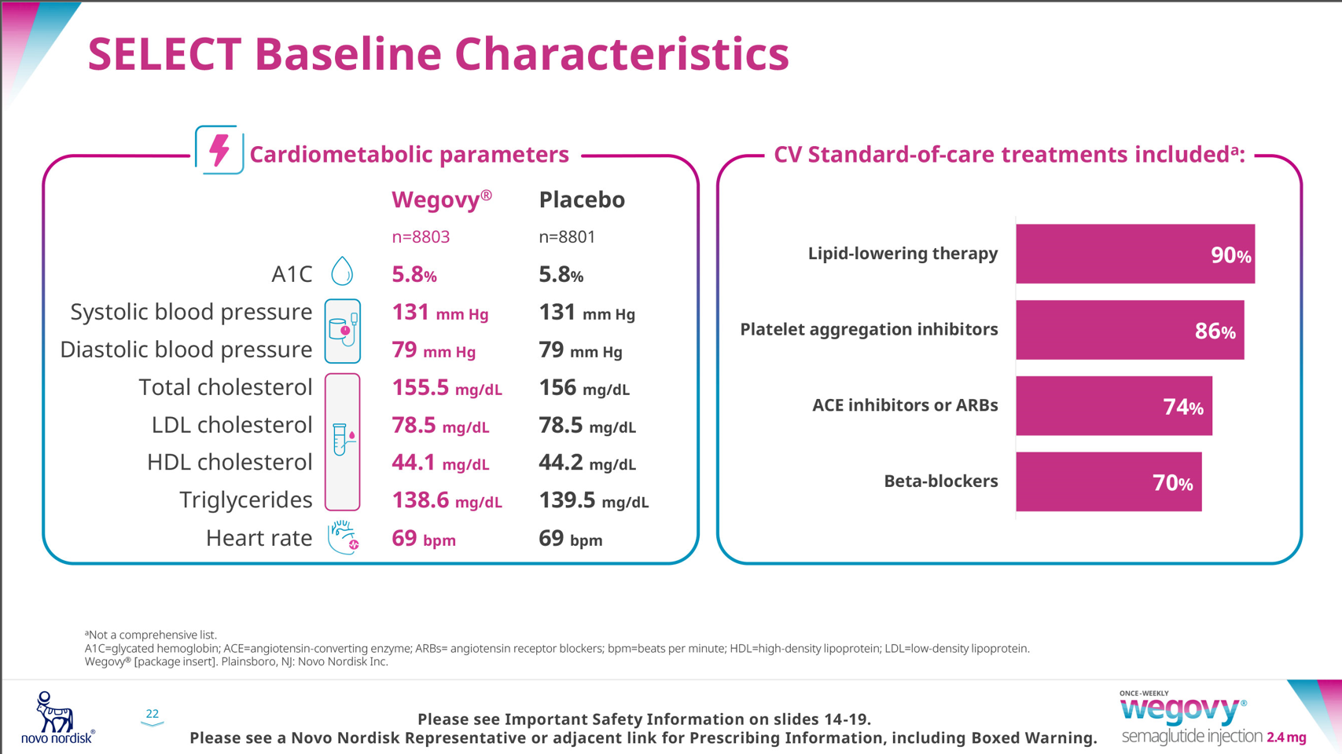

Slide 28
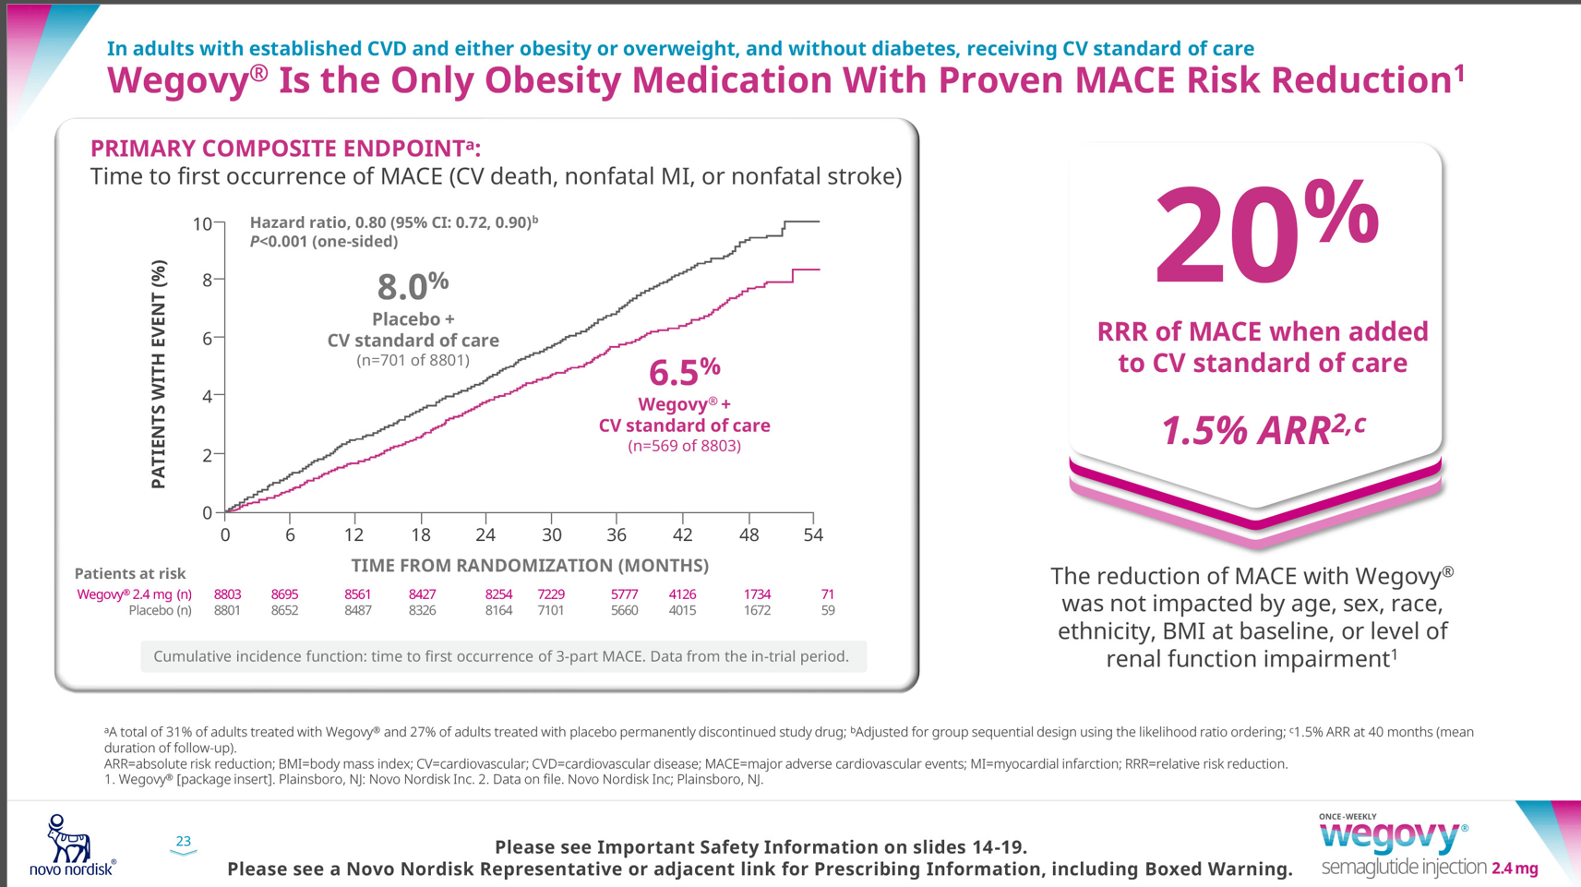

Slide 29
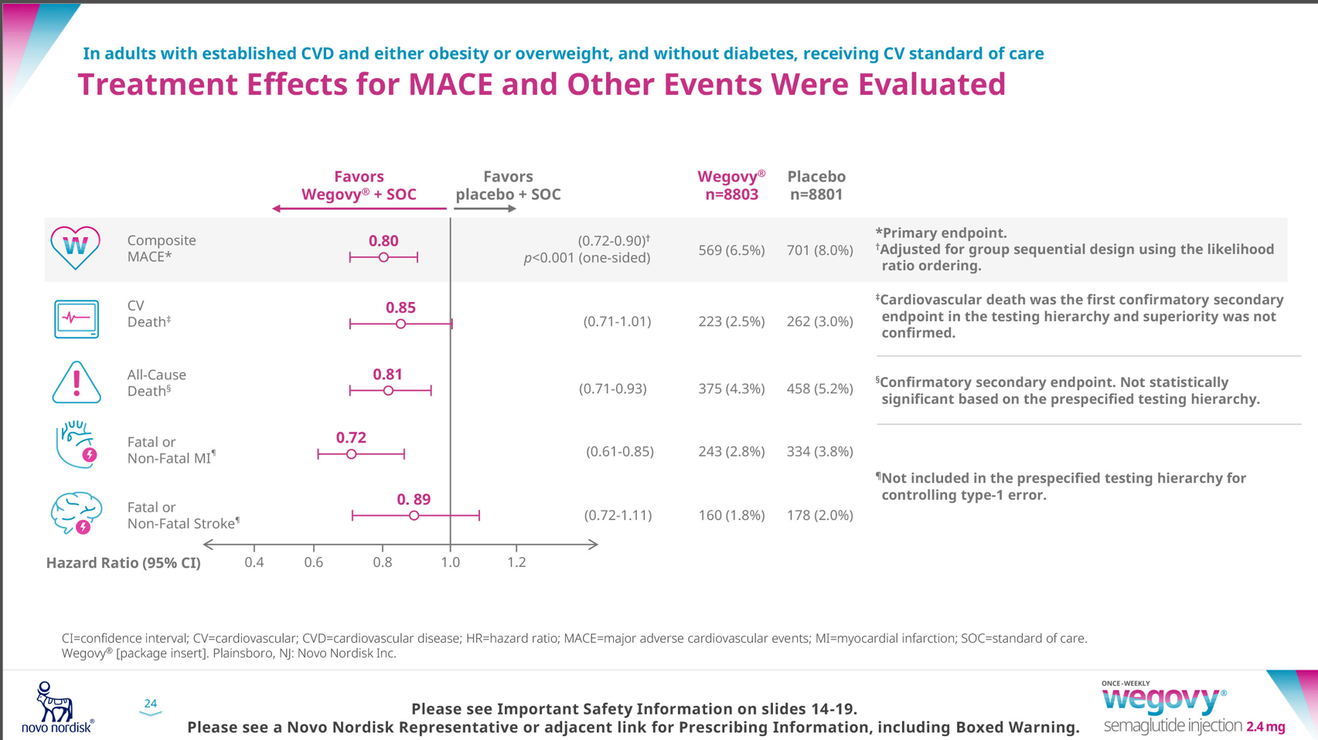

Slide 30
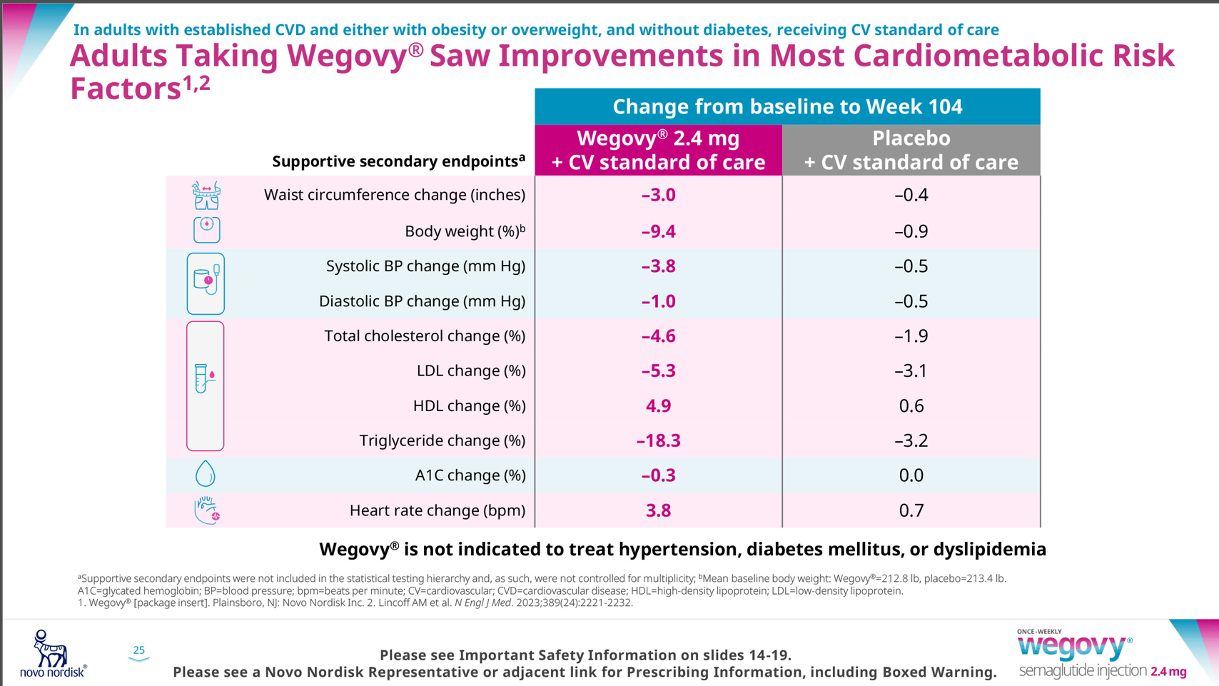

Slide 31
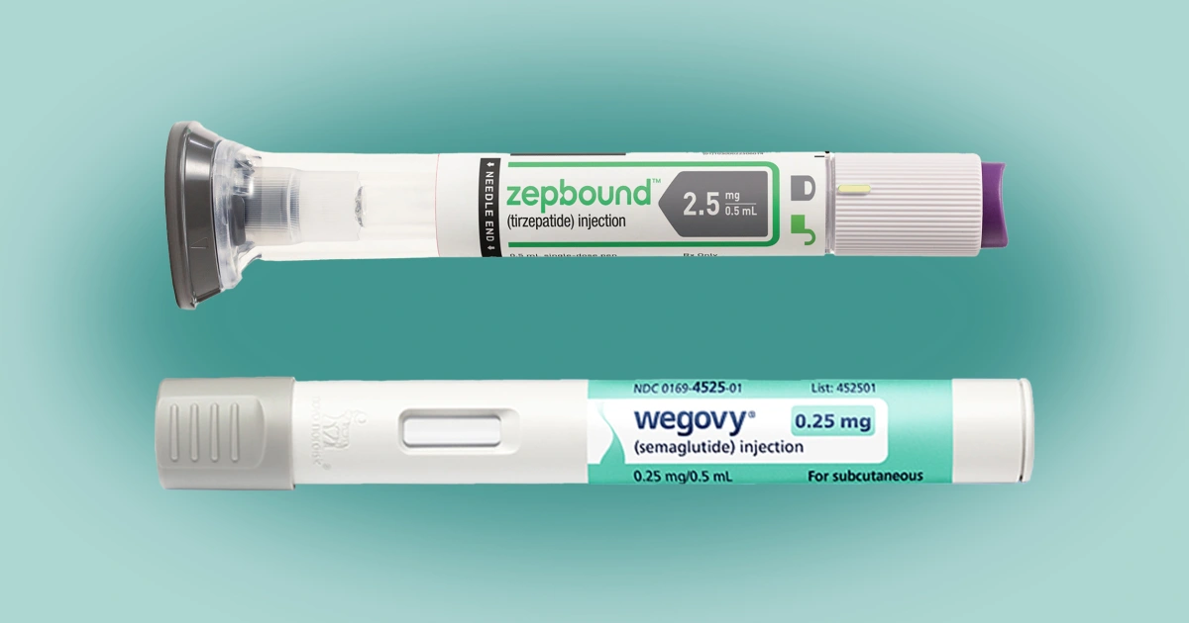
Zepbound: 2.5, 5, 7.5, 10, 12.5, 15
Wegovy: 0.25, 0.5, 1.0, 1.7, 2.4

Slide 32


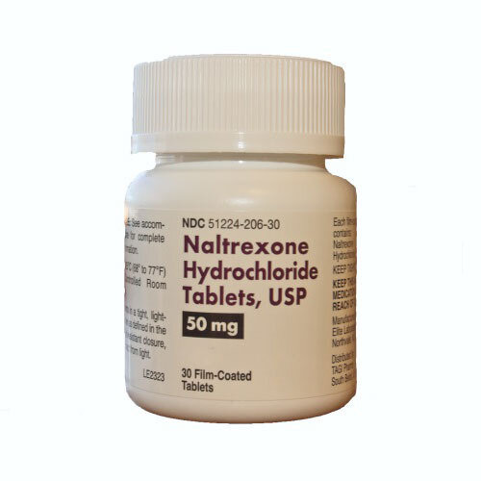
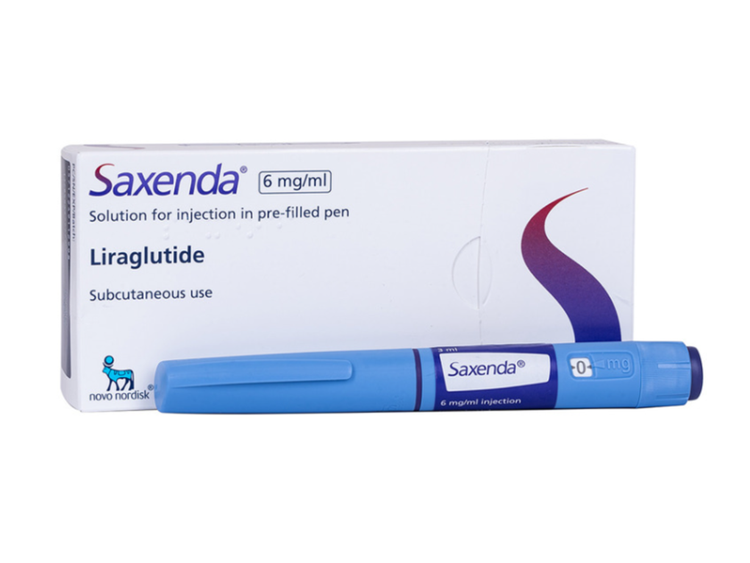

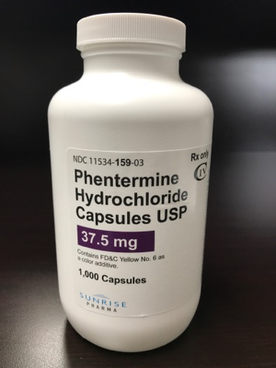
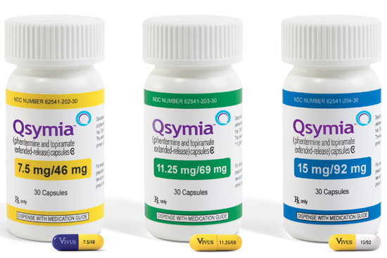


Other Meds We Use

Slide 33
Insurance and Supply Issues
MEDICARE DOES NOT COVER WEIGHT LOSS MEDICATIONS, in CA,
MEDI-CAL DOES!
Weight loss medication coverage placed in a separate bucket
CRITERIA BMI 27+ co-morbidity (HTN, DM, HL, OSA) or BMI 30+
WILL ALWAYS REQUIRE PA
Variables CO-PAYS
Variable Supply Issues since approval of Wegovy and Zepbound

Slide 34

Compounded Medications
Drug Quality and Security Act (DQSA) - 2013
FDA Drug Shortage List: Drugs in short supply are listed by the FDA.
Compounding Standards Compliance: Compounded drugs must meet safety and quality standards and must also comply with state pharmacy laws and regulations.
Temporary Compounding of Commercially Available Drugs: Allowed during shortages, under specific conditions and allowances end when the FDA removes a drug from the shortage list.

Slide 35

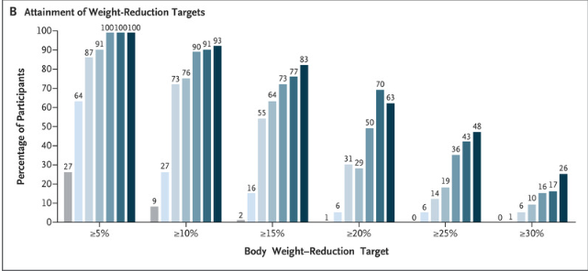
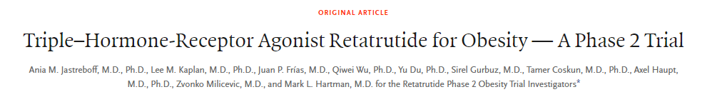
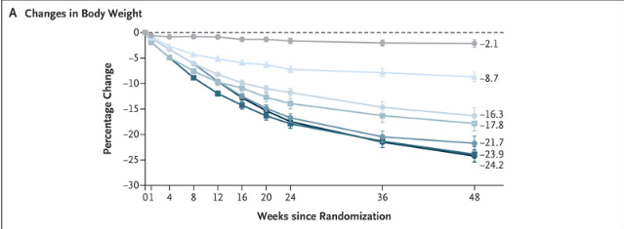

Slide 36
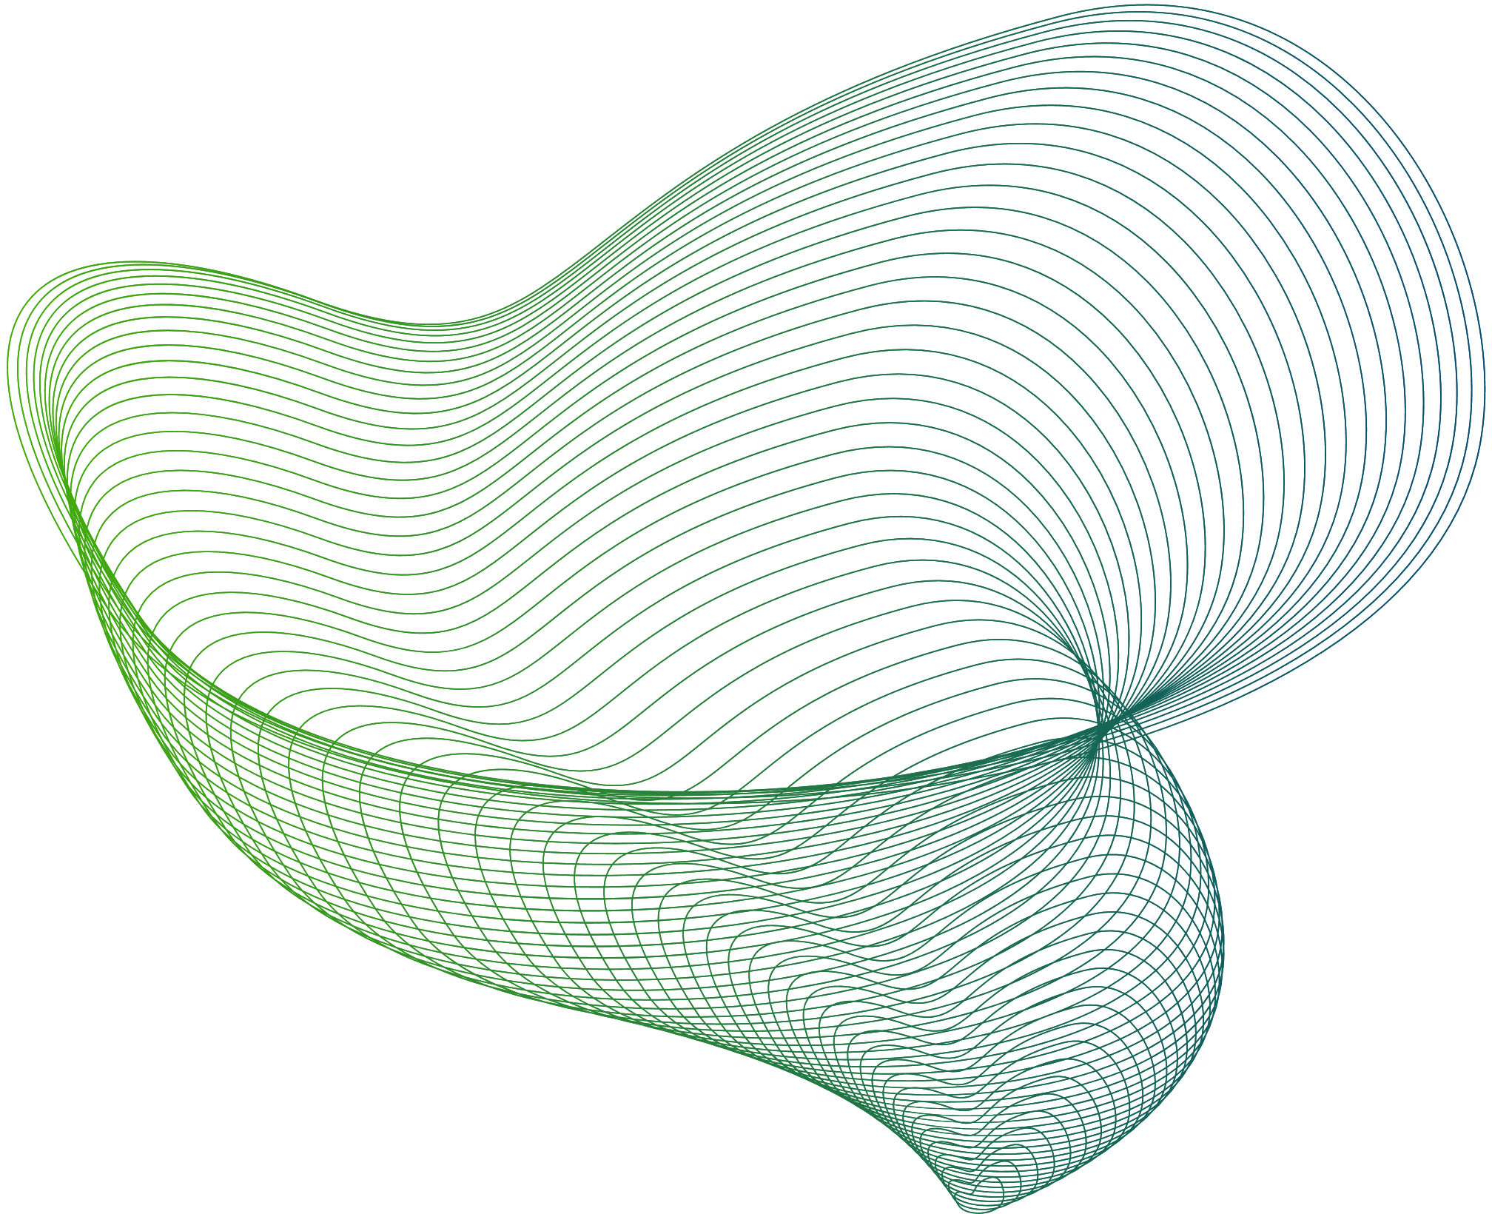
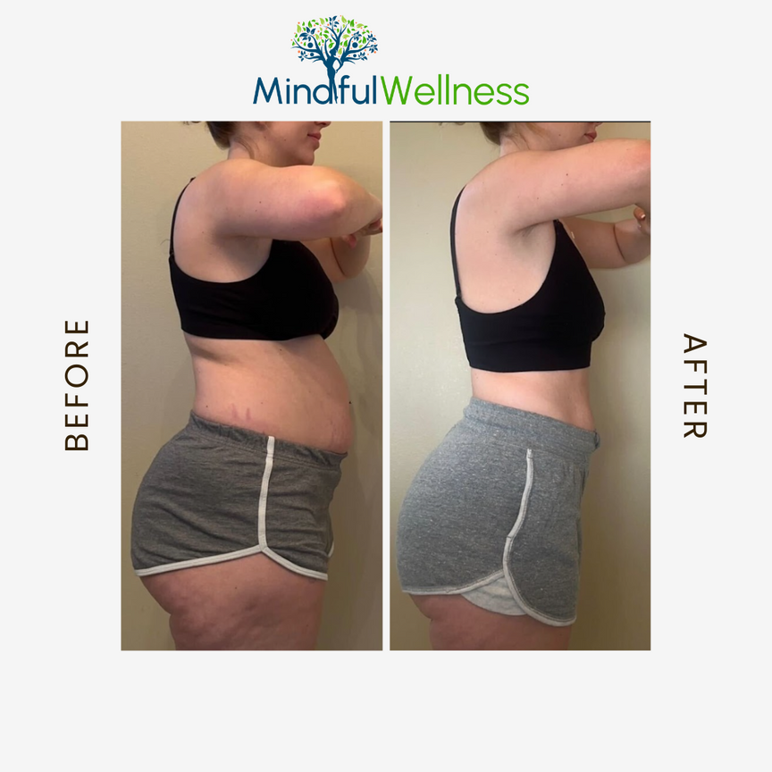


Slide 37

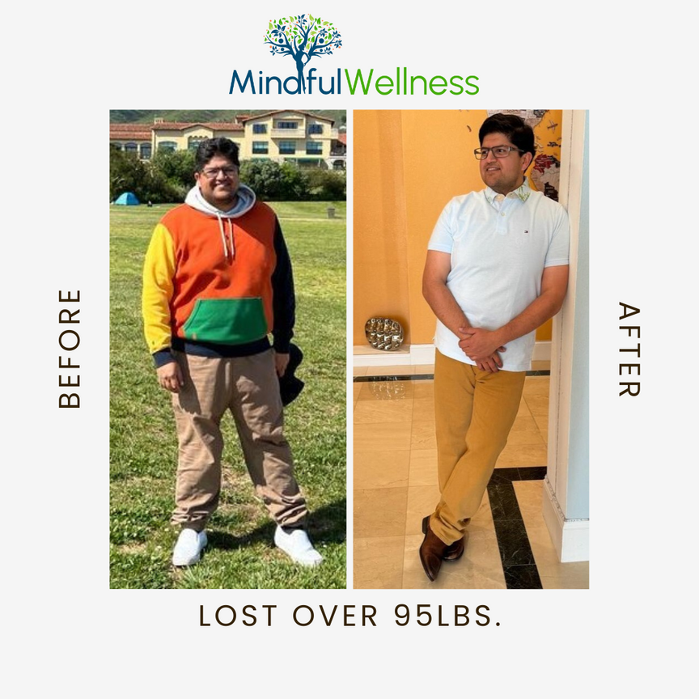

Slide 38



Slide 39



Slide 40

Thank you!
QUESTIONS?

Slide 41
References:
  Institute for Health Metrics and Evaluation (IHME). (2020). GBD 2019 results. https://globalhealth.washington.edu/focus-area/health-metrics-and-evaluation
  Collaborators, Non-communicable Disease and Risk Factor Collaboration (NCD-RisC). (2014). Trends in adult body-mass index in 200 countries: a pooled analysis of 1465 population-based surveys with 20·6 million participants. The Lancet, 384(9947), 783-803. https://www.thelancet.com/journals/landia/article/PIIS2213-8587(22)00033-X/fulltext
  World Health Organization. (2023, October 11). Obesity and overweight. https://www.who.int/news-room/fact-sheets/detail/obesity-and-overweight
  Sumithran, Priya, et al. "Long-term persistence of hormonal adaptations to weight loss." The New England Journal of Medicine 365.17 (2011): 1599-1607.
  Fothergill E, et al. "Persistent metabolic adaptations six years after "The Biggest Loser" competition." Obesity 23.5 (2015): 1073-1081.
  Drucker, D. J. (2006). "The biology of incretin hormones." Cell Metabolism, 3(3), 153-165.
  Holst, J. J., & Deacon, C. F. (2005). "Inhibition of the activity of dipeptidyl-peptidase IV as a treatment for type 2 diabetes." Diabetes, 54(11), 3149-3158.
  Nauck, M. A., & Meier, J. J. (2005). "The incretin effect in type 2 diabetes: for beta-cell preservation and beyond." Diabetes, Obesity and Metabolism, 7(6), 752-765.
  Seino, Y., Fukushima, M., & Yabe, D. (2010). "GIP and GLP-1, the two incretin hormones: Similarities and differences." Journal of Diabetes Investigation, 1(1-2), 8-23.
  Holst, J. J., & Gromada, J. (2004). "Role of incretin hormones in the regulation of insulin secretion in diabetic and nondiabetic humans." American Journal of Physiology-Endocrinology And Metabolism, 287(2), E199-E206.
  Kim, W., & Egan, J. M. (2008). "The role of incretins in glucose homeostasis and diabetes treatment." Pharmacological Reviews, 60(4), 470-512.
  Nauck, M. A., & Meier, J. J. (2005). "Incretins and the treatment of type 2 diabetes mellitus." American Journal of Therapeutics, 12(6), 499-511.
  McIntosh, C. H., Widenmaier, S., & Kim, S. J. (2009). "Glucose-dependent insulinotropic polypeptide (Gastric Inhibitory Polypeptide; GIP)." Vitamins and Hormones, 80, 409-471.
  Hales, C. M., Carroll, M. D., Fryar, C. D., & Ogden, C. L. (2020). Prevalence of Obesity and Severe Obesity Among Adults: United States, 2017-2018. NCHS Data Brief, (360), 1-8. PMID: 32487284
  Lempesis, Ioannis & Liu, Junli & Dalamaga, Maria. (2022). The catcher in the gut: Tirzepatide, a dual incretin analog for the treatment of type 2 diabetes mellitus and obesity. Metabolism Open. 16. 100220. 10.1016/j.metop.2022.100220.

Slide 42
References:
  Lei, L., Huang, J., Zhang, L., Hong, Y., Hui, S., & Yang, J. (2022). Effects of low-carbohydrate diets versus low-fat diets on metabolic risk factors in overweight and obese adults: A meta-analysis of randomized controlled trials. Frontiers in Nutrition, 9, 935234. Smith, J., Doe, A., Brown, C., & Johnson, M. (2022). Advances in Obesity Management: Comprehensive Review of Recent Studies. Frontiers in Nutrition, 9, 935234. https://doi.org/10.3389/fnut.2022.935234
  Kim, K.-K., Kang, J.-H., & Kim, E. M. (2021). Updated meta-analysis of studies from 2011 to 2021 comparing the effectiveness of intermittent energy restriction and continuous energy restriction. Journal of Obesity and Metabolic Syndrome, 31(3), 230-240. https://www.ncbi.nlm.nih.gov/pmc/articles/PMC9579470/pdf/jomes-31-3-230.pdf
  Guan, X., Chen, X., Li, X., Zhai, Z., Zhang, Y., & Wang, Z. (2023). Fruit and vegetable consumption and the risk of hypertension: a systematic review and meta-analysis of prospective studies. European Journal of Nutrition, 62(4), 1941–1955. https://doi.org/10.1007/s00394-023-03145-5
  Aune, D., Giovannucci, E., Boffetta, P., Fadnes, L. T., Keum, N., Norat, T., Greenwood, D. C., Riboli, E., Vatten, L. J., & Tonstad, S. (2017). Fruit and vegetable intake and the risk of cardiovascular disease, total cancer and all-cause mortality-a systematic review and dose-response meta-analysis of prospective studies. International Journal of Epidemiology, 46(3), 1029-1056. https://doi.org/10.1093/ije/dyw319
  Wang, X., Ouyang, Y., Liu, J., Zhu, M., Zhao, G., Bao, W., & Hu, F. B. (2014). Fruit and vegetable consumption and mortality from all causes, cardiovascular disease, and cancer: systematic review and dose-response meta-analysis of prospective cohort studies. BMJ, 349, g4490. https://doi.org/10.1136/bmj.g4490
  American Heart Association. (n.d.). AHA Recommendations for Physical Activity in Adults. Retrieved June 19, 2024, from https://www.heart.org/en/healthy-living/fitness/fitness-basics/aha-recs-for-physical-activity-in-adults
  Wilding, J. P. H., Batterham, R. L., Calanna, S., Davies, M., Van Gaal, L. F., Lingvay, I., McGowan, B., Rosenstock, J., Tran, M. T. N., Wadden, T. A., Wharton, S., Yokote, K., Zeuthen, N., & Kushner, R. F. (2023). Semaglutide and cardiovascular outcomes in obesity without diabetes. The New England Journal of Medicine, 389(15), 1361-1372. https://doi.org/10.1056/NEJMoa2307563

