Slide 1
Representation in Research to Remove Disparities in Alzheimer’s Disease
Samantha E. John, PhD
Clinical Neuropsychologist, NV PY 0930
Assistant Professor, Department of Brain Health Kirk Kerkorian School of Medicine, UNLV

Slide 2
Cognitive Aging & Neuropsychological Equity (CANE) Laboratory
Increase Access & Engagement of Diverse Populations
Explain Variability in Cognitive Aging
Improve Patient-Centered Care

Slide 3
Agenda
Alzheimer’s Disparities
Diversity & Representation in Research
Ways to Achieve Health Equity

Slide 4
Alzheimer’s Disease Disparities
The number of Alzheimer’s disease cases are expected to double by 2060, with largest increases expected among racial and ethnic minority groups and women (CDC, 2024)
African Americans ~ 2x more likely to have Alzheimer's disease (AD) (Steenland et al., 2015; Potter et al., 2009)
Hispanics ~ 1.5x more likely to have AD (O’Bryant et al., 2013)
Notes:
The number of Alzheimer's disease cases is expected to double by 2060, with the largest increases expected among people from racial and ethnic minority groups and women.

Slide 5
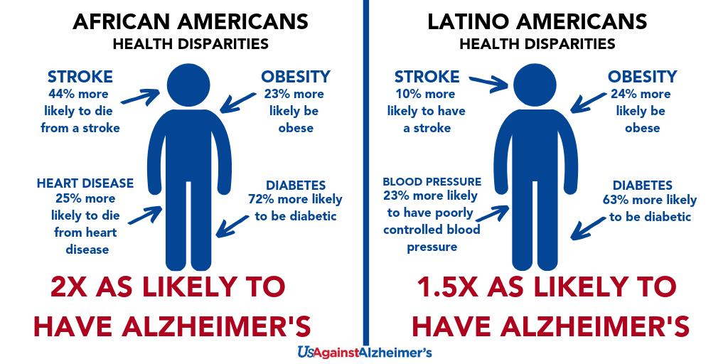
Alzheimer’s disease presents differently across ethnoracial groups
Notes:
These ethnoracial differences have been studied most in the Black/African American and Hispanic/Latinx communities and has focused on the increased risk to these groups above and beyond their non-Hispanic white counterparts

Slide 6
Alzheimer’s Disease Disparities
AD biomarkers, such as amyloid PET (Gleason et al., 2021; Wilkins et al., 2022), tau PET (Gleason et al., 2021), CSF assays (Gleason et al., 2021), and post-mortem Braak staging (Santos et al., 2019) vary within and among ethnoracial groups
African Americans more likely to possess AD mixed pathologies, especially AD with Lewy bodies and infarcts (Barnes et al., 2015)
Mexican-Americans more likely to possess comorbid diabetes & depression and express associations between blood-based biomarkers of AD and metabolic factors (O’Bryant, Xiao, Edwards, Devous, Bala, 2013)
Treatments for AD, such as cholinesterase inhibitors may have variable effects among ethnoracial groups (Perera et al., 2014; Pozzi et al., 2022)

Slide 7
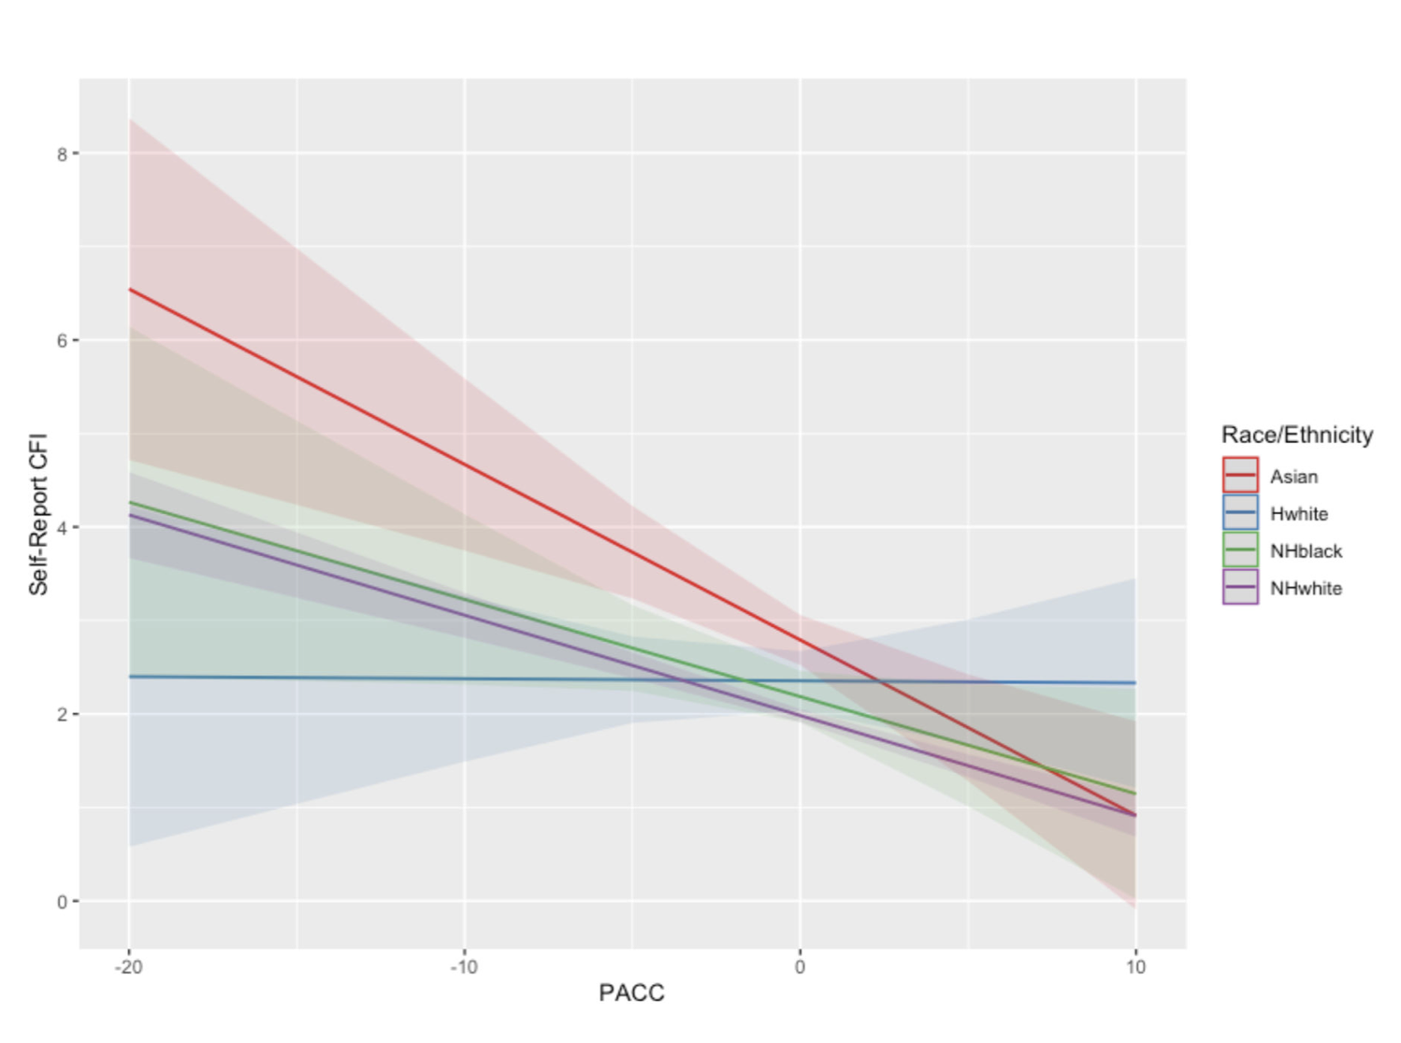
Differences in Symptom Reporting
Robinson et al. Alzheimers Dement. 2023
Notes:
Robinson T, Klinger H, Buckley R, et al. Subjective cognitive decline across ethnoracial groups in the A4 study. Alzheimers Dement. 2023;19(9):4084-4093. doi:10.1002/alz.13138

Slide 8
Agenda
Alzheimer’s Disparities
Diversity & Representation in Research
Ways to Achieve Health Equity

Slide 9
Current Trends in Research Participation/Inclusion
Ethnoracial diversity lacking in clinical trials for Alzheimer’s disease (AD), with white participants overrepresented at 92% (Peroutka, 2022)
Many organizations have called for better representation (Barnes, 2022; Grill et al., 2022; Gilmore-Bykovskyi et al., 2019)
National Institutes of Health
American Medical Association
Alzheimer’s Association
Food and Drug Administration
Increasing ethnoracial diversity will yield better generalizability of findings (Indorewalla et al., 2021; Yancey et al., 2006)

Slide 10
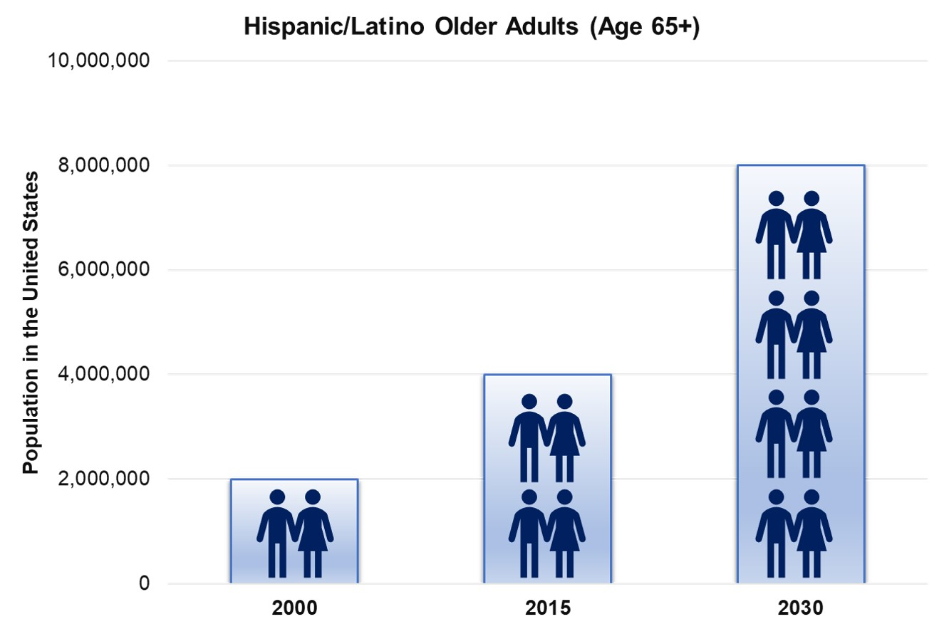
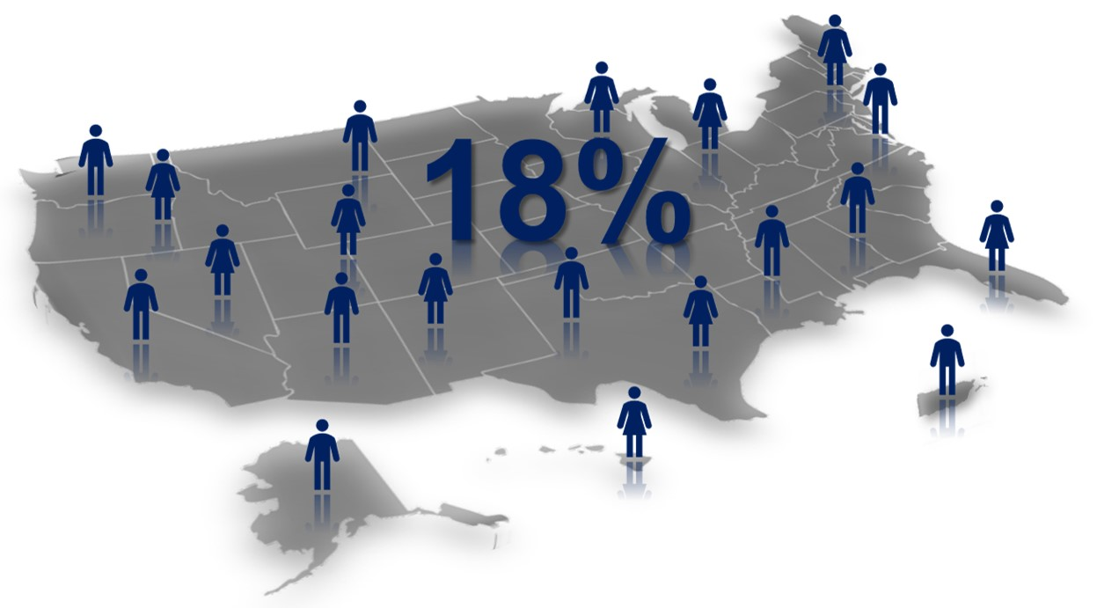
Population Diversity is Increasing
Source: US Census Bureau
Source: Pew Research Center

Slide 11
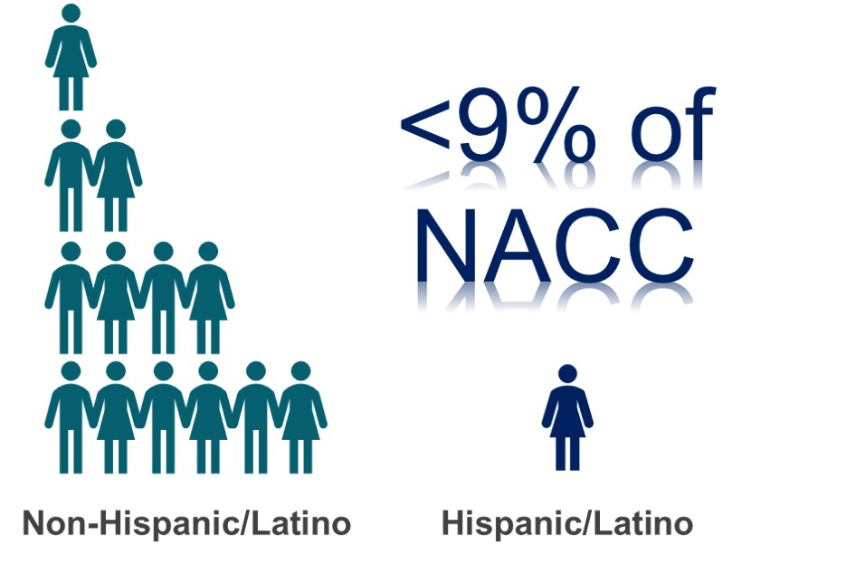
Recruitment Disparities
< 10% of clinical trials
Research findings often based on samples of:
Well-educated (14+ years)
Predominantly female
Majority Non-Hispanic white

Slide 12
Access & Inclusion in Observational Research

Slide 13
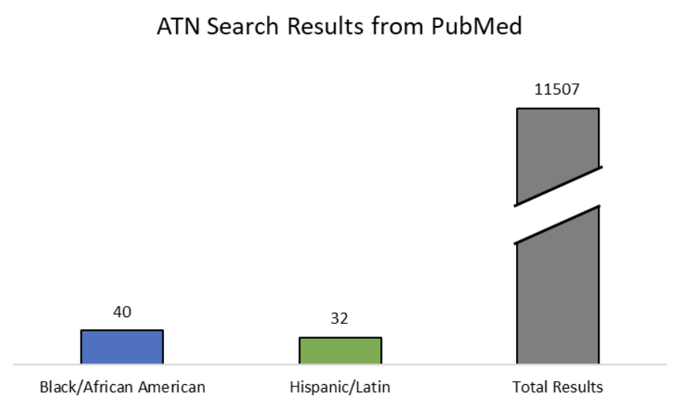
Representation in Published Research
Notes:
When surveying the current literature, journal article search results for AD papers that investigate biomarkers of disease (ATN – amyloid, tau, and neurodegeneration) result in shockingly few papers with study samples of Black/AA or Hispanic/Latino participants.

Slide 14
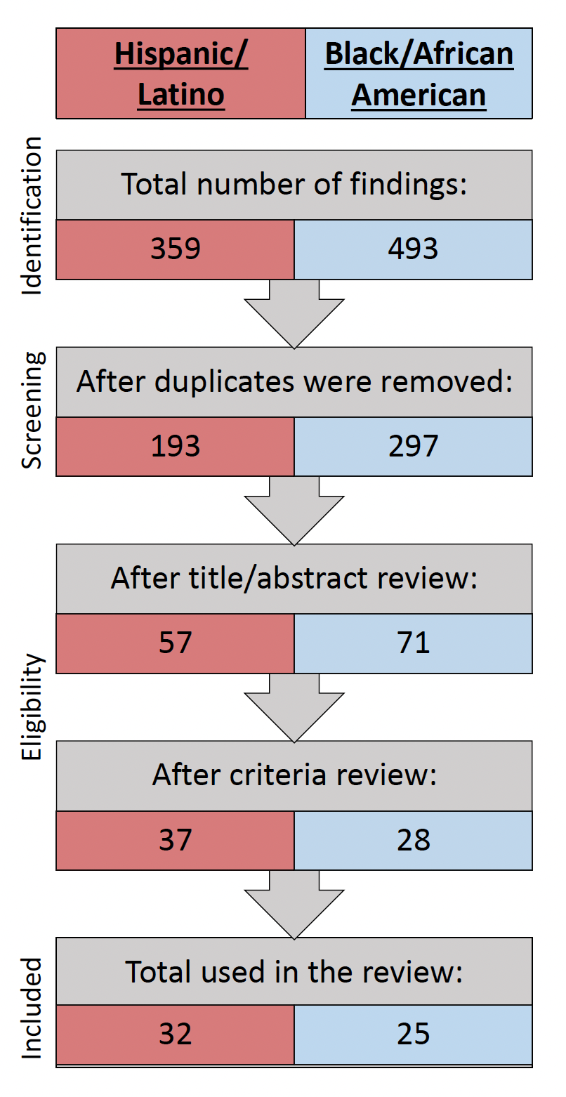
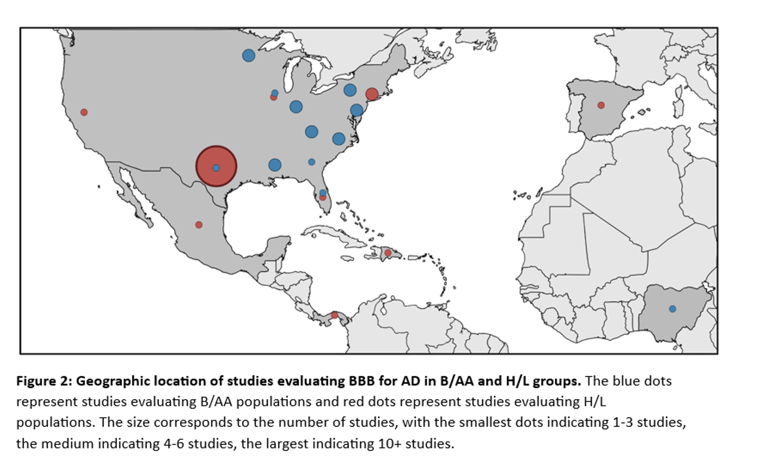
Ethnoracial Representation: Published Blood-Based Biomarker Research
(Leisgang-Osse, Moeller, Nguyen, Cummings, Kinney, John, in progress)
Notes:
Further, these papers are coming from a small subset of locations from across North and Central America, with Texas, Florida, and New York leading the U.S. in terms of Hispanic/Latino representation in research.

Slide 15
Origin of the Problem
Samper-Ternent et al. Ethn Dis. 2024
Notes:
Factors leading to Health Disparities Among Hispanic Older Adults
Samper-Ternent R, Silveira SL, Stevens A, Volpi E, Naik AD. Considerations When Designing and Implementing Pragmatic Clinical Trials That Include Older Hispanics. Ethn Dis. 2024;33(2-3):76-83. Published 2024 Apr 10. doi:10.18865/ed.33.2-3.076

Slide 16
The Result
Diverse folks are often excluded from research
Exclude
Or misrepresented when grouped with others
Misrepresent
Findings may not be as relevant or tailored
Limit Benefits

Slide 17
Agenda
Alzheimer’s Disparities
Diversity & Representation in Research
Ways to Achieve Health Equity

Slide 18
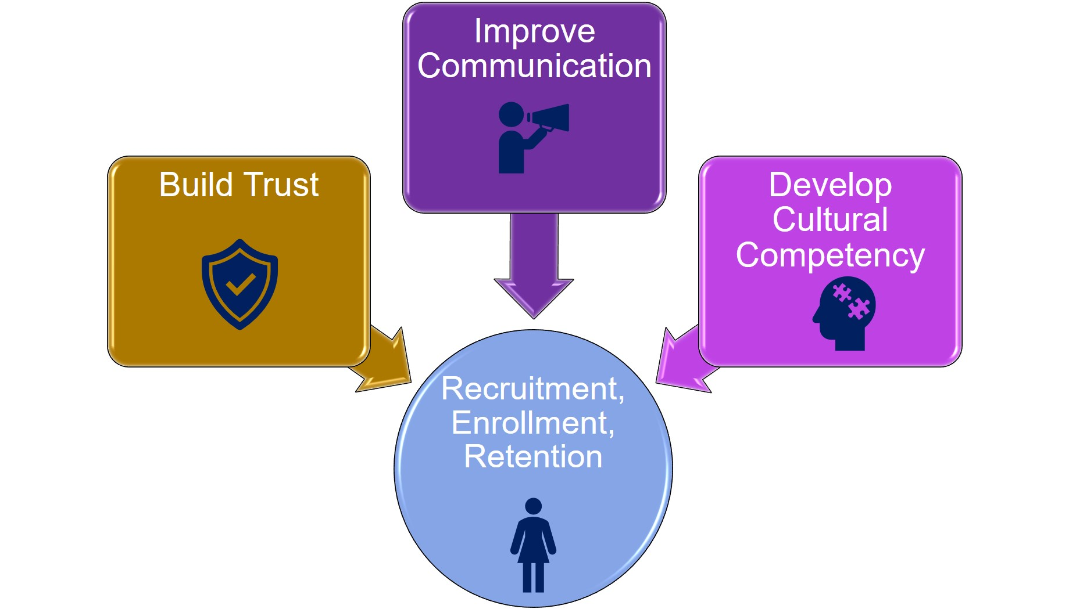
Required Components for Increasing Representation
Notes:
Diverse communities have diverse patterns of needs. In the context of Hispanics/Latinos communities, research on the science of inclusion has identified three general themes that can help facilitate recruitment of Hispanics/Latinos: the effective research teams build trust with local communities and improve communication with these local communities; the effective research teams also continuously work and strive to develop cultural competency. We note here that addressing communication barriers is not only directly related to recruitment, but also plays a significant role in building trust and developing cultural competency. Moreover, communication is not only across languages like English and Spanish, but also in the context of professional jargon vs lay language.

Slide 19
What Participants Want
Key Themes | Representative Quotations
How should we recruit and include you in research?
Flexibility; Removal of barriers | “make it easy on me & I’m happy to participate”; “weekend, evening, & phone visit options”
Share more information | For drug trials, “I want to get more information about who the drug has been tested on previously”; “especially if it’s been tested on people like me” “I want a second opinion”
What do you want out of participating in research?
Representation | Regarding research samples: “They’re missing me.”
Tailored benefits | “...participants are giving, but it's not clear what's coming back to them. …”; “let me choose what components I have to do”
Personal risk estimates | “I'd be interested in [knowing] the risk factors for myself”
Moeller & John, in progress

Slide 20
Community-Based Access & Engagement Keys to our Approach
NGAGE Model
Networks
Give First
Advocate
Give Back
Evaluate

Slide 21
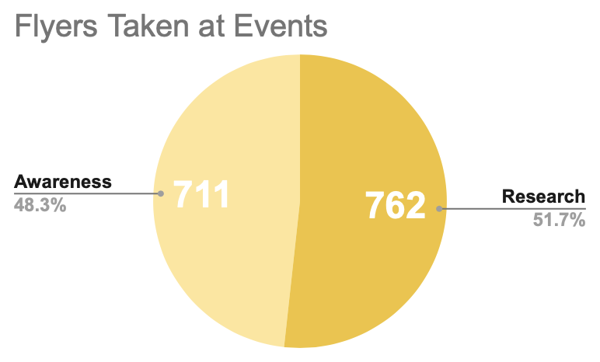
Outreach & Recruitment – 2024 Summary
32 events across 16 zip codes
~200 hours
244 new research sign ups
Representative data from January - June, 2024

Slide 22
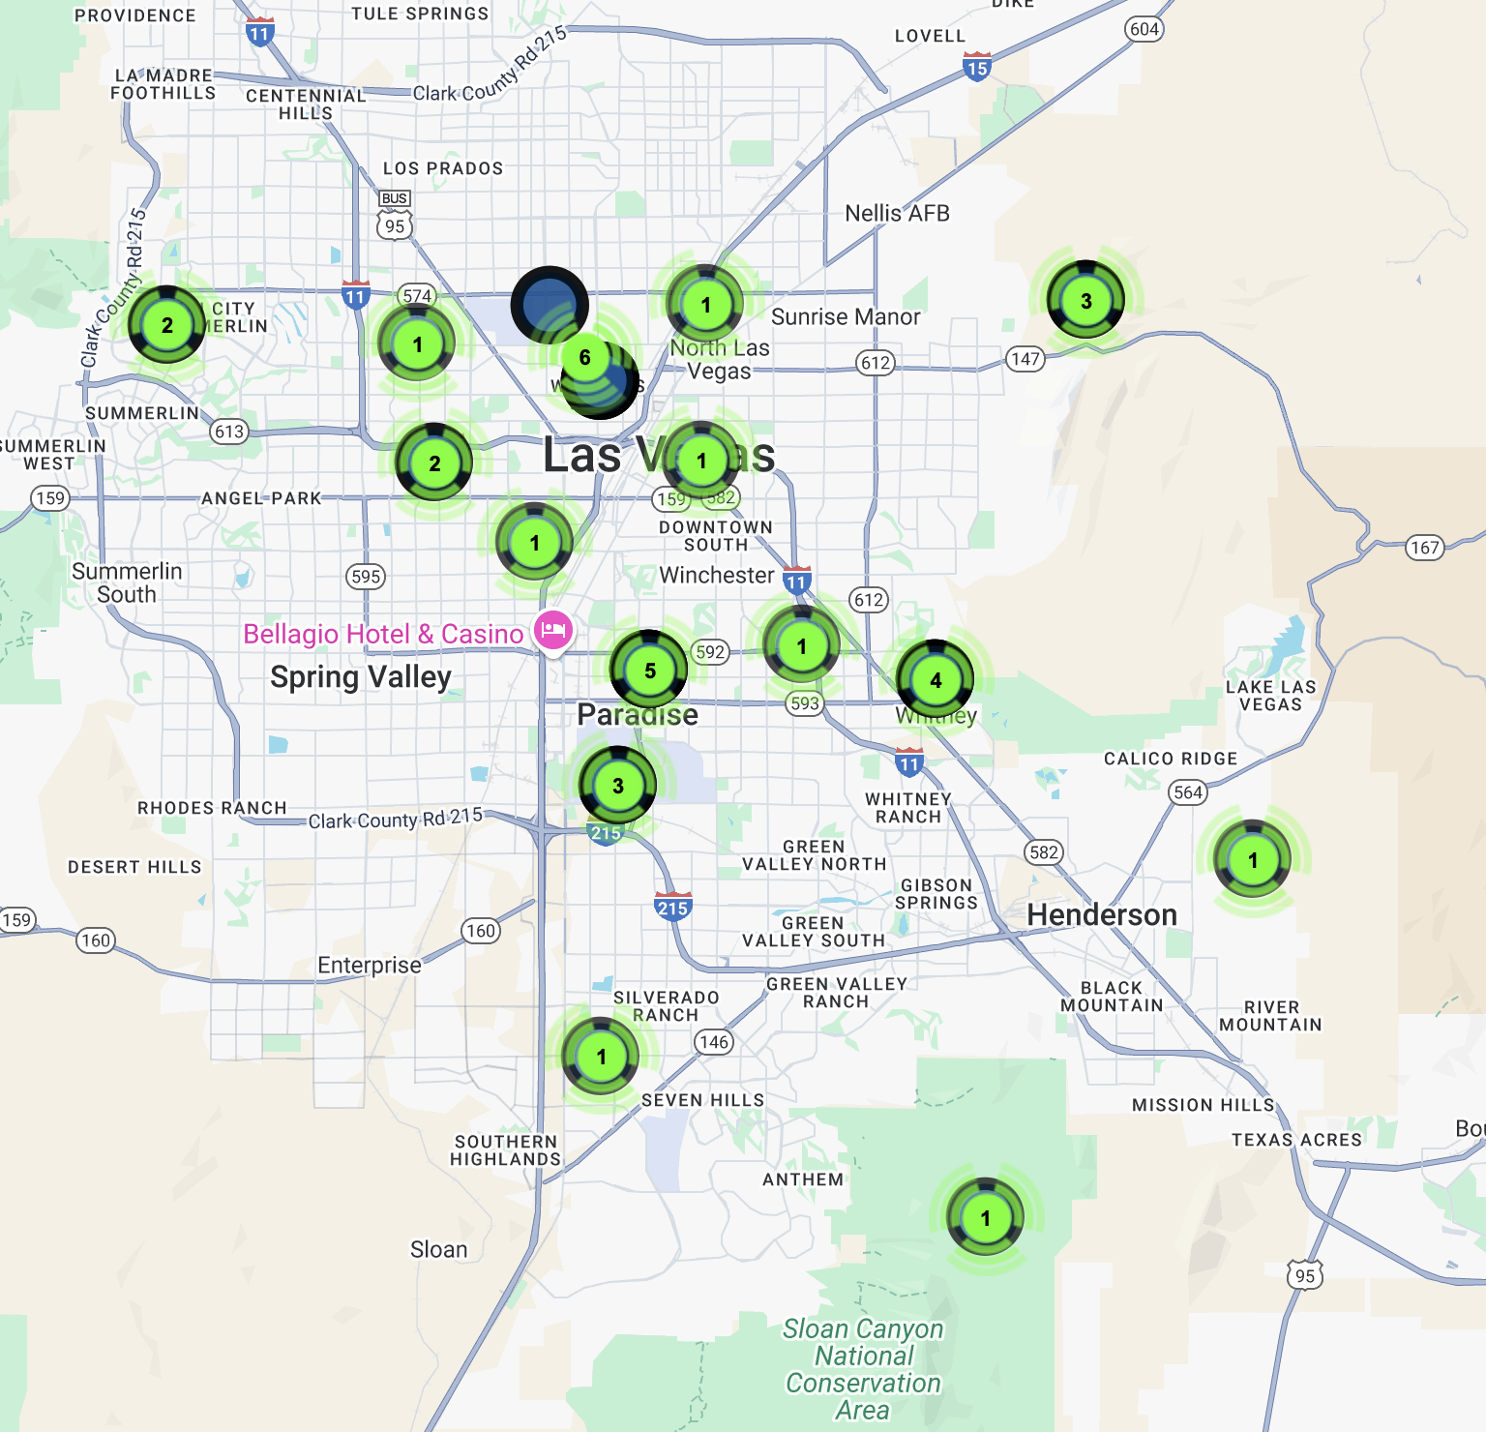
2024 Outreach Map

Slide 23
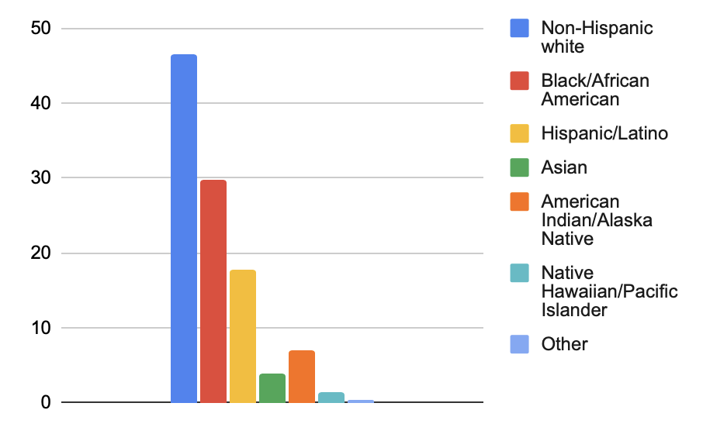
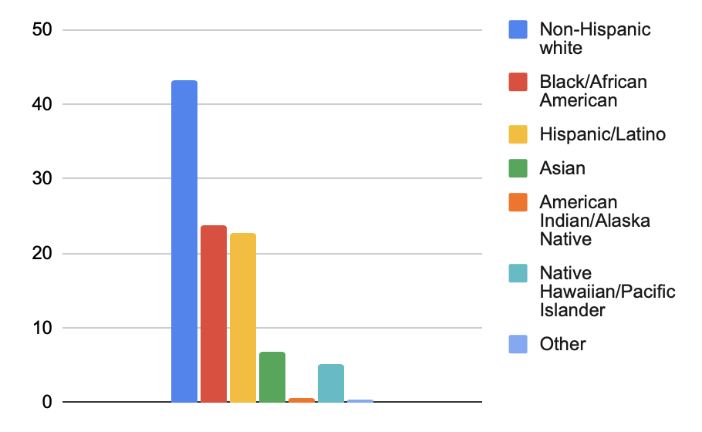
Evaluating our Effectiveness
Average Ethnoracial Representation at Events
January – June 2024
Average Ethnoracial Representation at Events
July - November 2024

Slide 24
Achieving Health Equity
Prepare the workforce to care for a racially and ethnically diverse older adult population
Increase diversity among providers for dementia care
Engage, recruit, and retain diverse populations in ADRD research and clinical trials
Enhance access to health care services
Improve the environments where we live, learn, work, and play
Alzheimer’s Association, Facts & Figures (2024)

Slide 25
Disparities in Care – Access & Quality
Minoritized populations received less optimal care and experienced delays in diagnosis
11% longer for Black Americans
40% longer for Hispanic Americans
Asian American older adults less likely to receive a diagnostic work-up for cognitive impairment
Black and Hispanic patients less likely to be referred for neuropsychological testing
Hinton et al. Alzheimers Dement. 2024

Slide 26
Disparities in Care – Treatment Options
Minoritized populations had lower rates of prescriptions for anti-dementia medications, cholinesterase inhibitors & memantine
Hispanic and Black older adults had higher discontinuation rates of anti-dementia medications
Black Americans with dementia were more likely to have increased hospital admission rates, longer lengths of stay and higher costs
Minoritized populations living with dementia were less likely to be in long-term care facilities with special memory care units
Hinton et al. Alzheimers Dement. 2024

