Slide 1
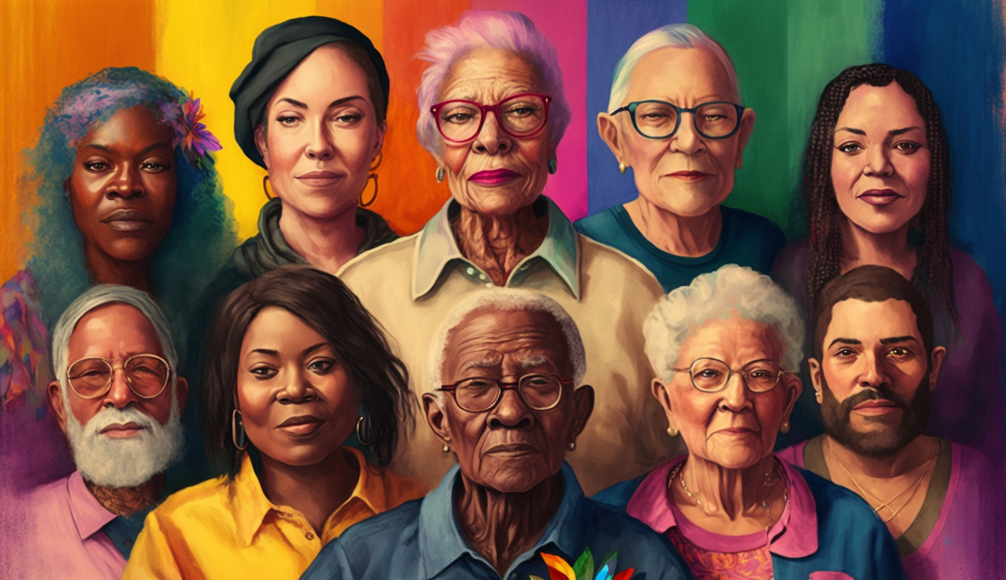
Standing Up for Inclusion of LGBTQIA+ Populations in Alzheimer's Disease & Related Dementia Research
Jace Flatt, PhD, MPH
Associate Professor
Pronouns: He/They

Slide 2
OUR TIME TODAY
Terminology
Why Inclusion Matters
Alzheimer’s Disease & Related Dementia Research
Collecting Sexual Orientation, Sex Assigned at Birth, and Gender Identity

Slide 3
Sexual minority – individuals who self-identify as asexual, bisexual, gay, lesbian, queer, as well as those who do not self-identify with these terms but whose sexual orientation varies from heterosexual
Gender minority – individuals who self-identify as transgender & non-binary, as well as those with a gender identity and/or expression that does not conform to social & cultural expectations based on the sex assigned to them at birth.
Cisgender - a term used to describe people whose gender identity aligns with the sex assigned to them at birth.
2016
Sexual & Gender Minorities Formally Designated as a Health Disparity Population for Research Purposes by NIMHD
https://www.nimhd.nih.gov/about/directors-corner/messages/message_10-06-16.html
Sexual orientation & gender identity may evolve over the lifespan.
Notes:
“Sexual and gender minority” is an umbrella term that encompasses lesbian, gay, two-spirit, bisexual, and transgender populations as well as those whose sexual orientation, gender identity and expressions, or reproductive development varies from traditional, societal, cultural, or physiological norms. This includes individuals with differences of sex development (DSD) or intersex.
New academic term, previously focused on “transgender”, GM intended to be a more inclusive term. Community members most likely will not use “GM” to describe themselves language is community-driven, and we can see generational patterns
The Minority Health and Health Disparities Research and Education Act of 2000 authorizes the Director of the National Institute on Minority Health and Health Disparities (NIMHD), in consultation with the director of the Agency for Healthcare Research and Quality (AHRQ)

Slide 4
Notes:
Before we get started, I wanted to brief you on some terminology that you may not be familiar with.
I introduced the talk today as ‘the health of LGBTQIA+ older adults and their caregivers’. And some of you might be unsure of what exactly I am referring to when I say LGBTQIA+, right?
So, if you look at this illustration, you can easily see that L stands for lesbian – pretty self explanatory. Same with the G, and the B. But then you get to T, and you see that T can represent two identities: transgender and transsexual. Similarly, with Q, and A.
I promise I am not trying to confuse you! What I am trying to communicate, is that the terminology associated with these populations is not perfect, nor is it stagnant. In fact, these terms have and will continue to evolve and change over time, and there are generational patterns in terminology that are used. For example, older adults are more likely to use transsexual than younger adults who would likely use transgender.
And the + sitting on the end of LGBTQIA, symbolizes all the other terms, which may not be captured here on in this illustration.
For brevity sake, you may hear or see the term “Sexual and gender minority” or (SGM), which is another umbrella term used by the National Institutes of Health, and largely in an academic context (less so in the community itself), that encompasses lesbian, gay, two-spirit, bisexual, and transgender populations as well as those whose sexual orientation, gender identity and expressions, or reproductive development varies from traditional, societal, cultural, or physiological norms. This includes individuals with differences of sex development (DSD), also described as intersex.

Slide 5
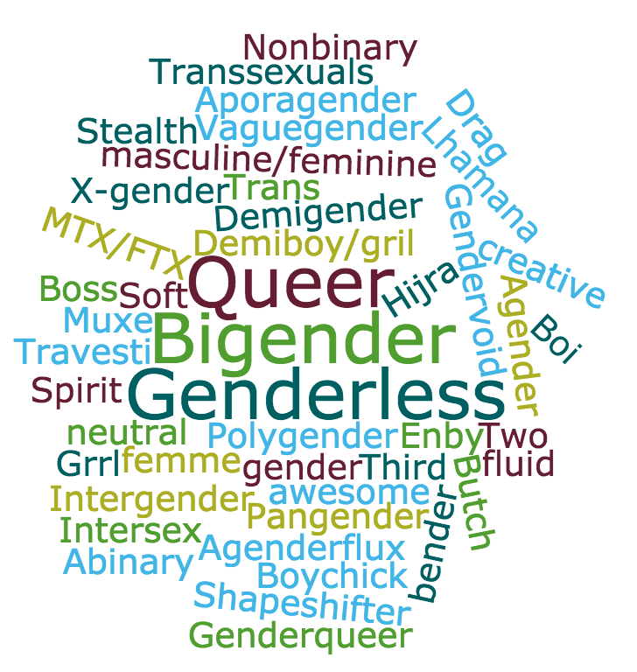
Notes:
Gender identity – one’s sense of being a man, woman, both, transgender, or some other identity, which may or may not correspond with the sex one is assigned at birth.
Can identify with any sexual orientation
Diverse subpopulations, Understudied and underrepresented in health-related research
Some older individuals may identify as a transsexual and not endorse being transgender. Middle to older aged GM identify more within binary distinctions (transgender man or woman) whereas younger adults are using multiple terms to describe their gender and gender identity and are more likely to identify along a gender spectrum (transfeminine)
GM adults represent a substantial portion of the population, about the same number of people who live in Hawaii or that reside in Phoenix, Az. This is not a small population.

Slide 6
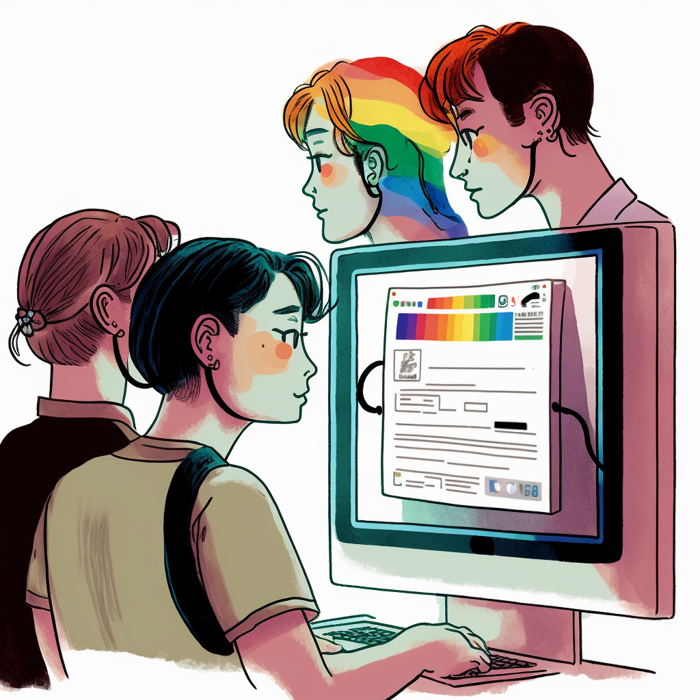
Why Inclusion Matters!

Slide 7
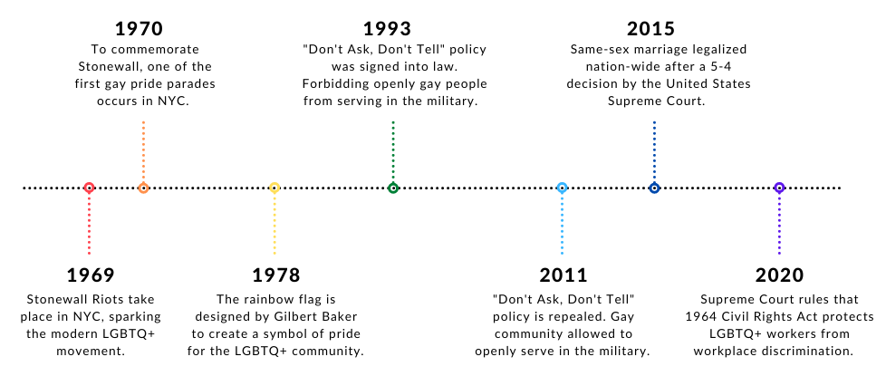
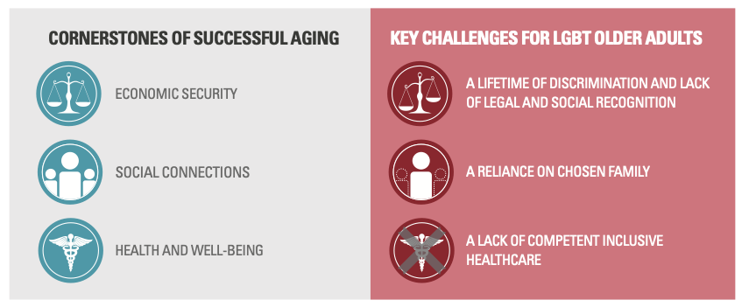
DSM: Historical & current pathologizing of sexual orientations (1973) & gender dysphoria/gender identity disorder (2013)
1947 Sex Perversion Elimination Act, Lavender Scare, 1969 Stonewall Riots, HIV/AIDS epidemic, The Equality Act, Growing Anti-Transgender Legislation & Hate Crimes
Lack protections for basic human rights (e.g., housing, employment, healthcare)
Intersecting & compounding effects of discrimination for intersecting marginalized identities (SGM status + racial/ethnic minority, serostatus, disability)
Notes:
Lack of opportunities & legal protections for basic human rights (e.g., housing, employment, healthcare)
Historical & current pathologizing of non-heterosexual sexual orientations (1973) & gender dysphoria/gender identity disorder (2013) in DSM
1947 Sex Perversion Elimination Act, Lavender Scare, 1969 Stonewall Riots, HIV/AIDS epidemic, The Equality Act, Growing Anti-Transgender Legislation & Hate Crimes
Intersecting & compounding effects of discrimination due to having intersecting marginalized identities (SGM status + racial/ethnic minority, serostatus, disability)

Slide 8
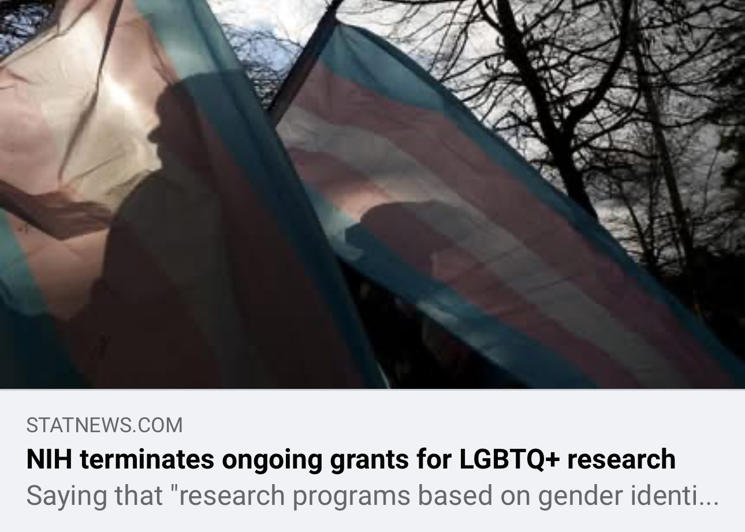
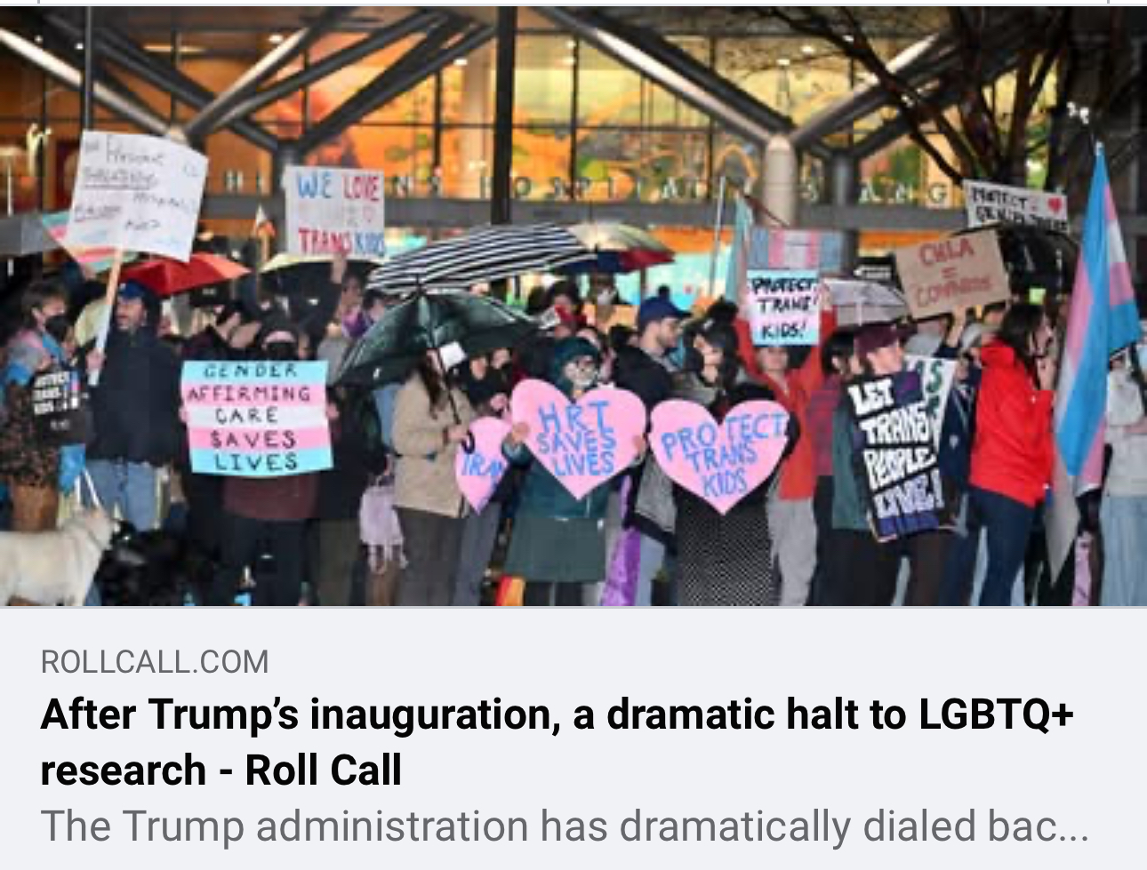
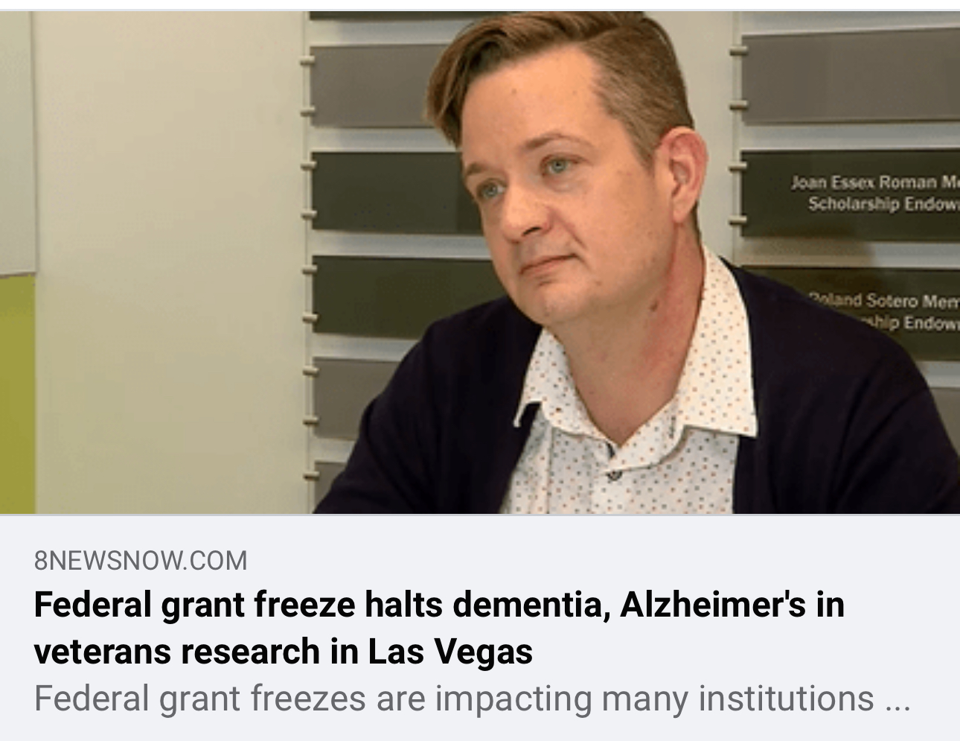
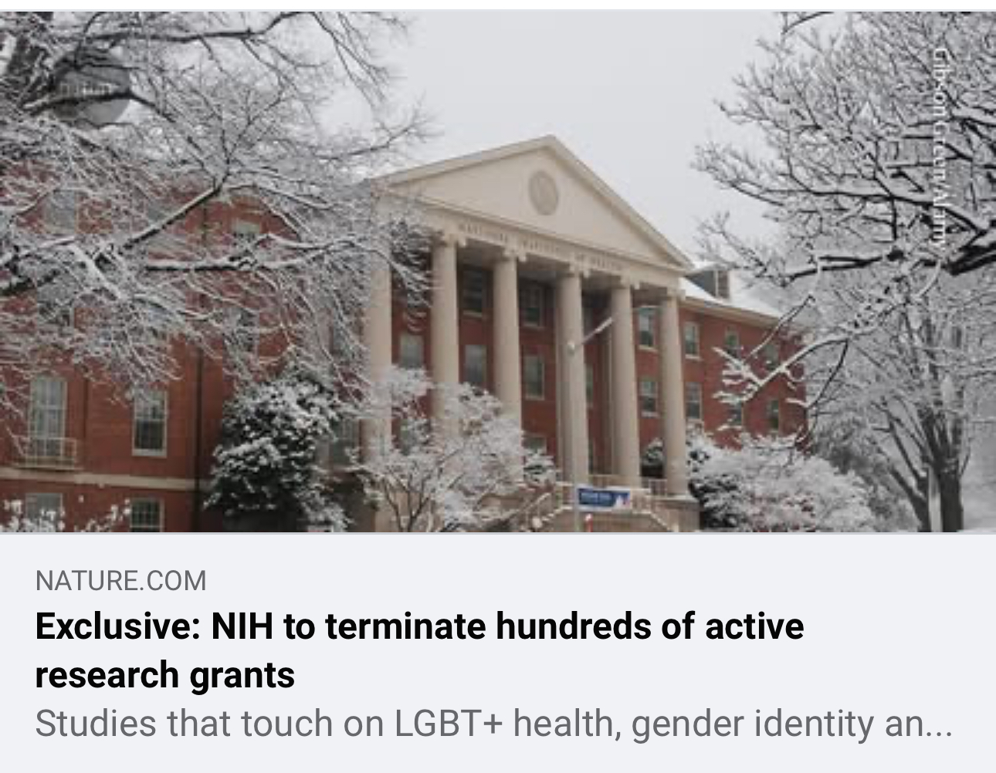
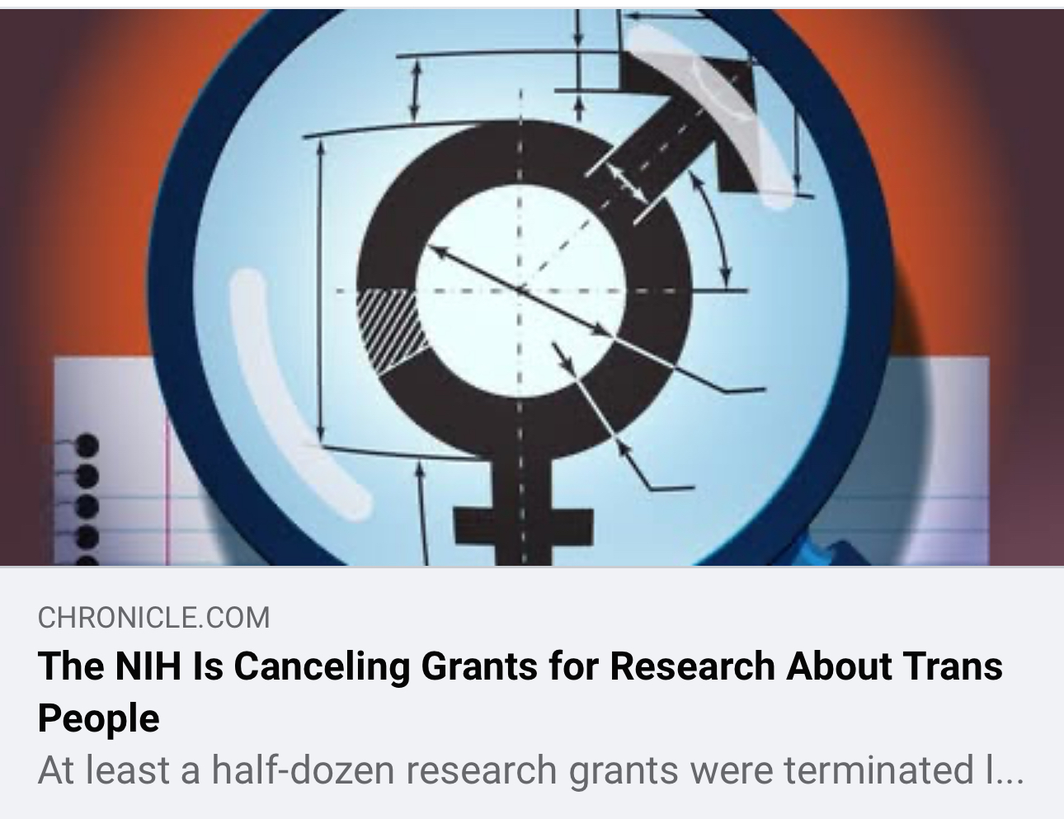

Slide 9
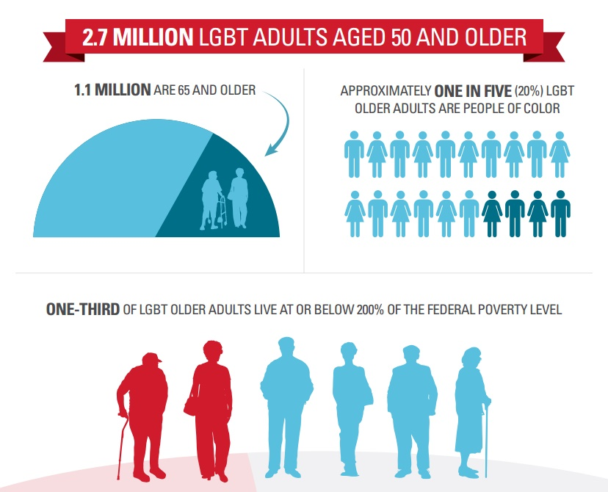
Lifetime exposure to stigma, discrimination, & trauma
Health disparities (poor health, depression, disability)
Less likely to be married or have children
2X as likely to report healthcare discrimination
2-3X as likely to live alone
Little to no caregiver support
Barriers to healthcare access & use
Notes:
2 to 3 million LGBTQIA+ adults in U.S. aged 50+ and 7 million by 2040

Slide 10
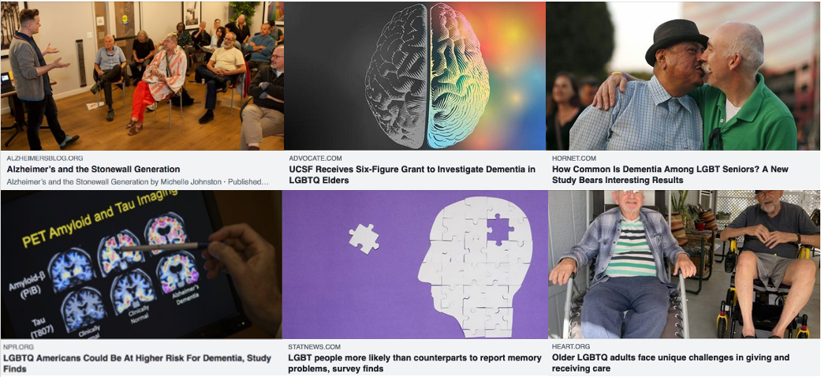
Research on LGBTQIA+ Populations & adrd
Notes:
Nationally representative cohort vs. community based cohort (sampling methods)

Slide 11
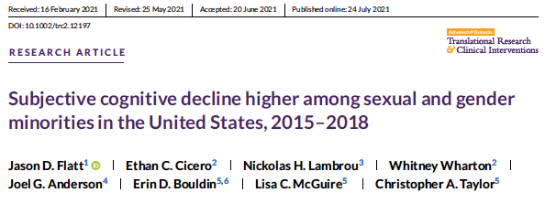
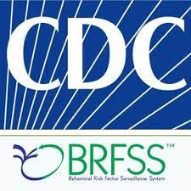
15.7% (13.1-18.2) vs 10.5% (10.1-10.9)
LGBTQIA+ Non-LGBTQIA+
Study supported by NIA - K01AG056669 (Flatt)
Notes:
2015-2018 U.S. Behavioral Risk Factor Surveillance System - 25 States
Subjective Cognitive Decline: “During the past 12 months, have you experienced confusion or memory loss that is happening more often or is getting worse?”

Slide 12
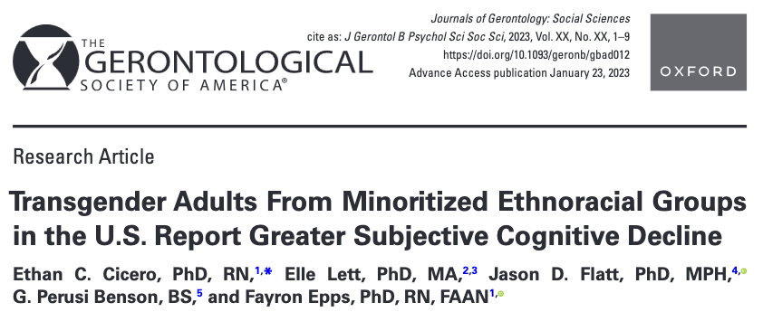
Ethan Cicero, PhD, RN
Assistant Professor
Nell Hodgson Woodruff
School of Nursing
Emory University
Flatt et al (2022) | Minoritized Ethnoracial Transgender | White Transgender | Minoritized Ethnoracial Cisgender | White Cisgender
17% | 22% | 15% | 12% | 9%
Ethnoracial included American Indian or Alaska native, Asian, Black, Hispanic/Latino, Multiracial, other race
Co-mentoring on NIA K23AG084851 & Alzheimer's Association (AARG-D-NTF)
Notes:
2015–2020 Behavioral Risk Factor Surveillance System
Case control approach 1-4 match trans to cisgender
Minoritized Ethnoracial groups reflected groups made vulnerable by systemic racism
NTF - study will examine the prevalence of ADRD among gender minority adults by subgroup (transfeminine, transmasculine, those using gender-affirming hormone therapy, racial/ethnic group membership) compared to their cisgender counterparts and this study will explore correlates of ADRD risk among gender minority adults.
Recruitment of transgender, nonbinary, and gender diverse older adults in health research: A scoping review
Transgender adults report greater cognitive and related functional challenges
A comparison of subjective cognitive decline and related limitations among transgender communities in the U.S

Slide 13
2018 national health study of intersex adults aged 18 & older in the U.S.
Questions from BRFSS & intersex-related health studies
Community Based Participatory Research approaches
N=198
41%
Intersex adults aged 40+ (n=71) reported problems with memory & concentration
Study supported by UCSF School of Nursing (Flatt)
Notes:
Community engaged study
Convenience sample of intersex adults
Intersex adults are born with a diverse set of congenital differences relating to gonads, chromosomes, and genitals that fall outside typical binary notions of male and female sex
It is challenging to estimate the prevalence of intersex traits because of lack of representation in research but around 2%

Slide 14
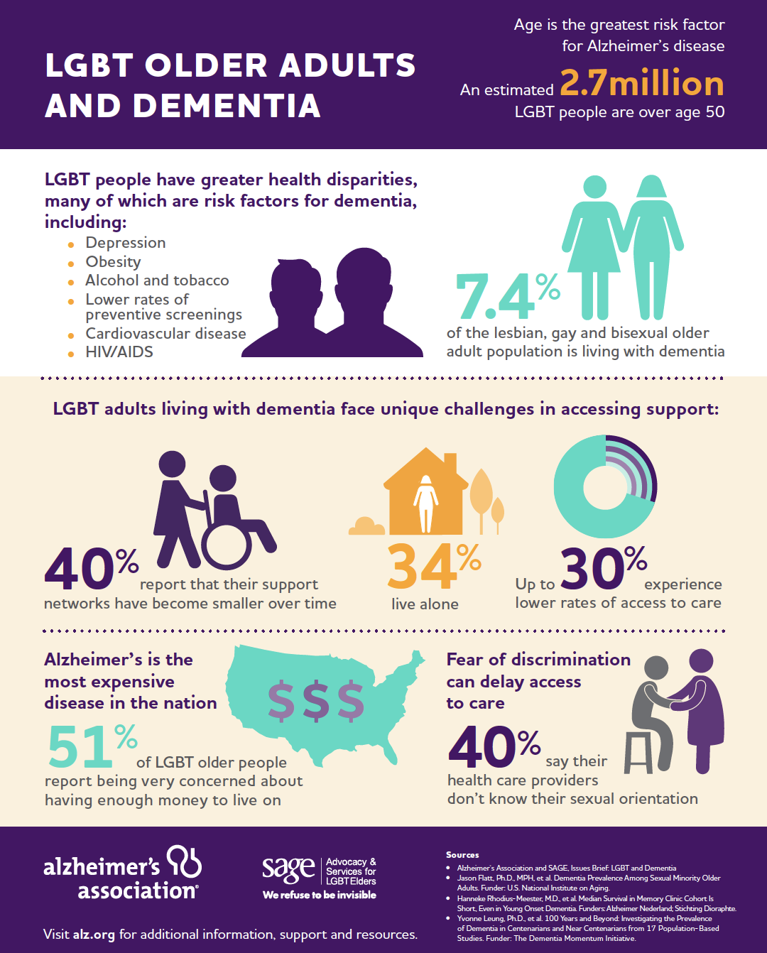
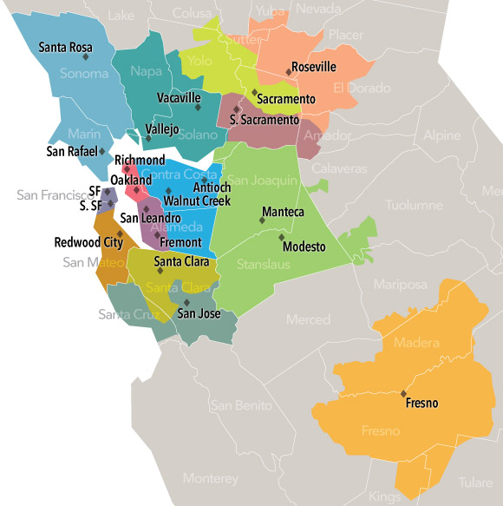
Supported by NIA - K01AG056669 (Flatt)
Dementia Prevalence in 2007
7.4% vs. 8.9%
Sexual Minority Heterosexual
Dementia diagnosed at younger age
Sexual Minority: 81.4 years
Heterosexual: 82.7 years
Kaiser: Research Program for Genes, Environment & Health
23% higher odds
of dementia for
lesbian & bisexual women
vs.
heterosexual women
Notes:
200,000 Kaiser Permanente Northern California members
4,337 sexual minority adults aged 60+
25% Lesbian
37% Gay men
38% Bisexual (48% female
Health diagnoses (ICD-9 codes) from electronic medical record (1996-2015)
Prevalence of health conditions
Interesting demographics: SM were younger by 2 years, racially/ethnically diverse (10% Asian, 4% Black, 5% Latino); unmarried (40% vs 2%), live alone (40% vs 23%)
risk/protective factors: more college degrees (66% vs 43%), more depression (28 vs 21%), HIV (4% vs <1%)
Cox proportional hazards models were used to compare incident dementia
Stratified by gender, Adjusted for age, race, and comorbidities, Censored for death and >90 day gaps in health plan coverage (Age as timescale – robust way to adjust for age. For instance, we adjusted for age starting at Jan 1st and age at censor date.

Slide 15
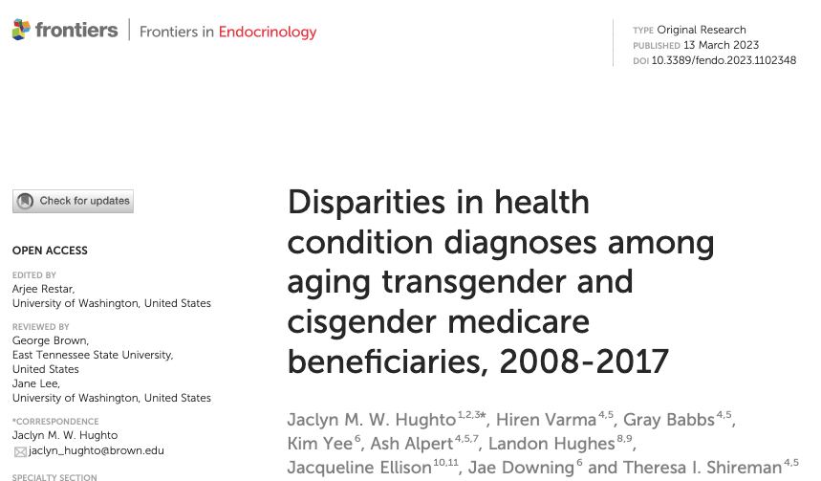
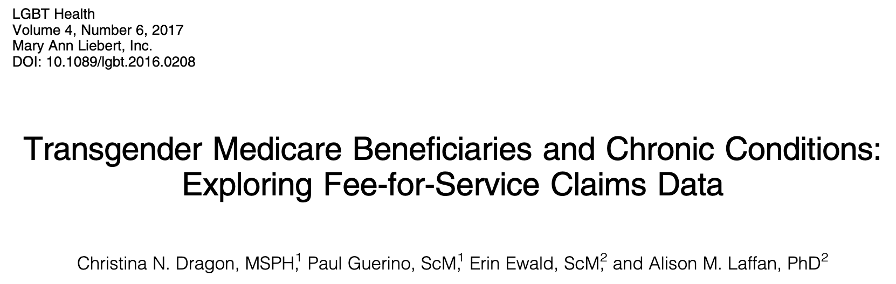
Dementia
18% vs. 12%
Transgender Cisgender
Christina Dragon, MSPH, CHES
Measurement & Data Lead
Sexual & Gender Minority Research Office
National Institutes of Health
Transgender Women 20.2%
Transgender Men 21.3%
Cisgender Men 12.3%
Cisgender Women 13.6%
Notes:
Apart from this one study that reported higher rates of dementia in older trans Medicare beneficiaries compared to cisgender beneficiaries, relatively little is understood about the epidemiology and risk of ADRD in the trans population.
Medicare beneficiaries 2015 (32 million+)----Entitlement based on age 65+---TG identity from ICD-9 diagnosis codes
So I want to frame what we do know about adult health in terms of ADRD and cognitive impairment.
Overall, GM adults experience a greater number of health disparities compared to cisgender adults. Many of the health disparities are risk factors for ADRD and cognitive impairment. Higher burden of disability, chronic health conditions, poorer mental health.
2015 Medicare claims revealed that when compared to cisgender older adults, GM older adults had higher rates of diabetes (39% vs 31%), depression (54% vs 25%), hyperlipidemia (76% vs 65%), hypertension (78% vs 67%), and obesity (23% vs 16%).
GM adults are disproportionately impacted by modifiable risk factors that account for approximately 40% of dementias worldwide.
(alcohol consumption, smoking, TBI and social isolation…..depression, diabetes, education, hypertension, obesity, physical activity)

Slide 16
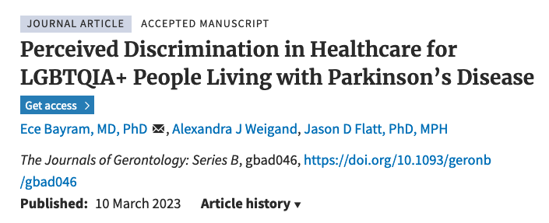
LGBTQIA+ people living with Parkinson’s disease reported highest frequency of perceived discrimination in healthcare
Discrimination higher for cisgender, heterosexual women and LGBTQIA+ people living with PD compared with cisgender, heterosexual men
Notes:
Another study led by a scientist, Dr. Eh JAy Bye ram at UC San Diego found SGM people with Parkinson’s disease reported greater perceived discrimination in healthcare
This was based on the Discrimination in Medical Settings Scale – included perceiving that you receive poorer service, fear of your identities and healthcare providers not listening to you.
Again another barrier for SGM people in accessing care for Central Nervous System Disorders

Slide 17
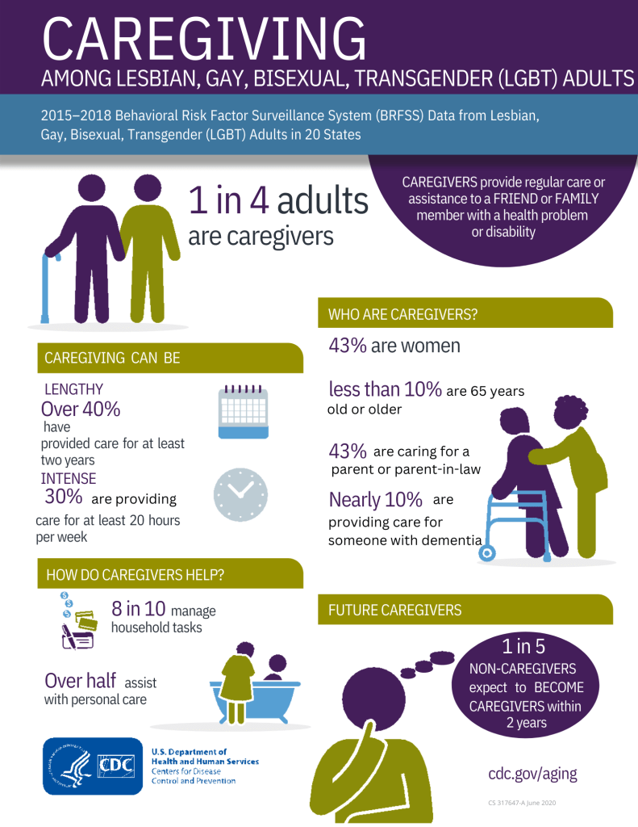
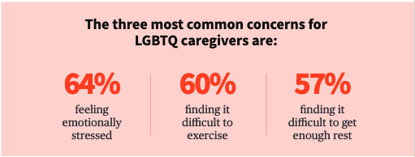

Slide 18
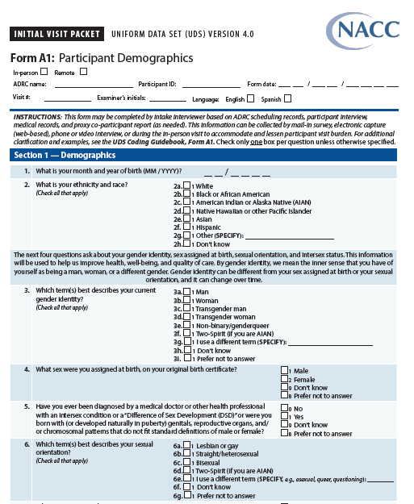
Collecting SOGI – Sexual Orientation & Gender Identity
NASEM report (2022) provided foundation for recommendations
National Alzheimer’s Coordinating Center - UDS 4.0
https://nap.nationalacademies.org/catalog/26424/measuring-sex-gender-identity-and-sexual-orientation
Flatt, J. D., & Cicero, E. C. (2023). Advancing equity in Alzheimer’s disease and mental health research for LGBTQIA+ older adults. Nature Mental Health, 1(6), 385-387.
Notes:
The National Academies of Science, Engineering, and Medicine report provided foundation for our SOGI measurement recommendations in ADRD and aging research
Some limitations to keep in mind –
Limited research exists that has validated and cognitively assessed SOGI measures with older adults
Understanding the difference between sex assigned at birth and gender identity from sexual orientation is a concern, especially cross-culturally. Numerous studies have translated SOGI measures into Spanish, but validation and cognitive testing were not always performed. Regional variations in Spanish language terminology may also represent challenges that should be considered.
Future research should include Cognitive testing of measures across different languages and geographic contexts and using diverse samples.

Slide 19
Acknowledgements & Disclosures
Collaborators: Joel G. Anderson, PhD, CHTP, FGSA; Ethan Cicero, PhD; Maritza Dowling, PhD; Krystal R. Kittle, PhD; Nickolas H. Lambrou, PhD; Whitney Wharton, PhD;
Dr. Flatt is supported by the National Institutes of Health (R01AG083177; K01AG056669; R24AG066599), Alzheimer’s Association, and Michael J Fox Foundation for Parkinson’s Research
The content is solely the responsibility of the authors and does not necessarily represent the official views of the National Institutes of Health
No conflicts of interest to report

Slide 20
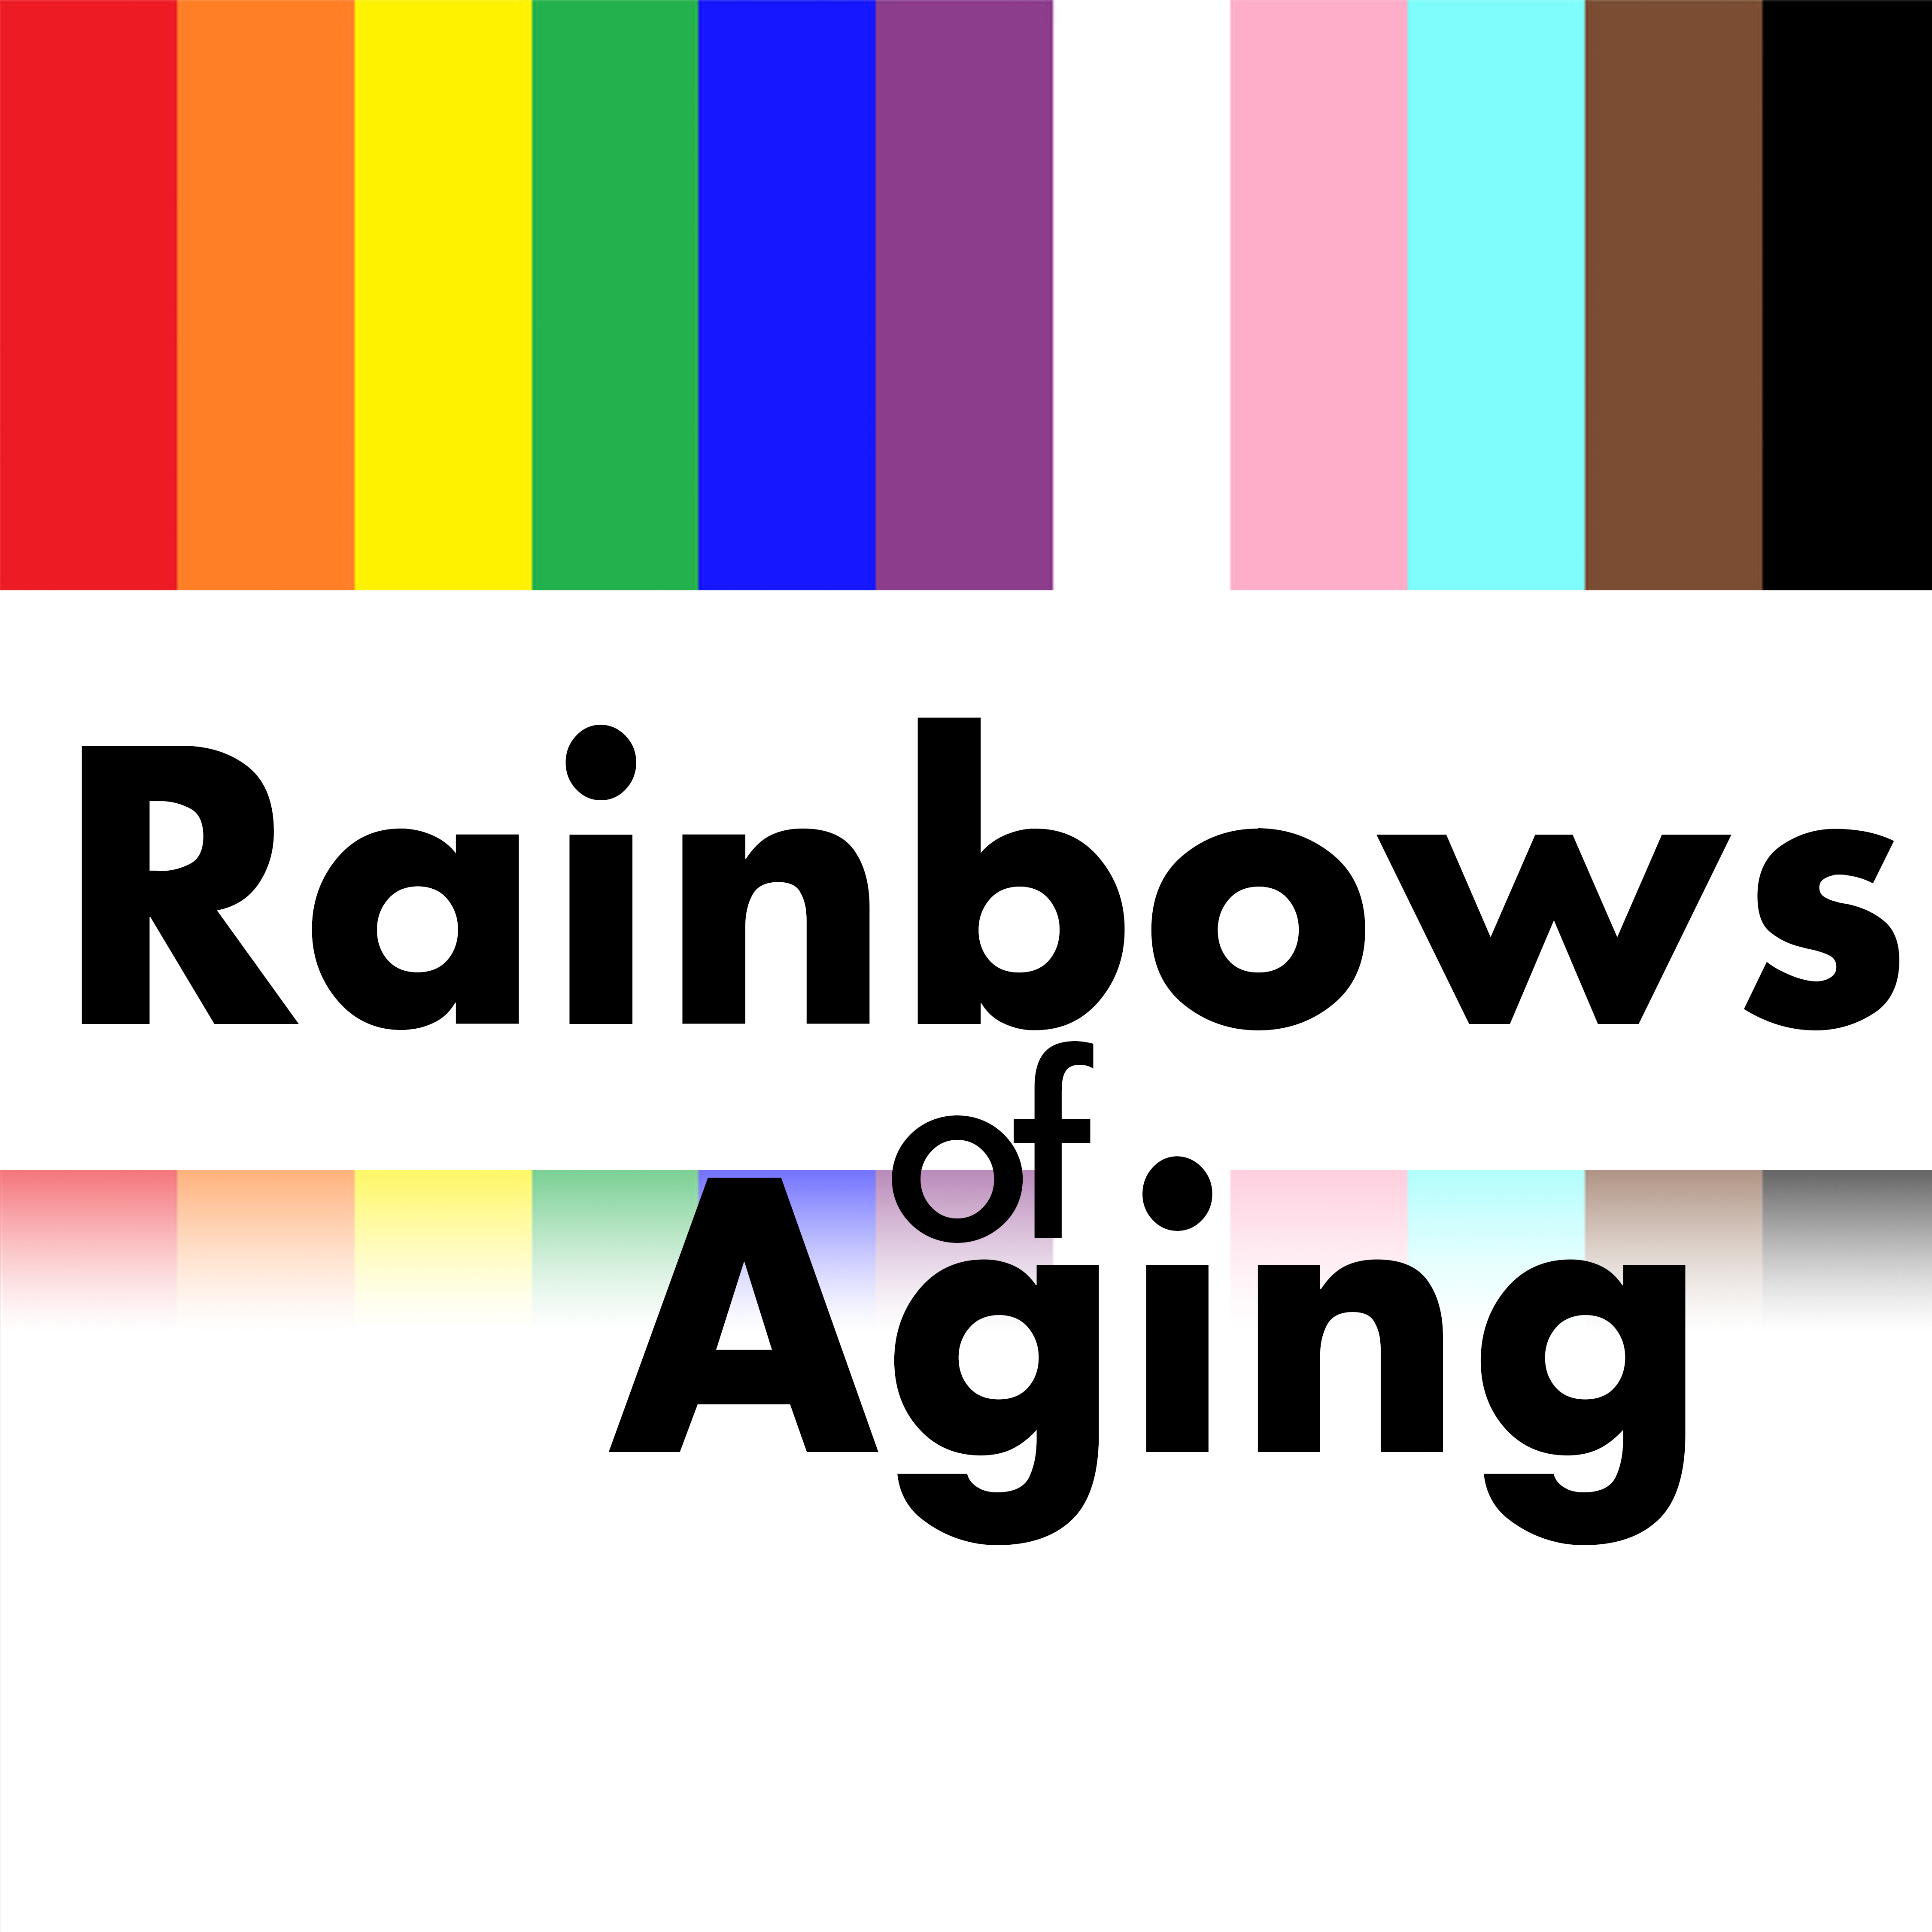
Thank you! Questions? Email: Jason.Flatt@unlv.edu www.RainbowsofAging.org

