Slide 1
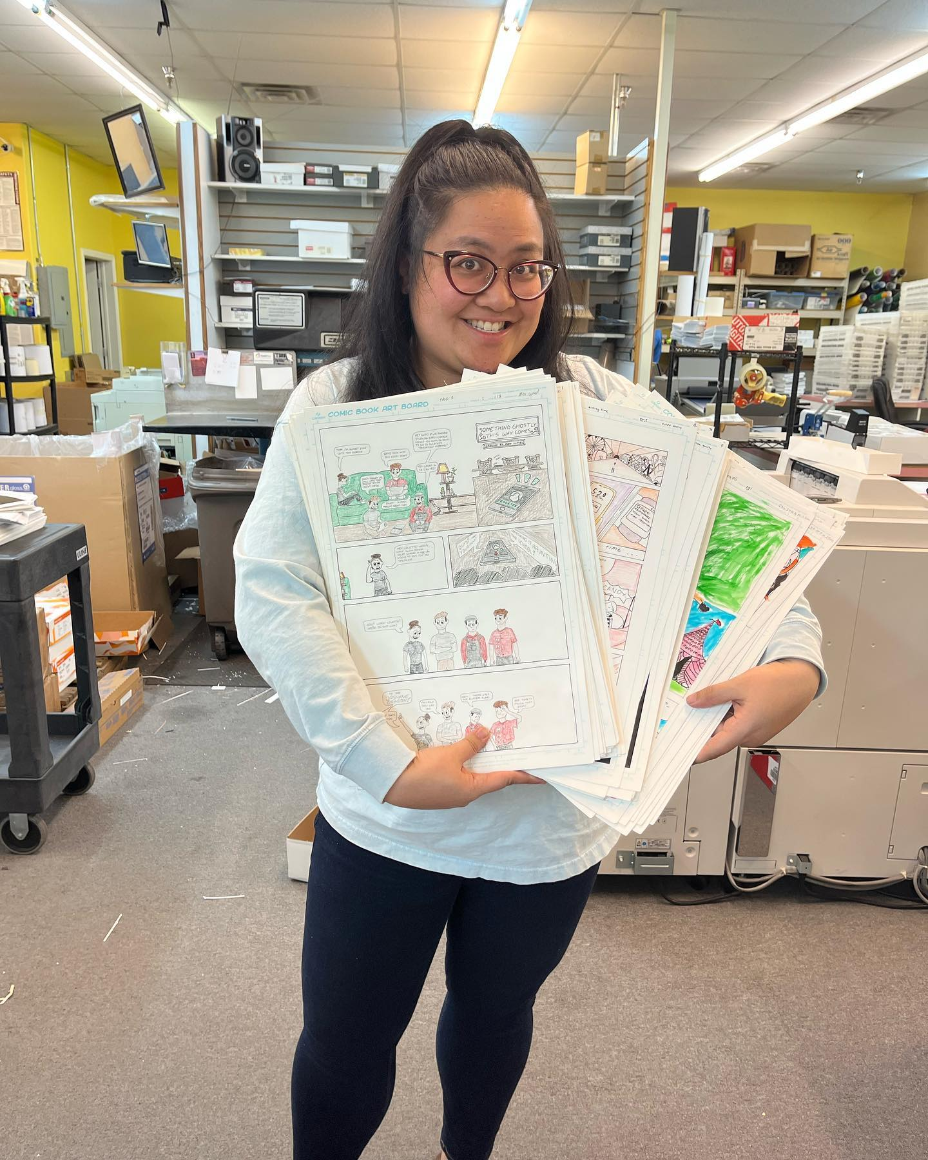
Comics & Health
Benefits of this Medium

Slide 2
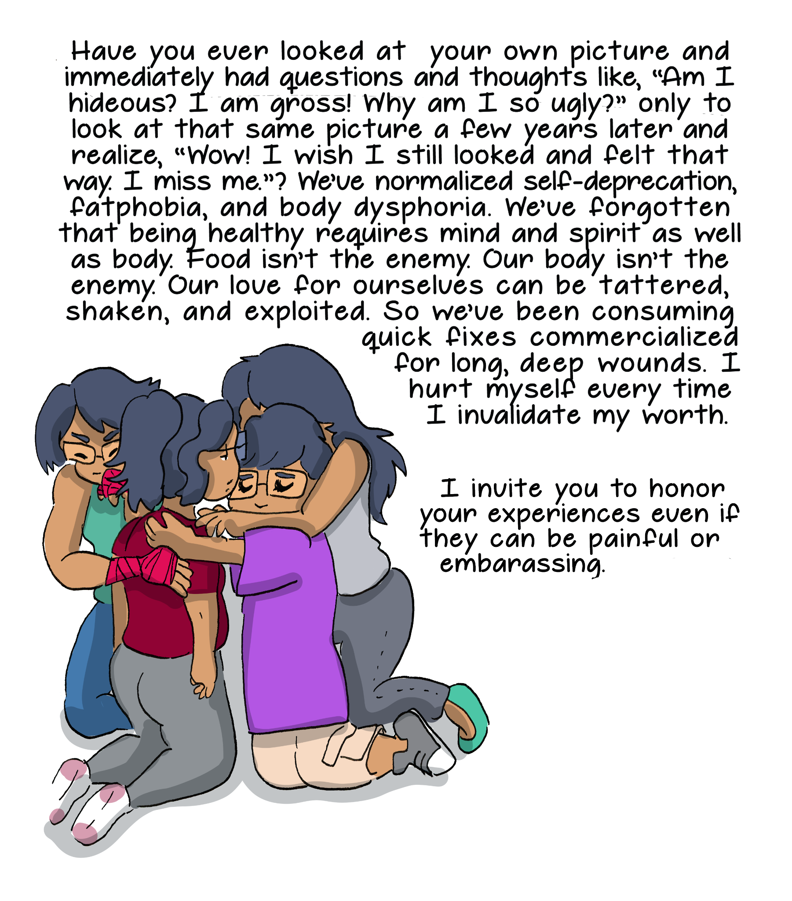
Benefits
Mental Health
Physical Health
Problem Solving
Communication
Accessibility
Community Building

Slide 3
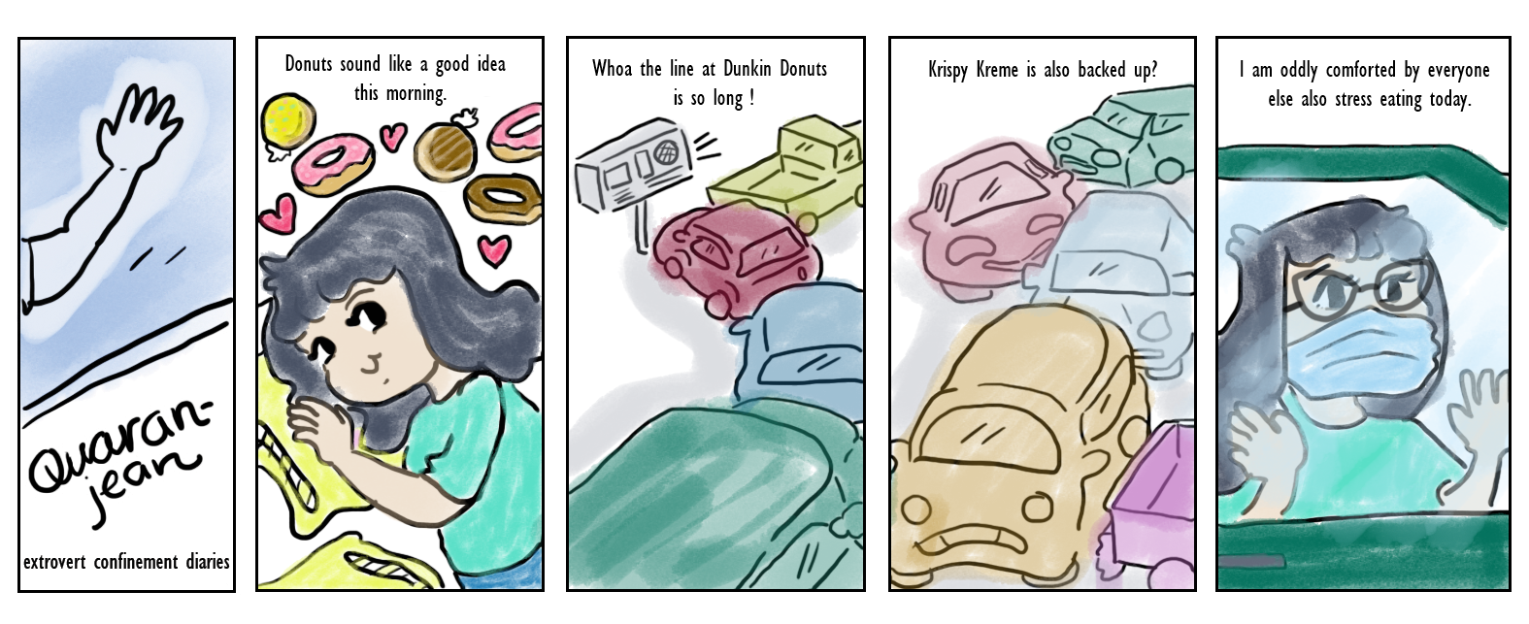
Mental Health

Slide 4
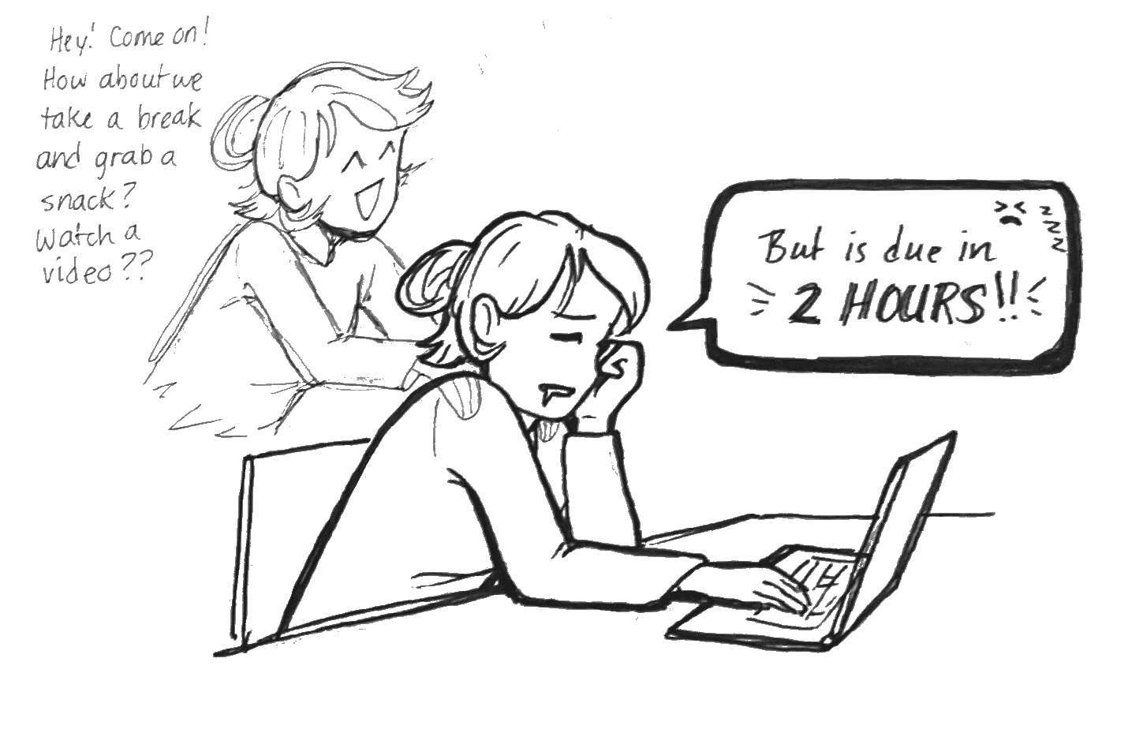
By Isabel Trujillo

Slide 5
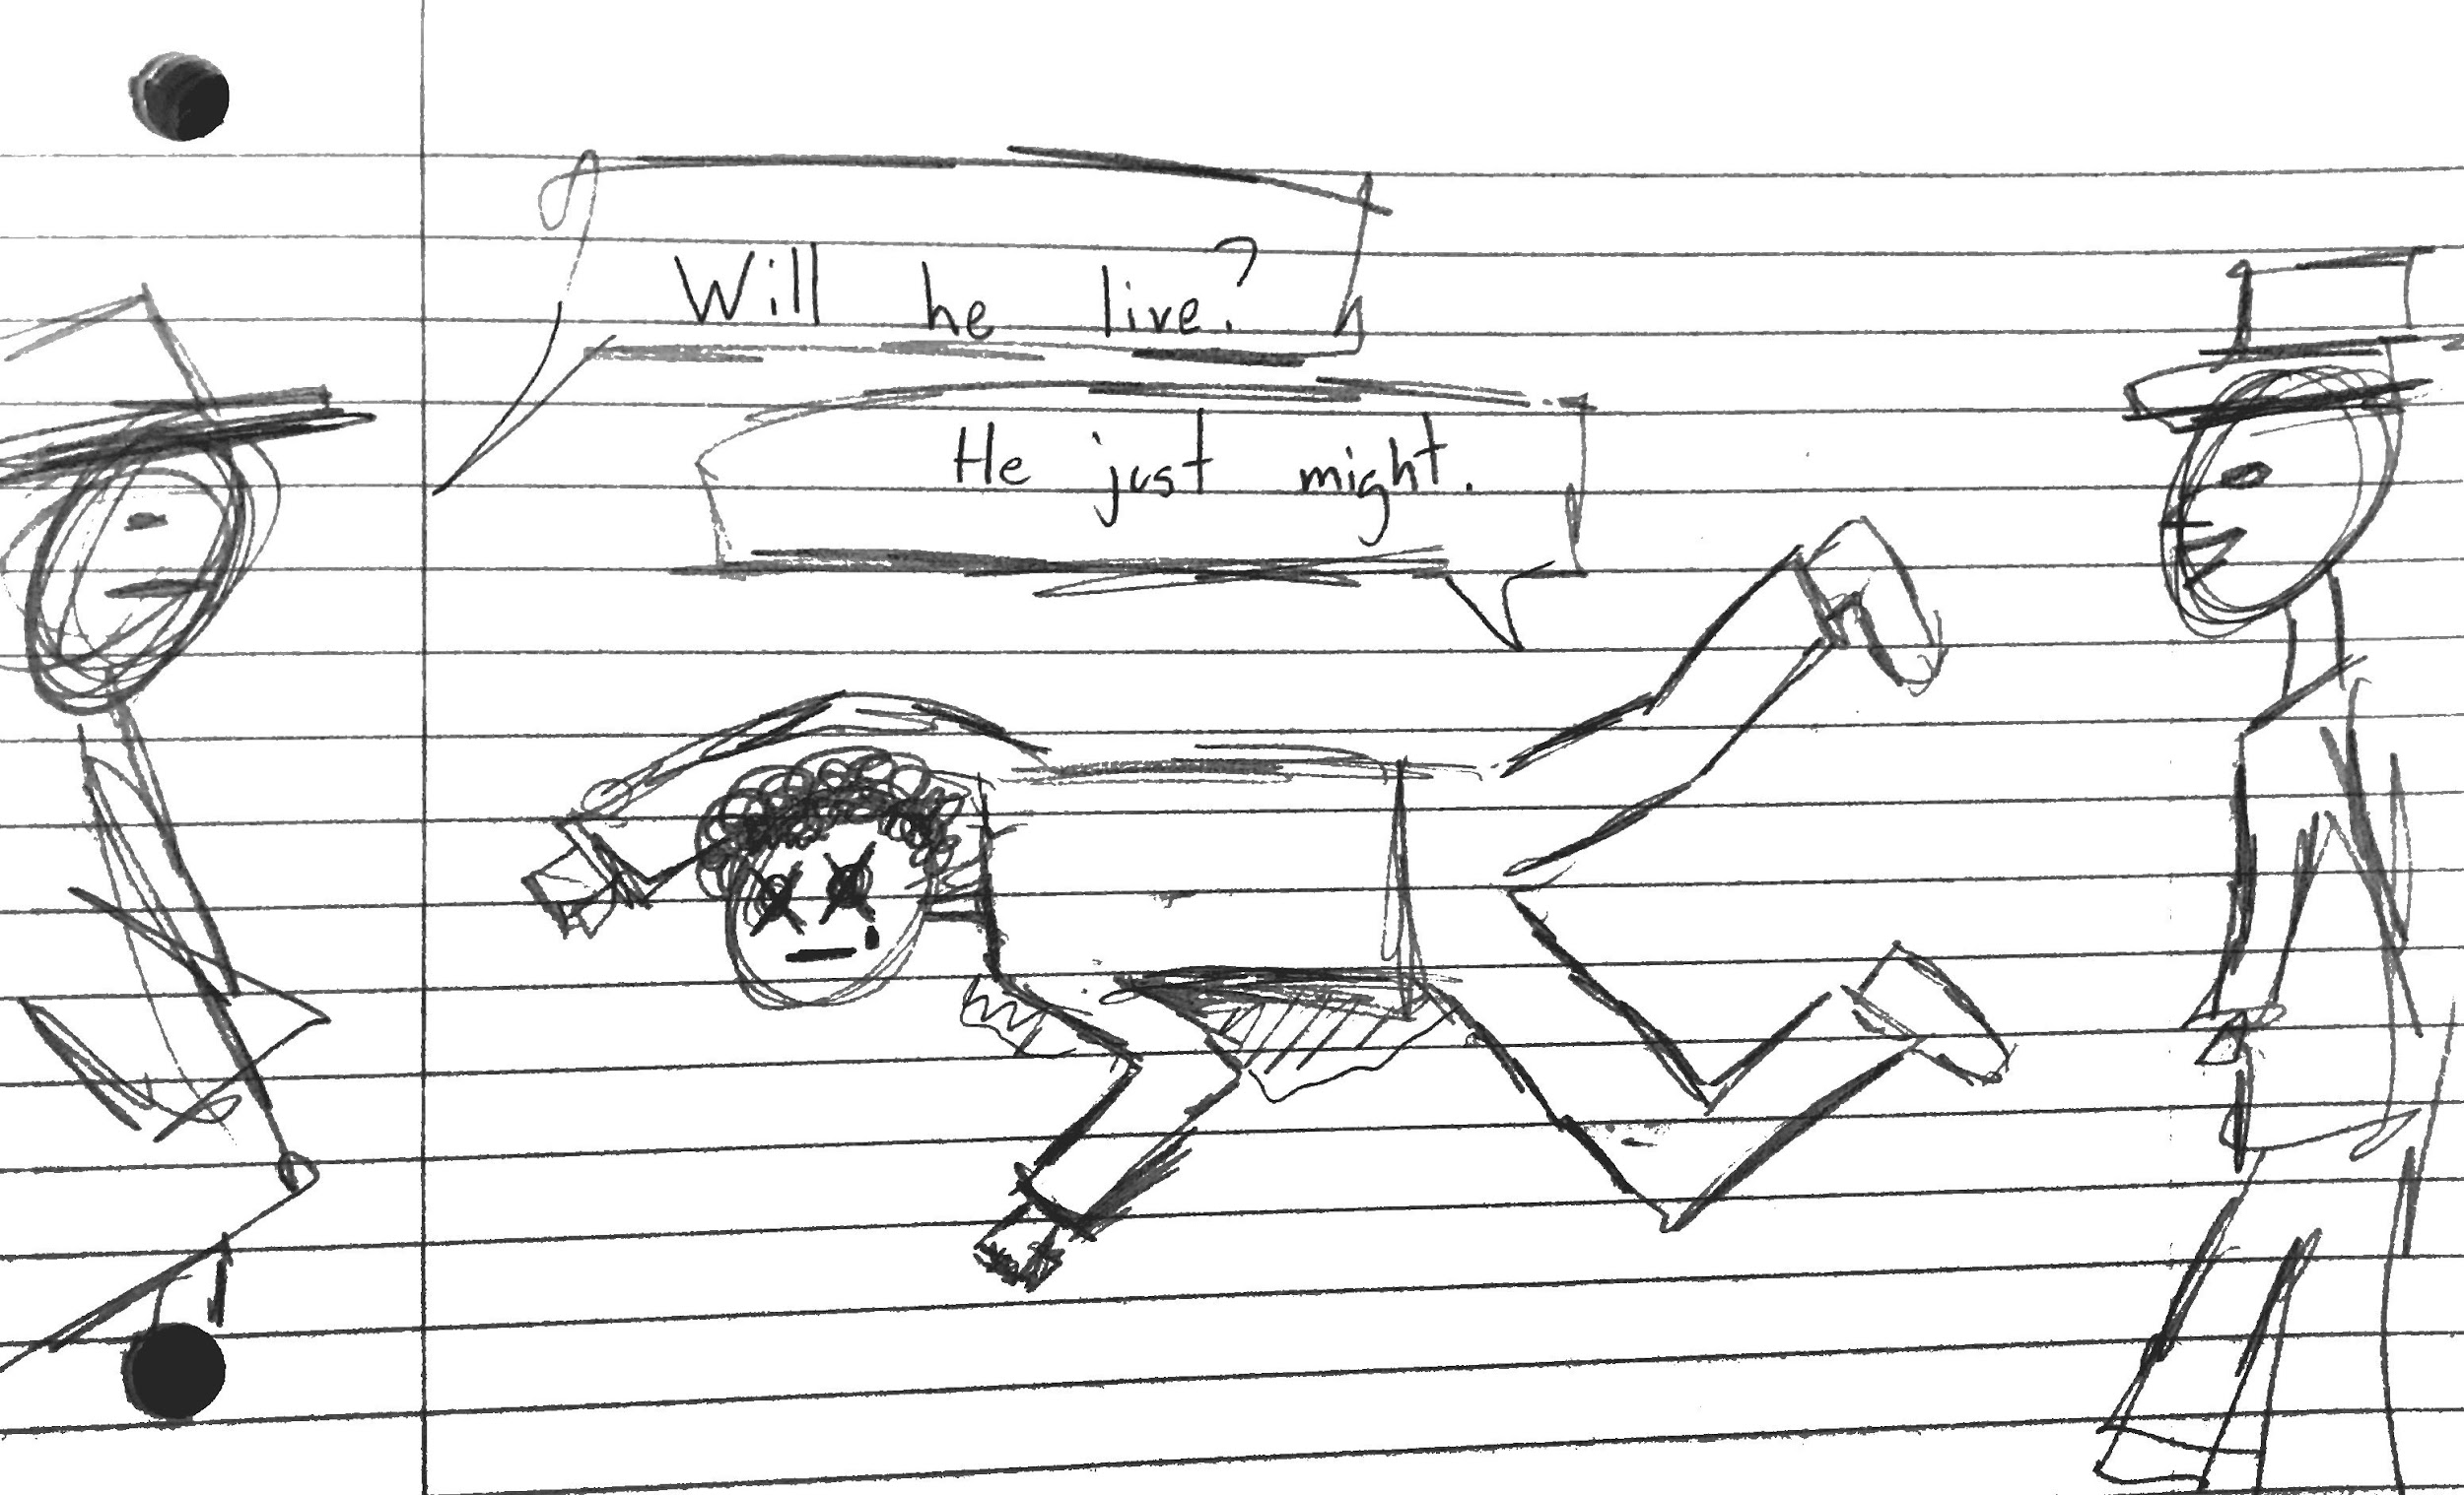
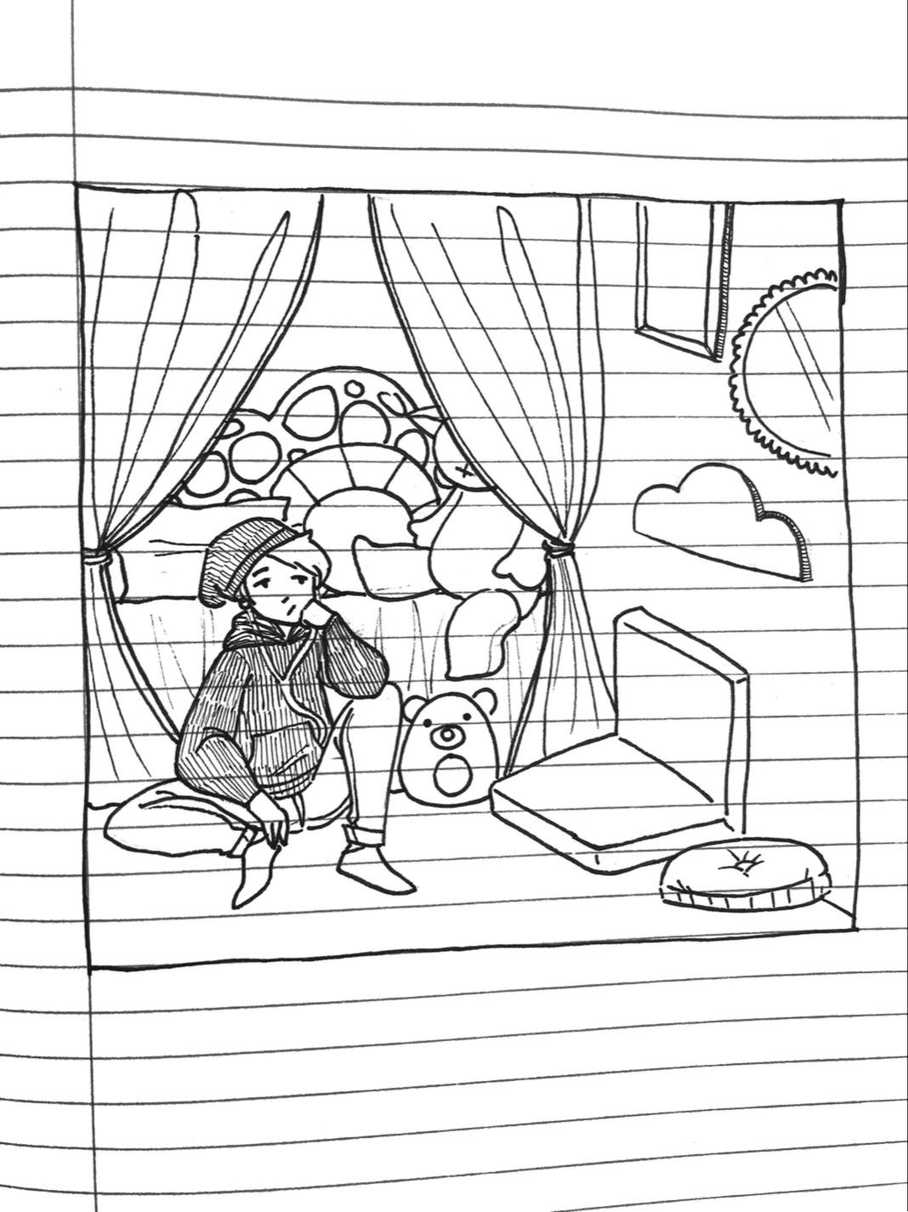
By Francisco Lopez Martinez
By Nico Navalta

Slide 6


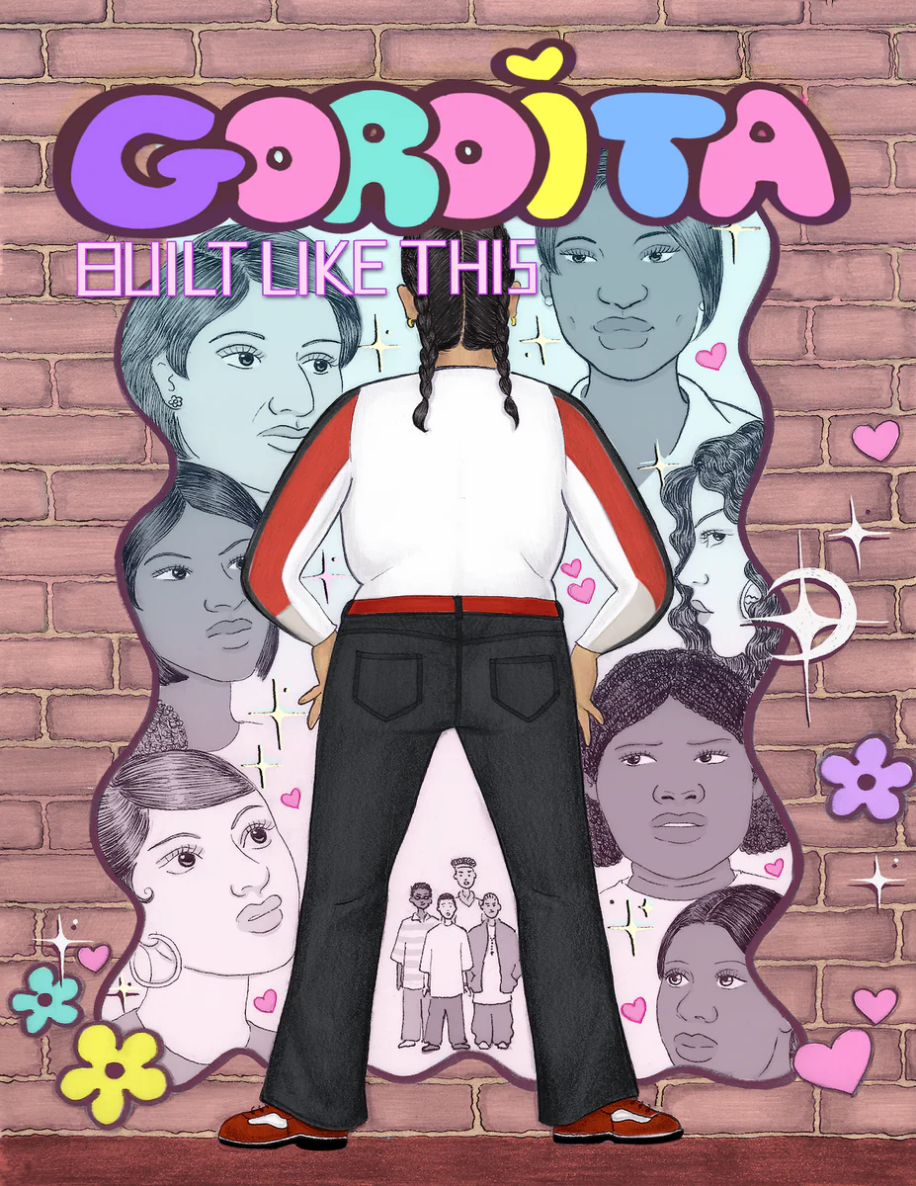


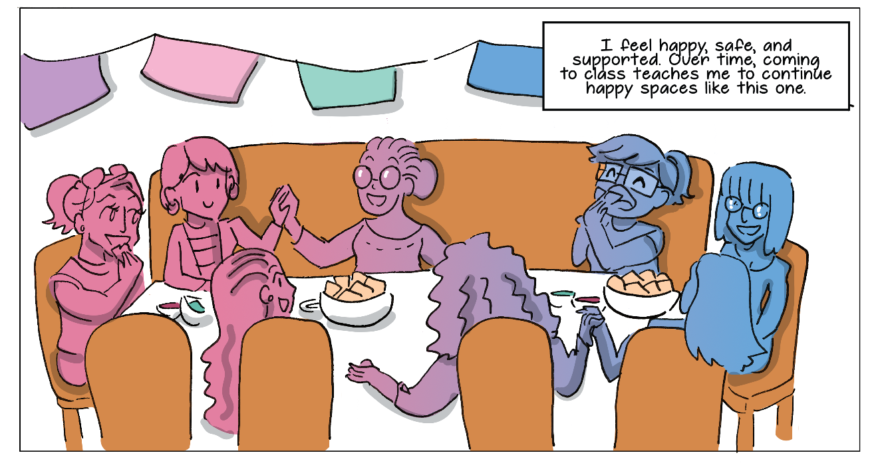
Physical Health

Slide 7
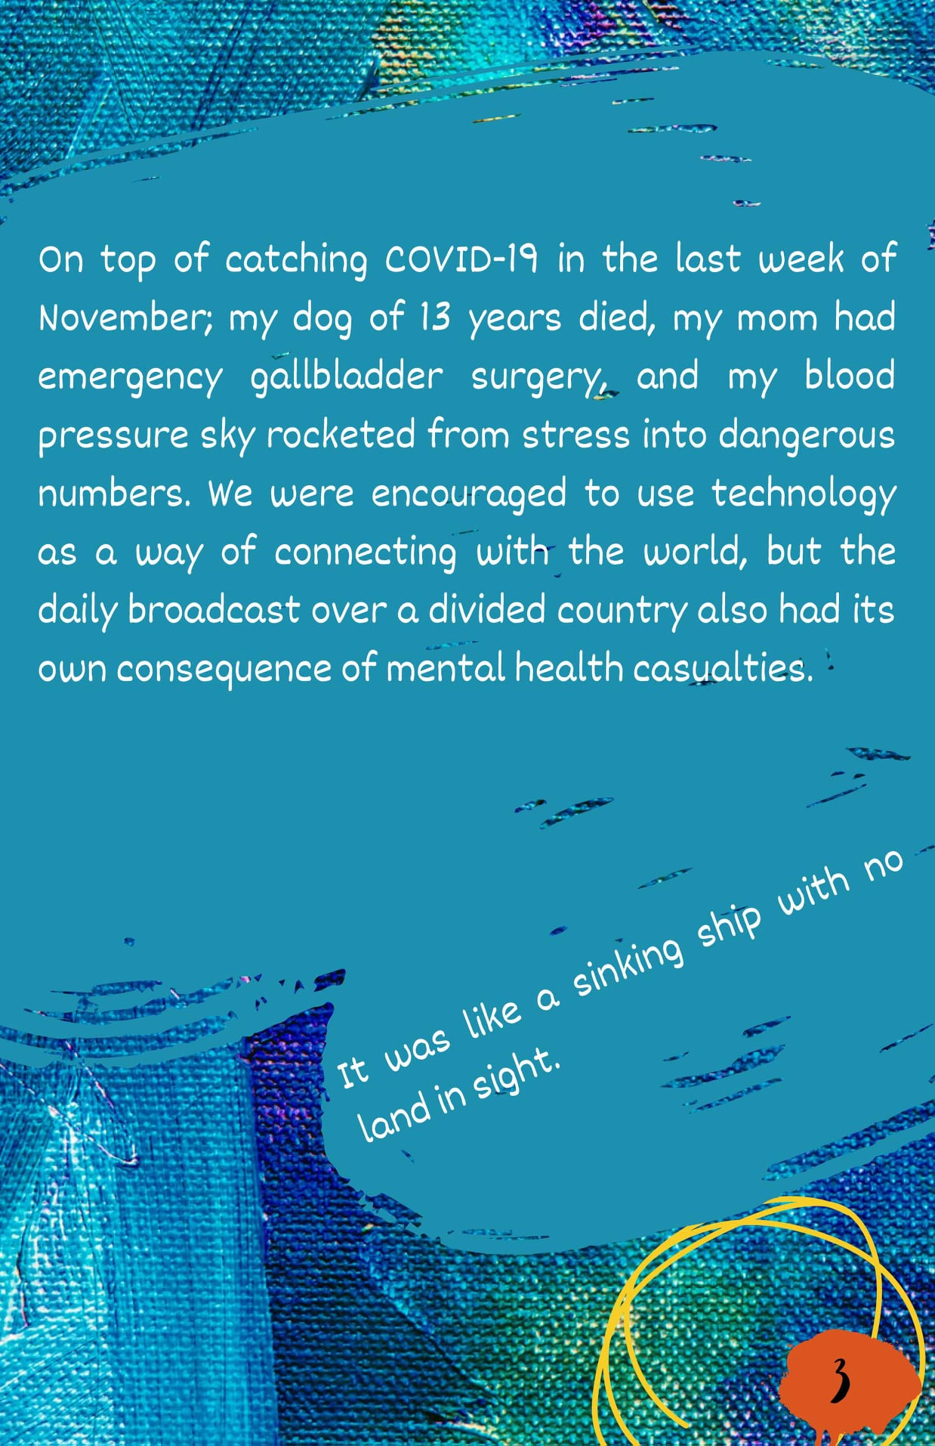
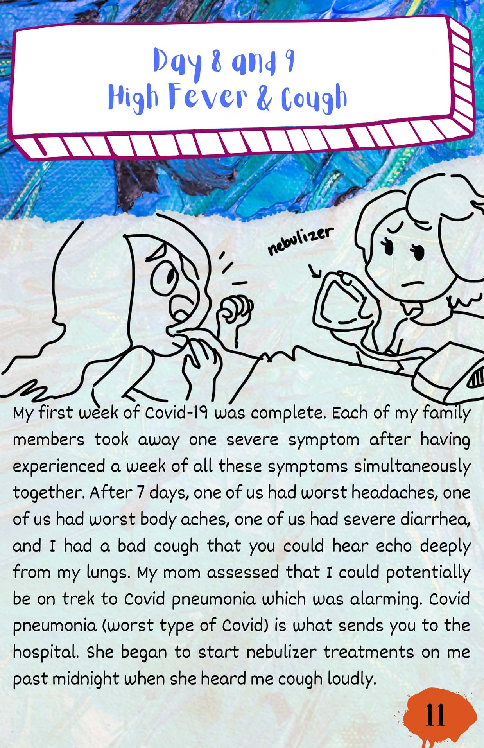

Problem
Solving

Slide 8

Communication
By Maria Rodriguez Horta

Slide 9
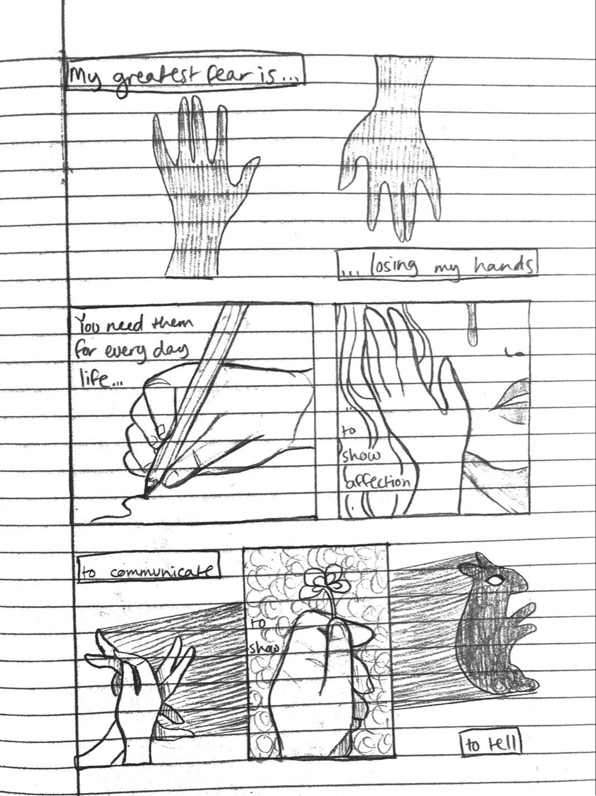
By: Nico Navalta

Slide 10
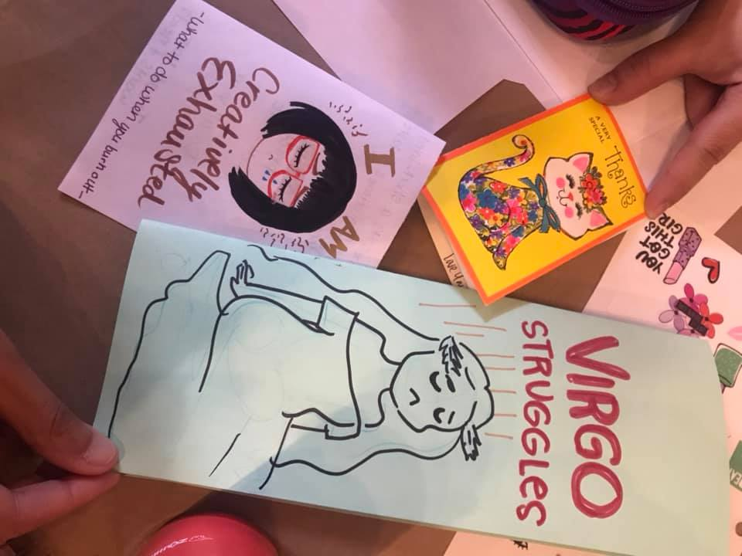

Accessibility

Slide 11
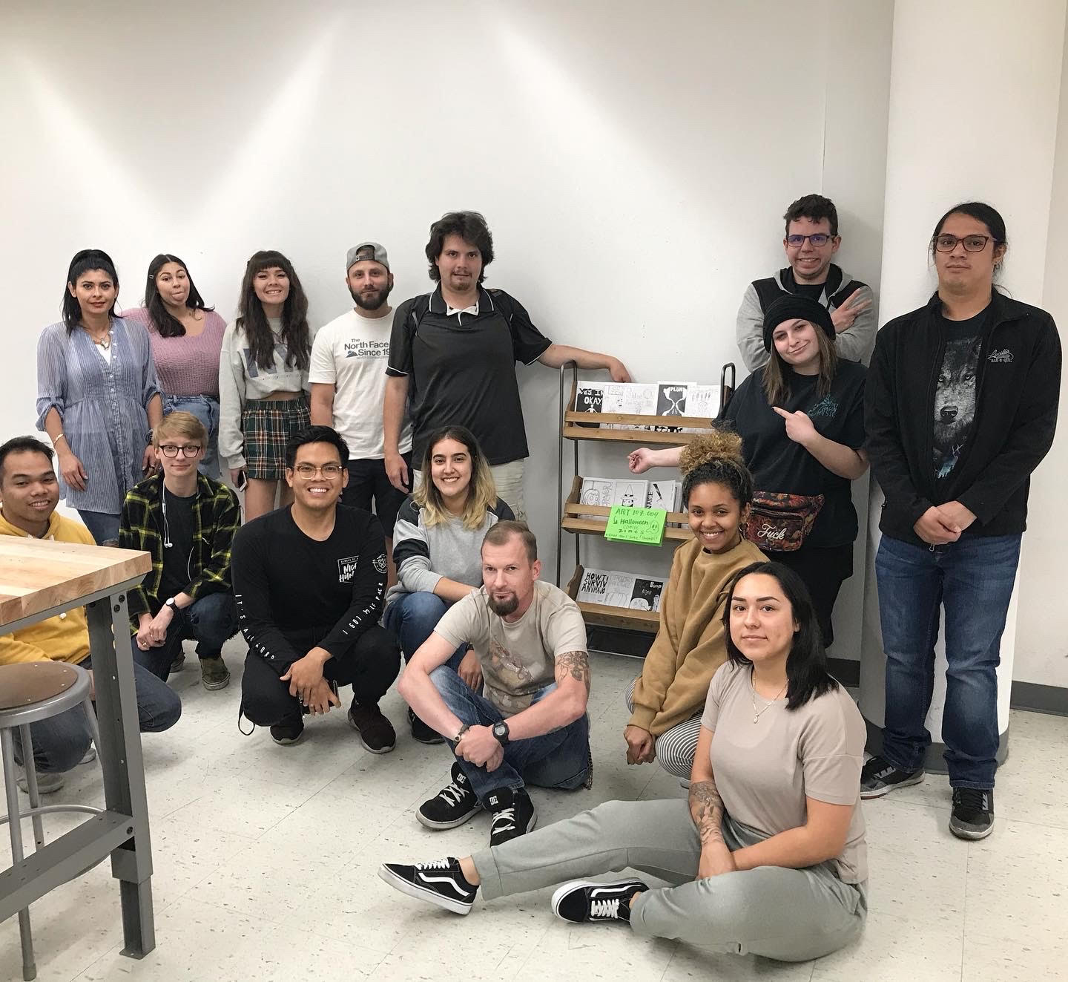
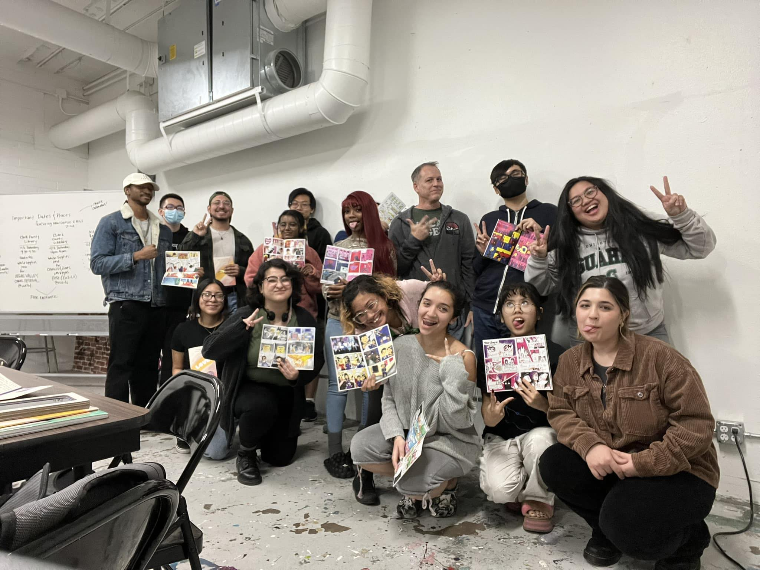
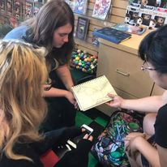
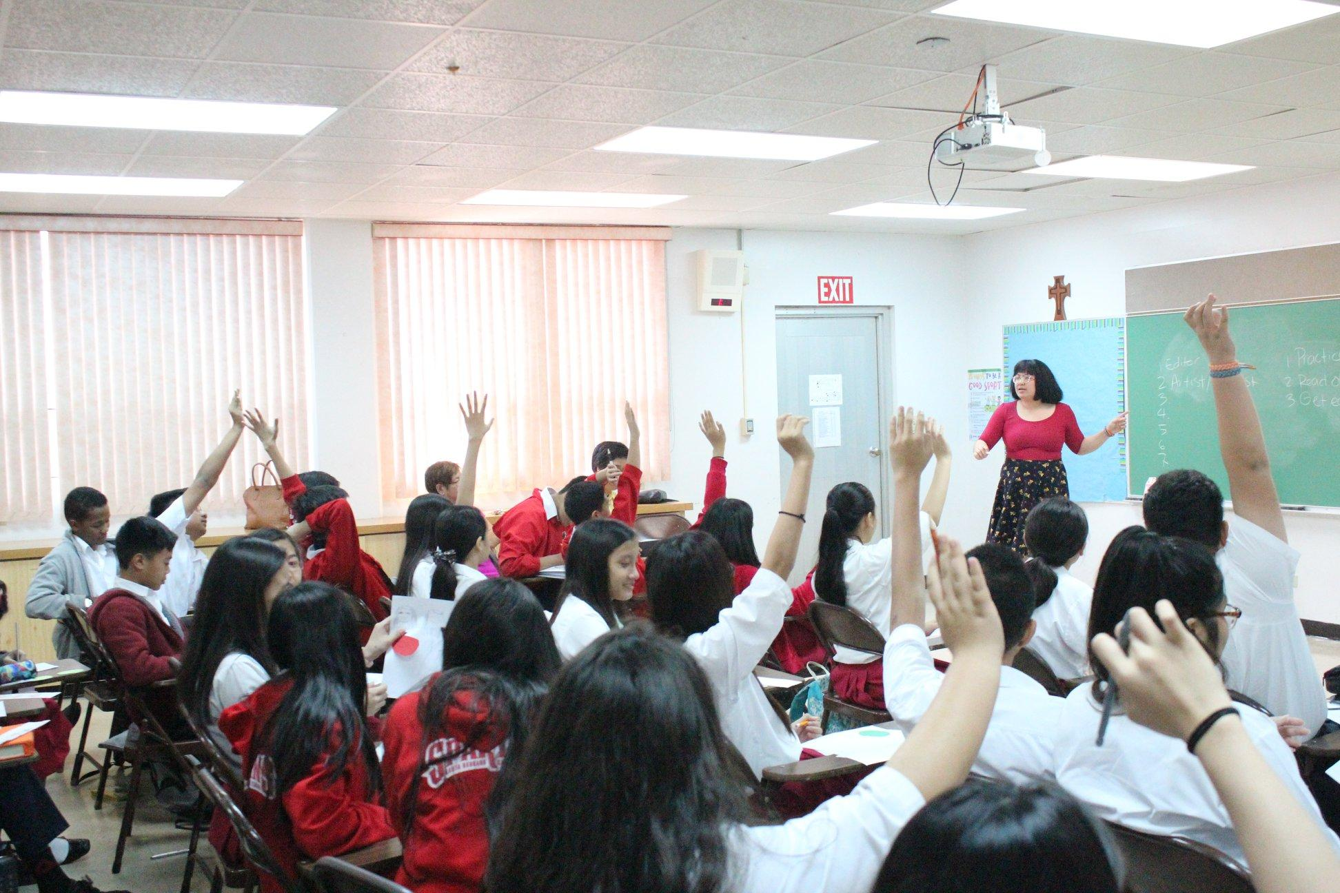

Community Building
Community Building

Slide 12

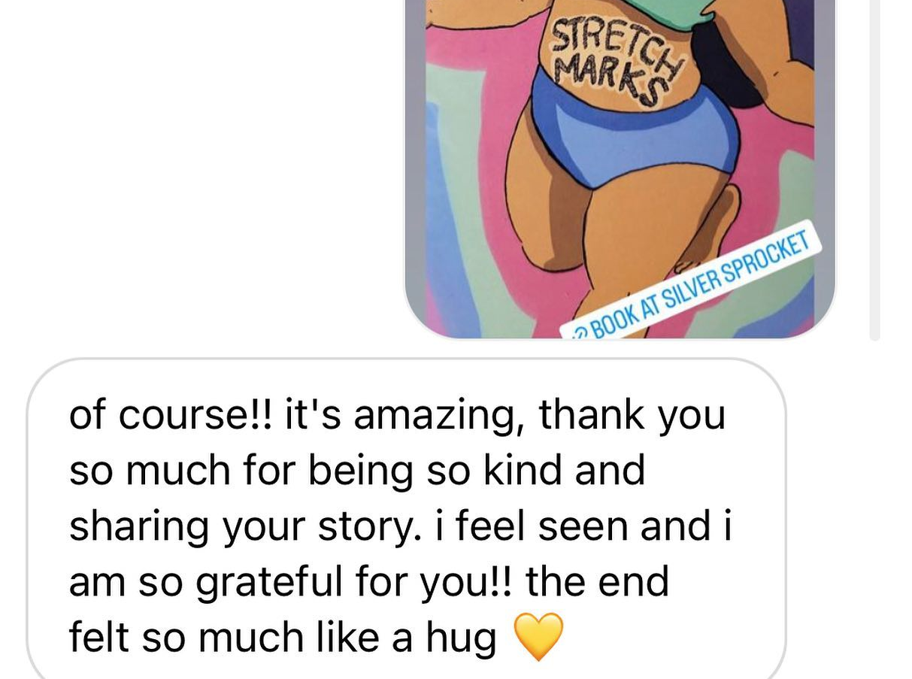
Stay in Touch
bit.ly/jeanmunson
jean.munson@unlv.edu

