Slide 1
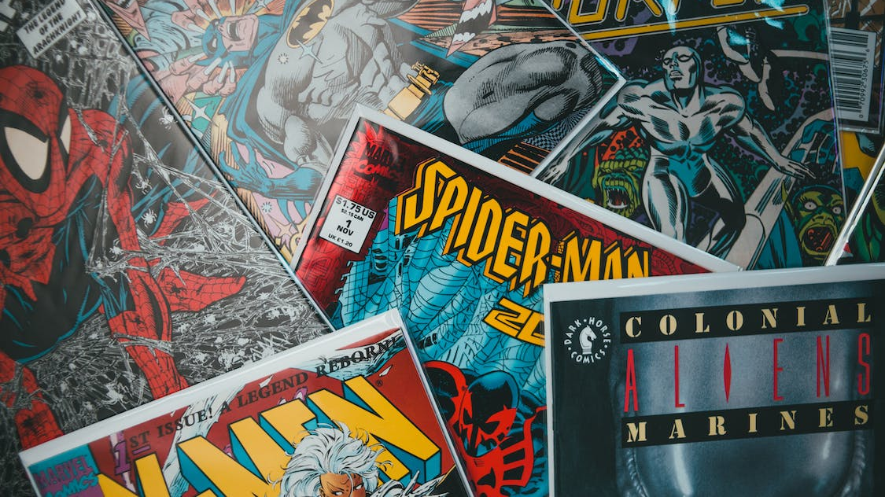
Comic Books & Mental Health
Notes:
Good afternoon, folks, fellow comic book and mental health nerds. I’m here to talk to you about the profound influence of comic books on our society, as they bridge psychology, culture, and storytelling, burning themselves into our collective unconscious.

Slide 2
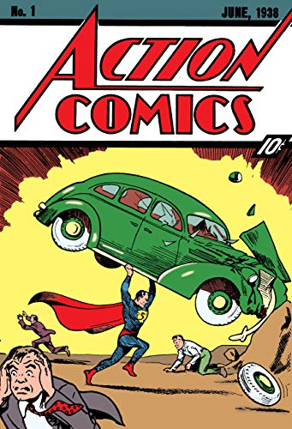
Notes:
I would assert that the relevant era started with a story by Jerry Siegel and Joe Shuster – Action Comics #1. He was born as Kal-El, the last son of a dying planet but we know him as Superman. How do we connect with such a strange character? Let’s come back to that and for a moment focus on the bigger picture around comics and mental health.
Comics have the power to captivate hearts and minds, activate emotions and remind us of our own experiences. They provide entertainment, but more than that – a tapestry of a deeper story – symbols, archetypes, psychological insights, and reflections of culture. We look at comic books and somehow, they open windows into the human psyche, revealing our hopes, fears, and help us see parts of ourselves we hope to keep hidden from others (and sometimes ourselves).
There’s a symbiotic relationship that exists between the storytelling within comics (and by extension, the media that originate from it) and our society. Comics are reflective of the experiences of generations, and while a contemporary backdrop makes for an easier willingness to suspend disbelief, the themes are often timeless. Like the range of comic book characters, the stories and writers reflect us at our best and worst; the greatest strength and deepest vulnerability are one and the same.

Slide 3
Common Criticisms of Comic Books
Unrealistic bodies / beauty standards
Portrayal of violence
Immersive quality leading to excessive escapism
Not accurately representing mental health matters
Notes:
Some criticisms around comic books in mental health are around the unrealistic beauty and body standards, the portrayal of violence, the immersive quality leading to excessive escapism, and not accurately representing mental health matters.

Slide 4
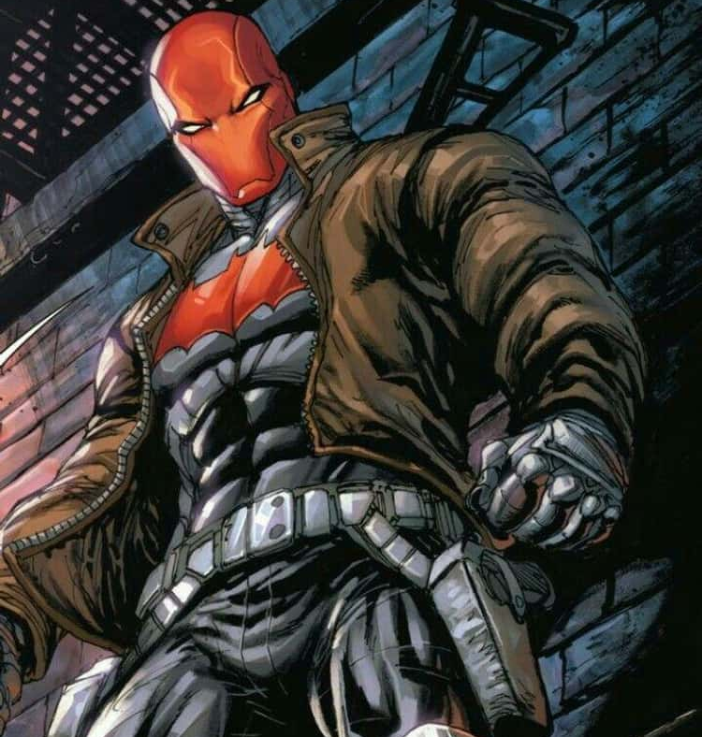
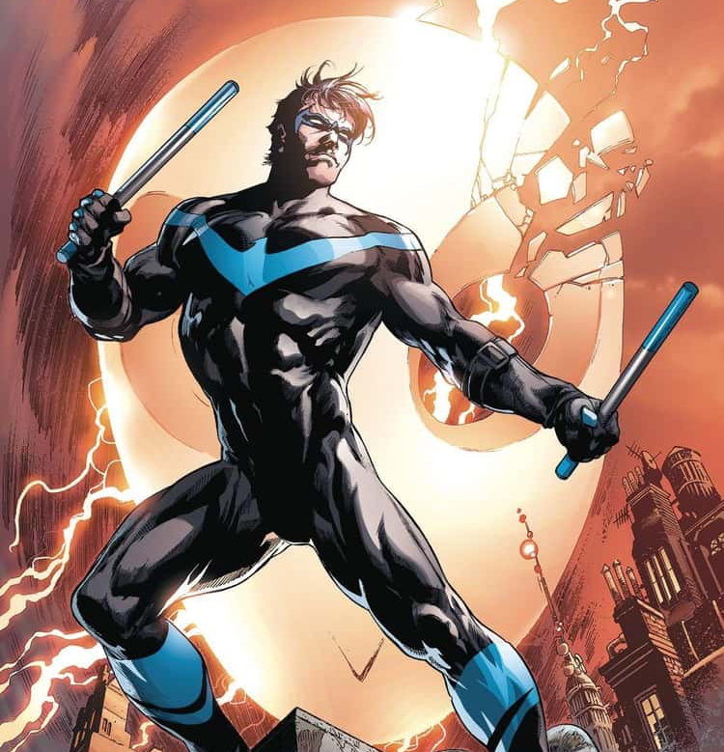
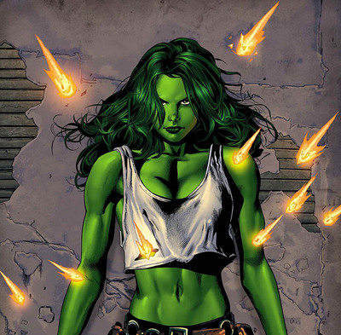
Notes:
Some of those are more legit than others. For example, it would be impossible for Batman to run across rooftops, dangle criminals from gargoyles, or fight dozens of assailants while looking like Homer Simpson. We expect our real-life heroes to pass physical tests (e.g. firefighters and police), why shouldn’t we expect the folks that can single-handedly save a plane full of people to be in extraordinary physical shape? If realism is the goal, let’s not start with body shapes – let’s start with talking to fish. Any single firefighters, paramedics, or police in the crowd by show of hands? Other single people – you’re welcome. Get numbers after we’re done talking.

Slide 5
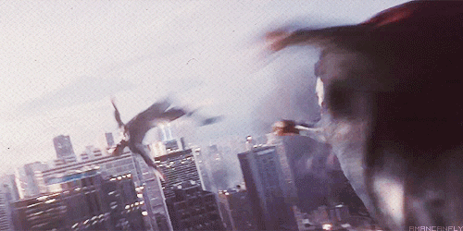
Notes:
As far as violence, no one is getting punched mid-air across miles or is in danger of the insane physics that exist in comics, but admittedly someone can try and cause some real damage. And there are some comics that glorify firearms, such as The Punisher. In general, heroes use their special abilities as weapons and generally in a non-lethal manner. Consider, for example the weapons of super strength, telekinesis, super speed, mind control, flight, and magnetism – guns don’t stand a chance against any of those abilities.

Slide 6
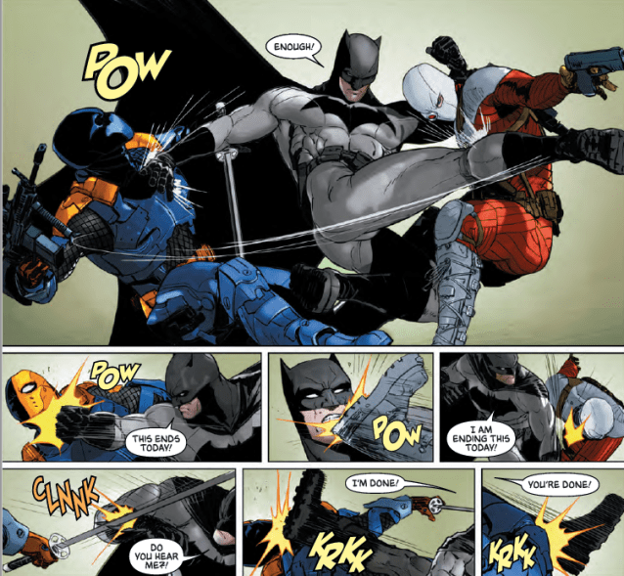
Notes:
In one frame, Batman may punch a criminal, but the reader must imagine the force, strength, and conditions needed to make the scene come alive. Research does not effectively nail down comics specifically as a primary force, but consumption of violent media is mentioned when examining factors related to violence. Consider though the ideology that a young mind could perceive – a hero has used violence and gained a positive outcome. Even messages about overcoming “evil” can be misinterpreted for selfish means. We all know that villains always have their master plan speech or want to explain to others why their choice is right – they’re two sides to the same coin.

Slide 7
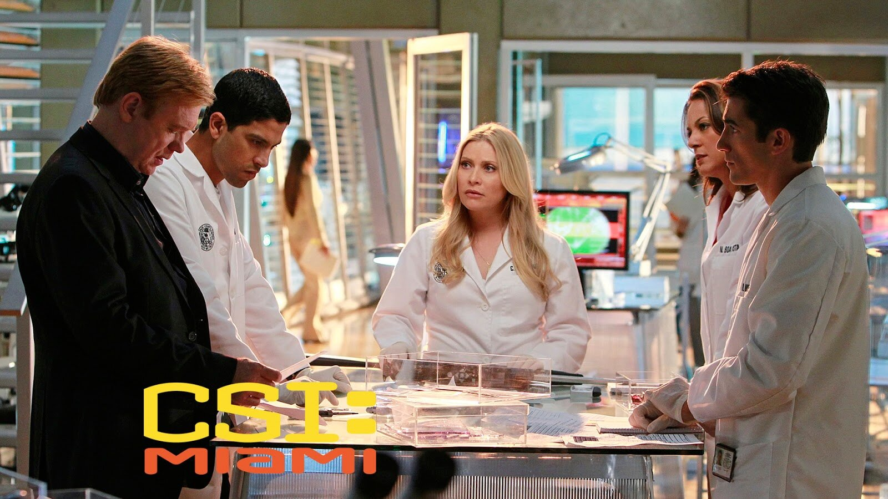
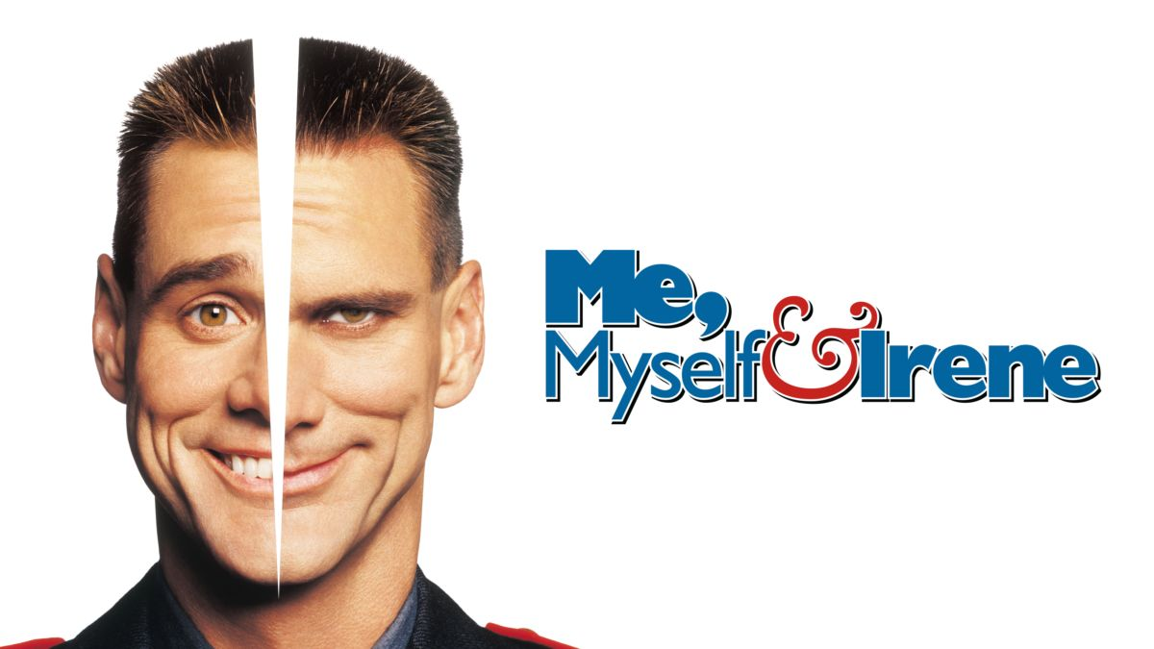
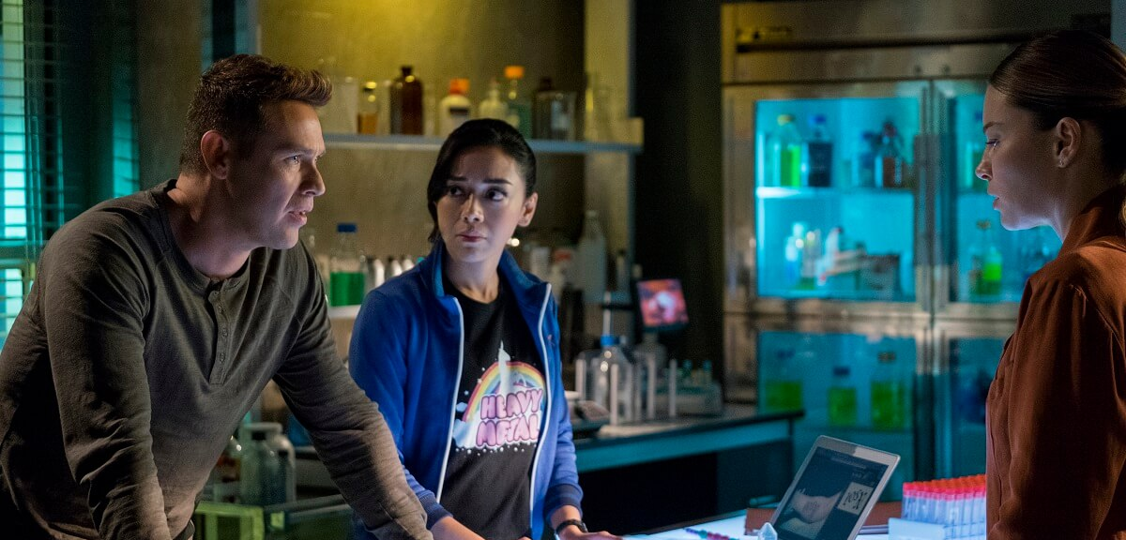
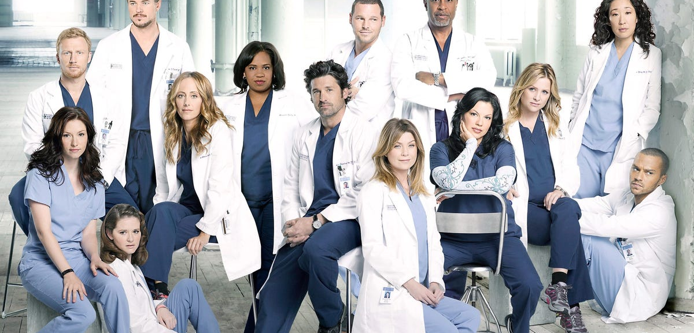
Notes:
The biggest problem with comics stems from inaccuracies that exacerbate stigmas, myths, and misinformation around mental health. Writers don’t always rely on experts (even if those experts all agreed on something). How many of you have watched a procedural show or movie about a field you’re familiar with and cringe at how awfully they misrepresent medicine, law, forensics, or mental health? The difference is that those mistakes in media around mental health create and exacerbate stigmas, which directly affects countless lives.
Does this mean that we need to limit, censor, or do away with comic books? Absolutely not. There is far too much good to let that mode of storytelling go. Let’s examine the lessons we can extract from these fantastic stories.

Slide 8
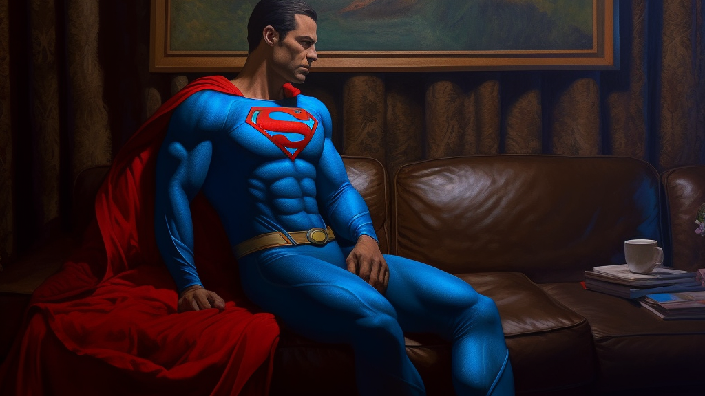
Notes:
For that, let’s jump back to Superman and put him on our couch – how do we identify with an alien with godly powers? Are we latent gods waiting for our abilities to unlock? I hope not. We don’t have enough thoughts and prayers to go around if people had laser eyes and the emotional regulation of Homelander. At a deeper level, we see ourselves. Has any of you ever longed to feel accepted, to feel belonging, to know where you fit in the world? Perhaps you’ve struggled with a sense of purpose, knowing your limits, or balancing relationship boundaries. That’s what Superman goes through on a larger, more dramatic stage.
Now, let’s look at a couple storylines in Superman.

Slide 9
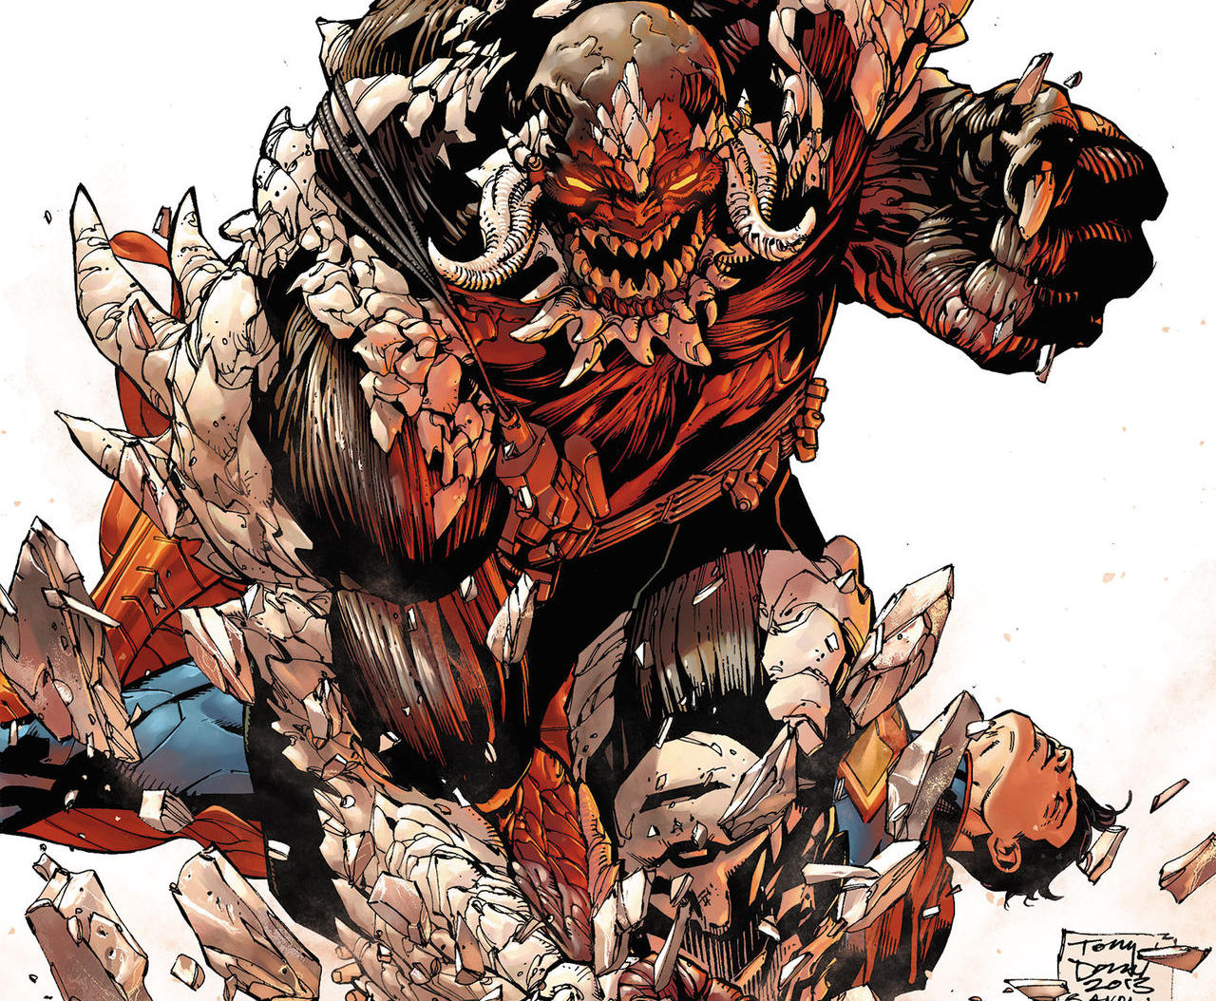
Notes:
In the storyline – The Death of Superman - he is confronted with the grim reality that he might not be able to save everyone, that there are limits to his powers. Superman's struggle with Doomsday serves as a metaphor many of our internal battles. We witness his vulnerability as he grapples with self-doubt, questioning his own abilities and the consequences of failure. This portrayal allows readers to empathize with the Man of Steel, recognizing that even the most seemingly invincible among us can experience moments of doubt and fear.
By exploring Superman's emotional journey, the Doomsday storyline encourages us to acknowledge and address our own mental health challenges. It reminds us that seeking help and support is not a sign of weakness, but rather an act of strength. Superman's ultimate triumph over Doomsday demonstrates the power of resilience and the importance of reaching out for assistance when we face our own "Doomsday" moments. Take a moment. Think about your Doomsday and take a moment to reflect on what you’re doing to confront it, seek support around it, and what limitations you have to resolve it. Is your Doomsday an external person or situation or is your Doomsday part of you? A moment or series of traumas that hold you back? A conversation you want to have but can’t bring yourself to start? An image of someone in your mind that you might have given more power than they deserve?

Slide 10
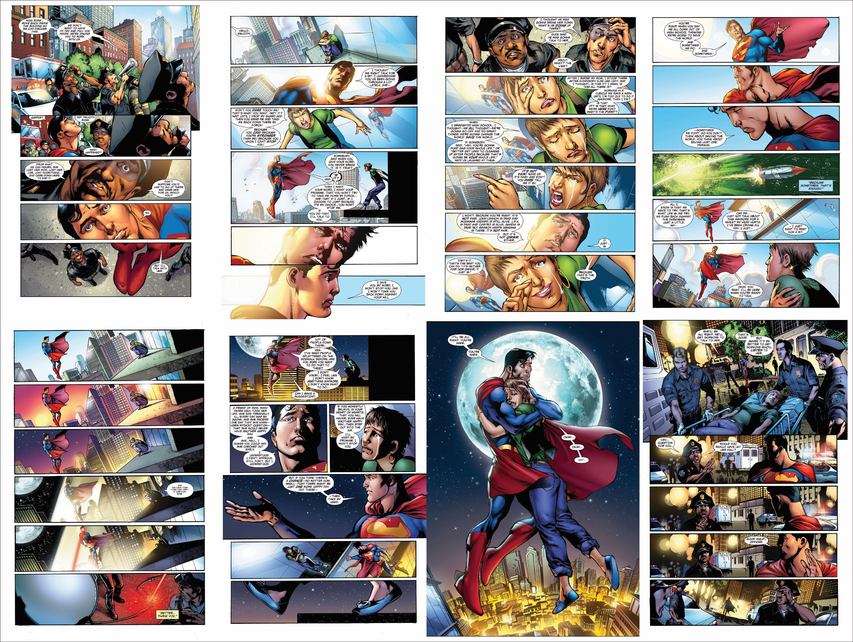
Notes:
Let’s take another look at a quick storyline. Superman finds himself questioning his role as a superhero, his place in the world, and his ability to make a meaningful difference. It is during this personal crisis that Superman encounters a young woman on the brink of suicide atop a skyscraper.
Superman's response to this desperate situation goes beyond physical heroics. Instead of simply swooping in to save the day, he chooses to engage in a heartfelt conversation with the woman, listening to her struggles and offering her hope. In this powerful moment, Superman's superhuman strength becomes secondary to his capacity for empathy and understanding.
"Grounded" showcases the importance of compassion, connection, and open dialogue when it comes to mental health. Superman's willingness to acknowledge the woman's pain, to genuinely listen, and to extend a helping hand exemplifies the support that individuals facing mental health challenges desperately need. Through this narrative, readers are reminded of the profound impact that even a simple act of compassion can have on someone's life.

Slide 11
Notes:
The beauty of these comic book storylines lies in their ability to inspire dialogue and raise awareness about mental health. Superman's struggles with Doomsday and his encounter with the suicidal woman resonate with readers because they reflect universal experiences and emotions. They remind us that mental health issues affect people from all walks of life, regardless of their extraordinary or mundane circumstances.
Beyond the pages of comic books, we must also recognize the role of mental health professionals in our communities. Superheroes like Superman may be able to offer hope and inspiration, but they are not substitutes for trained professionals who can provide the necessary guidance and support for those in need. We must actively encourage individuals to seek professional help when facing mental health challenges and ensure that access to mental health services is readily available and affordable for all.

Slide 12
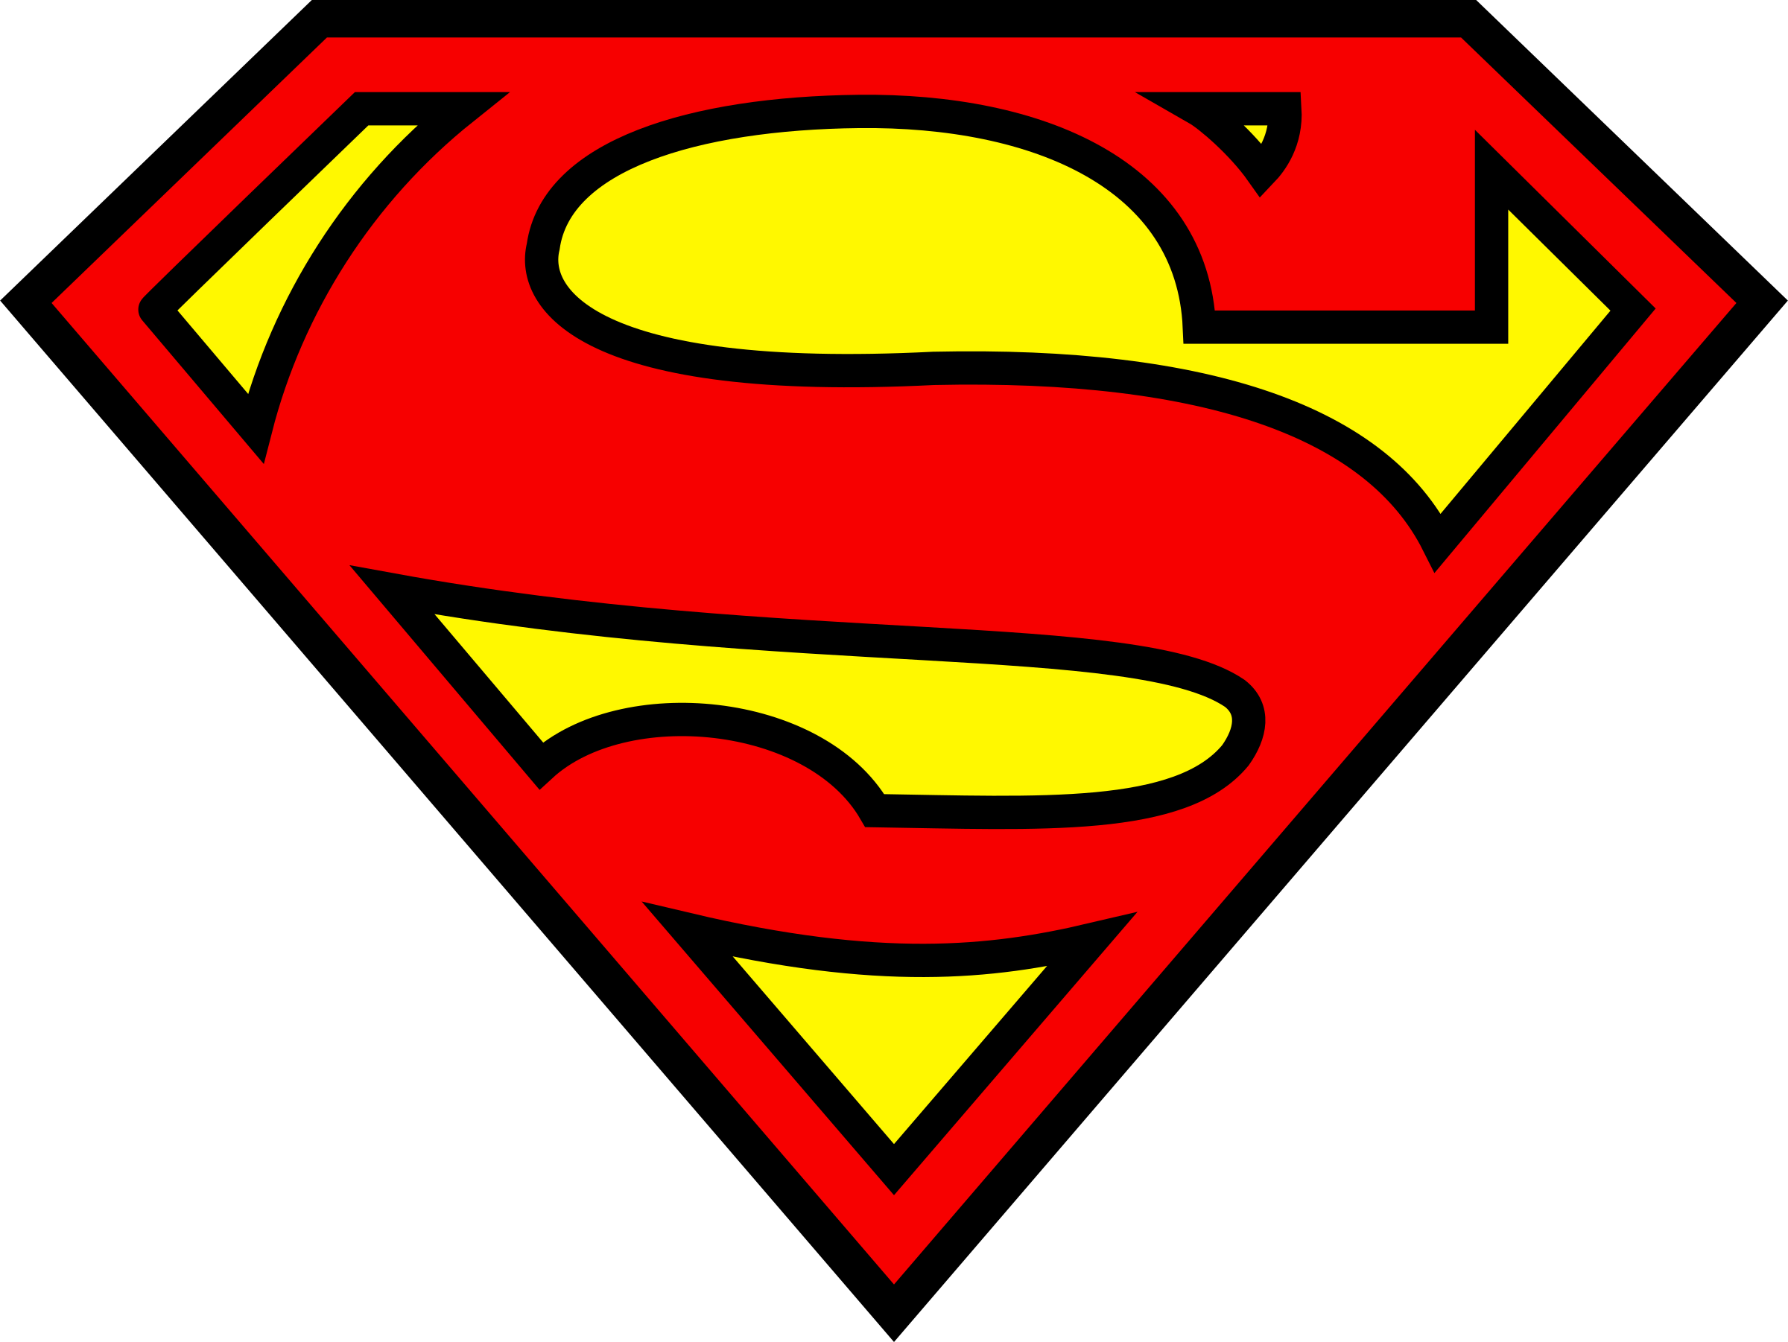
Notes:
In addition to professional support, it is vital that we build a network of social support for individuals struggling with mental health issues. Just as Superman finds solace in his relationships with friends, family, and the Justice League, we too can create a network of support and understanding in our own lives and for others. By fostering a community that encourages open dialogue, compassion, and acceptance, we can help individuals feel less isolated and more empowered to seek the help they need.

Slide 13
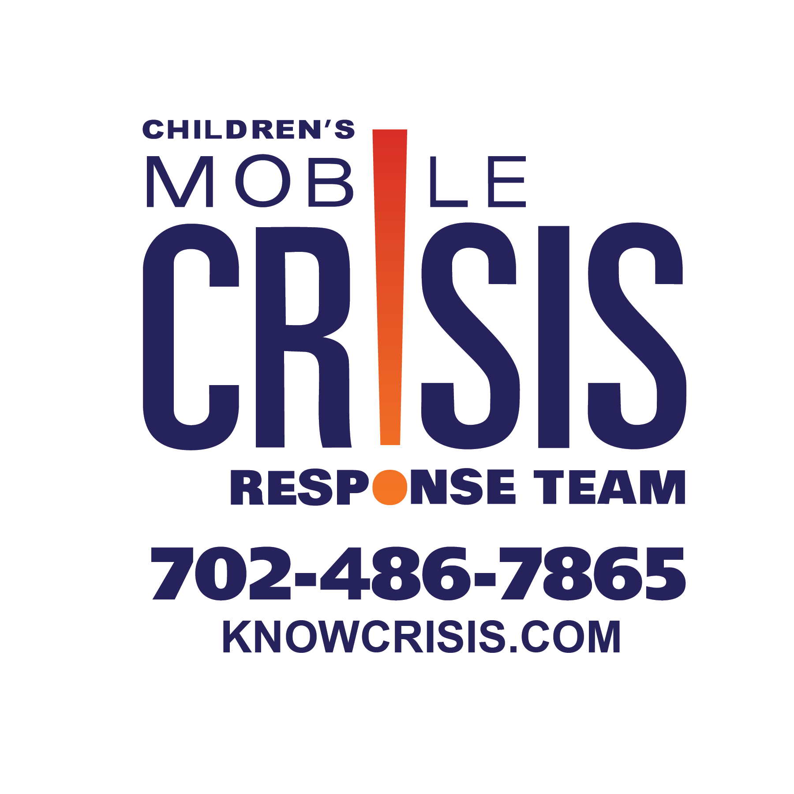
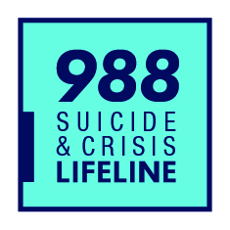
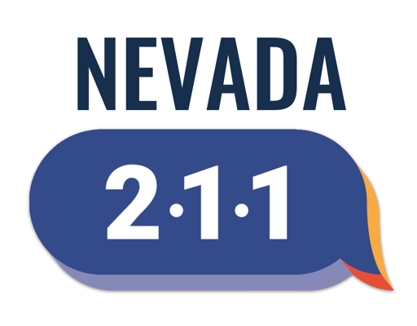
Resources
Notes:
To wrap this all up, the world of comic books, with its iconic characters and captivating narratives, provides a unique platform for exploring the complex terrain of mental health. The Doomsday storyline and the "Grounded" arc within the Superman mythos serve as powerful examples of how these stories can address mental health issues with depth, empathy, and authenticity.
Through Superman's struggles, we are reminded that even the strongest among us can face moments of doubt, fear, and uncertainty. These narratives encourage us to confront our own mental health challenges, seek support, and foster a culture of understanding and compassion.
Let’s harness the power of comic books, not just for entertainment or escape, but as a means to raise awareness, break down stigma, and promote conversations about mental health. Together, we can build a community that values and prioritizes mental well-being, creating a world where everyone can find the strength and support they need to soar to new heights, just like our beloved Man of Steel.

Slide 14
References
Jurgens, Dan. “Superman/Doomsday: Hunter/Prey #2.”
Straczynski, J. Michael. “Superman: Grounded Vol. 1”
Breeding, Brett. “Superman #75 Black
Jurgens, Dan. (1993). The Death of Superman.
Delhove, M., & Greitemeyer, T. (2021). Violent media use and aggression: Two longitudinal network studies. Journal of Social Psychology, 161(6), 697–713. https://doi.org/10.1080/00224545.2021.1896465
Huesmann LR. The impact of electronic media violence: scientific theory and research. J Adolesc Health. 2007 Dec;41(6 Suppl 1):S6-13. doi: 10.1016/j.jadohealth.2007.09.005. PMID: 18047947; PMCID: PMC2704015.

