Slide 1

LIVE
SMOKE
AND
VAPE-FREE
Get the Facts on Vaping

Slide 2
OVERVIEW
  Fact vs. Fiction
  Health Impacts
  E-Cigarette Use Disparities
  Flavoring
  Cannabis
  Nicotine Pouches
  Frequently Asked Questions
  Benefits of Quitting
  Teen Cessation Resources

Slide 3
FACT
vs.
FICTION
The aerosol from
e-cigarettes consists of primarily water.

Slide 4
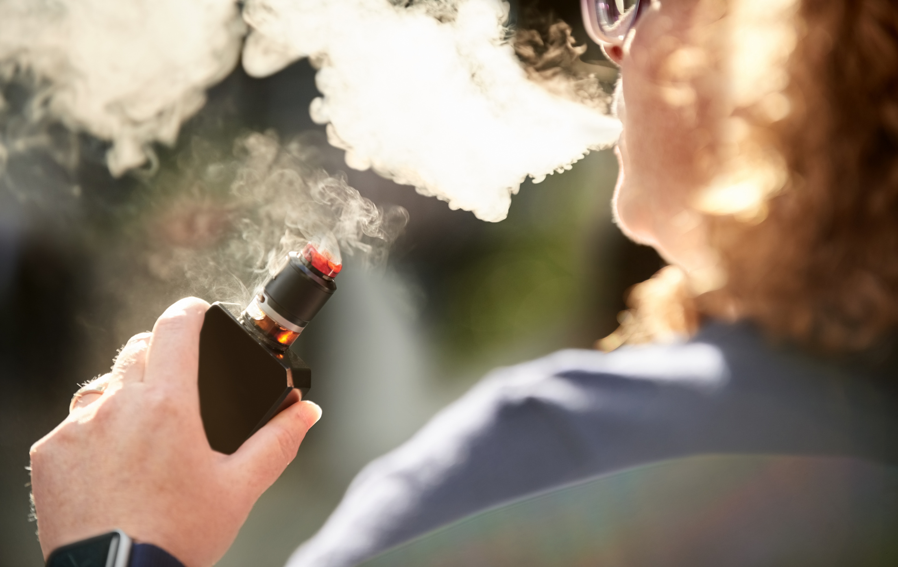
FICTION
The aerosol from e-cigarettes consists of primarily water.
  Source: Office on Smoking and Health, National Center for Chronic Disease Prevention & Health Promotion
FACT: The aerosol contains nicotine, cancer-causing chemicals, heavy metals, volatile organic compounds and flavorings.
Source: Office on Smoking and Health, National Center for Chronic Disease Prevention & Health Promotion

Slide 5
FACT
vs.
FICTION
Vaping is healthy and harmless.

Slide 6

FICTION
Vaping is healthy and harmless.
  Source: Office on Smoking and Health, National Center for Chronic Disease Prevention & Health Promotion
FACT: Vaping can harm both your physical and mental health. Vaping can increase levels of anxiety and depression. Vaping can damage your brain development as your brain doesn’t stop developing until your mid-20s.
Source: Office on Smoking and Health, National Center for Chronic Disease Prevention & Health Promotion

Slide 7
FACT
vs.
FICTION
All tobacco products including e-cigarettes contain nicotine.

Slide 8
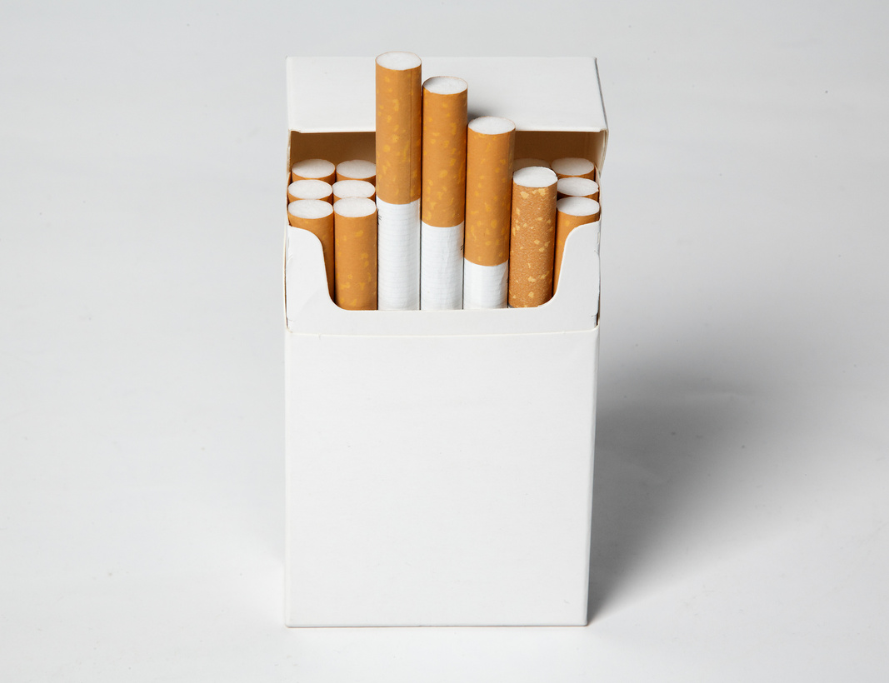

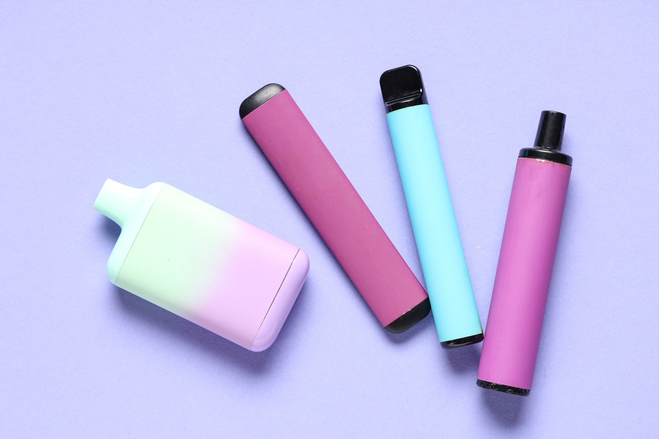
FACT
All tobacco products including e-cigarettes contain nicotine.
Nicotine is the addictive chemical found in all tobacco products including e-cigarettes. Nicotine can harm a teen’s brain development as our brains don’t stop growing until our mid-20s. Even tobacco products products that are advertised as containing 0% nicotine have been found to contain nicotine in them.
Source: Office on Smoking and Health, National Center for Chronic Disease Prevention & Health Promotion

Slide 9
FACT
vs.
FICTION
Flavored vapes do not attract teens to use them.

Slide 10
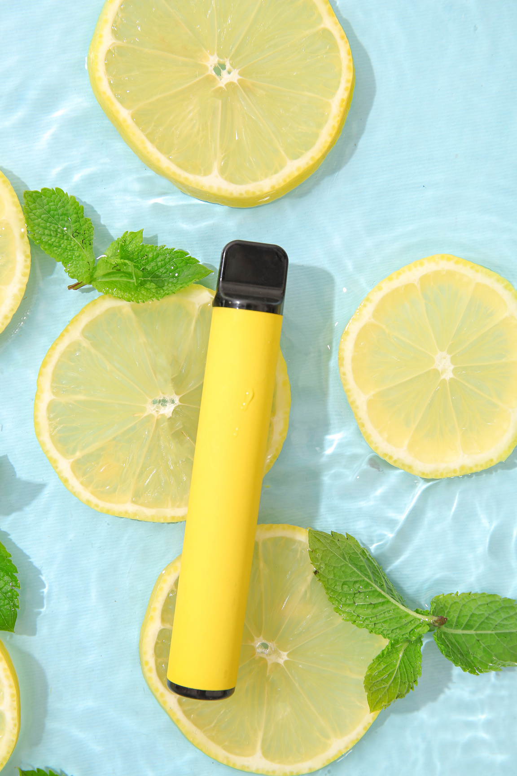


FICTION
Flavored vapes do not attract teens to use them.
  Source: Office on Smoking and Health, National Center for Chronic Disease Prevention & Health Promotion
FACT: According to the National Youth Tobacco Survey, flavored vapes is one of the top 10 reasons teens try vaping. The flavoring helps to hide the taste of tobacco from the vapes.
Source: Office on Smoking and Health, National Center for Chronic Disease Prevention & Health Promotion, National Youth Tobacco Survey

Slide 11
FACT
vs.
FICTION
More than 85% of teens who currently use e-cigarettes or nicotine pouches report using flavored products.

Slide 12



FACT
More than 85% of teens who currently use e-cigarettes or nicotine pouches report using flavored products.
Most teens who use vapes start with a flavored version. The most popular flavors are mint, candy and fruit.
Source: Office on Smoking and Health, National Center for Chronic Disease Prevention & Health Promotion

Slide 13
FACT
vs.
FICTION
I can buy cigarettes or vapes once I turn 18 years old.

Slide 14

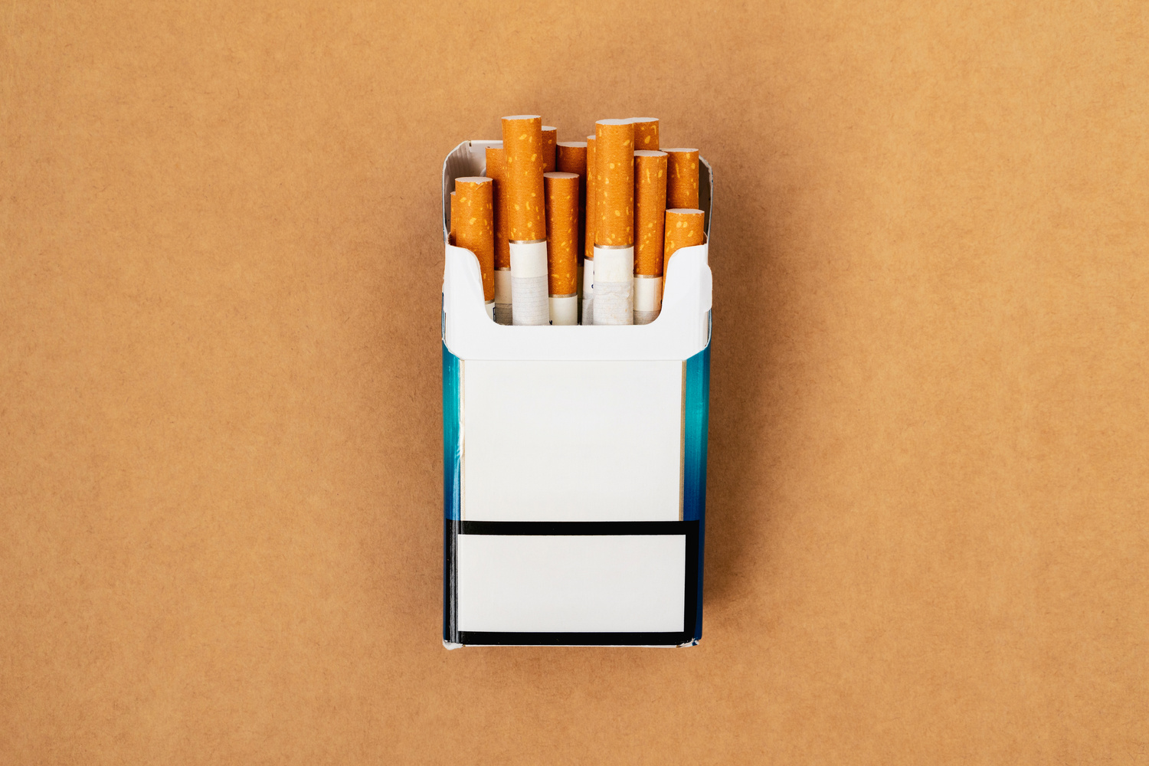
FICTION
I can buy cigarettes or vapes once I turn 18 years old.
  Source: Office on Smoking and Health, National Center for Chronic Disease Prevention & Health Promotion
FACT: The legal sales age for all tobacco products, including vapes, is 21 years old, nationwide and in Nevada. In Nevada, clerks have to ask & verify IDs for anyone under 40.

Slide 15
FACT
vs.
FICTION
Teens who vape cannabis don’t have negative health effects.

Slide 16
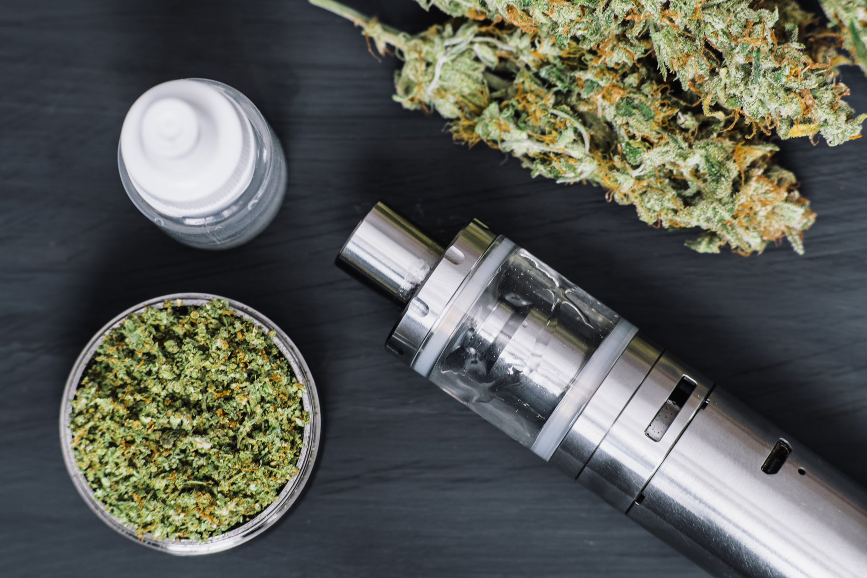
FICTION
Teens who vape cannabis don’t have negative health effects.
  Source: Office on Smoking and Health, National Center for Chronic Disease Prevention & Health Promotion
FACT: Vaping cannabis can cause harm to a teen’s physical and mental health. It can increase the risk of depression and social anxiety. It can cause difficulty maintaining attention, memory problems and problems at school or in their social life.
Source: CDC National Center for Injury Prevention & Control

Slide 17
FACT
vs.
FICTION
Teens who use e-cigarettes don’t get them from people they know.

Slide 18

FICTION
Teens who use e-cigarettes don’t get them from people they know.
  Source: Office on Smoking and Health, National Center for Chronic Disease Prevention & Health Promotion
FACT: In 2021, U.S. middle and high school students e-cigarettes reported the following:
  32.3% got vapes from a friend.
  28.7% got the vapes bought for them by someone they know.
  21.7% had someone they know offer them a vape.
Source: Office on Smoking and Health, National Center for Chronic Disease Prevention & Health Promotion, National Youth Tobacco Survey

Slide 19
FACT
vs.
FICTION
Nicotine addiction has a lot of signs including developing a tolerance for nicotine.

Slide 20
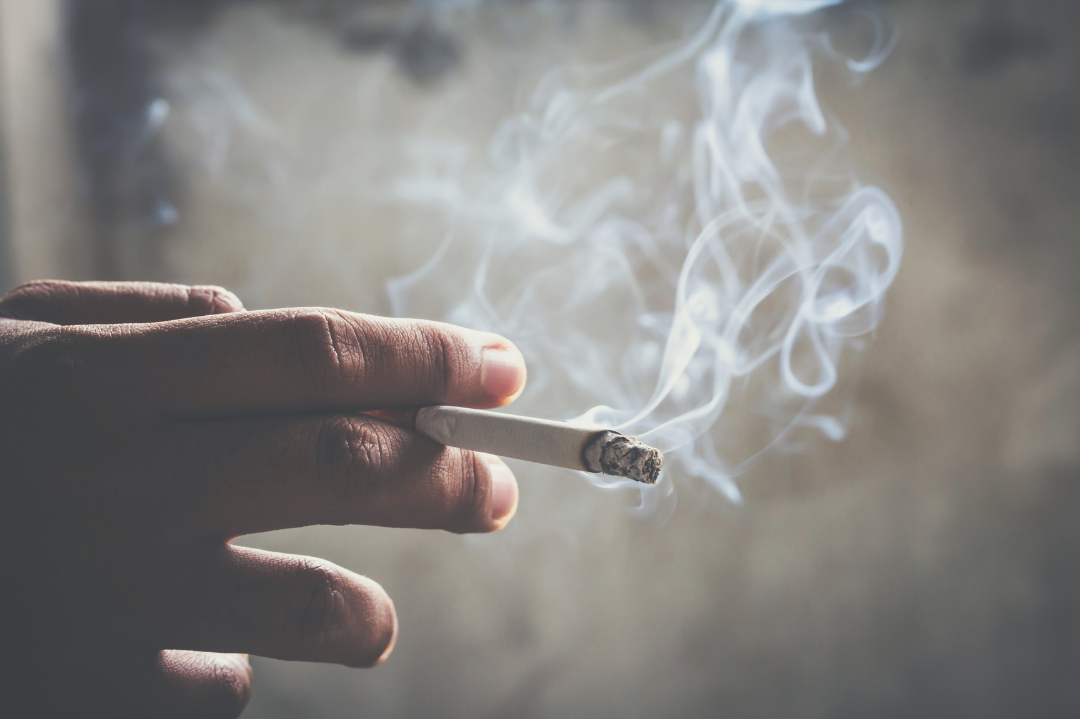
FACT
Nicotine addiction has a lot of signs including developing a tolerance for nicotine.
The signs of nicotine addiction in a person who uses any type of tobacco product include craving nicotine, being unable to stop using tobacco and developing a tolerance (the need to use more of the tobacco product to feel the same).
Source: Office on Smoking and Health, National Center for Chronic Disease Prevention & Health Promotion

Slide 21
FACT
vs.
FICTION
Nicotine pouches are the second most used tobacco product after e-cigarettes among middle and high school students.

Slide 22
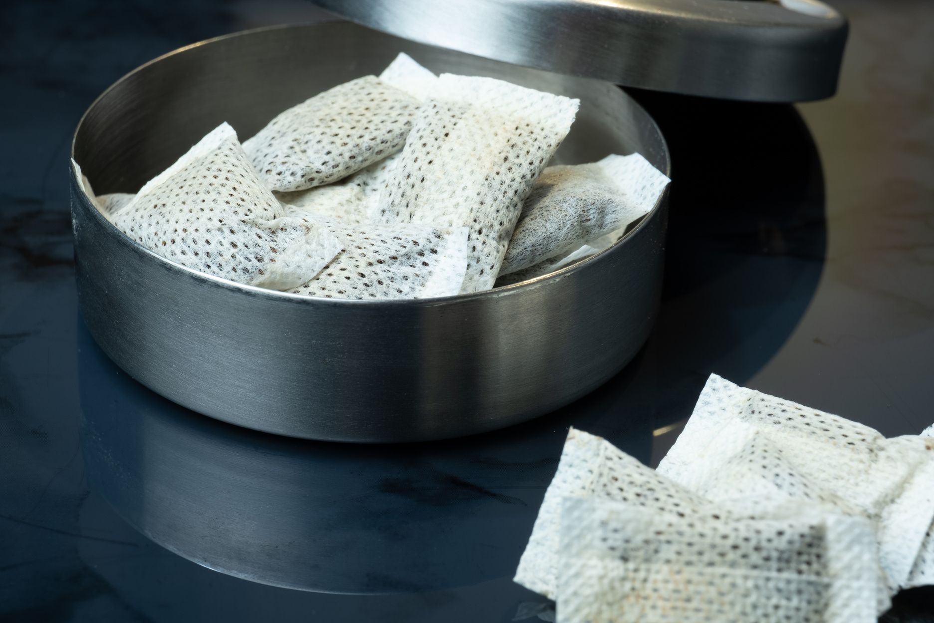
FACT
Nicotine pouches are the second most used tobacco product after e-cigarettes among middle and high school students.
Current nicotine pouch use among 10th & 12th graders doubled from 1.3% in 2023 to 2.6% in 2024. Nicotine pouch brands such as Zyn, On! and Velo are the most popular brands among teens.
Source: Truth Initiative

Slide 23
HEALTH IMPACTS
  E-cigarettes often contain harmful substances, including:
    Nicotine
    Flavoring such as diacetyl, a chemical linked to serious lung disease
    Cancer-causing chemicals
    Heavy metals such as nickel, tin, and lead
  Nicotine, a highly addictive chemical, can harm adolescent brain development, which continues into the early to mid-20s. It can affect the areas of attention, learning, mood and impulse control.
  Teens who use tobacco products are more likely to become chronic smokers, leading to nicotine addiction.
  Smoking at a young age increases the risk of heart disease, stroke, cancers, and early death.
Source: American Lung Association, Office on Smoking and Health, National Center for Chronic Disease Prevention & Health Promotion

Slide 24
E-CIGARETTE USE DISPARITIES
  In Nevada, tobacco use rates are higher among LGBTQ+ youth:
    43.5% of high school students who identify as LGBQ+ reported ever using electronic vapor products (vs. Heterosexual students (30.6%)).
    45.1% of high school students who identify as TQ (Transgender) reported ever using electronic vapor products (vs. Cisgender students (33%)).
  In Nevada, electronic vapor product current use rates are highest among American Indian/Alaska Native high school students (24.7%).
  In Clark County, electronic vapor product current use rates are highest among American Indian/Alaska Native middle school students (13.6%).
  In Clark County, Hispanic/Latino middle school students had the highest reporting rate of ever using electronic vapor products: 19.8%
Source: 2023 Nevada High School & Middle School Youth Risk Behavior State Reports

Slide 25
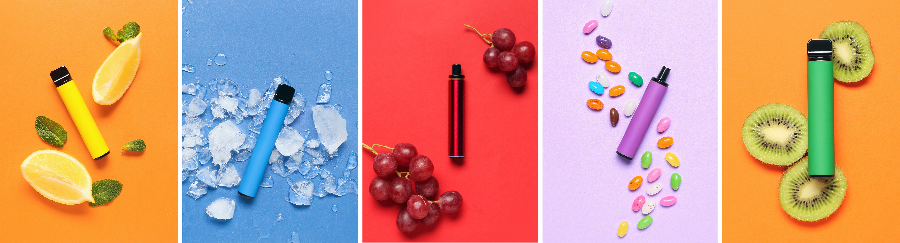
FLAVORING
  Masks the harshness of tobacco, making smoking more tolerable to new users.
  Entices youth and is one of the top reasons why youth report every trying an e-cigarette.
  Bright colorful packaging, sweetened flavors, and fun names attract youth.
  More than 85% of youth who currently use e-cigarettes or nicotine pouches report using flavored products.
  Most Popular Flavors:
    Fruit
    Candy, Desserts or Other Sweets
    Mint
Source: American Lung Association, Office on Smoking and Health, National Center for Chronic Disease Prevention & Health Promotion

Slide 26
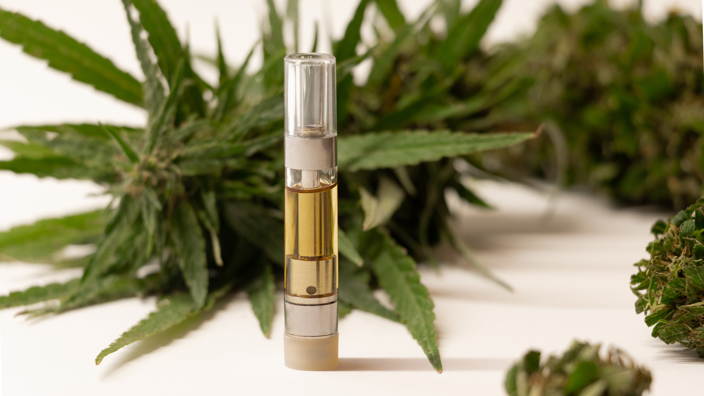
CANNABIS
  Vaping cannabis is not safer than smoking it.
  Vaping cannabis can cause bloodshot eyes, dry mouth and thirst, increased appetite, and shifts in behavior or mood.
  Products like vaporized concentrated waxes and oils may contain more THC.
  Vaping cannabis or nicotine can expose users to EVALI (E-Cigarette or Vaping Product-Use Associated Lung Injury), harmful cancer-causing chemicals, and marijuana poisoning.
Source: National Center for Injury Prevention and Control, CDC

Slide 27
NICOTINE POUCHES
A pouch filled with a powder made of nicotine, flavorings and other ingredients. The powder dissolves in the mouth and nicotine is absorbed through a person’s gums or mouth lining.
  480,000 (1.8%) of students nationwide reported current use of nicotine pouches
  More than 2 in 10 (22.4%) youth nicotine pouch users report using them daily
  More than 8 in 10 (85.6%) of current youth nicotine pouch users used flavored nicotine pouches
  Most popular flavors: Mint, Fruit
Source: 2024 NYTS, Office on Smoking and Health, National Center for Chronic Disease Prevention & Health Promotion

Slide 28
FREQUENTLY ASKED QUESTIONS
Do all electronic vapor products contain nicotine?
  Nearly all do – and those that don't have nicotine still have harmful chemicals in them.
  Many marketed as nicotine-free still contain nicotine.
Is vaping healthier than smoking cigarettes?
  The long-term health effects of electronic vapor products are still unknown.
  The FDA has not found any electronic vapor products to be safe and effective to help people quit smoking.
Source: Office on Smoking and Health, National Center for Chronic Disease Prevention & Health Promotion

Slide 29

BENEFITS OF QUITTING
  Lowers levels of anxiety, depression, and stress.
  Improves health and enhances quality of life.
  Reduces risk of adverse health effects, such as lung illness and brain damage.
  Reduces the financial burden for smokers.
Protects family members, friends, coworkers and others from the health risks associated with secondhand smoke!
Source: National Center for Chronic Disease Prevention & Health Promotion, Office on Smoking and Health

Slide 30



TEEN CESSATION RESOURCES
American Lung Association’s NOT Program
A voluntary program for teens who want to quit smoking or vaping. Approximately 90% of teens who participate quit tobacco.
  Website: notforme.org
Truth Initiative’s EX Program
A voluntary program for teens who want to quit smoking or vaping. It has been proven to increase the odds of quitting by up to 40%.
  Website: join.exprogram.com

Slide 31


Thank you!
For more information on how to live
smoke-and-vape-free, visit:
gethealthyclarkcounty.org

