Slide 1

Aquatic Health Plan Review Industry Outreach Meeting September 10, 2025

Slide 2
Agenda
Faster plan reviews
SOFA updates
Pump and skimmer updates
Future meeting topics

Slide 3

Faster Plan Reviews

Slide 4

What are the problems?
Long review times
Longer wait times for all new projects
Projects stacking up
Not enough time to get through reviews
Too much time spent on reinspections

Slide 5
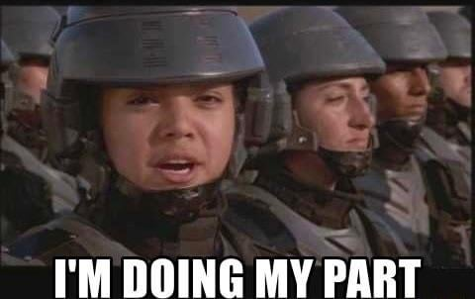
What can we do?
Free up time, and you can help!

Slide 6

With more time, we can…
Get through reviews efficiently
Start projects sooner
Schedule inspections without delay
Approve inspections faster

Slide 7
Strategies for Submission: New Construction
Complete submissions
Make sure all ownership/application documents are submitted for processing – projects aren’t assigned without this information
No missing plans, specs, hydraulics, etc. – reviews don’t start until we have this information

Slide 8
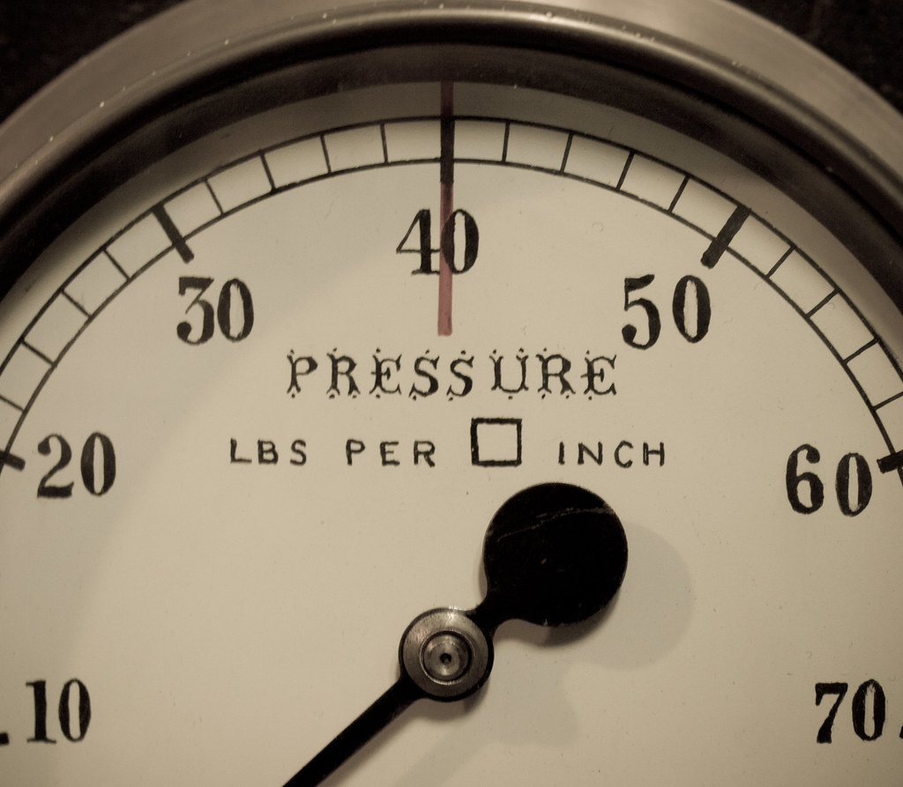
Strategies for Submission: New Construction – Hydraulics
Make sure published head loss matches the loss on the hydraulics
Be sure to convert units – psi or Hg to ft of head
This Photo by Unknown Author is licensed under CC BY

Slide 9

Strategies for Submission: New Construction – Equipment
Include the complete model number, not part number
For SOFAs, pay attention to flow rates for plumbing configuration and VGBA 2017 certification
Pipe size and plumbing configuration changes flow rating

Slide 10
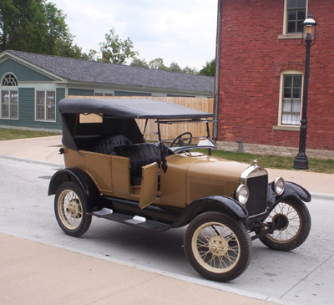
Strategies for Submission: New Construction – Equipment
Don’t list equipment that does not exist
VGB 2008 SOFAs are no longer manufactured
Pentair Intellibrite 5G is no longer manufactured
This Photo by Unknown Author is licensed under CC BY-SA

Slide 11

Strategies for Submission: New Construction – Revisions
The faster the turnaround, the faster the review

Slide 12
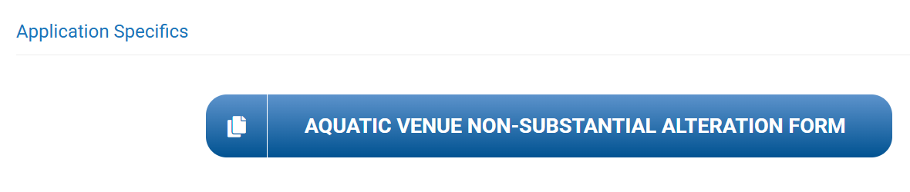
Strategies for Submission: Remodels
Use the current remodel application from our website

Slide 13
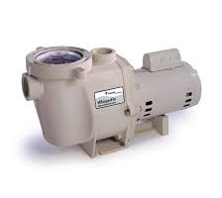
Strategies for Submission: Remodels – SOFAs
SOFA pipe size must match plumbing in the ground
Include the correct flow rating for the plumbing configuration
The flow of the pump cannot exceed the SOFA flow rating

Slide 14

Inspections
If we need to check plumbing, the venue needs to be drained
If we need to calculate flow, the venue needs to be full

Slide 15

Inspections
Call for an inspection when you are ready to pass
Give adequate lead time with all inspection requests
Be realistic when planning project submissions and construction timelines
This Photo by Unknown Author is licensed under CC BY-SA

Slide 16

Together, we can accomplish greatness!
Reduced review times
Fewer failed inspections
Faster project approval

Slide 17
Updates
SOFAs, skimmers, pumps

Slide 18
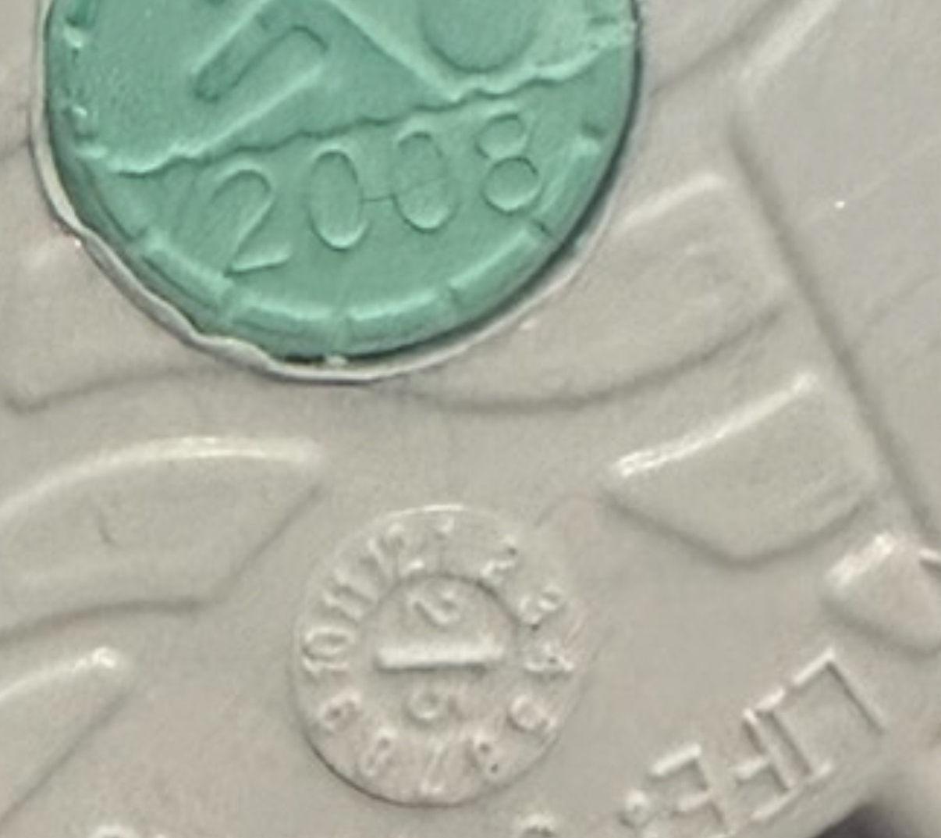
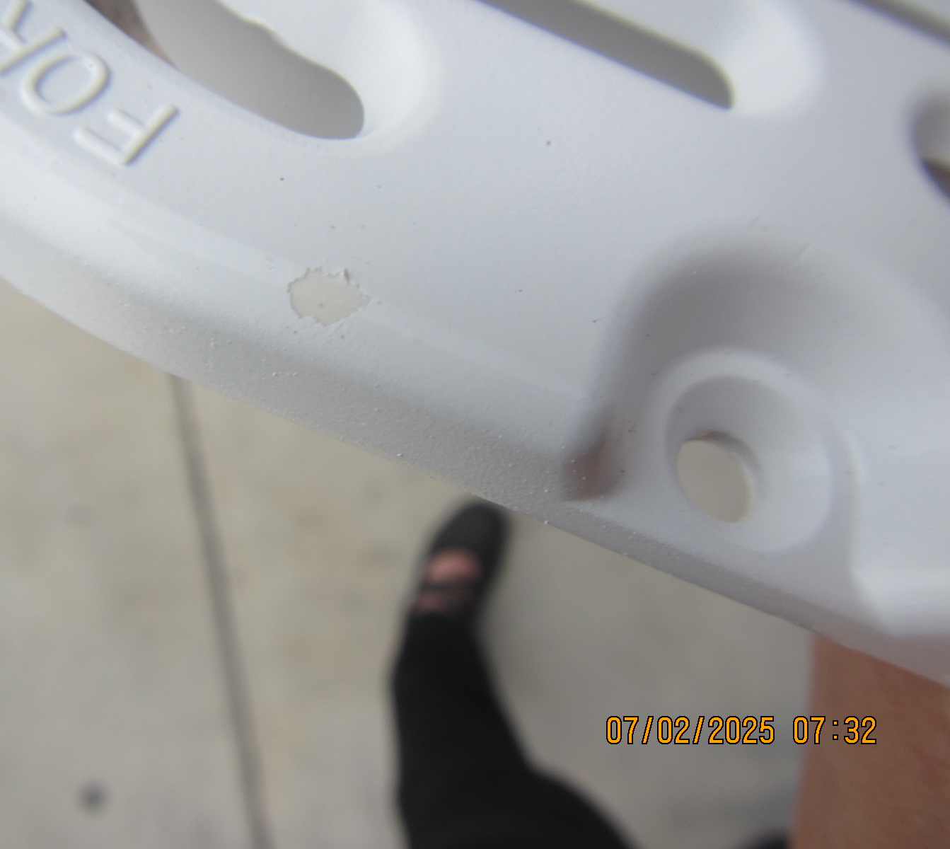
“Fake” SOFAs

Slide 19
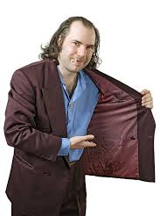
2008 vs. 2017 SOFAs
2008 stock is dwindling
Misrepresented products sold online
Only purchase from reputable distributors
Avoid purchasing from third parties or secondary markets

Slide 20

2008 SOFA replacements
Beginning Jan 1, 2026, we will no longer accept new VGB 2008 installs
Applies to all remodels and replacements
*Any 2008 installs through December must be verified in brand new condition

Slide 21
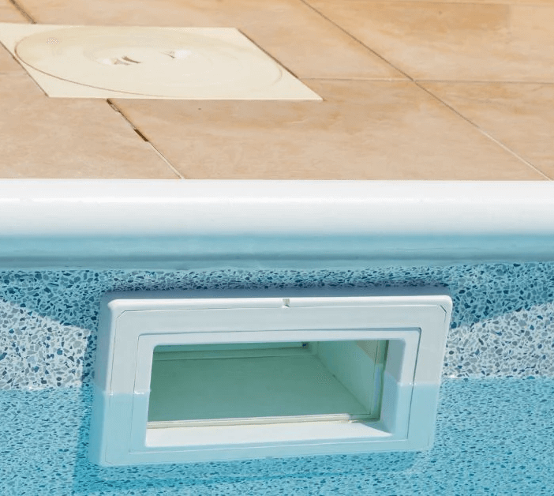
Skimmers
No like-for-like
Remodel is always required

Slide 22
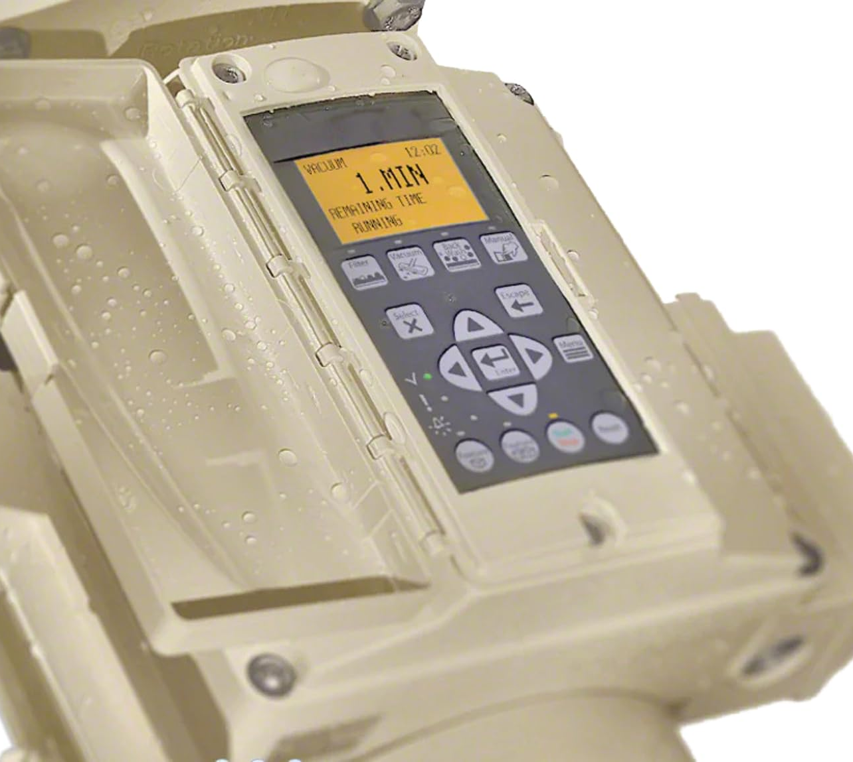
Pump Displays
Must be provided on-site for all new installs
Can be installed on the pump, installed externally, or dedicated display at the property

Slide 23
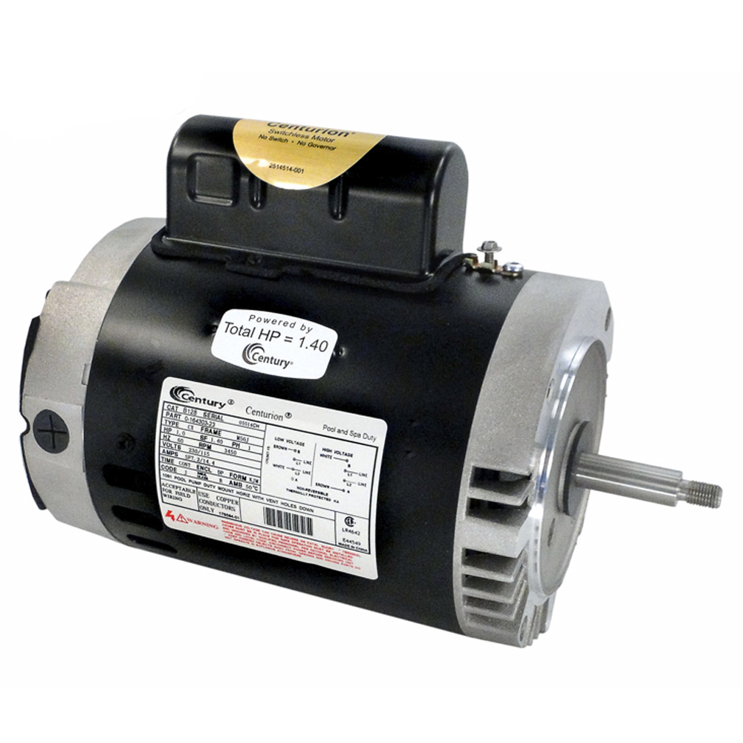
DOE Motor Rule
Most single-speed motors we see will no longer be manufactured
Effective at the end of September

Slide 24

Future Meetings
What topics do you want to see?

Slide 25
Thank you!
SNHD Aquatic Health Plan Review
aquatic@snhd.org
www.snhd.info/aio

