Slide 1
AHP Industry Meeting
October 29, 2024

Slide 2
Topics of discussion
Water Chemistry Study
Self Reporting Incidents
Permits & Billing –Dates to Remember
Facility Name/address Change vs Change of Permit Holder
Submitting a Successful Waiver Application
SOFA’s (Drain Covers)

Slide 3
Water Chemistry Study
January – June 2024

Slide 4
Cyanuric Acid- risks and concerns
High levels may negatively affect health by irritating the eyes, skin, and respiratory system. It can also damage the liver or gastrointestinal track (Chen et al., 2024).
When cyanuric acid is repeatedly added it can cause a lack of available chlorine.
Excess levels reduce chlorine activity increasing the risk of waterborne illness because of inadequate elimination of viruses, bacteria, and other pathogens (Chen et al., 2024)

Slide 5
Cyanuric Acid & Automation
Count of PR | High Level of Cyanuric?
Automated Feed Equipment (Y/N) | Y | N | Grand Total
Y | 10 | 829 | 839
N | 92 | 1124 | 1216
Grand Total | 102 | 1953 | 2055
5% of the 2,055 inspection report samples showed high CYA (>100ppm).
1% of facilities with automated feed equipment had high levels of CYA (>100ppm).
8% of facilities without automated feed equipment had high levels of CYA (>100ppm)

Slide 6
Cyanuric Acid
Count of PR |  | High Level of Cyanuric?
Management Closed (Y/N) | Automated Feed Equipment (Y/N) | Y | N | Grand Total
N | N | 31 | 531 | 562
 | Y | 2 | 561 | 563
N Total |  | 33 | 1092 | 1125
Y | N | 61 | 593 | 654
 | Y | 8 | 268 | 276
Y Total |  | 69 | 861 | 930
Grand Total |  | 102 | 1953 | 2055
High CYA levels were observed in 6% of non-management closed facilities without automation, compared to 0% of non-management closed facilities with automation.
Facilities without automation were 15x more likely to have closures by SNHD due to high CYA levels than those with automation.

Slide 7
Chlorine- risks and concerns
High concentrations of chlorine in the water can cause high concentrations of chlorine in the air above the pool creating different routes of chemical exposure (Couto et al., 2021).
High chlorine levels can cause respiratory symptoms and irritation of the eyes.
Low chlorine concentration levels increase bathers' risks for infection to bacteria like E. coli, Hepatitis A, Giardia, and Cryptosporidium (CDC, 2024).

Slide 8
Chlorine & Automation
26% of inspections without automated feed equipment had chlorine out of range.
18% of inspections with automated feed equipment had chlorine out of range.
23% of all inspections showed chlorine out of range.
Count of PR | Cl/Br was IN or OUT
Automated Feed Equipment (Y/N) | IN | OUT | Grand Total
N | 894 | 322 | 1216
Y | 688 | 151 | 839
Grand Total | 1582 | 473 | 2055

Slide 9
Chlorine
18% of facilities that were not management closed, without automation had chlorine out of range (Ref. 3-503.1) compared with 10% of those not management closed with automation.
Facilities without automation were 1.8x more likely to have closures by SNHD due to chlorine levels out of range than those with automation.
Count of PR |  | Cl/Br was IN or OUT
Management Closed (Y/N) | Automated Feed Equipment (Y/N) | IN | OUT | Grand Total
N | N | 459 | 103 | 562
 | Y | 505 | 58 | 563
N Total |  | 964 | 161 | 1125
Y | N | 435 | 219 | 654
 | Y | 183 | 93 | 276
Y Total |  | 618 | 312 | 930
Grand Total |  | 1582 | 473 | 2055

Slide 10
Conclusion
A higher percentage of facilities without automation are closed by SNHD due to high cyanuric acid and out of range chlorine levels than facilities with automation.
Facilities with automation are more likely to have lower levels of cyanuric acid and chlorine levels in range, than those without automation.
There is an increased risk of harm to bathers due to high cyanuric acid and chlorine levels out of range in facilities that do not use automation.
It is important to maintain proper water chemistry levels to ensure quick and effective inactivation of pathogens associated with recreational water and best to prevent adverse reactions in bathers.
Facilities that use automation have fewer closures by SNHD due to improper water chemistry.

Slide 11
References
Centers for Disease Control and Prevention. (2024). Home pool and hot tub water treatment and testing. https://www.cdc.gov/healthy-swimming/about/home-pool-and-hot-tub-water-treatment-and-testing.html
Chen, Z., Su, Y., Chen, J., Li, Z., & Wang, T. (2024). Study on the health risk of cyanuric acid in swimming pool water and its prevention and control measures. Front Public Health, 11, 1294842. doi: 10.3389/fpubh.2023.1294842
Couto, M., Bernard, A., Delgado, L., Drobnic, F., Kurowski, M., Moreira, A., Rodrigues-Alves, R., Rukhadze, M., Seys, S., Wiszniewska, M., & Quirce, S. (2021). Health effects of exposure to chlorination by-products in swimming pools. Allergy, 76(11), 3257–3275. https://doi.org/10.1111/all.15014

Slide 12
Self-Reporting Incidents
Self-reporting of incidents is required per SNHD 2018 Aquatic Facility Regulations
•5-402.4 Immediately notify the Health Authority if a drowning, near drowning, or water rescue event occurs.
Who do I notify?
•Your assigned inspector and/or
•Aquatic Health Program at aquatic@snhd.org or (702) 759-0572

Slide 13
Important Dates QR code to opt in
Billing Timeframes
May 28th- Invoices generated
June 1st - Invoices mailed out
June 1st to July 31st- Payment due
Late fees
Aug 1st- Late fees added
50% late fee
Opt in for electronic invoice
Notes:
Talk about printing health permits and the website location after making payment.

Slide 14
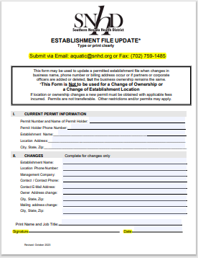
Establishment Forms
Aquatic Establishment Update Form
Property Managers Responsibility
Late Fees Will Not Be Waived Due To Neglect
Notes:
This form may be used to update a permitted establishment file when changes in business name, phone number or billing address occur or if partners or corporate officers are added or deleted, but the business ownership remains the same.
Discuss failure to pay and closure process. (5 days to pay or closed)

Slide 15
Change of Permit Holder Time Frames
30 days to execute change of permit holder documents to avoid penalty.
Deed, Close of escrow, lease agreement, legal contract, etc.
Plan Review conducts Change of Permit Holder inspection
Operations will conduct annual inspection within 90 days.

Slide 16
Successful Waiver Application
IGNACIO LEYCEGUI

Slide 17
WHAT IS A WAIVER?
A written agreement between SNHD and the permit holder that authorizes a modification of one or more regulatory requirements and has no impact on the health and safety of patrons.
Notes:
A waiver may be granted by modifying or waiving the requirements of the Aquatic Facility Regulations if public health and safety will not be impacted because of the approved waiver.

Slide 18
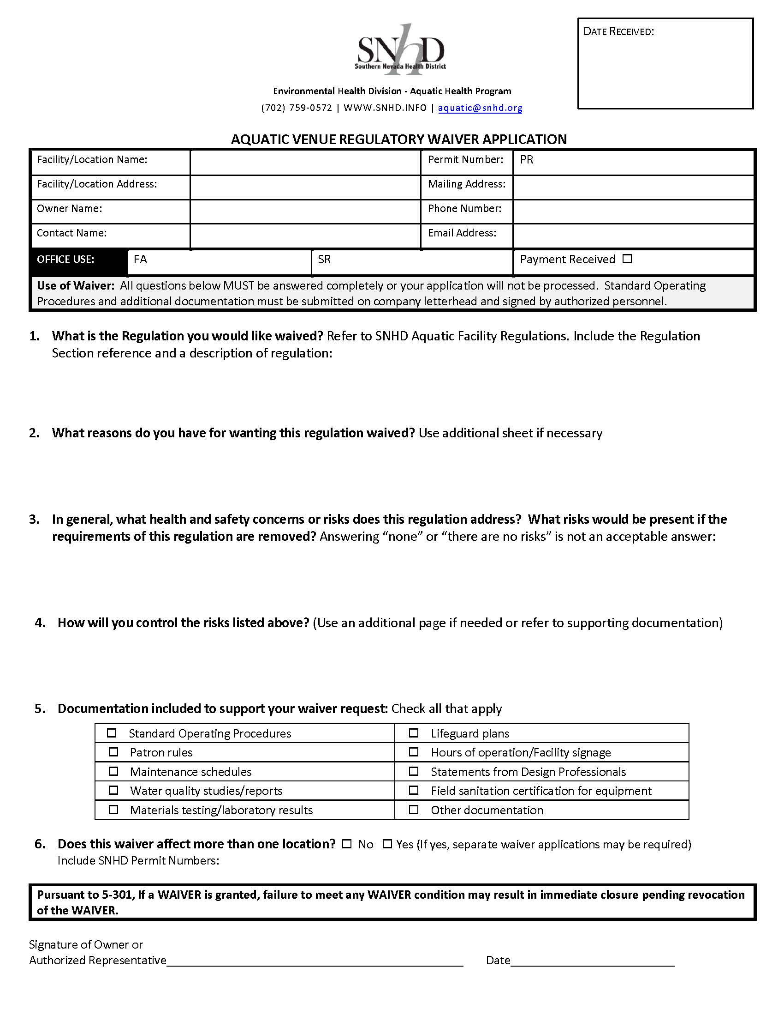
WHERE CAN I FIND THE APPLICATION?
Waiver application form
https://www.southernnevadahealthdistrict.org/permits-and-regulations/aquatic-health-program/waivers/
Notes:
This form may be used to update a permitted establishment file when changes in business name, phone number or billing address occur or if partners or corporate officers are added or deleted, but the business ownership remains the same.

Slide 19
QUESTION 1: WHAT IS THE REGULATION YOU WANT WAVIED?
Include the Regulation Section reference and a description of regulation.
Include specific subsection of the regulation you wish to be waived if applicable.
Notes:
Refer to SNHD Aquatic Facility Regulations.
Be as specific as possible
Multiple regulation waiver requests may require separate applications for each regulation unless they are related.

Slide 20
QUESTION 2: WHAT REASONS DO YOU HAVE FOR WANTING THIS REGULATION WAIVED?
Provide a reasonable reason as justification for the waiver request.
Remember: A waiver may be granted by modifying or waiving the requirements of the Aquatic Facility Regulations if public health and safety will not be impacted as a result of the approved waiver.
Notes:
Bad examples: I don't agree with the regulation or I don't need to comply.
Good examples: Cost could be a reason. High occupancy. Signage referring to children. Built prior to Regulations.

Slide 21
QUESTION 3: TWO PARTS IN GENERAL, WHAT HEALTH & SAFETY CONCERNS OR RISKS DOES THIS REGULATION ADDRESS? WHAT RISKS WOULD BE PRESENT IF THE REQUIREMENTS OF THIS REGULATION ARE REMOVED?
Think risk management! What risk is the regulation designed to prevent or minimize?
The risk can be minimal, or it can be extreme leading to injury or death.
Answering “none” or “there are no risks” is not an acceptable answer and may lead to denial of the waiver application.
Notes:
It’s ok to include an extreme risk because once you recognize the risk you can identify ways to minimize or possibly eliminate it which leads into question 4. Extreme risk won't jeopardize approval.

Slide 22
QUESTION 4: HOW WILL YOU CONTROL THE RISKS LISTED ABOVE?
Be very specific & provide justification why the waiver should be approved.
Go above and beyond what regulation requires to minimize the increased risk of waiving the regulation.
Notes:
Examples:
If proposing alternate equipment or alternate system to reduce risk, include make and model numbers if applicable.
If proposing implementing a procedure or policy to reduce risk, outline the procedure or policy as much as possible. (High occupancy)

Slide 23
SECTION 5: WAIVER SUPPORT DOCUMENTATION
Notes:
If documentation doesn't fit, check boxes for applicable supporting documentation. Include supporting documentation with waiver application.

Slide 24
QUESTION 6: DOES THIS WAIVER AFFECT MORE THAN ONE LOCATION?
MULTIPLE AQUATIC VENUES
YES
AFFECTS ALL PERMITS
NO
AFFECTS ONLY ONE PERMIT
Notes:
If there are multiple aquatic venues at your facility you wish the waiver to apply to, then check yes and list the permit numbers for those aquatic venues.
Separate waiver applications for each aquatic venue would not be required in this case.

Slide 25
WHERE TO SUBMIT APPLICATION?
Submit completed waiver application & supporting documents to aquatic@snhd.org
ADMIN STAFF will provide payment invoice.
Additional documentation may be requested during review.
If denied, a signed letter will be sent detailing reason for denial.
Upon approval, a letter will be sent detailing the conditions of the waiver for applicant signature.
Notes:
Review of the application will begin once payment is received.
A written response will be sent to the applicant detailing requirements. This is what delays waiver submissions. The back and forth.
If complications or miscommunication: Calls or in person meeting may be needed to address concerns
Wavier must be signed by SNHD management to be valid. Stress waiver application must be signed and dated to be received.

Slide 26
Suction outlet fitting assemblies (sofa)
Disclaimer: The following photos are for illustrative purposes only. The Southern Nevada Health District is not affiliated with and does not endorse the use of any product manufacturer.

Slide 27
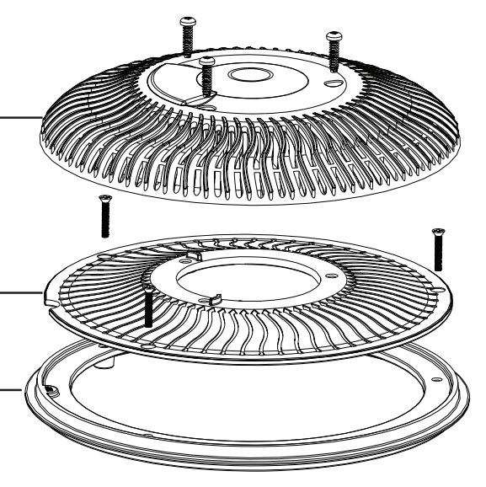
SOFA DEFINITION:
2017 ANSI/APSP-16:
Suction outlet fitting assembly (SOFA): All components, including the cover/grate, used to attach a cover/grate(s) to the finished surface of a pool and to an individual suction system.

Slide 28
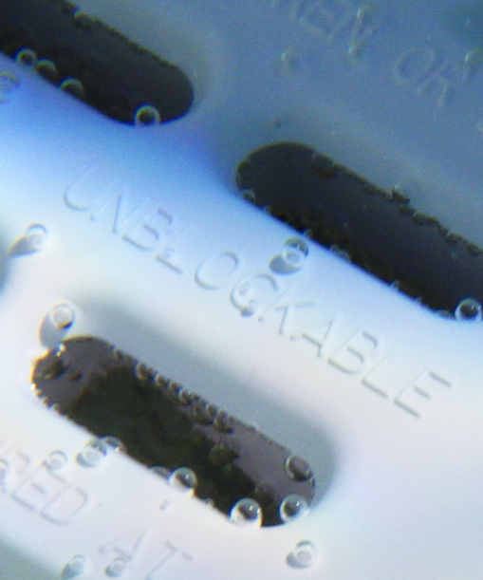
VGB 2008 vs VGBA 2017
What changed?
Updated testing procedures
Differences in maximum flow rating (often reduced)
Markings on the cover have changed
VGBA 2017
“Blockable” or “Unblockable”
Notes:
Federal requirement

Slide 29
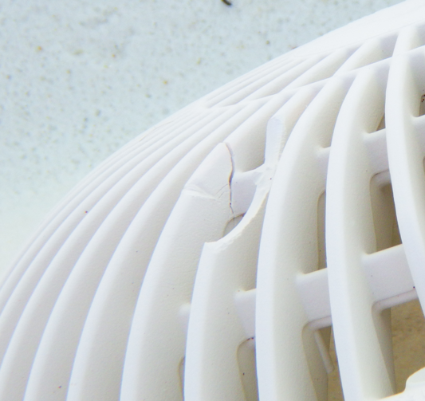
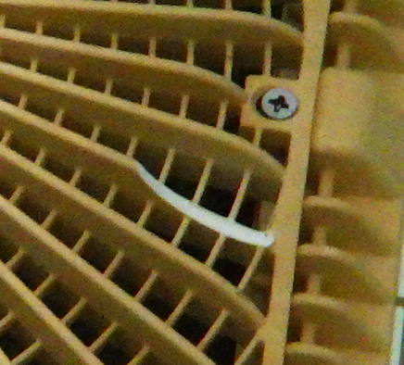
Nothing Lasts Forever

Slide 30
ANY SOFA change from VGB 2008 to VGBA 2017 requires an SNHD remodel application snhd.info/aquatic/non-substantial-alteration-remodel
Notes:
Discuss GOOD TIME TO MAKE CHANGES NOW before the next pool season. 2008 covers are not readily available and will delay operation.

Slide 31
But it’s the middle of summer….
Vgba 2017 sofas observed in an aquatic venue without an approved snhd remodel.
What do you do?
Non-compliance may lead to closure by OPERATIONS STAFF UNTIL APPROVED BY PLAN REVIEW STAFF
Notes:
will be required to either revert to the previously approved sofa (EXPLAIN THIS AND WHAT WE LOOKING FOR as this may no longer be an option)
or submit a remodel application, including any after-the-fact fees

Slide 32
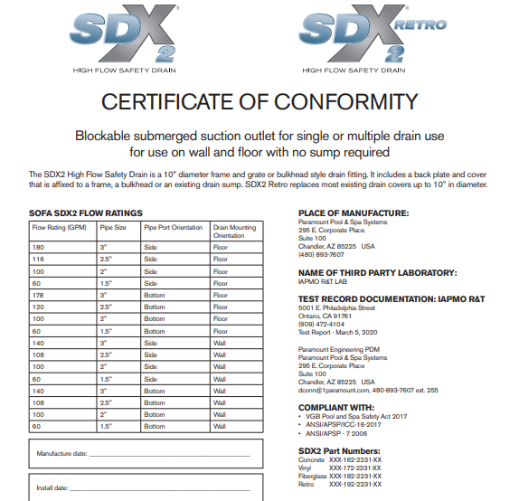
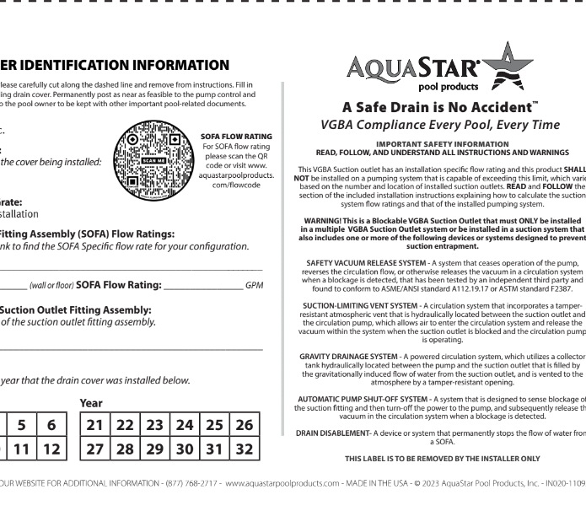
HOW CAN I TELL HOW OLD THE SOFA IS?
Most have a 5 – 7-year lifespan, after installation. SEE MANUAL
Must be kept on site and available upon inspector request
One per SOFA
Updated each time a new SOFA is installed
Notes:
Document will be required at all SNHD SOFA Remodel Final Inspections
, like-for-like

Slide 33
Questions?

