Slide 1
AHP INDUSTRY MEETING
Candice Stirling
Linda Nguyen
Alicia Mitchell
Ignacio Leycegui

Slide 2
Agenda
Proper technique for water quality testing
Qualified operator and company registration
Most common closures
Lifeguard plan requirements
Discussion, topic requests
Question and Answer

Slide 3
Proper Technique for Water Quality Testing
Notes:
We are currently using Taylor test kit with DPD powder. We are not advertising, promoting, and/or selling Taylor products. The goal for the next few slides is for us clarify some fine details in water testing techniques.

Slide 4
Good Techniques
Location
Rinse
Collect
Read
Test
*Follow your instruction manual
Notes:
In the next few slides, I will be talking about where is the best location to get your water sample, when to rinse your plastics, how to collect your sample, how to add your reagent, and how to read your sample. I will not be talking about specific steps on testing since that can be found in your test kit manual.

Slide 5
Location
Away from return inlets and skimmers
Between the shallow and deep end
Notes:
Best location to collect sample is away from return inlets and skimmers; relatively away from the pump room where the pool starts to slope towards the deep end. If there is no depth change, then the position is not important so look for that you are not near any returns or skimmers.
We will talk more on skimmers later..

Slide 6
Rinse
2. Rinse the tubes, caps, and sample collection bottles before and after use
Notes:
Rinse clean. I typically rinse 3 times. Avoid dirty tubes to give inaccurate results.

Slide 7
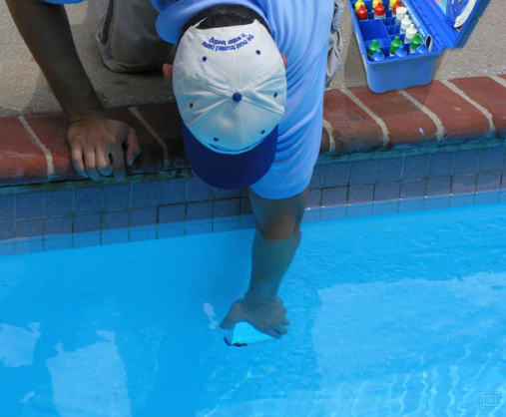
Collect
3. Collect sample when the water surface is at your elbow
Notes:
Why? For outdoor pools, UV light is at the surface. Other chemical contaminants are located within 18 inches of water surface. During studies water is typically collected within 12 inches of the water surface, so the best practice is to collect below 12 inches, so up to the elbow. I’m 5’2 and the natural shortest length from holding bottle to elbow is about 12.5 inches.
-MAHC Annex 5.7.4.3 Bulk Water Sample
Photo from Pool and Spa Magazine

Slide 8
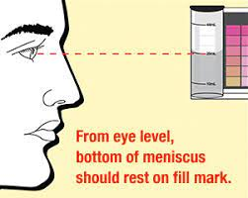
Read
At eye level
At the bottom of the meniscus
Notes:
Bring up or down to eye level to read volume.
The low point of the curve rest on the fill mark is the right volume. Correct sample volume to make sure accurate result.

Slide 9
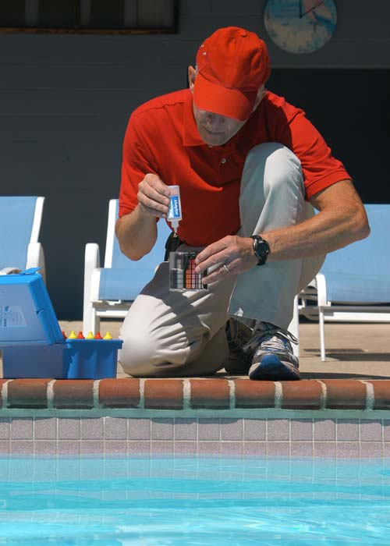
Test
4. Hold the reagent bottle completely vertical
Notes:
Each reagent is created to have a number of analyte per drop of reagent, so uniform drops are important. In order to have a uniform-size drop you have to have the bottle completely inverted when testing. Pay attention, if drop size gets progressively smaller, wipe the tip with a clean towel and retest.

Slide 10
Operator and Company Registration
AFR 4-101

Slide 11
What is a Qualified Operator (QO)?
“QUALIFIED OPERATOR”
means an individual,
with an active HEALTH AUTHORITY registration, responsible for the operation and maintenance of
the water systems and the associated infrastructure of the AQUATIC FACILITY.

Slide 12
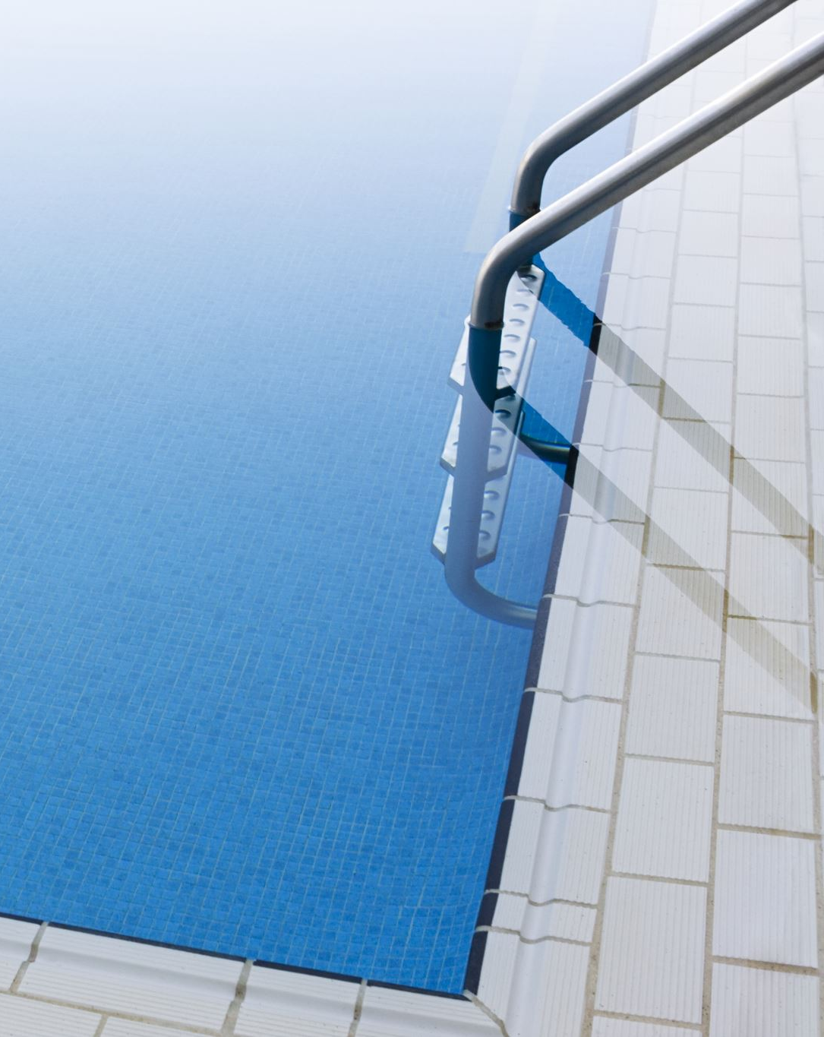
Should you register?
If you, or your company,
service an aquatic venue
that is permitted by the SNHD
you MUST register
before providing service.

Slide 13
Not registered but already providing service?
Certified but not registered?
Violation and compliance schedule to register, then closed if schedule isn’t met.
Not even certified?
Immediate closure with fees.

Slide 14
How to register (individual):
Get a nationally recognized operator certification.
Download a Qualified Operator Application from our website and fill it out.
Send the completed application and a copy of your certification to aquatic@snhd.org.

Slide 15
How to register (company):
Get a nationally recognized operator certification and ensure all employees servicing permitted venues are certified.
Download a Pool Company Registration application from our website and fill it out.
Send the completed application and list of employee certifications to aquatic@snhd.org.

Slide 16
Expiration and Renewal
Company registrations are good for 2 years.
Individual registrations expire when your national certification expires.
There is no reminder to renew, so track your expiration date. Additional fees will be assessed for renewals that are more than 30 days beyond their expiration. Email aquatic@snhd.org to renew.

Slide 17
Most common IHHs leading to closure:
Water Chemistry
Disinfection
pH
Cyanuric acid
Enclosure
Suction Outlet Covers
IMMINIENT HEALTH HAZARD (IHH)
Conditions observed indicating that a product, practice, circumstance, or event creates a situation that requires immediate correction or closure to prevent injury or illness
Notes:
Most common closures are a result of an IHH being present.

Slide 18
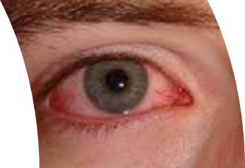
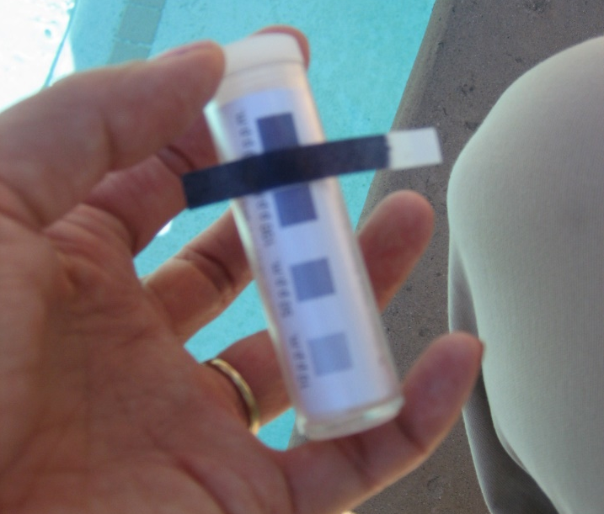
Disinfection
What is the IHH?
Concentration of disinfectant residual is too high or too low.
Chlorine:
Aquatic Venues w/o Cyanuric Acid: Maintain between 1.0 – 10.0 PPM
Aquatic Venues w/ Cyanuric Acid: Maintain between 2.0 – 10.0 PPM
Spas: Maintain between 3.0 – 10.0 PPM
Bromine:
Maintain between 3-8 PPM
Why?
Inadequate disinfectant residual promotes spread of pathogens
Excessive disinfectant residual is harmful to bathers

Slide 19
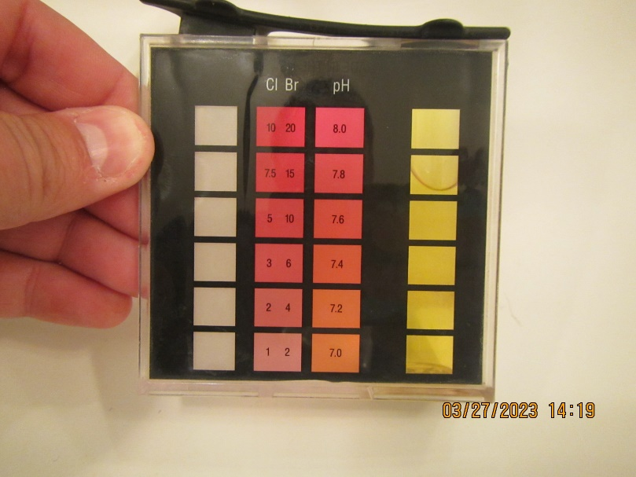
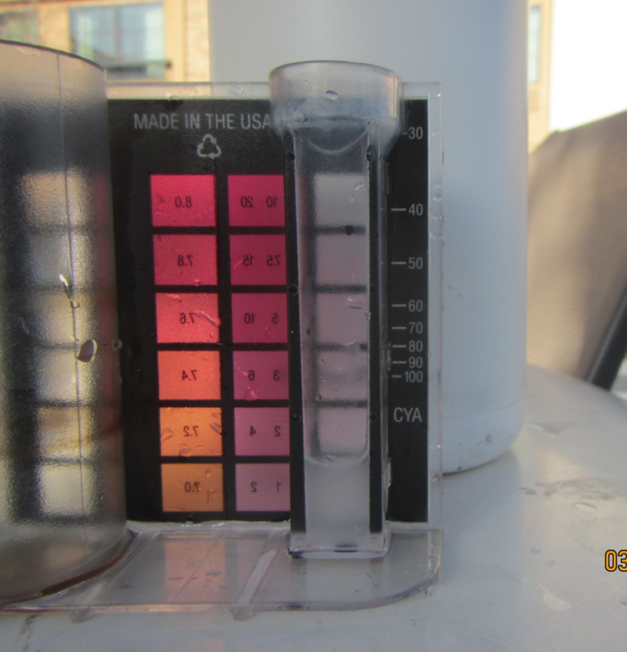
pH & Cyanuric Acid
Water Chemistry
What is the IHH?
pH less than 6.5 or more than 8
Maintain between 7.2 – 7.8
Cyanuric acid level at or above 100 ppm
Why?
pH outside of the proper range is harmful to bathers
pH outside of the proper range interferes with function of disinfectant residual
High cyanuric acid inhibits disinfectant residual effectiveness

Slide 20
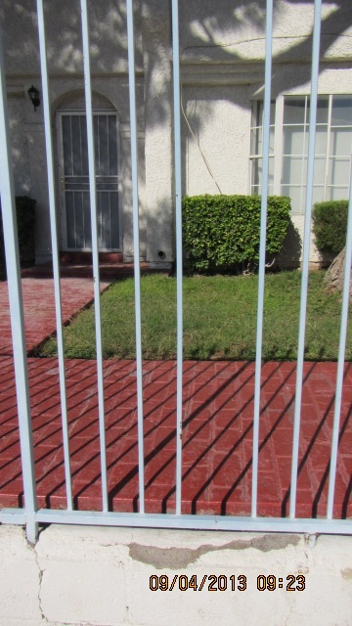
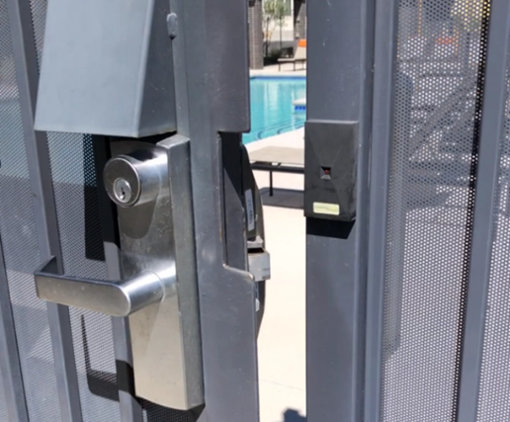
Gates & Doors
What is the IHH?
Gaps at base of barrier (from grade to the bottom of fence) and in-between any vertical posts of 7 inches or more
Gates/doors are not self-closing and self-latching from any given distance.
Why?
Uninhibited access to aquatic venue especially for children

Slide 21
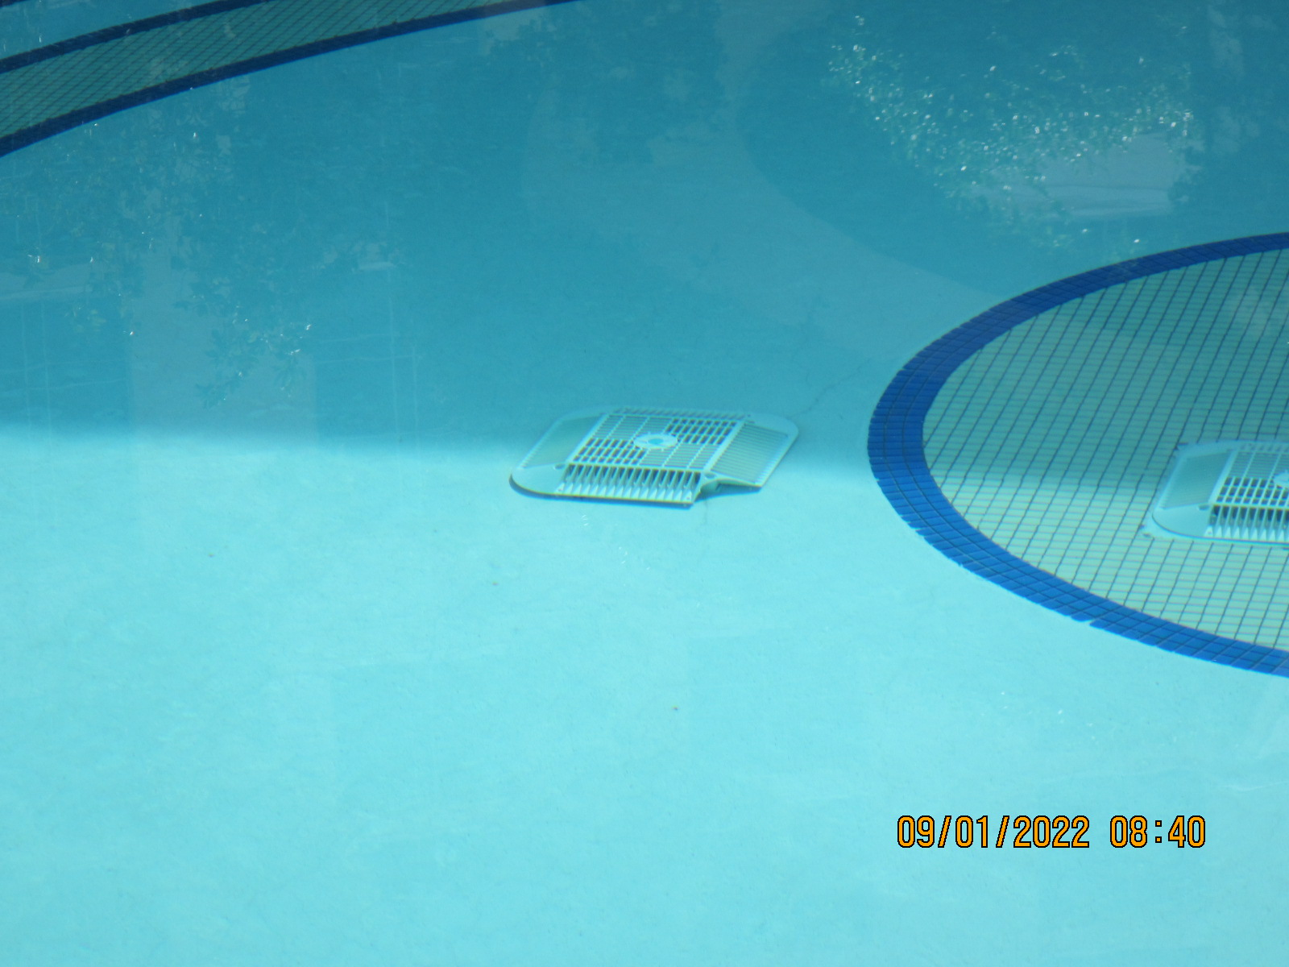
Drain Cover Hazard
What is the IHH?
Broken, unsecure, missing suction outlet covers
Why?
Suction entrapment hazard
Physical entanglement

Slide 22
Avoiding Common Closures
4-401.3 Safety and Maintenance Inspection and Recordkeeping (A) The QUALIFIED OPERATOR or RESPONSIBLE PERSON shall ensure a daily AQUATIC FACILITY preventive maintenance inspection is done before opening including but not limited to:
Enclosures and gates​
Suction outlet covers
Adequate water chemistry
Safety and Maintenance Inspection Checklist and AV Maintenance Logs can be found under Aquatic Health as well as other resources on SNHD website snhd.info.
If an IHH is observed at an aquatic venue, close the Aquatic Venue immediately then inform the Qualified Operator to correct IHH.

Slide 23
Creating Lifeguard Plans
Compliant with regulation

Slide 24
Section 1-3
List each venue name, permit number, square footage, & capacity
Provide hours of operation, operating season, & number of lifeguards
Provide diagram of each venue with lifeguard placement and zone.
Notes:
Permit number square footage and capacity can be found on inspections reports or check with your inspector
Be as specific as possible with hours and seasons. Know how many lifeguards will be on site.
If you have a rover please include in diagram roving zone. Blind spots must be addressed. How long does it take to get to the furthest part of each zone.

Slide 25
Section 4
Rotation schedule vs written rotation
Lifeguard responsibilities & Supervisor responsibilities
Rotation procedures
Notes:
Document what type of guard your using for each zone. Lifeguard Manual
Rotation schedule should communicate who is where when and how long lifeguarding lasts. Must match operating hours. If written out make sure it matches diagram and meets no more than 60 consecutive minutes.
What are lifeguards responsible for while on duty to ensure bather safety.
What are lifeguard supervisor responsibilities to ensure lifeguards are ensuring bather safety.
Rotation procedures communicates how lifeguards will maintain zone coverage while transitioning between stations and/or tasks. (THIS IS A COMMON VIOLATION OBSERVED AT INSPECTIONS)

Slide 26
Section 5
Safety equipment and location
Lifeguard qualification and location of certificates
Other requirements or information.
Notes:
List of all safety equipment associated with aquatic facility. Include first aid kit.
What qualifies lifeguards at your facility? Where are certifications located for both lifeguards and lg supervisors?
This could include EAP and/or security plan. SOP- How the facility operates during inadequate coverage, pool deck closures, slow season closures & special events.

Slide 27
Third Party Lifeguard Companies
Notes:
Can write lifeguard staffing plans (Required for those wanting less lifeguards than required by regulation.)
Can verify correct lifeguard chair placement
Provide lifeguards
Modified plans must get SNHD approval prior to implementation.

Slide 28
Industry Meeting Topic Discussion
What would you like to see and talk about?

Slide 29
Question & Answer

Slide 30
IF EVERYONE IS MOVING FORWARD TOGETHER, THEN SUCCESS TAKES CARE OF ITSELF
Henry Ford

Slide 31
THANK YOU
Alicia Mitchell mitchella@snhd.org
Ignacio Leycegui leycegui@snhd.org
Candice Stirling stirling@snhd.org
Linda Nguyen nguyen@snhd.org
www.Snhd.info aquatic@snhd.org

