Slide 1

Trust, Transparency, and Technology: Public Health and AI
Heather Anderson-Fintak, Esq.
General Counsel
Health District After Dark
June 18, 2026

Slide 2
Technology, AI, and Privacy at SNHD
Nevada law & HIPAA considerations
Governance, risk review, and project approval
Data minimization and de-identification
Security, incident response, and accountability

Slide 3
Nevada Law
Nevada's data security statute, NRS Chapter 603A, imposes independent obligations on governmental agencies that maintain personal information of Nevada residents.
NRS 603A.210(1): governmental agencies must implement and maintain reasonable security measures to protect personal information from unauthorized access, acquisition, destruction, use, modification, or disclosure.
NRS 603A.210(2): governmental agencies must, to the extent practicable, comply with the current version of the CIS Controls published by the Center for Internet Security or corresponding NIST standards.
Medical records are to be maintained as confidential. NRS 629.051
NRS 439.592 provides that electronic health records and health information exchanges that comply with NRS 439.581-439.595 are deemed to satisfy these confidentiality requirements.

Slide 4
Health Insurance Portability and Accountability Act of 1996 (HIPAA)
HIPAA Privacy Rule standardizes the use and the disclosure of individuals’ protected health information (PHI) by entities subject to the rule. These entities are called “covered entities.”
Responsibilities before data is shared
Business Associate Agreements

Slide 5
Governance and Oversight
Project intake and review process
Risk assessments and project charters
Legal, privacy, security, and operational review
Leadership accountability and ongoing monitoring

Slide 6
Data Protection and Security
Minimum Necessary Data Principle
Requires covered entities to take reasonable steps to limit the use or disclosure of, and requests for, protected health information to the minimum necessary to accomplish the intended purpose. 45 CFR § 164.503 (b)
De-identification standards
Rule of 5

Slide 7
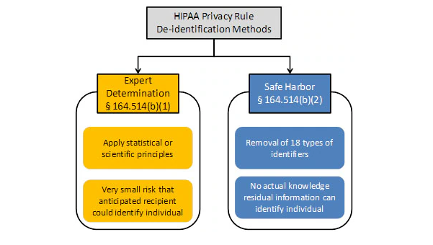
Data Protection Cont.

Slide 8
Researchers and Public Access
IRB review requirements
Data use agreements
Public records considerations under NRS 239
Balancing transparency with privacy

Slide 9
How AI Can Support Public Health
Outbreak detection and surveillance
Call center and chatbot support
Inspection and field documentation
Resource targeting and health communications
Translation and accessibility services

Slide 10
Benefits and Risks
Benefits: timeliness, capacity, consistency, multilingual support
Risks: bias, inaccuracies, privacy leakage, overreliance, vendor use
Need for validation and human oversight

Slide 11
Guardrails for Responsible Use
Required human review
Validation and testing
Escalation procedures
Documented limitations and accountability

Slide 12
Workforce Retention and Union Considerations
Job redesign and augmentation
Training and upskilling
Monitoring and due process
Bargaining obligations and change management

Slide 13
Risk-Tiered AI Use Cases
Low Risk: email drafting, translation, topic exploration
Moderate Risk: communications, policy support, grant drafting
High Risk: disease modeling, patient care support, research publications
Controls need to increase with risk

Slide 14

Questions?

