Slide 1
Vaccines, Coverage, and Outbreaks: The Story in Our Data
Benjamin J. Ashraf, PhD, MPH, CHES
SNHD Health District After Dark
1/29/26
Notes:
“Hello everyone, my name is Benjamin Ashraf, and I’m an epidemiologist with the Southern Nevada Health District.
For my portion of today’s presentation, I’ll focus on data related to select vaccine-preventable diseases, their associated vaccinations, and recent trends observed in our community.

Slide 2
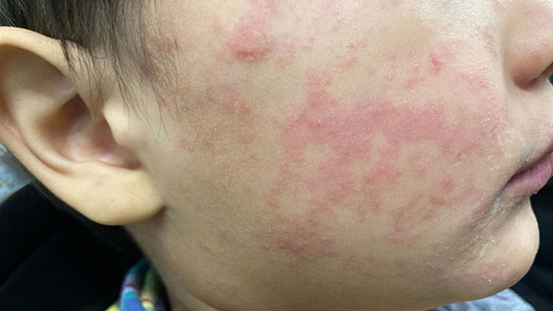
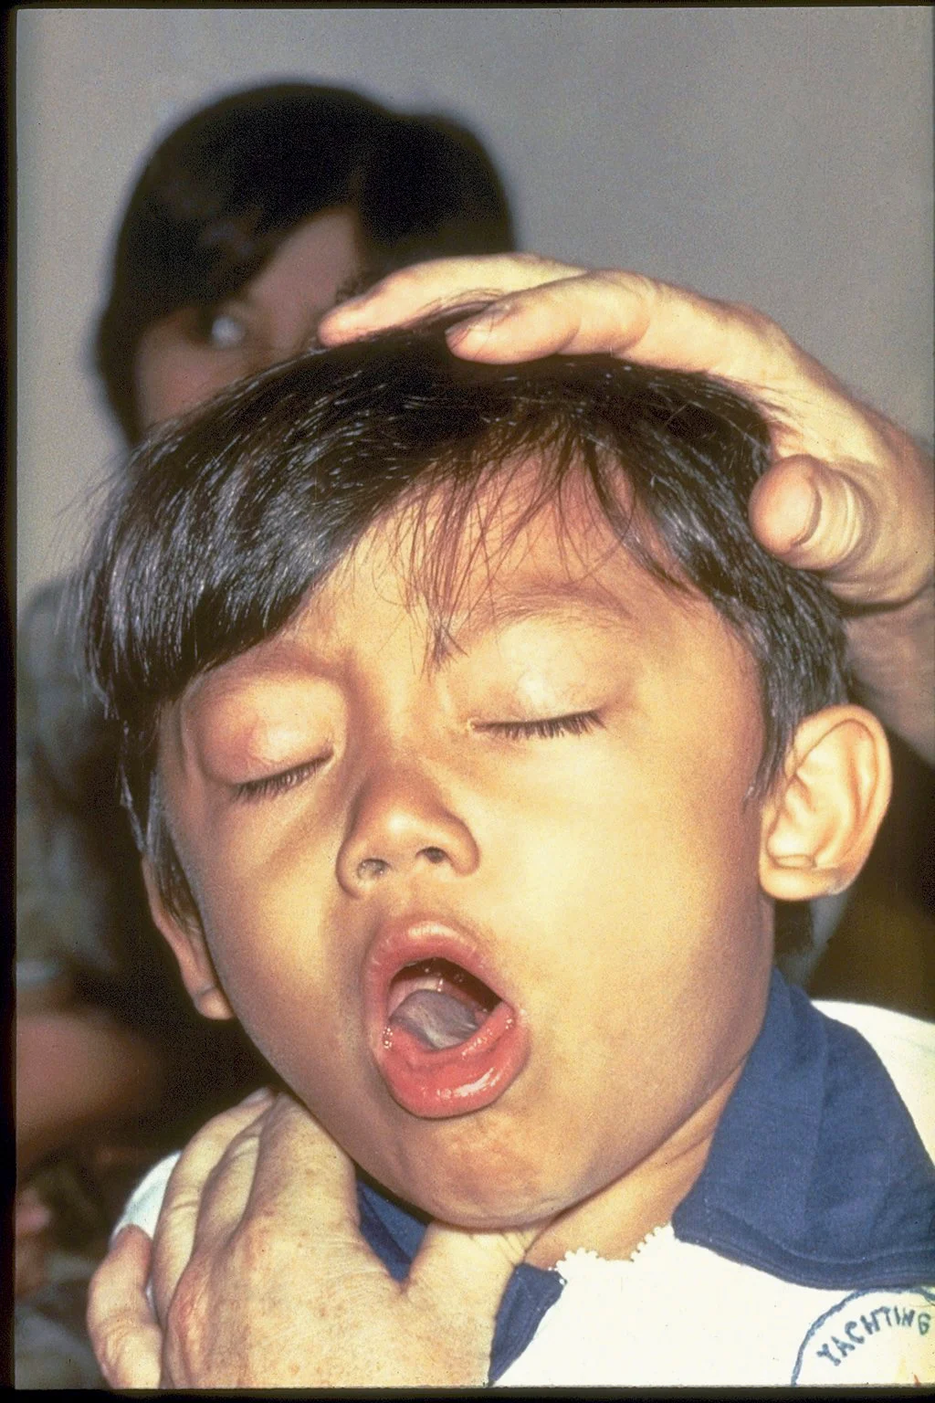

What will we be talking about today
We are going to focus on three vaccine preventable diseases
Measles, Pertussis, and Influenza
Source: CDC.GOV
Source: CDC.GOV
Source: Immunize.org
Notes:
“For today’s presentation, I’ll focus on three vaccine-preventable diseases: measles, pertussis, and influenza.
These three diseases were selected because they’ve each been in the news recently, with outbreaks or increases in hospitalizations reported across the country.
They also behave differently when vaccination coverage declines. Measles can re-emerge suddenly in explosive outbreaks, pertussis tends to surge every few years, and influenza returns seasonally.
Most importantly, these diseases aren’t abstract. They have real consequences in our communities, leading to hospitalizations, long-term health impacts, and in some cases, death.”

Slide 3
Measles in the United States
Indicator | 2026 (To date) | 2025 (Full Year) | 2024 (Full Year)
Total Cases | 171 | 2,242 | 285
Hospitalized Cases | 2 (1%) | 254 (11%) | 114 (40%)
Deaths | 0 | 3 | 0
Vaccination Status: Unvaccinated or Unknown | 95% | 93% | 89%
Adapted from CDC.GOV, Date of Access 01/20/26
Notes:
Now I want to begin with measles, which has been in the news over the last year.
“This slide summarizes the measles burden in the United States over the past few years, including total reported cases, hospitalizations, deaths, and vaccination status.
What stands out is a sharp increase in reported measles cases in 2025 compared to 2024, rising from 285 cases to more than 2,200 cases nationally. While measles remains relatively rare overall, this increase is important because it shows how quickly cases can rise once transmission occurs.
It’s also important to note that these data are based on CDC surveillance and may be incomplete, particularly for the most recent years, as case reporting and classification can lag.
Another key point is vaccination status. Across these years, most reported cases occurred among individuals who were unvaccinated or had unknown vaccination status.
Finally, there has been recent discussion around measles elimination status. Elimination means that there is no continuous local transmission in the United States for 12 months or longer; however, elimination does not mean the disease is gone. Measles cases can still be imported from other countries, and outbreaks can occur in communities where vaccination coverage is declining. This is why maintaining high vaccination coverage remains critical.”

Slide 4
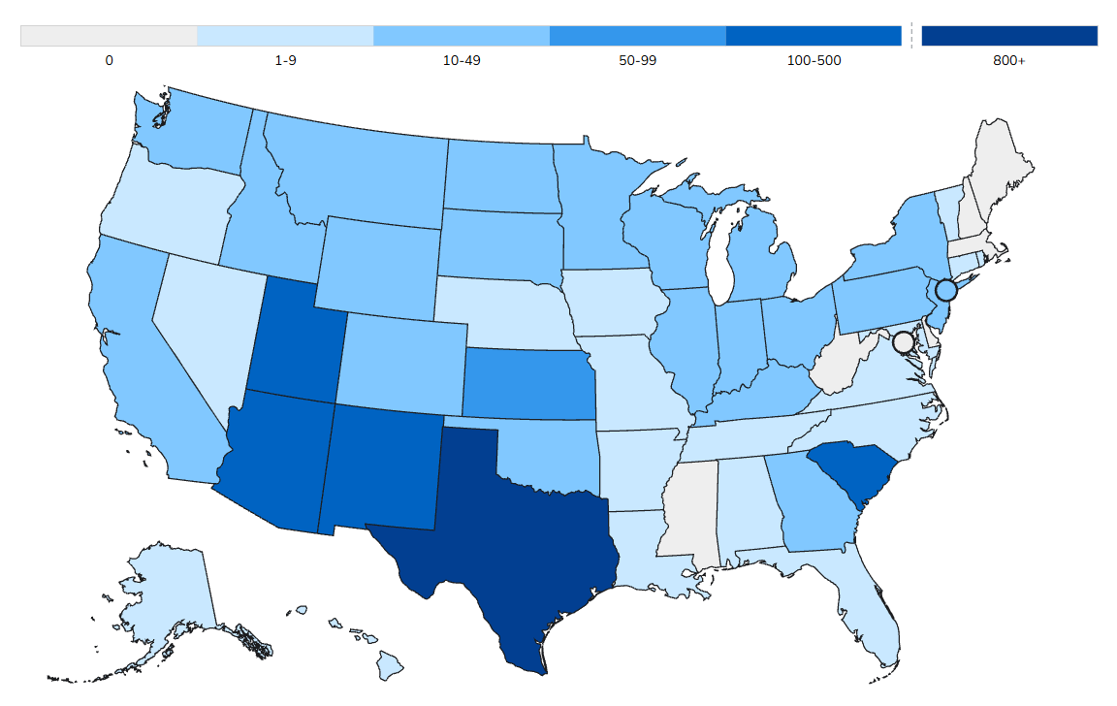
Distribution of measles cases within the United States in 2025
Number of Measles Cases
Source: CDC.GOV, Date of Access 1/20/26
Notes:
“This slide shows the geographic distribution of reported measles cases in the United States in 2025 .
During this time, Nevada has reported only two measles cases. However, as shown on the map, there are higher levels of activity in some surrounding states and other regions of the country. This is important context because measles is highly contagious, and cases in nearby areas can increase the risk of importation into our community. For that reason, it’s important that we remain proactive in our surveillance and prevention efforts.
In addition to traditional case-based surveillance, measles monitoring has also incorporated wastewater surveillance in some settings. This is important because wastewater surveillance can help identify viral circulation in communities, sometimes before cases are detected through clinical reporting.
Together, these approaches help public health agencies better understand where measles may be circulating and support early detection and response, particularly in areas with increased regional activity.”

Slide 5
Confirmed Pertussis Cases by MMWR Year (2-Year Rolling Average) Clark County, NV
For 2013, there were 58 total confirmed pertussis cases, including 14 cases among children ≤ 1 year of age
Notes:
“This slide shows confirmed pertussis cases by MMWR year within Clark County, with total cases shown in green and cases among children age one year or younger highlighted in orange.
To help interpret the bars, I’ve included an example here for 2013. In that year, there were 57 total confirmed cases, and 14 of those occurred among infants. The orange portion of the bar represents that infant subset within the total.
Across the full time period, infants make up a smaller share of cases overall, but they’re an important group to monitor because they’re at higher risk for severe disease. The pattern over time also shows the cyclical nature of pertussis, with periods of higher and lower activity rather than a steady trend.”

Slide 6
Trends in Confirmed Influenza Hospitalizations Clark County, NV MMWR Week 40 (2025) to Week 1 (2026)
Notes:
“This slide shows weekly influenza-associated hospitalizations by MMWR week within Clark County, based on reported hospitalizations in our surveillance system.
Early in the season, hospitalization counts were relatively low and stable through October and into early November. Beginning in late November and early December, we see a steady increase in hospitalizations, followed by a sharp peak in mid-to-late December.
This pattern is consistent with what we typically observe during influenza seasons, where hospitalizations tend to rise as transmission increases and seasonal activity intensifies. The subsequent decline toward early January suggests that activity may be beginning to ease, although continued monitoring is important.
Overall, this trend highlights the substantial burden influenza can place on the healthcare system during peak season, particularly as hospitalization counts can increase rapidly over a short period of time.”

Slide 7
Vaccines that Protect Against These Diseases
Measles:
MMR and MMRV (typically given in childhood)
2 dose series (administered 1 and age 4)
Pertussis
DTaP, and Tdap (children, adults, and during pregnancy)
4 doses of DTaP administered at (2, 4, 6, 15-18 months)
Tdap administered starting at 7 years or older (depending on DTaP doses received)
Influenza
Seasonal Influenza Vaccines (available annually for children and adults)
2 doses during the initial year up to the 8 years and then one dose annually.
Notes:
“For each of the diseases we’ve discussed, there are safe and effective vaccines available in our community.
Measles is prevented through the MMR vaccine. Pertussis is prevented through the DTaP series in childhood, with Tdap boosters recommended later in life. And influenza is prevented through annual flu vaccination.
These vaccines are widely available through healthcare providers, pharmacies, and public health clinics.”

Slide 8
MMR and DTaP Vaccination Coverage/ Exemption Trends Among Kindergarten Students Attending Public Schools in Clark County, Nevada
Academic Year | Up to Date for Measles | Up to Date for Pertussis
Academic Year: 2022 – 2023 | 92.23% | 91.49%
Academic Year: 2023 – 2024 | 92.12% | 90.79%
Academic Year: 2024 - 2025 | 90.57% | 89.13%
Adapted from: Nevada Division of Public and Behavioral Health (DPBH) School Immunization Survey. Up-to-date is defined as two doses of measles containing vaccines and 4-5 doses of pertussis containing vaccines.
Academic Year | Total Exemptions for Measles | Total Exemptions for Pertussis
Academic Year: 2022 – 2023 | 4.88% | 4.78%
Academic Year: 2023 – 2024 | 5.78% | 5.82%
Academic Year: 2024 - 2025 | 6.86% | 6.79%
Adapted from: Nevada Division of Public and Behavioral Health (DPBH) School Immunization Survey. Total Exemptions are defined as the sum of both religious and medical exemptions
Notes:
“This slide focuses on kindergarten students and shows two related measures over three academic years.
The chart at the top shows the percentage of kindergarten students who are up to date on measles- and pertussis-containing vaccines. Over this period, we see a gradual decline in the percentage of students who are up to date for both diseases.
The chart below shows the percentage of kindergarten students with vaccine exemptions for measles and pertussis over the same time frame. In contrast to the coverage trends, exemption percentages increase over time.
Taken together, these two charts highlight an important pattern: as exemption rates rise, the proportion of students who are fully vaccinated declines. This has implications for school-based and community -based protection, particularly for highly contagious diseases like measles and for infants and others who may be more vulnerable to severe outcomes.”

Slide 9
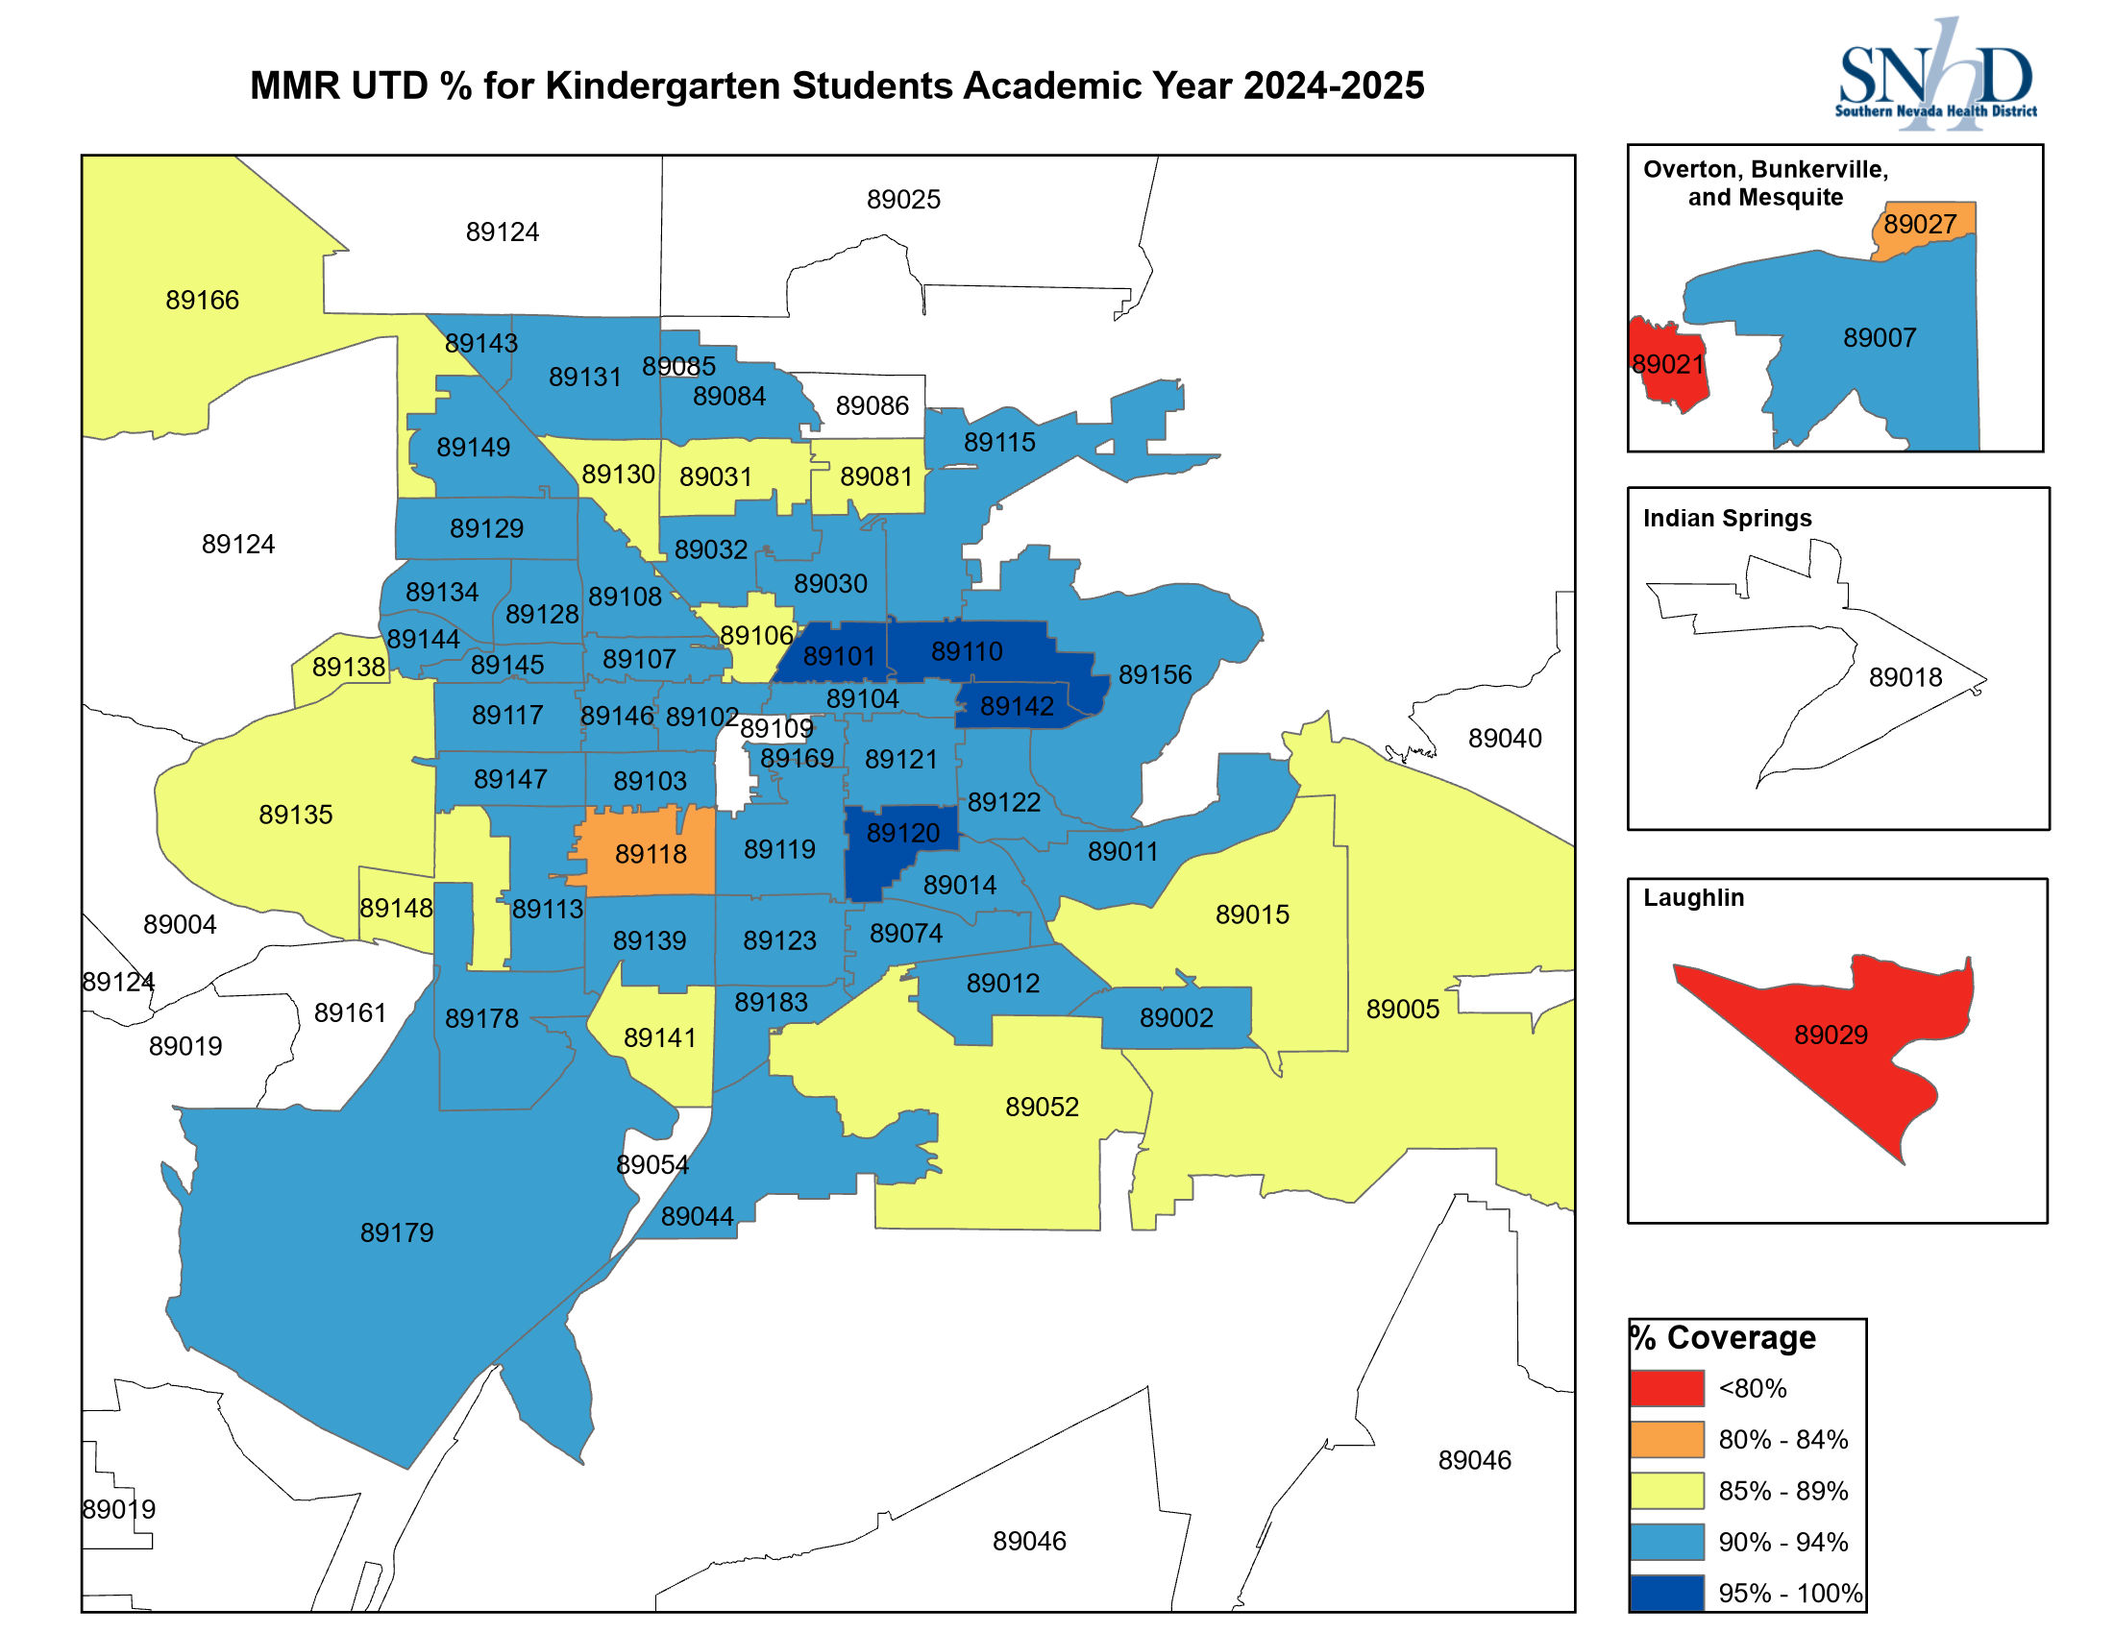
*White zip codes represent locations with no reported data or locations where data was suppressed due to small numbers of students. Please note that 95% coverage is recommended to achieve community immunity. Please note that UTD is defined as (Up-to-Date)
Source: Nevada Division of Public and Behavioral Health (DPBH) School Immunization Survey.
Notes:
“Continuing with measles vaccinations, this slide shows MMR vaccination coverage among kindergarten students for the 2024–2025 academic year, displayed by ZIP code. Coverage is grouped into ranges to make geographic patterns easier to see.
Overall, many areas of the county have coverage at or above 90 percent. However, the map also highlights pockets where coverage is lower, including several ZIP codes below 90 percent and a small number below 80 percent.
You’ll also notice some ZIP codes shown in white. These represent areas where coverage data are either not reported or suppressed due to small numbers, rather than indicating zero coverage.
These localized areas of lower coverage are important from a public health perspective. Measles is highly contagious, and community immunity typically requires around 95 percent vaccination coverage. Even when overall coverage appears high, pockets below that threshold can increase the risk of outbreaks if the virus is introduced.
This map helps us identify where additional outreach, monitoring, or support may be most beneficial to maintain protection for school-aged children and the broader community.”

Slide 10

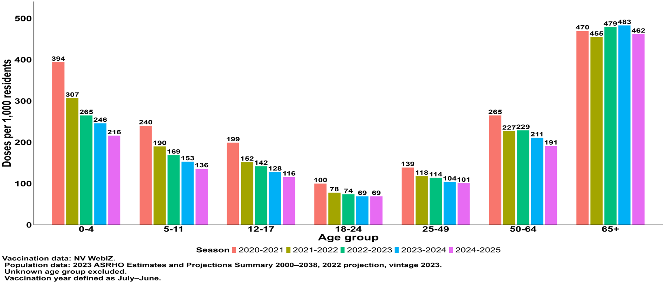
Notes:
“This slide shows influenza vaccination uptake measured as doses administered per 1,000 residents, stratified by age group and influenza season. Presenting the data this way allows us to compare both age-specific patterns and changes over time.
Across all seasons, vaccination uptake is highest among the youngest children and among adults age 65 and older. These groups are often prioritized for influenza vaccination because they are at higher risk for severe outcomes, which likely contributes to the higher uptake we see here.
In contrast, vaccination uptake is consistently lower among adolescents and younger adults, particularly those in the 18–24 and 25–49 age groups. This pattern is relatively stable across seasons and highlights age groups where vaccination coverage has historically been more challenging.
Another notable pattern is that vaccination rates appear lower in more recent seasons compared with earlier seasons across several age groups. While there may be multiple factors influencing this trend, it underscores the importance of ongoing efforts to promote influenza vaccination each season.
Overall, this slide highlights both persistent age-related differences in influenza vaccination uptake and changes over time that are important for planning targeted outreach and prevention strategies.”

Slide 11
Conclusion
Recent outbreaks and hospitalizations highlight the ongoing impact of vaccine-preventable diseases
Vaccination trends vary by disease and age group.
However, declines and gaps in coverage are present within the community
Maintaining high vaccination coverage is essential to reduce risk at the community level
Notes:
“In summary, recent outbreaks and hospitalizations highlight the ongoing impact of vaccine-preventable diseases.
Vaccination trends vary by disease and by age group, but we continue to see declines and gaps in coverage within our community.
Maintaining high vaccination coverage remains essential to reducing risk at the community level and protecting those who are most vulnerable.”

Slide 12
Acknowledgments
For any questions,
Benjamin J. Ashraf
ashraf@snhd.org
The author would like to acknowledge the following for their assistance with this presentation.
Members of the SNHD Division of Disease Surveillance and Control
Members of the SNHD Office of Informatics
Nevada State Immunization Program

