Slide 1
Understanding The New CDC Immunization Guidelines
Lyanna LaFredo, MD, FAAP
Assistant Professor of Pediatrics
Medical Director, UNLV Health School-Based Clinics

Slide 2
DISCLOSURES:
I do not have any relationships, financial or otherwise, with companies or institutions other than UNLV.

Slide 3


What I Do:
Treat patients from 0-21 years of age
Teach medical students, family practice residents, and pediatric residents in the ambulatory setting
Work at the UNLV Health school-based clinics
Family Support Center Clinic, next to the CCSD Family Support Center on Maryland Parkway
Dr. Gopal and Jeannette Das Healthcare Clinic inside William H. Bailey Middle School

Slide 4
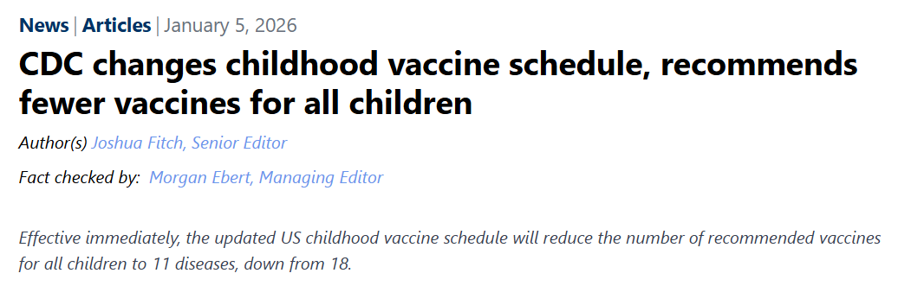
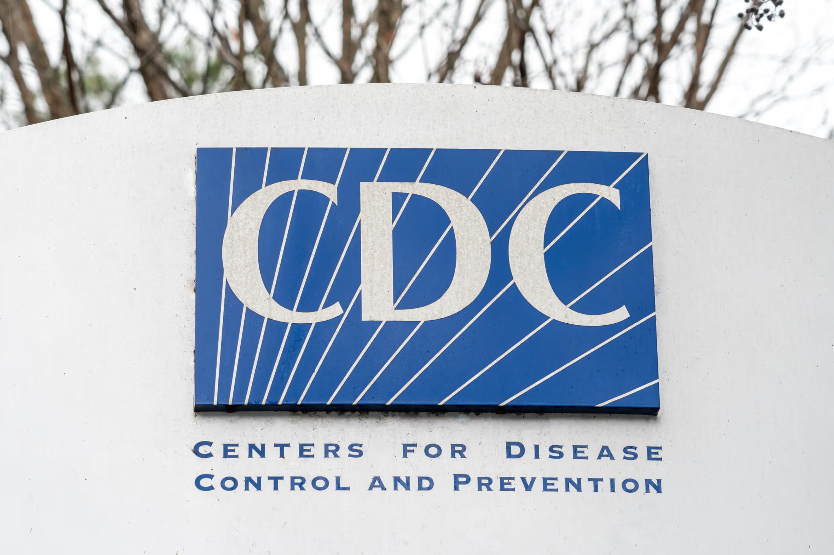
https://www.contemporarypediatrics.com/view/cdc-changes-childhood-vaccine-schedule-recommends-fewer-vaccines-for-all-children

Slide 5
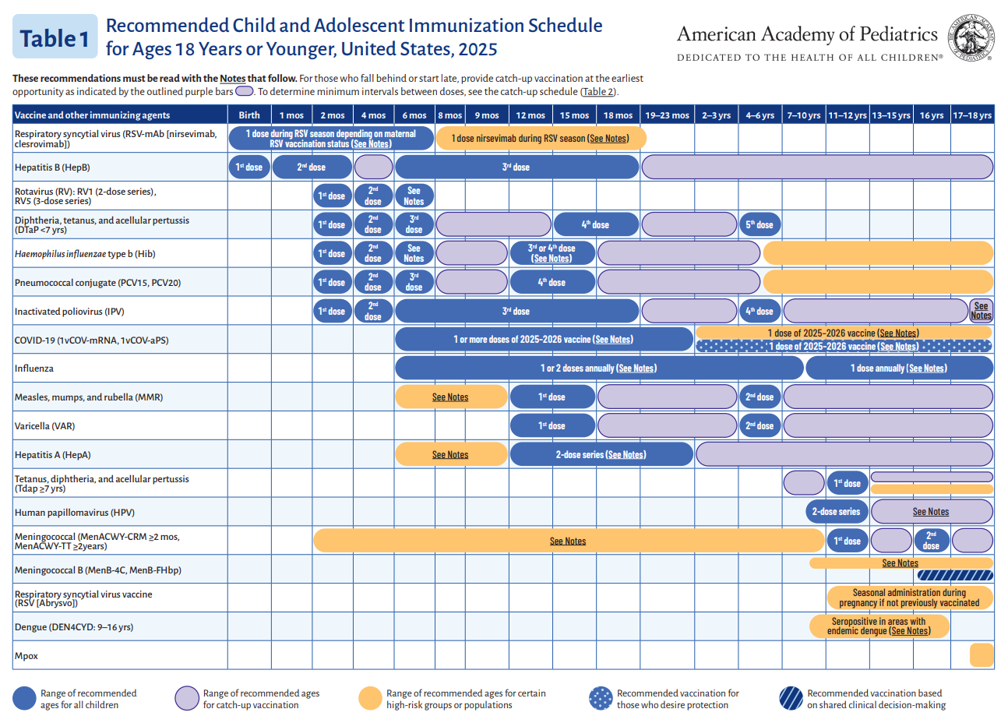
Notes:
The previous CDC schedule, still followed by the AAP, includes 18 immunizations.

Slide 6
The AAP Immunization Guidelines
18 total immunizations on the schedule
14 immunizations are routinely recommended for all children, with age-based specifications
Four immunizations are recommended for high-risk groups or shared decision-making: MenB, maternal RSV vaccine, Dengue, and Mpox.

Slide 7
Nevada School & Child Care Facilities Immunization Requirements
Mandated by NRS 392.435 and NRS 432A.230
DTAP: 4-5 doses before age 7 & Tdap: booster dose required from 7th grade
Hepatitis A: 2 doses
Hepatitis B: 3 doses
MMR: 2 doses
Varicella/ chickenpox: 2 doses
Polio: 3-4 doses
MCV4: 1st dose by 7th grade with a 2nd dose at age 16 yo
Hib: required for child care facilities
PCV: required for child care facilities
A total of 7 distinct immunizations for school and 8 for child care facilities
Allows for religious and medical exemptions only

Slide 8
The New CDC Childhood Immunization Schedule
Separated the immunization schedule into 3 distinct categories
Immunizations Recommended for All Children
Immunizations Recommended for Certain High-Risk Groups or Populations
Immunizations Based on Shared Clinical Decision-Making

Slide 9
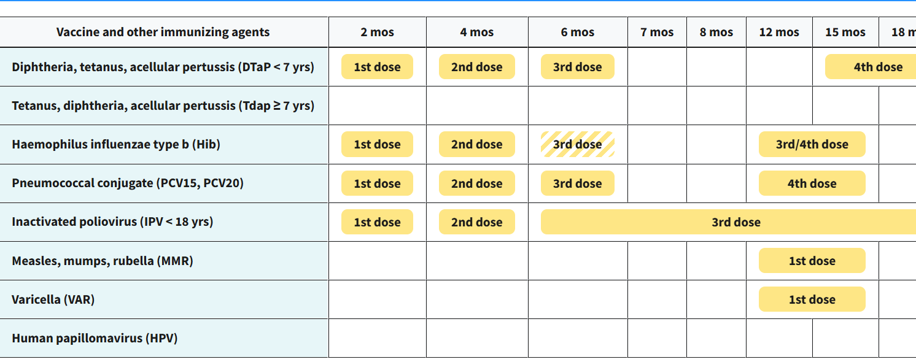
Immunizations Recommended for All Children

Slide 10
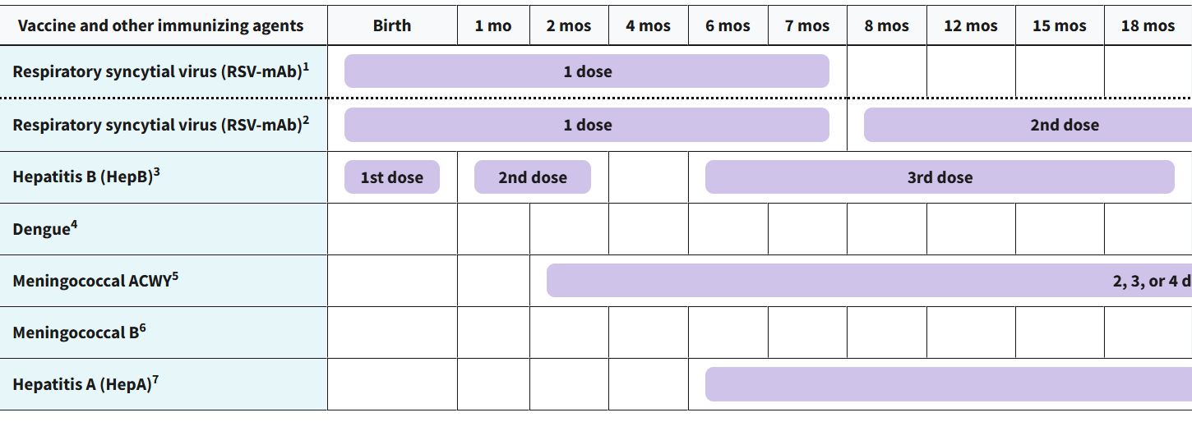
Immunizations for High-Risk Groups

Slide 11
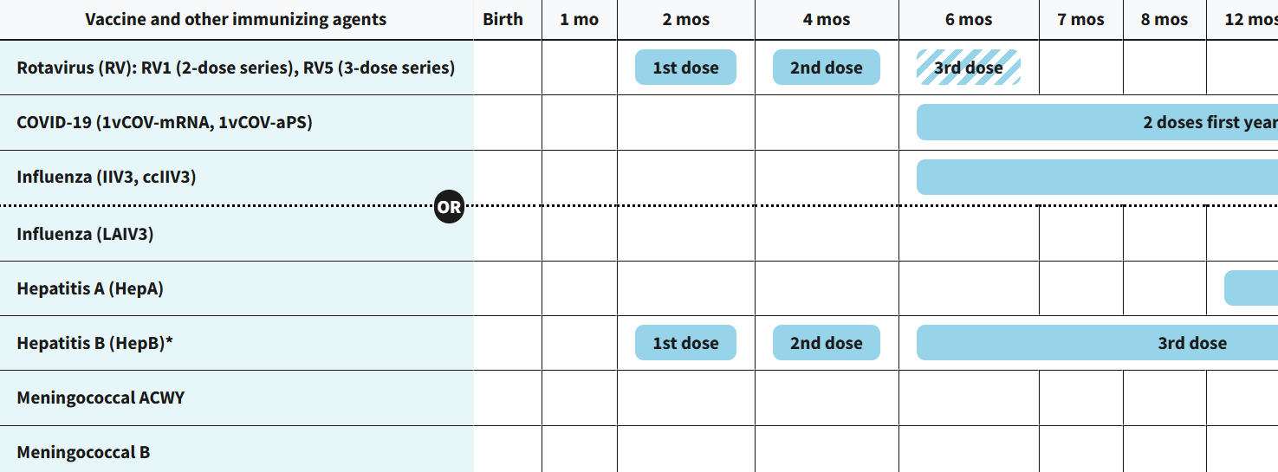
Immunizations Based on Shared Decision-Making

Slide 12
Main Takeaways
Universally recommended immunizations cut in half (from 14 to 7)
Four of the 7 state-mandated school immunizations continue to be routinely recommended by the CDC: DTaP/Tdap, polio, MMR, and varicella.
Six of the 8 state-mandated child care immunizations continue to be routinely recommended by the CDC: DTaP, polio, MMR, varicella, Hib, and PCV.
Three state-required immunizations with revised recommendations: Hepatitis A, Hepatitis B, and MCV4.
Six previously recommended immunizations are now via shared decision-making: rotavirus, COVID-19, influenza, hepatitis A, hepatitis B, and Men ACYW.

Slide 13
