Slide 1


Immunization
(in 10 minutes)
Brian Labus
PhD, MPH, REHS
Associate Professor

Slide 2
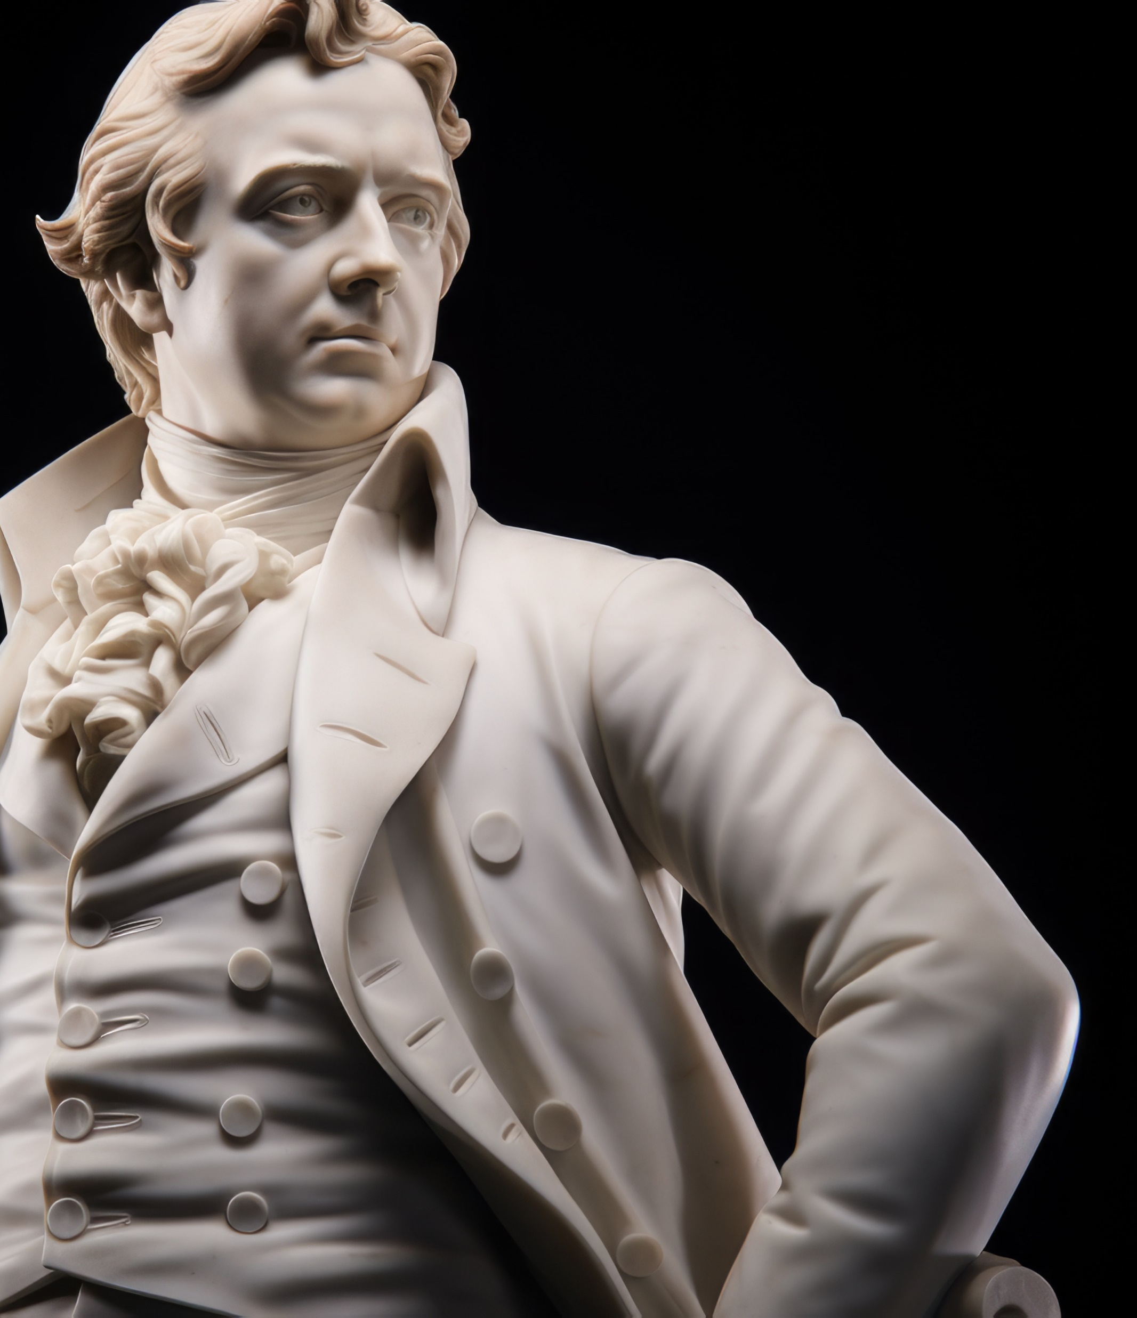
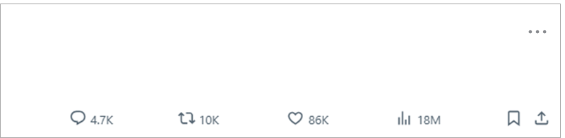
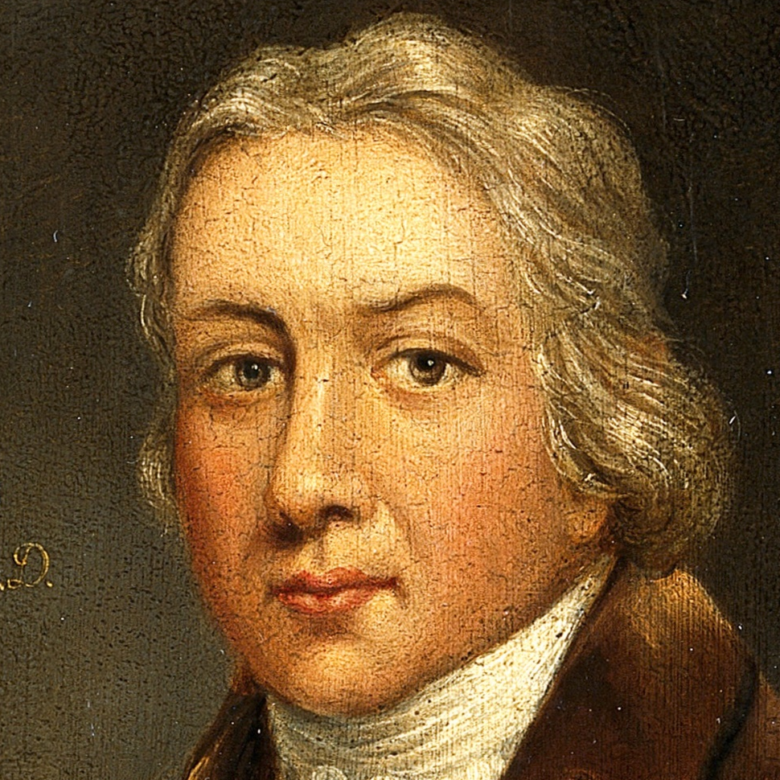

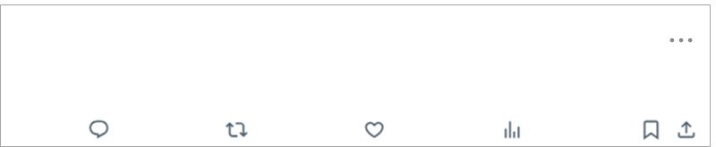

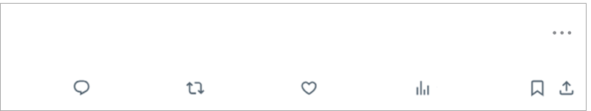
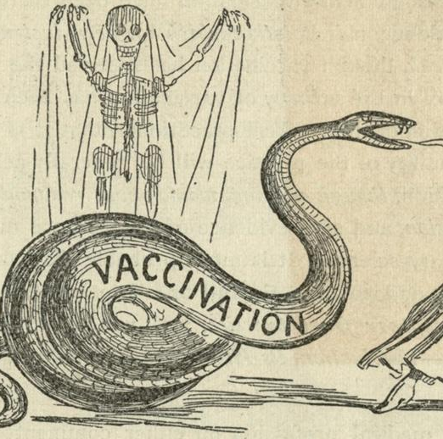

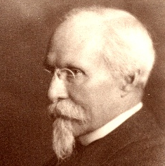
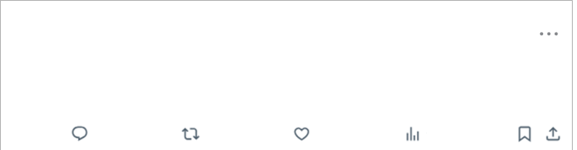
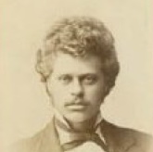
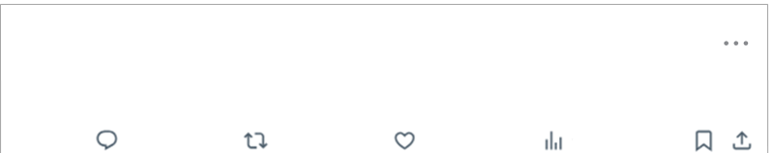
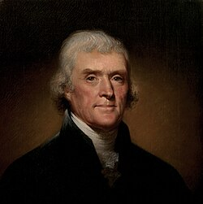
Edward Jenner, MD
@edwardjenner . May 14, 1796
I think I found a way to prevent smallpox!
#cowpox #firstvaccine
Rev. Edmund Massey
@standrewholborn
Disease is sent either for the trial of our faith, or for the punishment of our sins
Anti-Vaccination League
@antivaccinationleagueleicester
Better a felon's cell than a poisoned babe
John Pitcairn
@antivaccinationleagueamerica
The immunity theory by which vaccination is supported is a pure hypothesis.
#BroDoYouEvenMiasma?
Henning Jacobson
@henningjacobson
What about the inherent right of every freeman to care for his own body and health in such way as seems to him best.’ #SeeYouInCourt
Thomas Jefferson
@PresidentJefferson
Future nations will know by history only that the loathsome
smallpox has existed and by you has been extirpated.

Slide 3
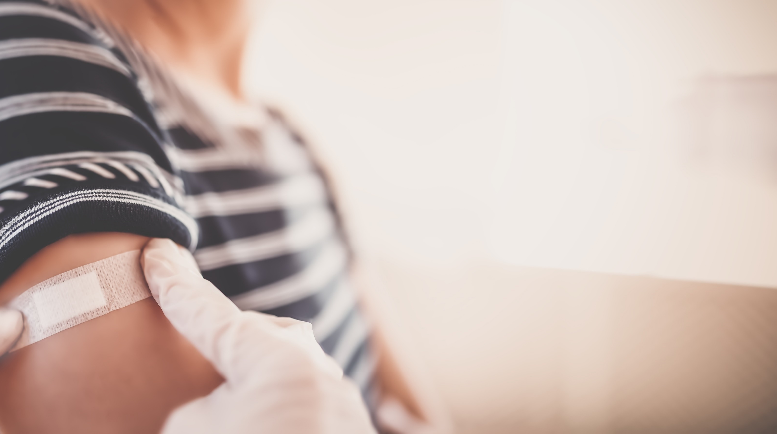
What are vaccines?

Slide 4
How does immunization work?
Immunization
Illness
IgG
Antibody concentration
IgM
Time

Slide 5
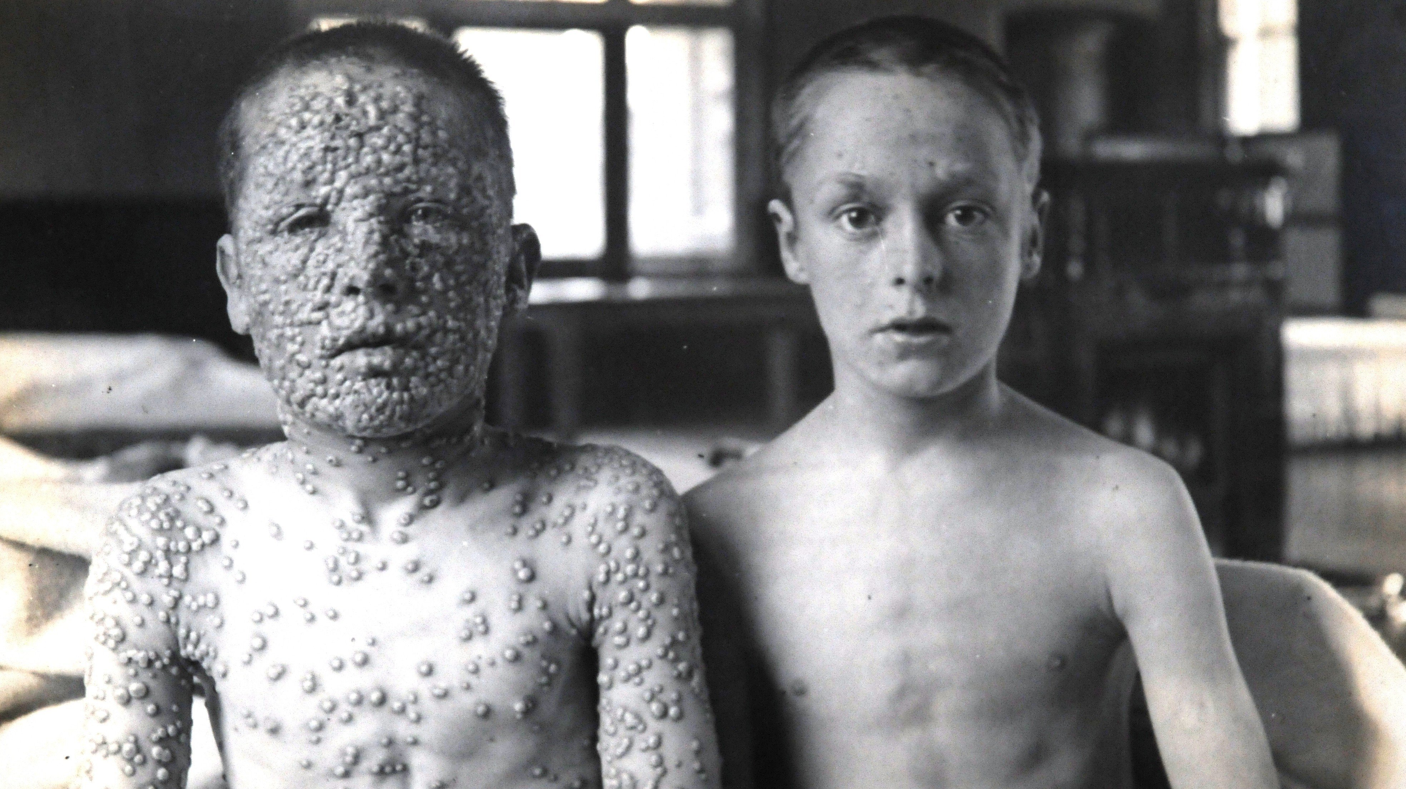
How do we evaluate
vaccine safety?

Slide 6
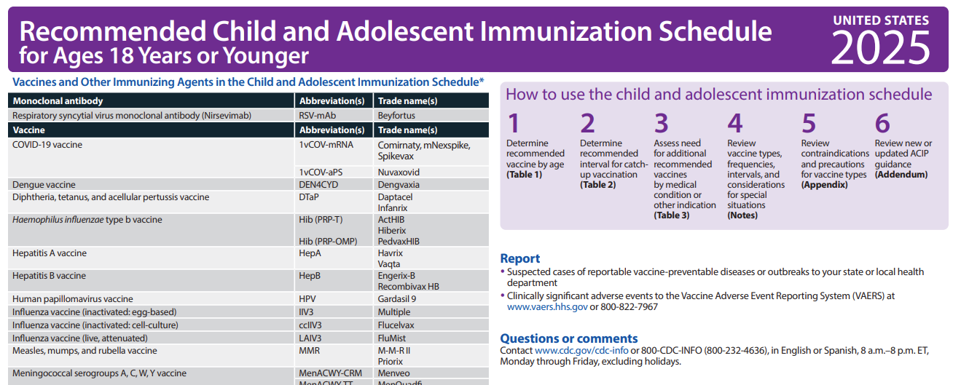
What’s required? Recommended?
A best practice?

Slide 7
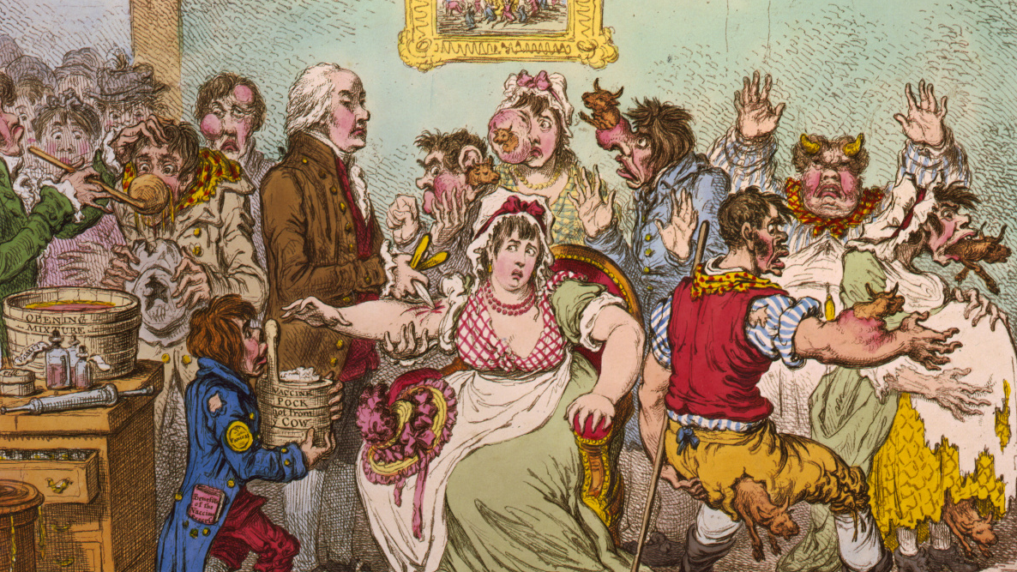
Where does vaccination
hesitancy come from?

Slide 8

What’s changed?

