Slide 1
Building Trust in Vaccines:
2026 Childhood Immunization Recommendations and Navigating Hesitancy in Clinical Practice
Chris Elaine Mariano, DNP, APRN, CPNP-PC
January 29, 2026

Slide 2
Disclosures
The presenter has no relevant financial or non-financial relationships to disclose.
The presenter is representing the Southern Nevada Health District (SNHD).
The views and information presented are those of the presenter and do not necessarily reflect official policy or positions of SNHD unless explicitly stated.
Notes:
Before we begin, the presenter has no relevant financial or non-financial disclosures. The presenter represents the Southern Nevada Health District. The views expressed do not necessarily reflect official SNHD policy unless otherwise stated.

Slide 3
Objectives
Review key updates to the 2026 HHS/CDC Childhood Immunization Recommendations and 2026 American Academy of Pediatrics Recommended Child and Adolescent Immunization Schedule for ages 18 Years or Younger.
Identify common drivers of vaccine hesitancy among parents and caregivers.
Apply evidence-based communication strategies to address vaccine concerns in clinical practice.
Strengthen trust-building approaches to support informed vaccine decision-making.
Notes:
“Today’s presentation will focus on several key objectives.
First, we will review key updates to the 2026 HHS/CDC Childhood Immunization Recommendations and 2026 American Academy of Pediatrics Recommended Child and Adolescent Immunization Schedule for ages 18 Years or Younger, with attention to changes that impact clinical practice and patient counseling.
We will also identify common factors that contribute to vaccine hesitancy among parents and caregivers, including concerns about safety, misinformation, and trust in health systems.
Building on that, we will apply evidence-based communication strategies that clinicians can use to address vaccine questions and concerns in a respectful, effective, and patient-centered manner.
Finally, we will discuss ways to strengthen trust-building approaches in clinical encounters to support informed vaccine decision-making and maintain strong therapeutic relationships with families.”

Slide 4
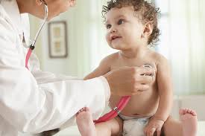
Let’s start with a story...
Notes:
When we talk about vaccine hesitancy, people often imagine confrontation—debates in exam rooms, misinformation in the news, or angry online comments. But let me start with a quieter story.
Last fall, I met Maria—a 42-year-old mother of three. She came to the immunization clinic for her child’s one-year old vaccines. When the front desk staff asked, “Are you here today for your one-year-olds vaccines?” Maria hesitated.
Not because she was angry. Not because she’d read something inflammatory online. But because, as she put it softly: “Does my child need all of the recommended vaccines right now?"
Her hesitancy wasn’t political. It was practical. And her real question wasn’t, “Do vaccines work?” It was, “Does my child need to get all the vaccines at one time?”
This talk is about that kind of hesitancy. The kind that lives in gray spaces, shaped by trust, culture, experience, and circumstance.

Slide 5
CDC Childhood Immunization Recommendations
Immunizations Recommended for All Children
Immunizations Recommended for Certain High-Risk Groups or Populations
Immunizations Based on Shared Clinical Decision-Making
Notes:
This slide highlights three categories of childhood immunization recommendations.
First are vaccines recommended for all children, which are based on age and standard immunization guidelines.
Second are vaccines recommended for certain high-risk groups or populations, including children with specific medical conditions, risk factors, or increased exposure risk.
Lastly, some vaccines are offered through shared clinical decision-making, where the provider and family engage in an individualized discussion to weigh risks, benefits, and personal preferences.

Slide 6
Immunizations Recommended for All Children
Immunizations Recommended for All Children
Vaccine-Min Age | 2 mos | 4 mos | 6 mos | 12-15 mos | 15-18 mos | 4-6 yrs | 11-12 yrs
DTaP | 1st dose | 2nd dose | 3rd dose |  | 4th dose | 5th dose
Tdap |  |  |  |  |  |  | 1st dose
Hib* | 1st dose | 2nd dose | 3rd dose | 3rd/4th dose
Pneumococcal (PCV15, PCV 20) | 1st dose | 2nd dose | 3rd dose | 4th dose
IPV | 1st dose | 2nd dose | 3rd dose (6-18mos) |  |  | 4th dose
MMR |  |  |  | 1st dose |  | 2nd dose
Varicella |  |  |  | 1st dose |  | 2nd dose
HPV¹ |  |  |  |  |  |  | 1st dose
Adapted from: https://www.hhs.gov/childhood-immunization-schedule/index.html
Released on January 5, 2026
Notes:
The Department of Health and Human Services continues to recommend routine vaccination for all children against serious diseases, including diphtheria, tetanus, pertussis, Hib, pneumococcal disease, polio, measles, mumps, rubella, HPV, and varicella. These recommendations are supported by strong scientific evidence and broad international consensus.
Recent studies show that one dose of the HPV vaccine provides protection comparable to two doses. Based on this evidence, and in alignment with several peer countries, the CDC now recommends a single-dose HPV schedule.
Overall, the updated CDC childhood and adolescent immunization recommendations continue to provide strong protection against diseases that can cause severe illness or death in children.

Slide 7
Immunizations Recommended for Certain High-Risk Groups or Populations
Immunizations Recommended for Certain High-Risk Groups or Populations
Vaccine-Min Age | Birth | 1 mo | 2 mos | 6 mos | 8 mos | 9 yrs | 10 yrs
RSV* | 1 dose |  |  |  | 2nd dose (8 mos-19 mos)
Hepatitis B¹ | 1st dose | 2nd dose |  | 3rd dose (6mos-18mos)
Meningococcal ACWY² |  |  | 2, 3 or 4 doses series
Meningococcal B³ |  |  |  |  |  |  | 1 dose
Hepatitis A⁴ |  |  |  | 1 dose
Adapted from: https://www.hhs.gov/childhood-immunization-schedule/index.html
Released on January 5, 2026
Notes:
Like all medical treatments, vaccines have different risks and benefits depending on the individual. Factors such as higher exposure risk, underlying health conditions, or the risk of spreading disease to others can affect vaccination recommendations.
For certain high-risk groups, additional vaccines may be recommended, including those for RSV, hepatitis A, hepatitis B, dengue, meningococcal ACWY, and meningococcal B.

Slide 8
Immunizations Based on Shared Clinical Decision-Making (SCDM)
Immunizations Recommended for Certain High-Risk Groups or Populations
Vaccine-Min Age | Birth | 1 mo | 2 mos | 6 mos | 8 mos | 9 yrs | 10 yrs
RSV* | 1 dose |  |  |  | 2nd dose (8 mos-19 mos)
Hepatitis B¹ | 1st dose | 2nd dose |  | 3rd dose (6mos-18mos)
Meningococcal ACWY² |  |  | 2, 3 or 4 doses series
Meningococcal B³ |  |  |  |  |  |  | 1 dose
Hepatitis A⁴ |  |  |  | 1 dose
Adapted from: https://www.hhs.gov/childhood-immunization-schedule/index.html
Released on January 5, 2026
Notes:
Public health guidance cannot always identify exactly which children will benefit most from certain vaccines or who may be at higher risk. In these cases, shared clinical decision-making between clinicians and parents—based on the child’s individual needs—is important.
Vaccines commonly guided by shared clinical decision-making include those for rotavirus, COVID-19, influenza, meningococcal disease, hepatitis A, and hepatitis B.

Slide 9
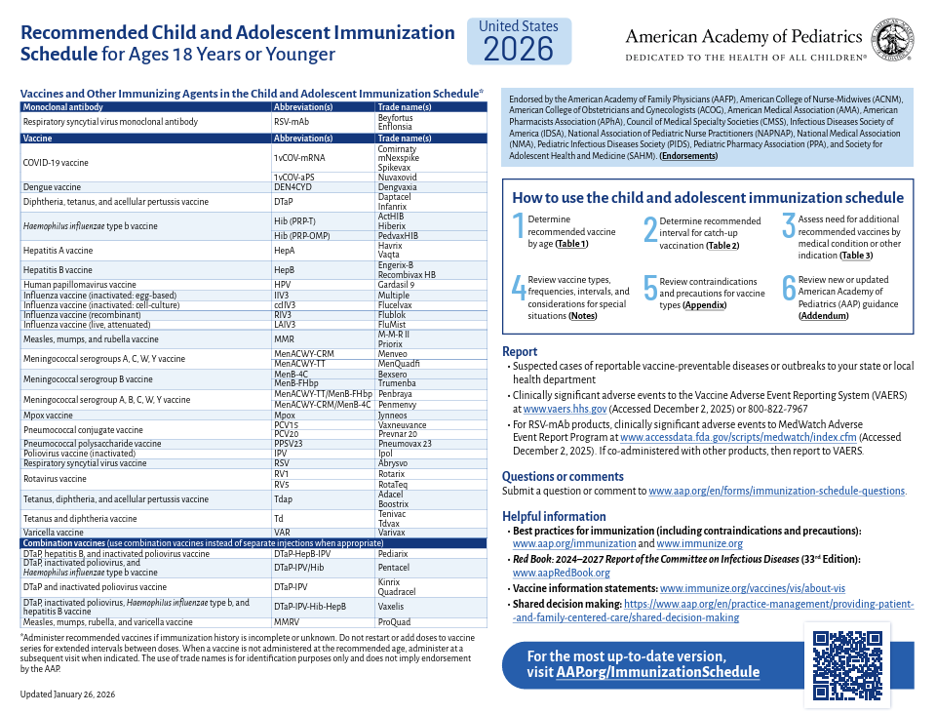
chrome-extension://efaidnbmnnnibpcajpcglclefindmkaj/https://downloads.aap.org/AAP/PDF/AAP-Immunization-Schedule.pdf
Notes:
On January 26, 2026, the American Academy of Pediatrics released its updated childhood and adolescent immunization schedule. This schedule continues to recommend routine vaccination against a broad range of vaccine-preventable diseases, consistent with long-standing pediatric practice and current scientific evidence. The AAP schedule emphasizes timely immunization based on age, risk, and clinical guidance, with the goal of protecting individual children and supporting community health. It reflects U.S. disease patterns, safety data, and expert consensus from pediatric and public health professionals.

Slide 10
Category | HHS / CDC (Jan 5, 2026) | American Academy of Pediatrics (Jan 26, 2026)
Overall Approach | Narrowed routine schedule; increased risk-based and shared clinical decision-making | Maintains broad, routine immunization recommendations
Routine Vaccines | Reduced number of vaccines universally recommended | Continues routine vaccination for most childhood vaccines
Influenza | High-risk or shared clinical decision-making | Routine annual vaccination for all children
Hepatitis A | High-risk or shared clinical decision-making | Routine for all children
Rota Virus | High-risk or shared clinical decision-making | Routine for infants
Meningococcal | Primary risk-based | Routine (MenACWY) with risk-based/shared clinical decision-making for others
HPV | Modified recommendation (single-dose option emphasized) | Standard routine multiple-dose schedule
COVID-19 | Risk-based or shared clinical decision-making | Routine recommendation with updated guidance
Use of Shared Clinical Decision-Making | Expanded across multiple vaccines | Limited to select vaccines
Guiding Philosophy | Alignment with select international schedules | Emphasis on U.S. pediatric evidence and epidemiology
Notes:
This slide compares the 2026 childhood immunization schedule from the HHS/CDC and the American Academy of Pediatrics. The CDC schedule narrows some routine recommendations and increases the use of risk-based and shared clinical decision-making, while the AAP schedule maintains broad routine vaccination for most childhood vaccines.
Specific differences include influenza, hepatitis A, and rotavirus, which are risk-based or shared clinic decision-making vaccines in the CDC schedule but remain routine per the AAP. Meningococcal, HPV, and COVID19 vaccines also have variations in timing or dosing between the two schedules.
Overall, both schedules are evidence-based and reflect slightly different approaches: the HHS/CDC emphasizes individualized, risk-based recommendations, while the AAP follows a broader routine approach based on U.S. pediatric guidance.

Slide 11
World Health Organization “3 C’s”
Confidence
Complacency
Convenience
Notes:
“The World Health Organization describes vaccine hesitancy using the ‘3 C’s’ model. Vaccine hesitancy means delaying or refusing vaccines even when they’re available, and it exists on a spectrum — not everyone who is hesitant refuses all vaccines.
The first ‘C’ is Confidence, which reflects trust in vaccine safety, healthcare providers, and the health system. The second is Complacency, where individuals don’t see vaccine-preventable diseases as a serious risk, often because those diseases have become less visible over time. The third is Convenience, which refers to how easy it is to get vaccinated — including access, cost, timing, and comfort. Together, these factors help explain what influences vaccine decisions.”
The World Health Organization describes vaccine hesitancy through the “3 C’s” model.
What influences vaccine acceptance: A model of determinants of vaccine hesitancy.
Vaccine Hesitancy
Vaccine hesitancy refers to delay in acceptance or refusal of vaccines, even when vaccines are available. It is influenced by three main factors:
Confidence – trust in the vaccine, the healthcare provider, and the system delivering the vaccine
Complacency – believing the disease is not a serious risk or that vaccination is unnecessary
Convenience – access to vaccination, including time, location, cost, and comfort
Vaccine-hesitant individuals are not all the same. Some may accept all vaccines but have concerns, some may delay or refuse certain vaccines, and others may refuse all vaccines.
Vaccination Confidence
Vaccination confidence is the level of trust in:
The safety and effectiveness of vaccines
Healthcare providers and health systems
Public health authorities and vaccine recommendations
Confidence exists on a continuum, from very low to very high, and is one of several factors that influence vaccine decisions.
Vaccine Complacency
Vaccine complacency occurs when people do not see vaccine-preventable diseases as a real threat and therefore do not view vaccination as necessary. This can be influenced by:
Low awareness of disease severity or spread
Underestimating the benefits of vaccines
Lack of knowledge
Ironically, the success of immunization programs can contribute to complacency when diseases become rare.
Vaccination Convenience
Vaccination convenience refers to how easy and accessible vaccination services are. This includes:
Availability of appointments
Location and timing
Cost and affordability
Comfort and quality of the experience
Convenience is also influenced by how much priority an individual places on vaccination.

Slide 12
Confidence Begins with Us
Notes:
“Every question about vaccines is an opportunity — not an argument.”
Key points:
Our role is not to convince, but to connect.
Show empathy before evidence.
Build psychological safety — a space where patients feel heard, not judged.
Use motivational interviewing: ask permission, explore values, and affirm autonomy.

Slide 13
Motivational Interviewing and Shared Clinical Decision-Making
Motivational Interviewing | Shared Clinical Decision Making | Correlation
Patient-centered communication that explores ambivalence about vaccination | Collaborative approach where clinicians and patients weigh risks, benefits, and values together. | Both empower patients to make informed choices based on their values and evidence.
Uses open-ended questions, reflective listening, and affirmations to build trust and elicit motivations. | Provides evidence-based guidance and recommendations, then invites patient input. | MI builds trust and understanding, making SCDM more effective.
Goal: Resolve hesitancy by guiding patients towards their own reasons for accepting vaccines. | Goal: Make a shared, informed decision about vaccination. | MI can be used within SCDM conversations to explore concerns before jointly deciding.
- Gagneur A. Motivational interviewing: A powerful tool to address vaccine hesitancy. Can Commun Dis Rep. 2020 Apr 2;46(4):93-97. doi: 10.14745/ccdr.v46i04a06. PMID: 32281992; PMCID: PMC7145430.
- https://www.cdc.gov/acip/vaccine-recommendations/shared-clinical-decision-making.html
Notes:
“On this slide, I want to highlight the relationship between Motivational Interviewing and Shared Clinical Decision-Making.
Motivational Interviewing, or MI, is a patient-centered communication style. It helps us explore a patient’s ambivalence about vaccination in a non-judgmental way. Through open-ended questions, reflective listening, and affirmations, MI helps build trust and understand what’s really driving a patient’s concerns.
Shared Clinical Decision-Making, or SCDM, is more focused on the decision itself. It’s a collaborative process where clinicians and patients weigh the risks, benefits, and individual values together, using evidence-based guidance. The goal is to arrive at a shared, informed decision.
What’s important is how these two approaches work together. Both empower patients to make informed choices. MI often lays the groundwork by building trust and understanding, which makes Shared Clinical Decision-Making more effective. In practice, MI can be used within SCDM conversations to explore concerns first, and then move toward a joint decision.”

Slide 14
Step-by-Step Approach
Build rapport and ask permission.
Explore concerns and ambivalence.
Provide clear, evidence-based information.
Discuss values and preferences.
Support an informed, shared decision.
Affirm the patient and plan follow-up.
Oliver, K., Techniques and Talking Points to Address Vaccine Hesitancy
Notes:
“When discussing vaccines, we begin by building rapport and asking permission to have the conversation, setting a respectful and empathetic tone. We then explore concerns using open-ended questions and reflective listening to understand hesitations and what matters most to the patient or parent.
Next, we provide clear, evidence-based information about the benefits, risks, and alternatives in a neutral and tailored way. We discuss values and preferences and work together to make an informed, shared decision — whether that means vaccinating, delaying, or planning next steps. Throughout the conversation, we emphasize autonomy, avoid pressure, and offer ongoing support. Using Motivational Interviewing within Shared Clinical Decision-Making helps build trust and supports informed vaccine decisions.”
Start by building rapport and asking permission to talk about vaccines. Explore concerns with open-ended questions and reflective listening. Provide a clear, evidence-based information about risks and benefits. Discuss values and preferences, then make a shared, informed decision. Finally affirm the patient’s, parent’s or guardian’s autonomy and offer follow-up support. Using MI within SCDM helps build trust and supports informed vaccine decisions.
Build Rapport and ask permission.
Start the conversation with empathy.
Example: “Is it ok if we talk about your child’s vaccines today?”
2. Explore Concerns and Ambivalence
Ask open-ended questions to understand hesitancy.
Reflective listening: “It sounds like you are worried about the side effects.”
Goal: Identify values, fears, and motivations.
3. Provide clear and evidence-based information.
Share the benefits, risks, and alternatives of vaccination.
Keep explanations neutral, concise and tailored.
Example: “This vaccine helps prevent serious illness and hospitalization. Here is what is known about the side effects.”
4. Discuss values and preferences.
Explore the patient’s priorities and what matters most to them.
Example: “Given what we discussed, what matters most to you when deciding about this vaccine?”
5. Support an Informed and Shared Decision
Decide together on next steps: accept, delay or schedule vaccines.
Emphasize autonomy; avoid pressuring the patient.
6. Affirm and Plan Follow-up
Reinforce the patient’s autonomy and strengths.
Example: “I appreciate how carefully you are considering your child’s health. We can revisit any questions at anytime.”

Slide 15
Practical Example
A parent expresses concern about the Human Papillomavirus Vaccine (HPV) safety:
MI: “I hear you are worried about the side effects. Can you tell me more about what concerns you the most?”
MI helps the parent voice concerns and feel heard.
SCDM: Based on your child’s age and health, here are the benefits and risk. Let’s talk through them together so you can decide what is right for your family and child.
SCDM ensures the final decision is evidence-based and shared.
Gagneur A. Motivational interviewing: A powerful tool to address vaccine hesitancy. Can Commun Dis Rep. 2020 Apr 2;46(4):93-97. doi: 10.14745/ccdr.v46i04a06. PMID: 32281992; PMCID: PMC7145430.
Notes:
Motivational Interviewing (MI): Example: “I hear you are worried about the side effects. Can you tell me more about what concerns you the most?”
MI encourages parents to voice their concerns and feel truly heard.
It creates a safe space for open dialogue, which is essential for addressing hesitancy.
Shared Clinical Decision-Making (SCDM): Example: “Based on your child’s age and health, here are the benefits and risks. Let’s talk through them together so you can decide what is right for your family and child.”
SCDM ensures that the final decision is both evidence-based and collaborative.
It reinforces trust and supports informed, personalized choices for the child’s care.

Slide 16
What happens after a second declination or delay?
Let the patient know you will offer it again.
Offer reading material
Don’t over-remember
Relax. You’ve done your best for this patient
Oliver, K., Techniques and Talking Points to Address Vaccine Hesitancy
Notes:
“When a patient declines or delays a vaccine a second time, it’s important to stay calm and supportive. Let them know the vaccine will be offered again at future visits and provide reliable reading materials they can review on their own. Avoid pressuring them or over-remembering, and remember to relax — you’ve done your best to guide and support this patient’s health decisions.”

Slide 17
Conclusion

Slide 18
Key Takeaways
Reviewed important updates to the 2026 HHS/CDC Childhood Immunization Recommendations and 2026 American Academy of Pediatrics Recommended Child and Adolescent Immunization Schedule for ages 18 Years or Younger to support clinical practice.
Identified common drivers of vaccine hesitancy among parents and caregivers.
Applied evidence-based communication strategies to effectively address vaccine concerns.
Emphasized the importance of building trust to support informed, shared vaccine decision-making.
“Together, we can protect children’s health and strengthen our community through immunization.”
Notes:
“By understanding the latest immunization guidance, addressing hesitancy with empathy, and building trust through clear communication, we empower families to make informed decisions and protect children’s health—because every vaccine administered saves lives, and every conversation is a chance to strengthen both care and community.”

Slide 19
Acknowledgments
For any questions,
Chris Elaine Mariano,
Mariano@snhd.org
The author would like to thank the following for their support and contributions to this presentation:
Members of the SNHD Immunization Program
Members of the SNHD Office of Epidemiology
Dr. Rosann Sugay

Slide 20

Email: mariano@snhd.org

